Slide 1
Digital Logic Design and Application
Lab Course 5
Lecturer:
TA:
Lab Room:

Slide 2
Content
EDA tools ( testbench)
Datapath Design
Controller Design
CPU Integration
CPU Design Improvement
  Verify the CPU on a real FPGA board;
  Enlarge instruction set (for example, LDR/STR) and modify datapath & controller modules based on new instruction set
  Compose a better testbench and do verification again

Slide 3
CPU Organization
Datapath
ALU
CPU
Registers
Datapath
PC
Control
Unit
Control Unit
state_transition
IR

Slide 4
Top structure of our CPU
CPU
Data
path
Control
Unit
En_group, Reg_en
Regs control signals
Reg group
IR
Alu
Alu_in_sel Alu_in_sel
ALU control signals
Opcode
PC
State
transition
En_pc pc_ctrl
PC control signal
Alu_mux
Other signals

Slide 5
Minimum CPU system
Stored program instructions
Provide clock signal
signal | direction | width | fucnation
clk | I | 1 | clock signal
rst | I | 1 | active-low reset
addr | I | 16 | address signal
en_ram_in | I | 1 | active-high
ins | O | 16 | data signal
en_ram_out | O | 1 | active-high
signal | direction | fucnation
clk_in1 | I | input clock signal
resetn | I | active-low reset
clk_out1 | O | output clock signal
locked | O | output clock signal valid

Slide 6
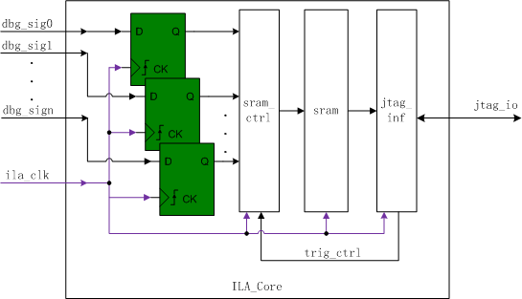
ILA-Integrated logic analyzer

Slide 7
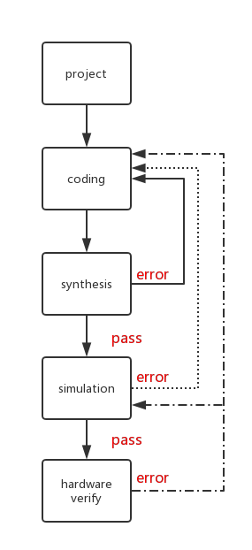
FPGA Design Flow

Slide 8
1. Create New Hardware Project
Follow the steps of lab1.ppt to create New Hardware Project.

Slide 9
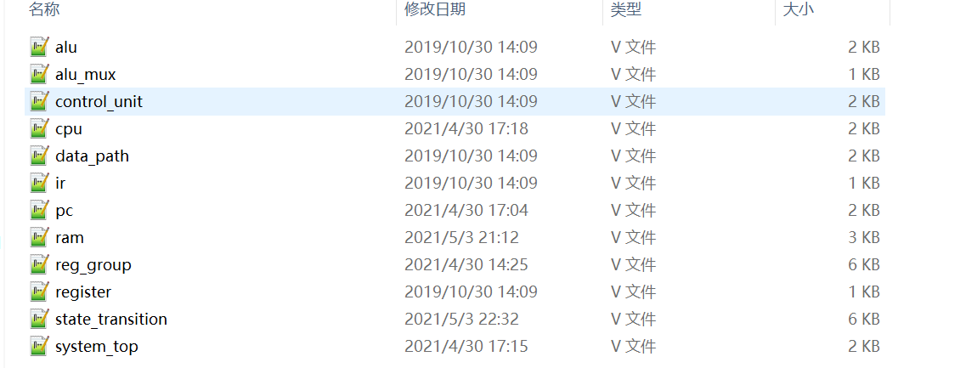
Follow the steps of lab2.ppt to add files in the code folder
2. Create New Source File
-step1

Slide 10
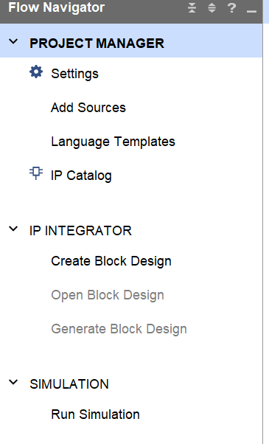
3. ADD
IP CORE
-step1-1
1. Left-click

Slide 11
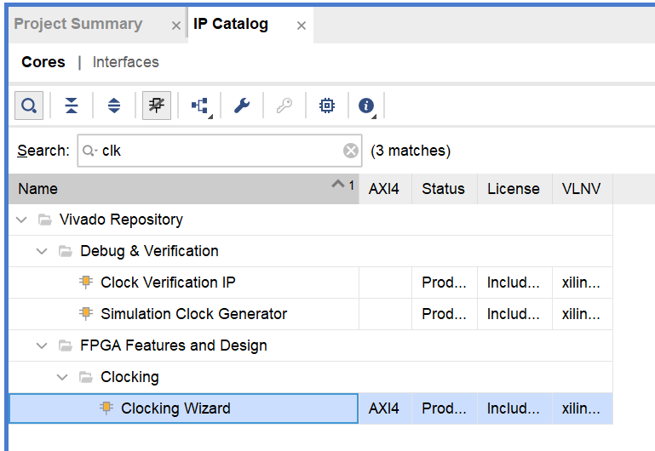
3. ADD
IP CORE
-step1-2
1. Input name to search IP cores
2. Double click

Slide 12
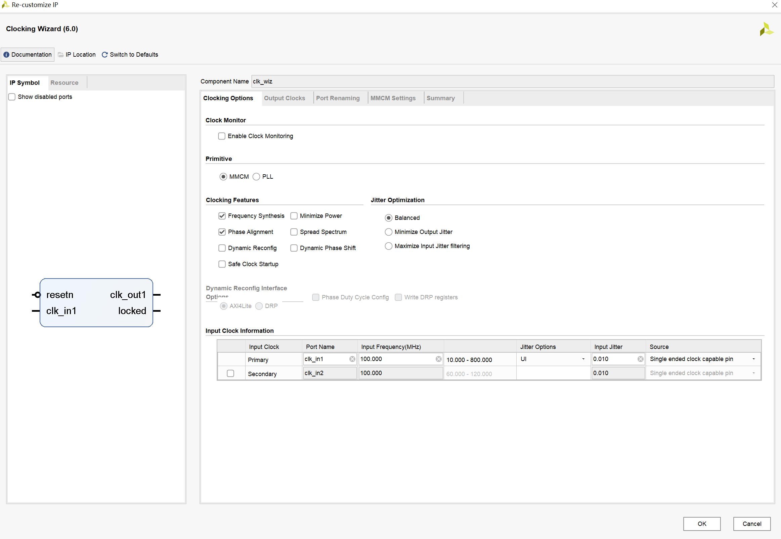
1. Module’s name
3. ADD
IP CORE
-step1-3
2. Input clock

Slide 13
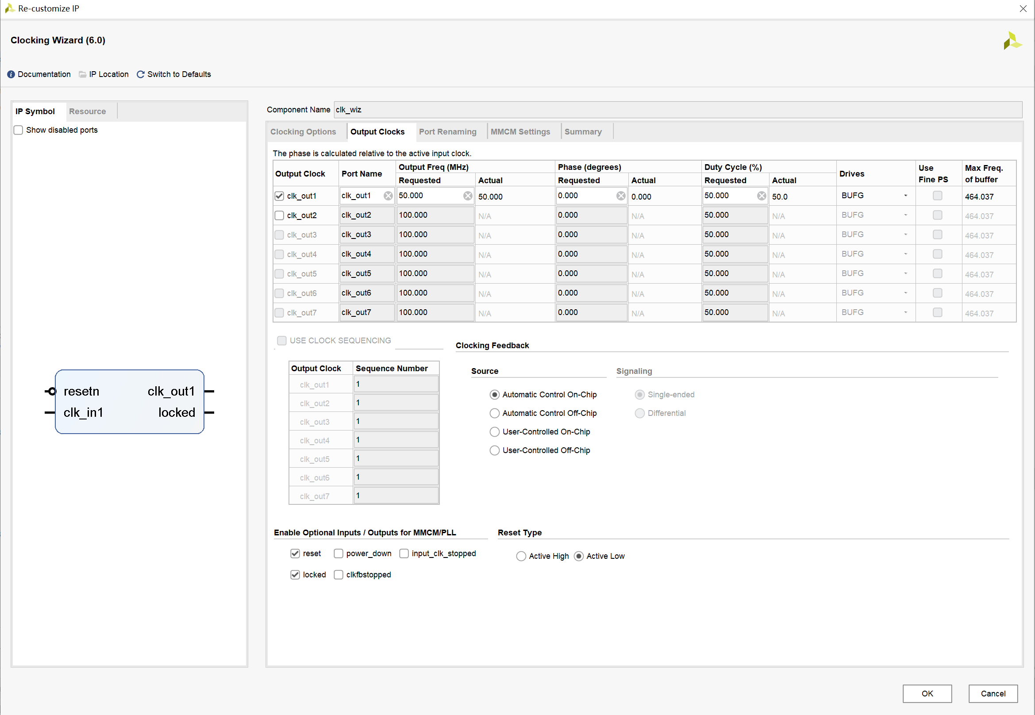
3. ADD
IP CORE
-step1-4
1. Output clock
2. Active-low
3. Click ok

Slide 14
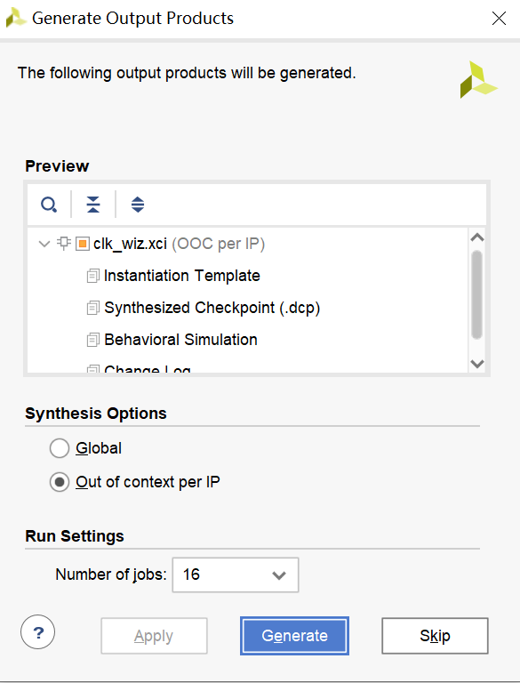
3. ADD
IP CORE
-step1-5
1. Generate the IP core

Slide 15
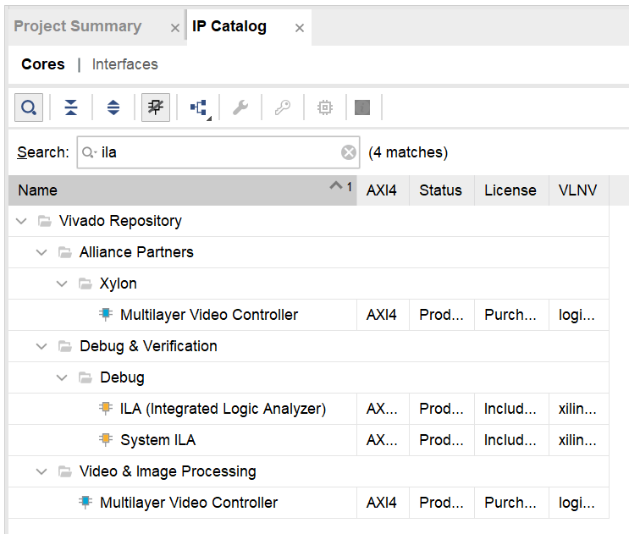
3. ADD
IP CORE
-step2-1
1. Input name to search IP cores
2. Double click

Slide 16
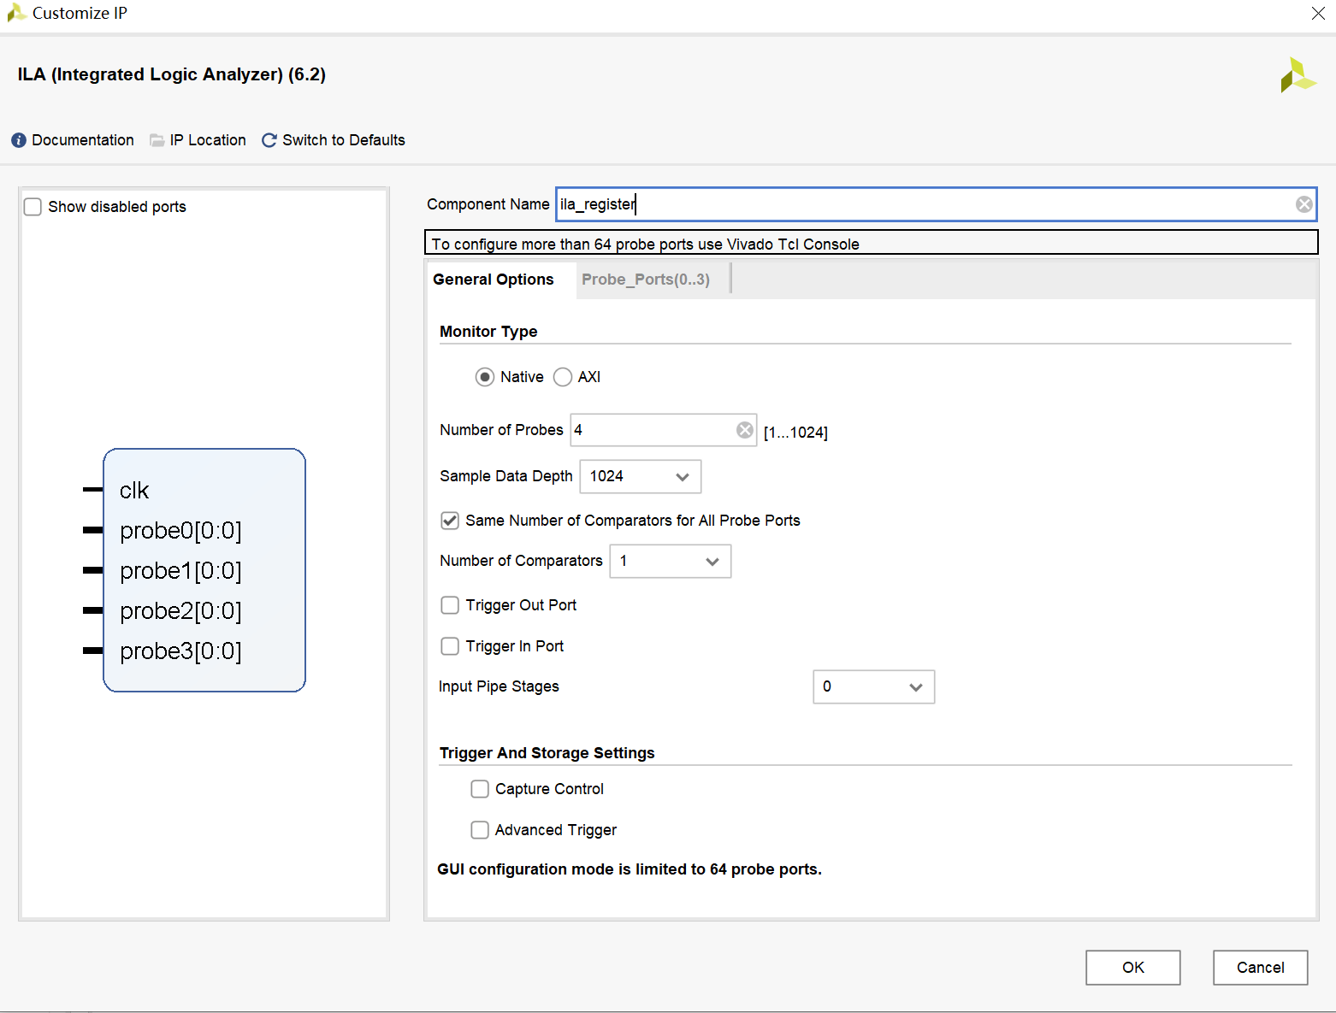
1. Module’s name
3. ADD
IP CORE
-step2-2
2. Input parameter

Slide 17
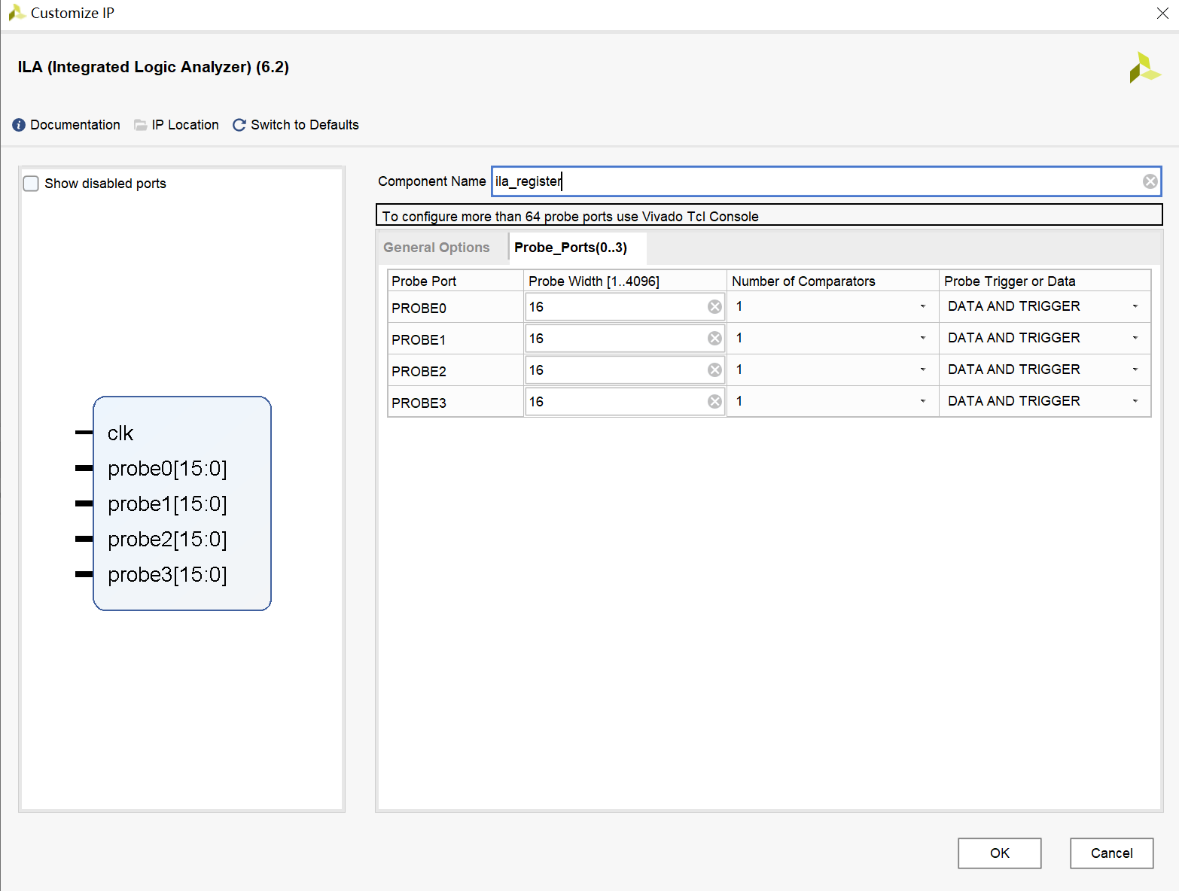
3. ADD
IP CORE
-step2-3
1. Input parameter
2. Click ok

Slide 18
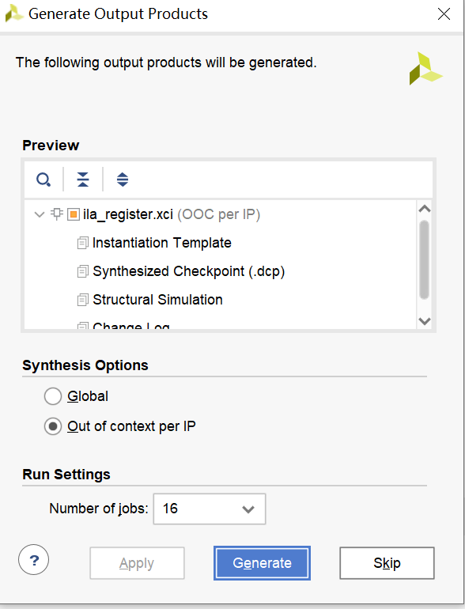
3. ADD
IP CORE
-step2-4
1. Generate the IP core

Slide 19
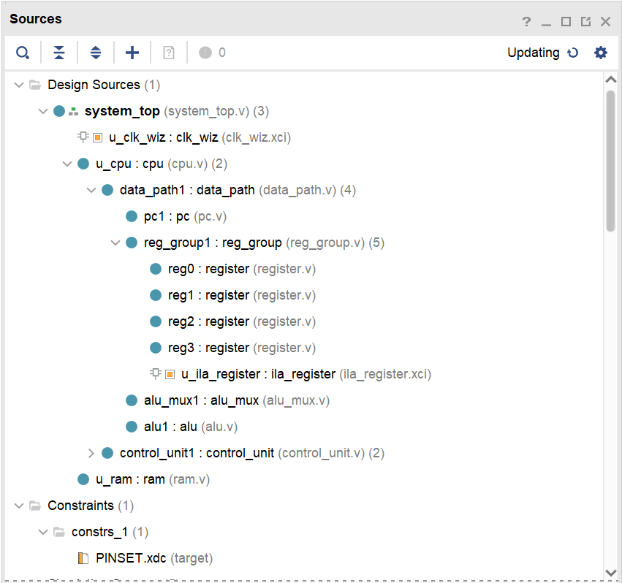
4. Verify
Design Sources

Slide 20
5. Do Synthesis and get the circuit
Follow the steps of lab1.ppt to do Synthesis and get the circuit.

Slide 21
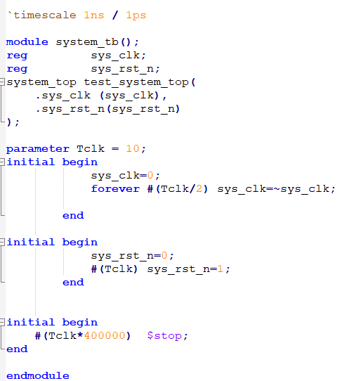
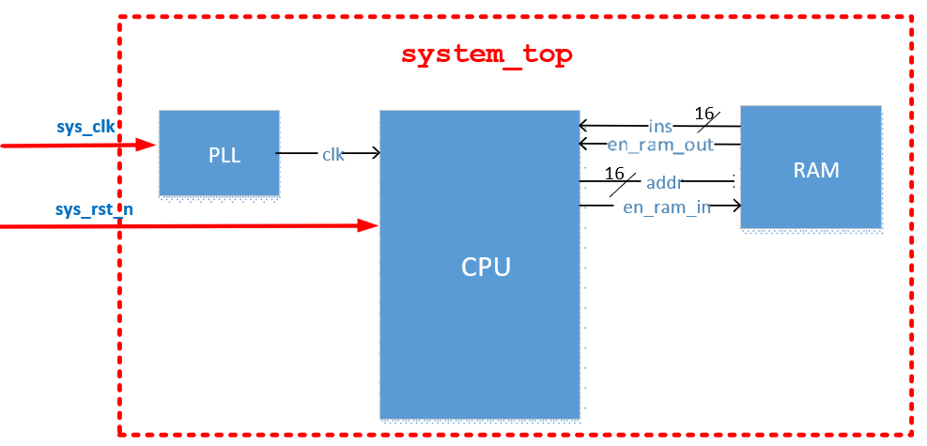
6. Create Simulation Source File
-step1
Copy the content in system_tb.v

Slide 22
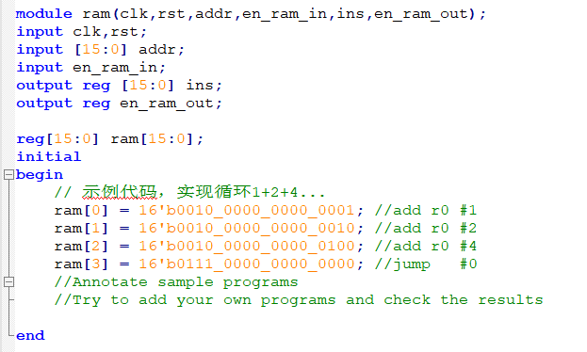
Run the sample program or your own program
6. Create Simulation Source
File
-step2

Slide 23
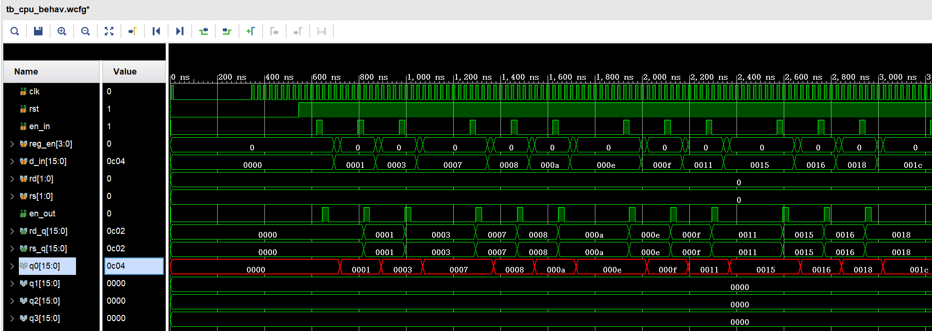
Run simulation and observe the variation of signals. Make sure all of these are right.
7. Do the simulation and debug.

Slide 24
FPGA Design Flow

Slide 25
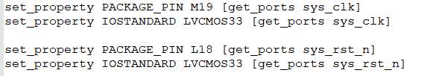
8. Create Constraint Source
File
Follow the steps of lab1.ppt

Slide 26
9. Generate Bitstream
File for FPGA
Follow the steps of lab1.ppt

Slide 27
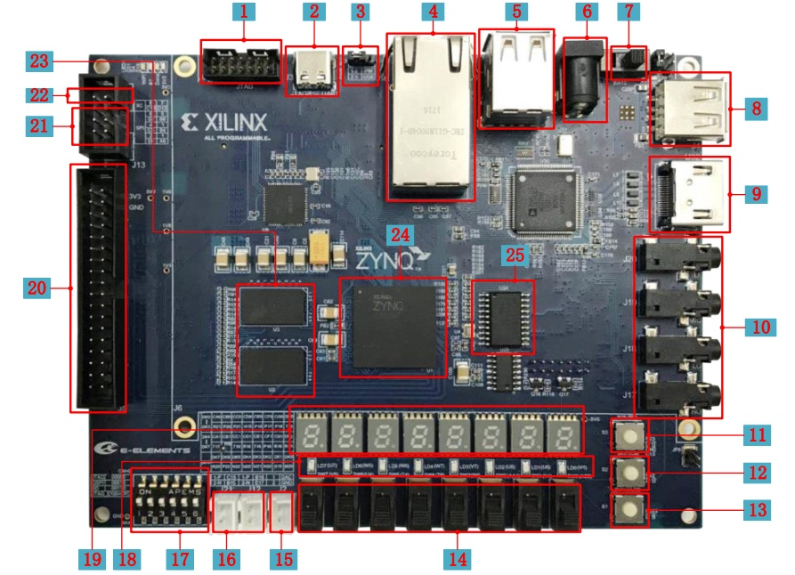
10.Connect FPGA Target Board With Computer
1. Put all switch(17 ) to ON
2.Connect J3(2) and USB port of computer with USB cable
3.Power on with switch (7)
4.system reset L18(13)

Slide 28
11. Program Device
Follow the steps of lab1.ppt

Slide 29
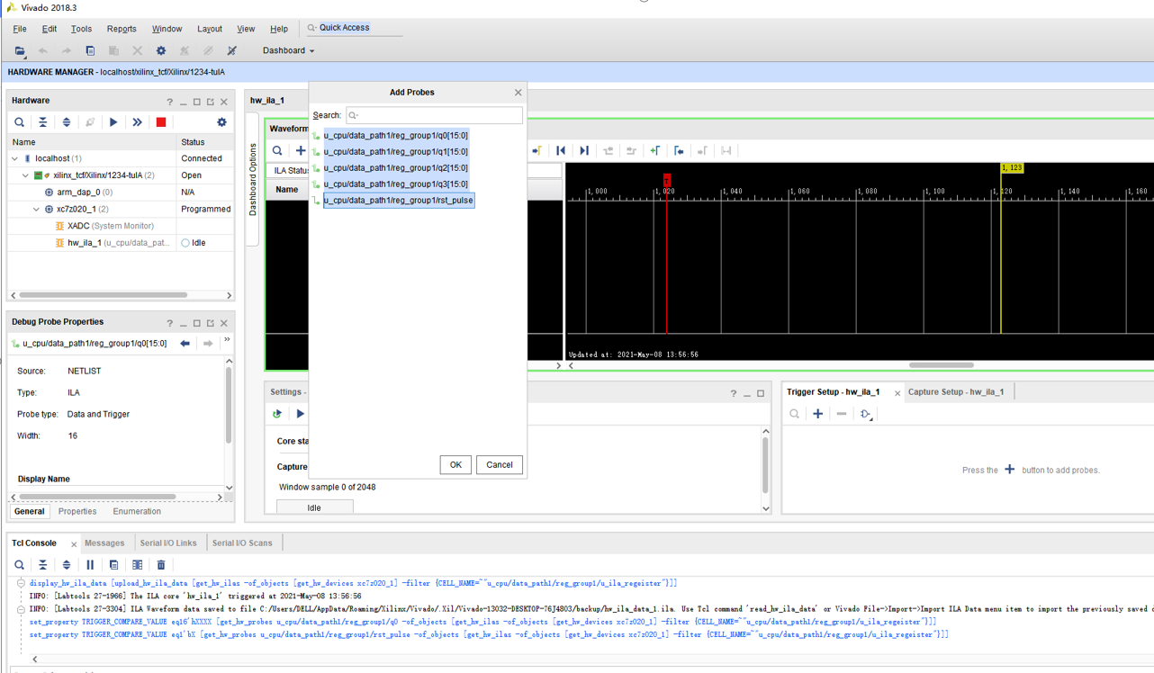
2. Add signals
12. Run ILA to see the data in the registers
-step1
3. Select all
1. Select the ila
4. Click ok

Slide 30
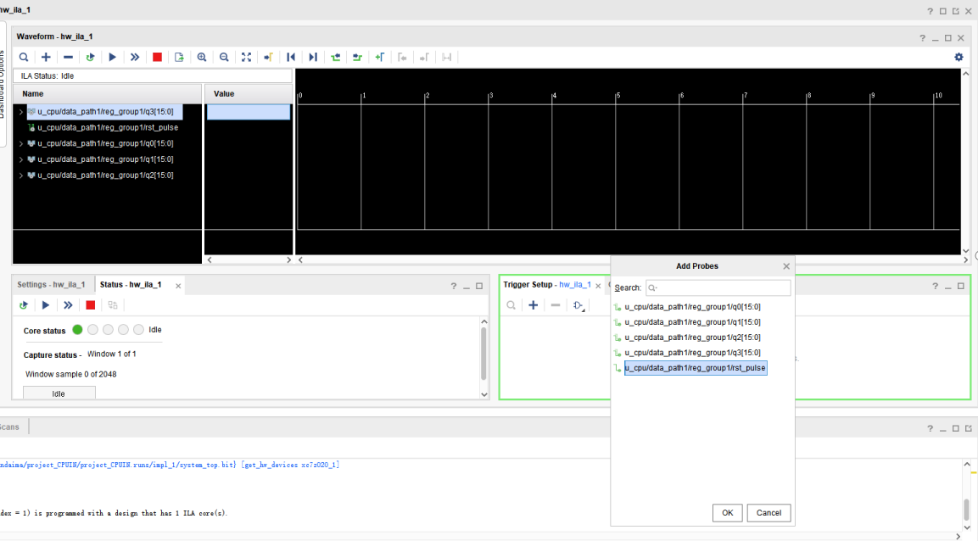
12. Run ILA to see the data in the registers
-step2
Add Trigger Signal
1
2
3

Slide 31
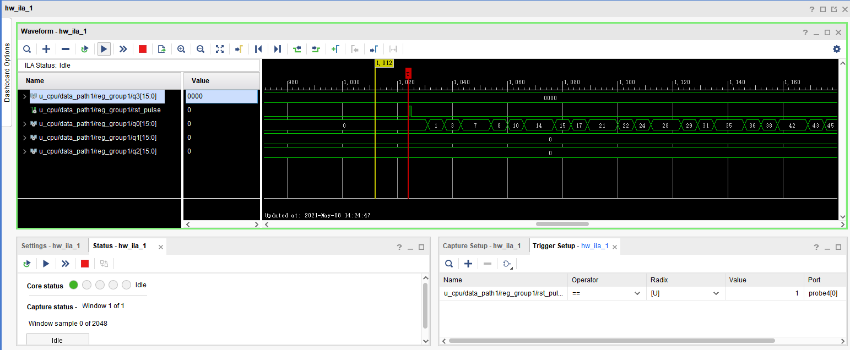
12. Run ILA to see the data in the registers
-step3
2.Start Trigger
1. Set Trigger Condition
3.Press the reset button on the board !!!!!!

Slide 32
Add the instruction and simulate
· Implement the Instruction
  add new state in state_transition
  Add function in alu
· Design your own testBench
· Simulate that and check the results

Slide 33
Digital Logic Design and Application
Lab Course 5
~~End~~

