Slide 1
Song Matching & IDing
***
Analyzing and Hashing Audio With Python Scientific Stack
And SQL DB

Slide 2
Link to talk material
bit.ly/MMNYC15
GitHub

Slide 3
Talk outline
Airing of grievances
Feats of strength
Pontification

Slide 4
Who is this guy?
Miloš Miljković
@miishke

Slide 5

WW
WW

Slide 6
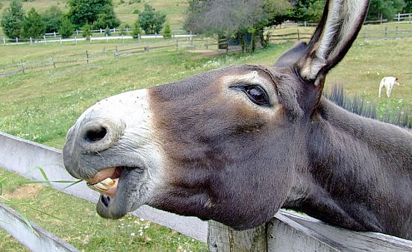
Data science mule
Slow, not too smart, and hard working under burden.

Slide 7
?

Slide 8

SOTU 2015

Slide 9
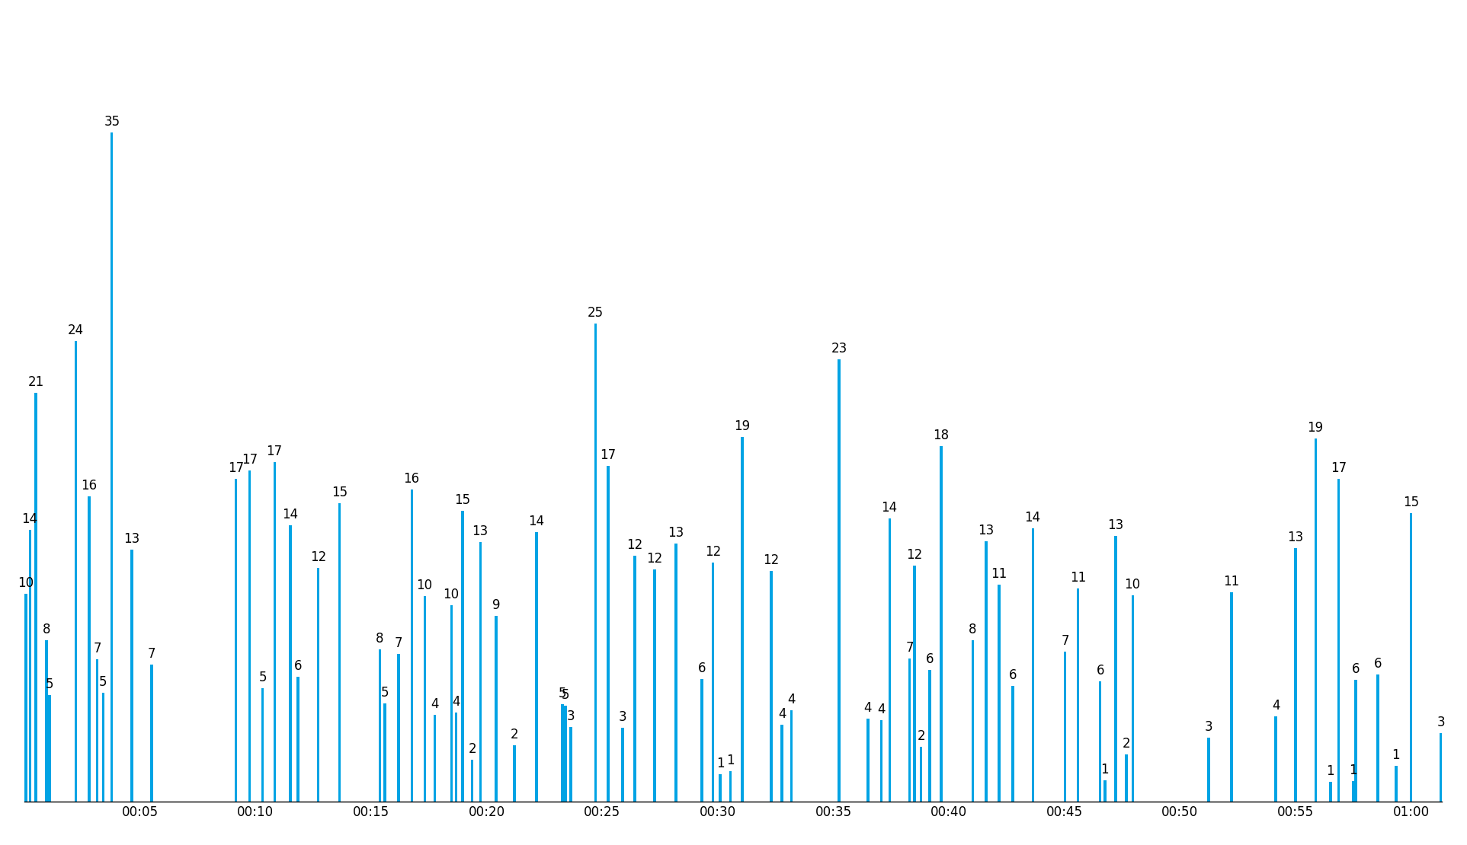
SOTU 2015 – applause occurrence time [min] and duration [s]

Slide 10
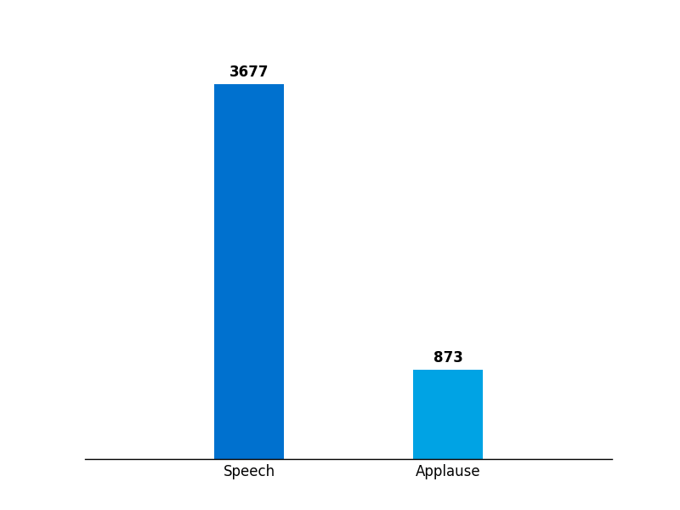
SOTU 2015 – speech and applause duration [s]

Slide 11
Somebody said something on Twitter

Slide 12
Literature search

Slide 13
Who is doing it?

Slide 14
Why do it?

Slide 15
outlier

Slide 16
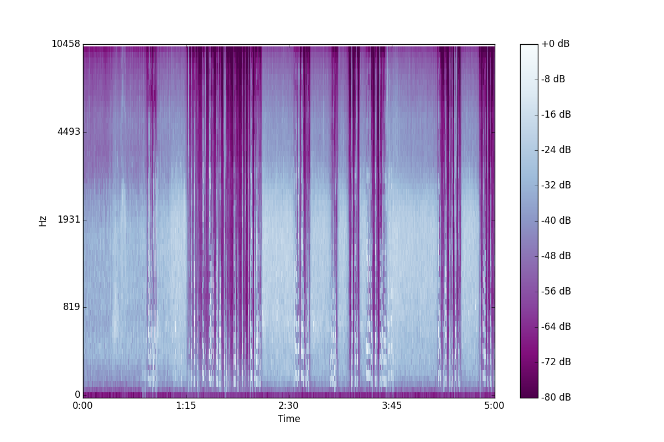
Step one

Slide 17

Steps 2 to N

Slide 18
Awesome paper
Andrew Wang
An Industrial-strength Audio Search Algorithm
Clearly written, informative figures
Seven (7) pages long

Slide 20
Sound & human hearing
20 – 20,000 Hz
Loudness in dB (logarithmic scale)
Quiet study room ~40 dB
Jackhammer ~95 dB
Jet engine ~140 dB

Slide 21
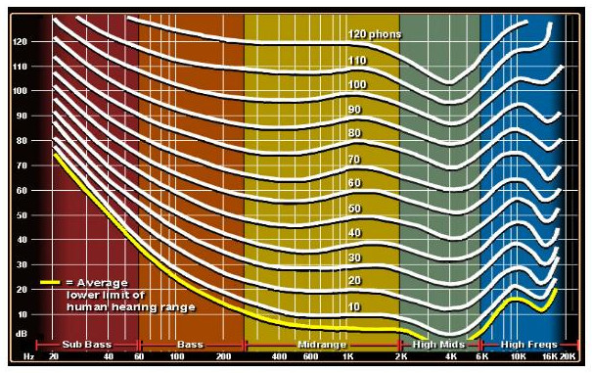
Human auditory system

Slide 22
Recording & encoding
ADC → pulse-code modulation
16 bit signed integer
Shannon – Nyquist theorem
20 kHz → 40 kHz
CD audio 44.1 kHz

Slide 23
Audio bit rate
sampling rate x bit depth x n
44,100 x 16 x 2 = 1,411 kb/s
MP3 highest quality is 320 kb/s

Slide 24
Short time Fourier transform
STFT

Slide 25
bit.ly/FTSEA15
William Cox
@gallamine

Slide 26
STFT
Analysis of frequencies in signal when frequency varies in time
Speech, music, seismology, ECG…

Slide 27
STFT in a nutshell
Apply DFT to windowed segments of data
Windows overlap
Windows are apodized

Slide 28
STFT Q&A
How long are window segments?
Why do windows overlap?
Why do we mess with windows?
What is apodization?

Slide 29
Jupyter notebook time!

Slide 30
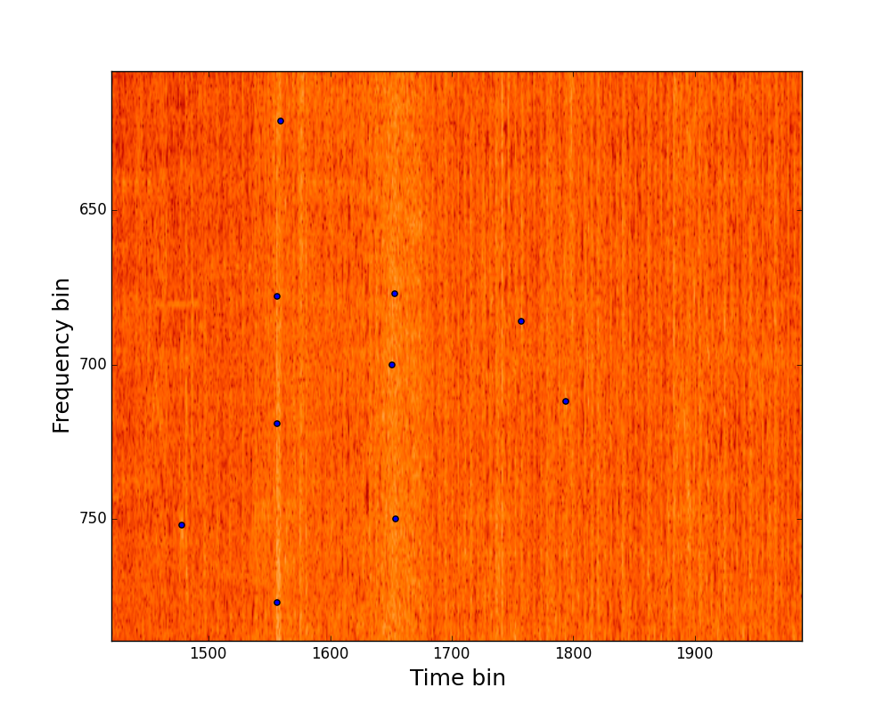
Peak quadrants

Slide 31
Churning out numbers
Make quadrant for each peak
In each quadrant for each peak pair record f₁, f₂, Δt
Pass [f₁, f₂, Δt] through hash function

Slide 32

Beaty of simplicity

Slide 33
Align and match
For each peak record offset time and its hashes
Find matching hashes and get song IDs
d = offset_{song} - offset_{recording}

Slide 35
SQL DB
CREATE TABLE fingerprint(
hash
songID
offset
);
CREATE TABLE song(
songID
song_name
);

Slide 36
Power of Python
scipy → read in raw audio
matplotlib → spectrogram
scikit-image → find peaks
Python → hash
Python → set intersection

Slide 37
Performance
DB size
Search time
No messing with play speed
False positives or are they?
Python → set intersection

