Slide 1

DETERMINE STRESSES IN THE MEMBERS OF THE PLANAR TRUSS PLOBLEM
Group 23
Pham Duc Minh - 2352759
Tran Gia Minh - 2312118
Nguyen Phuc Minh Tam - 231033

Slide 2
01
Theoretical basis
Contents
02
Algorithm

Slide 3
Method of Joints
A process used to solve for the unknown forces acting on the members of a truss system.
A member is a straight structural element connecting the joints in the truss system.
Where:
A truss is a structure consisting of members connected at the joints.

Slide 4
Method of Joints
The joints are considered as particles subjected to forces due to the connections between the truss memebers & applied loads. Since the joints are always in a state of equilibrium, it follows two equations:
(1)
(2)
For a planar truss, we will apply (1) to the two coordinate axes Ox, Oy & combine with (2), we get:

Slide 5
Procedure for applying Method of Joint
Step 01
Assign numbers or letters to members

Slide 6
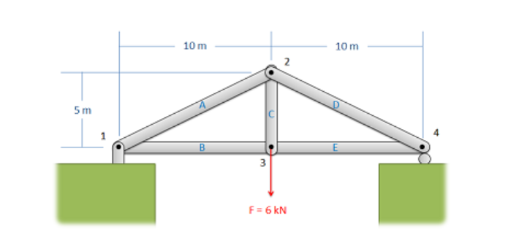
Picture 1. The first step is labeling each joints and each members

Slide 7
Procedure for applying Method of Joint
Step 01
Step 02
Assign numbers or letters to members
Release the supports & draw the reactions

Slide 8
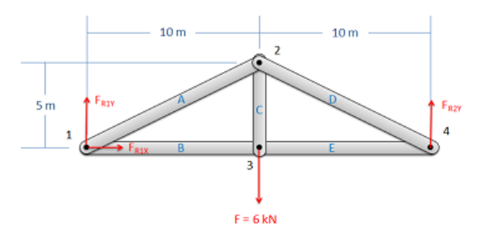
Picture 2. Consider the entire truss as a rigid body and find reaction forces

Slide 9
Procedure for applying Method of Joint
Step 01
Step 02
Step 03
Assign numbers or letters to members
Release the supports & draw the reactions
Solve

Slide 10
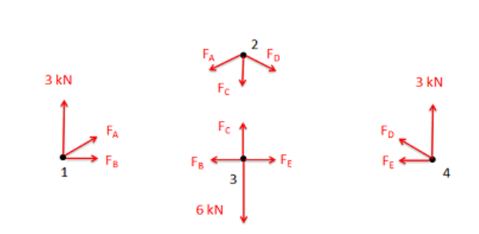
Draw external forces & applied force
Specify the positive direction
If the resultant force is positive it is tension, otherwise it is compression
Sơ đồ FBD

Slide 11
Inverse of the Matrix
n-by-n square matrix
Matrix A is invertible if B is a n-by-n square matrix
E.G:
B is invertible matrix of A

Slide 12

Properties
Given matrices A, B are invertible with $k≠0, then:$

Slide 13
Algorithm
Input
Computation
1
Enter the coordinates of joints, external forces, reactions
Find the applied force
2
Output
3
Solve the applied force

Slide 14
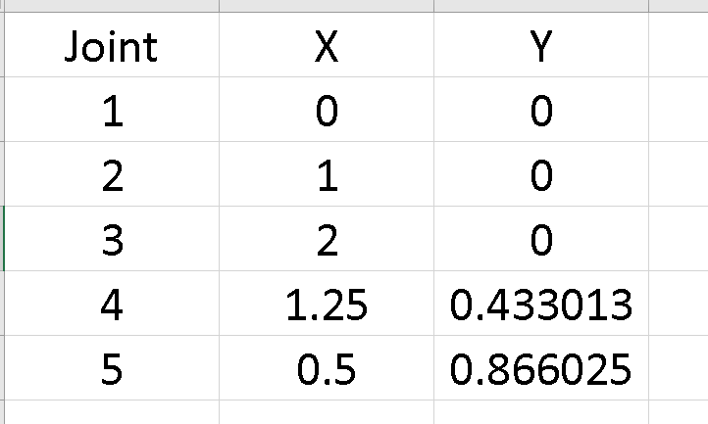
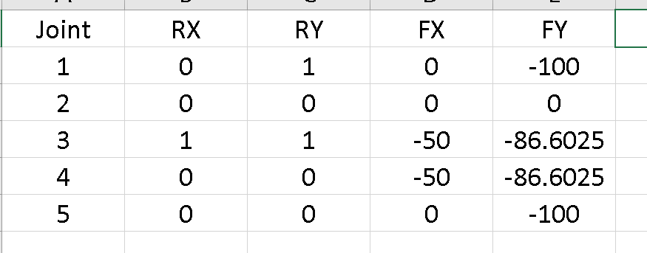
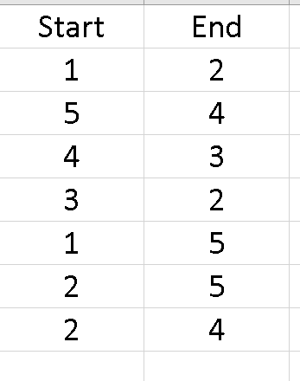
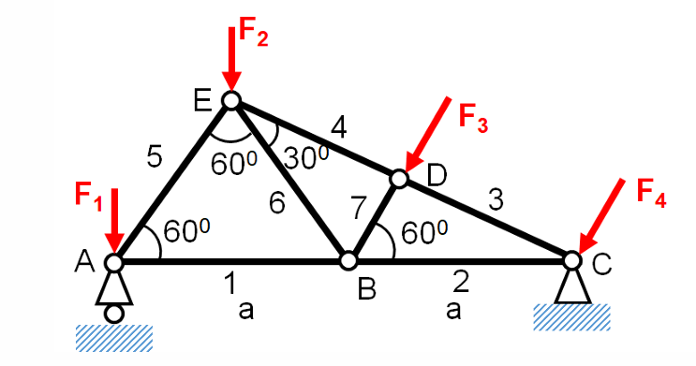
Solution
Step 1: Enter the Joints, external forces, & reactions
Joints
External forces, & reactions
The members

Slide 15
Solution
Step 2: Find the applied force by using:
Where:
A the matrix containing the coefficents of S
S the vector of forces (stresses) in the members to be determined
F the matrix of external forces

Slide 16
Solution
b: the number of joints k: the number of members
r: the number of supports n = 0, 1,…, 2b – 1
m = 0, 1,…, k + r - 1
Find the matrix A
A(0, 0)
Consider AB
B(1, 0)
, m = 0
=>
With joint A
, m = 0
=>
, m = 0
=>
With joint B
, m = 0
=>

Slide 17
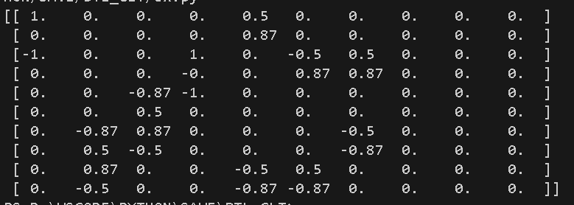
Solution
Similarly, for the remaining bars, we obtain the matrix A as follows:

Slide 18
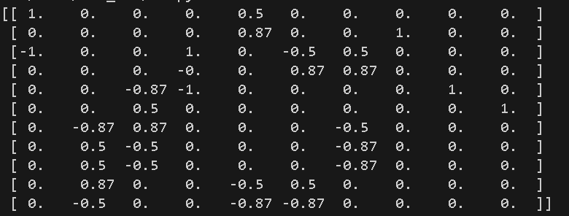
Solution
Then, we enter the reactions to matrix A:
With joint A
k = 8
k = 9
With joint C
k = 10

Slide 19
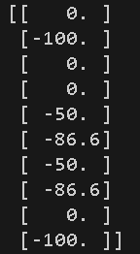
Solution
b: the number of joints n = 0, 1,…, 2b – 1
m = 0
Find the matrix F
With joint A
Similarly, for the other joints, we get:

Slide 20
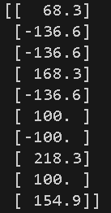
Solution
Finally, we solve S, and get:
Bar AB = 68.30 (Tension)
Bar ED = 136.60 (Compression)
Bar CD = 136.60 (Compression)
Bar BC = 168.30 (Tension)
Bar AE = 136.60 (Compression)
Bar BE = 100 (Tension)
Bar BD = 100 (Compression)
At joint A:
At joint 3:

Slide 21
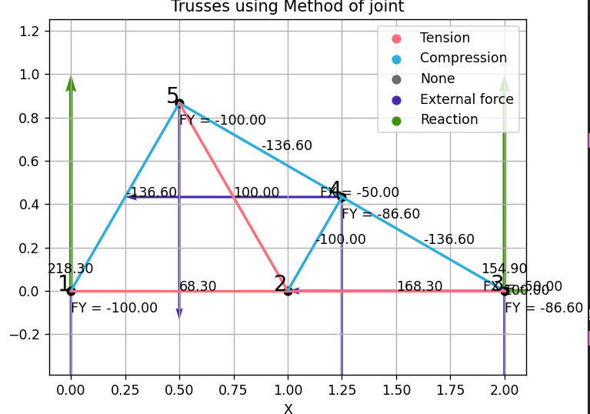
Conclusion
Code has successfully met the requirements of the problem, from calculating the stresses in each bar & the reactions at the joints
We have improved the code to make it more convenient, including:
Enter the information through Excel
Output the truss diagram

Slide 22
References
Python Software Foundation. (2001). Python. Retrieved from math — Mathematical func tions: https://www.python.org/ .
Beer, F., E. Johnston, DeWolf, J., & Mazurek, D. (2010). Statics and Mechanics of Materials (Vol. 6). New York, U.S.A: McGraw-Hill Education.
Cherney, D., Denton, T., Thomas, R., & Waldron, A. (2013). Linear Algebra. California: Creative Commons.
NumPy Developers. (2008). NumPy documentation. Retrieved from NumPy: the absolute basics for beginners: https://numpy.org/doc/stable/index.html
The Matplotlib development team. (2012). Matplotlib 3.9.2 documentation. Retrieved from Quick start guide: https://matplotlib.org/stable/

Slide 23
Thanks!
Do you have any questions?

