Slide 1
Analysis and classification of ESWD reports
Mija Pilkaite

Slide 2
Goal
Classify the references from European Severe Weather database based on the event they are describing;
Build a binary classifier that could recognize severe weather data from non-severe weather data;

Slide 3
My Data
22 317 entries
Severe weather events (‘EVENT_TYPE, ‘REFERENCE’) in the region of France
Many more features, however, 2 used
REFERENCE column in both English and French

Slide 4
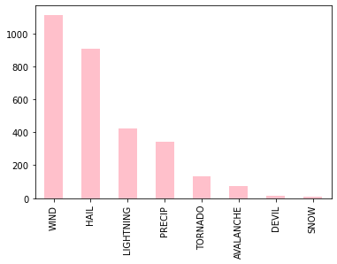
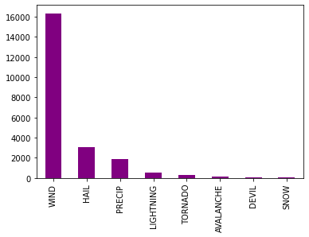
Distribution of the data
Data distribution before removing null values
Data distribution after removing null values

Slide 5
Potential applications
ESWD is currently volunteer based
Remove human error/bias
Expand the database
Apply the same standard to every data entry
Broader research possibilities

Slide 6
Weather type classification

Slide 7
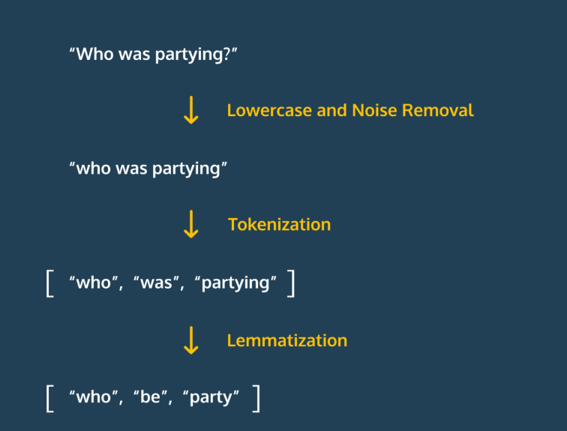

Data Preprocessing
Classifying according to the text language
Removal of stop words and punctuation using Spacy
Tokenization
Lemmatization
Removing references that do not contain any information about the weather

Slide 8

Examples
“Report via Kachelmannwetter.com, 4 Nov 2022.“ REMOVE
"Haute-Alpes : un skieur de 55 ans décède dans une avalanche à Vars"", FRANCE BLEU, 11 DEC 2022"
['Haute-Alpes', 'skieur', '55', 'an', 'décéder', 'avalanche', 'Vars', 'FRANCE', 'bleu', '11', 'DEC', '2022']"

Slide 9
English data
"['Joel', 'Feneule', 'Facebook', '17', 'Nov', '2022’]”,
['eyewitness', 'report', 'Courrier', 'picard', 'Facebook', '23', 'oct', '2022’],
['Guillaume', 'Woznica', 'Facebook', '13', 'Feb', '2020', 'element', 'church', 'collapse', 'security', 'perimeter', 'set’]”
MOSTLY NOISE!!!

Slide 10
Methods used
Feature representation
Bag of Words
Term Frequency – Inverse Document Frequency vector (TF-IDF)
Sbert (Sentence Bert)
Models
Logistic Regression
Random Forest
Fully Connected Neural Network

Slide 11
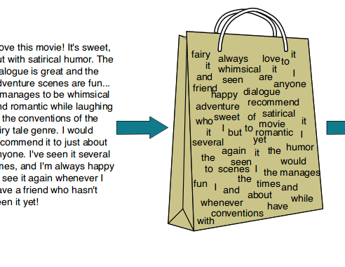
Bag of Words
Unordered set of words – a dictionary, value = frequency in an entry
Key idea: frequency is correlated with importance
Simplicity, scalability and extensibility
Underperforms with unknown words

Slide 12
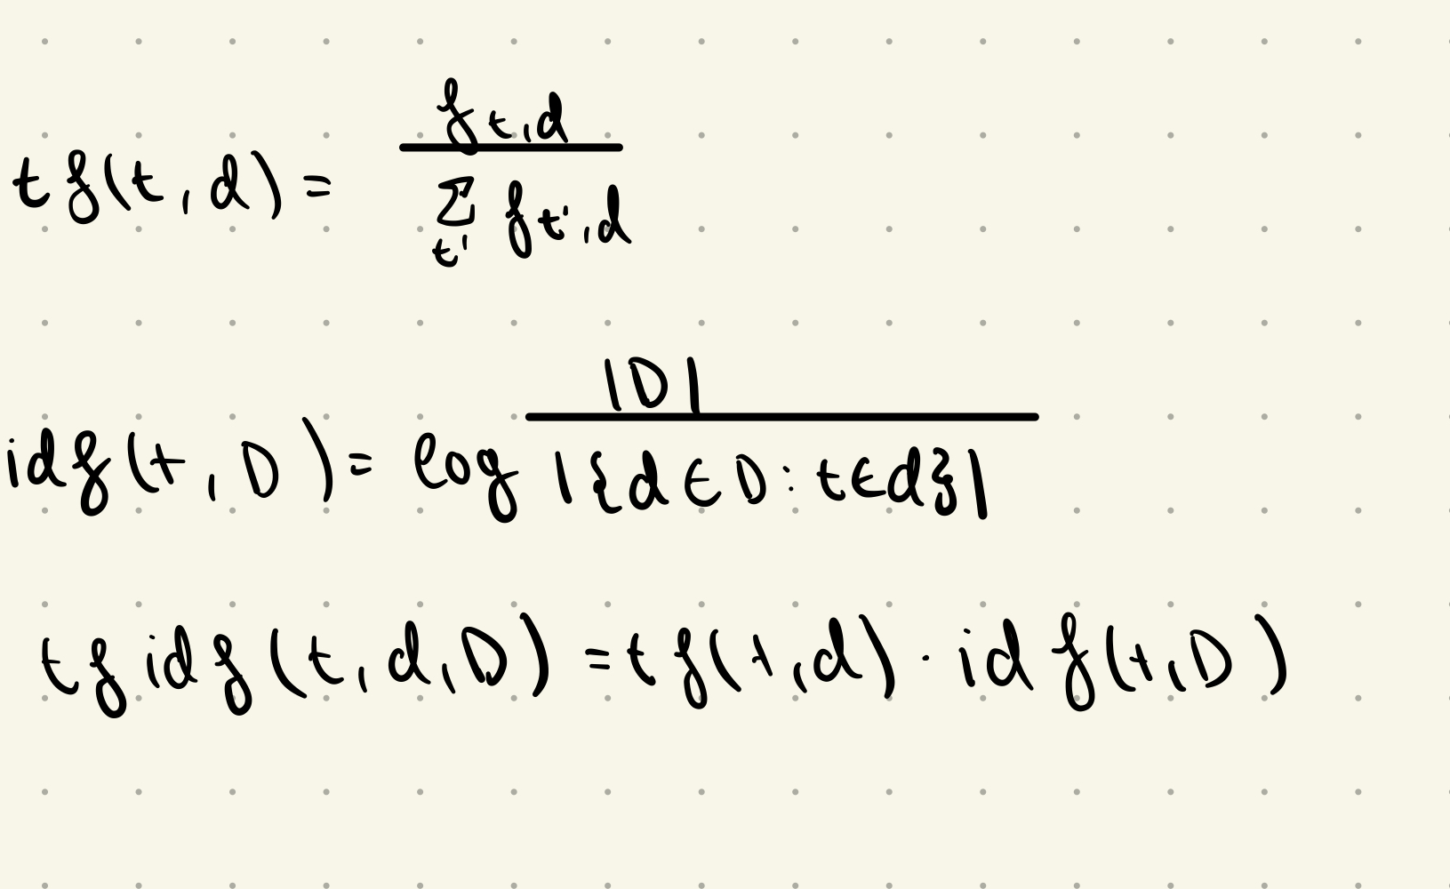
TF-IDF vector
Common words deemed less important
Logarithm to scale: number of documents typically much larger than length of documents
More weight to rare terms
Easily comprehensible, fast
Notes:
So in summary, TF-IDF is a simple but effective method for generating vector representations of text documents. It has many useful properties and works well in practice for a variety of basic NLP tasks. While more complex models can outperform TF-IDF for some problems, it continues to be a strong baseline that is easy to implement and interpret. For many smaller text datasets, TF-IDF may be all you need.

Slide 13

SBert
Bidirectional Encoder Representations from Transformers by Google AI.
It takes a sentence, analyzes its meaning, and represents it as a point in a high-dimensional space.
Captures both semantic and syntactic information
Computationally heavy
Notes:
Does not need text preprocessing. A Siamese neural network is an architecture that contains two or more identical neural networks that share the same weights. It is used for learning similarity between inputs.
The key idea is that if two inputs are similar, the representations learned by the shared network should also be similar. By contrast, dissimilar inputs should produce very different representations.
he basic architecture of a Siamese network contains:
Twin neural networks with shared weights: The twin networks map two separate inputs to vector representations. By using tied weights, the networks learn similar representations for similar inputs.
A distance metric: A layer after the twin networks computes a distance (like L1 or L2 norm) between the two output representations.
A classification or thresholding step: The distance is then used to determine if the inputs are similar or not. This can be a binary classification or a threshold value.
A margin: Often a margin value is used to set the threshold for similarity. Only input pairs with a distance under the margin are considered similar.

Slide 14
Models
RANDOM FOREST
Ensemble method combining many trees
Capture non-linear relationships in the data.
Reduces overfitting
FULLY CONNECTED NEURAL NETWORK
Powerful non-linear model
Helps capture complex relationships
Can learn semantic relationships
LOGISTIC REGRESSION
Simple and fast linear model
Easily interpretable weights
Easy to extract the most important features
Notes:
They have different inductive biases (linear, trees, neural) so they will learn differently from the data.
Ensembling them together will produce an overall model with better performance than any single method alone.
If one method overfits, the other methods may compensate by generalizing better.
Linear and simpler models act as a baseline, while more complex models may not necessarily perform better.
You get the interpretability benefits of logistic regression, the power of neural networks, and the generalizability of random forests all together.
Ensemble methods are machine learning models that combine multiple base learners to produce a more powerful final model.

Slide 15
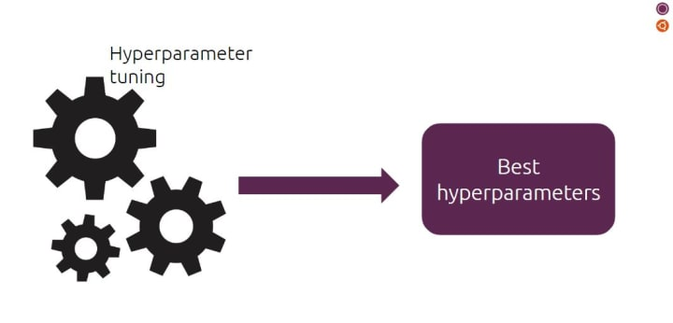
Hyperparameter tuning
Combination of parameters that works best
Prevent overfitting
Optimization and resource usage
ACCURACY!!
Notes:
Does not need text preprocessing.

Slide 16
Data Train-Test Split
Sklearn train_test_split
80% train, 20% test

Slide 17
RESULTS

Slide 18
Bag of Words
FULLY CONNECTED NEURAL NETWORK
82.6% accuracy
LOGISTIC REGRESSION
83.5 % accuracy
83.3 F1 score
RANDOM FOREST
max depth: None, min samples leaf’: 1, ’min samples split’: 5, ‘n estimators’: 100
84.3 % accuracy
83.4 F1 score
Notes:
They have different inductive biases (linear, trees, neural) so they will learn differently from the data.
Ensembling them together will produce an overall model with better performance than any single method alone.
If one method overfits, the other methods may compensate by generalizing better.
Linear and simpler models act as a baseline, while more complex models may not necessarily perform better.
You get the interpretability benefits of logistic regression, the power of neural networks, and the generalizability of random forests all together.
F1 score of accuracy and recall weighted average
Precision = True Positives / (True Positives + False Positives) Recall = True Positives / (True Positives + False Negatives)

Slide 19
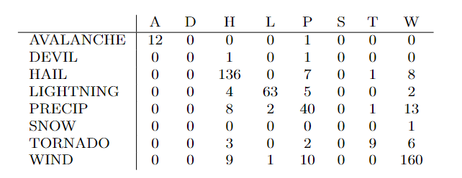
Bag of Words (LR confusion matrix)

Slide 20
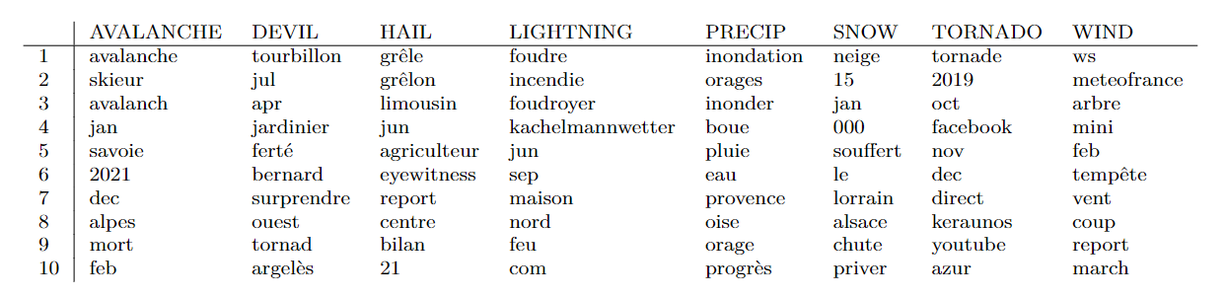
Bag of Words (LR most important features)

Slide 21
Most misclassified
Actual: LIGHTNING Predicted: WIND
Reference: [’Orages’, ’départ’, ’feu’, ’maison’, ’détruite’, ’arbre’, ’couché’, ’tarn’, ’Haute-Garonne’, ’tarn-et-garonne’, ’FRANCE’, ’TV’, ’INFO’, ’30’, ’aug’, ’2022’]
Actual: PRECIP Predicted: WIND
Reference: ['orage', 'charente', 'rafale', '111.9', 'kilomètre', 'heure', 'semaine', 'pluie', 'minute', 'charente', 'libre', '21', 'june', '2022’]
Actual: LIGHTNING Predicted: HAIL
Reference: [’intempérie’, ’orage’, ’faire’, ’gros’, ’dégât’, ’ouest-aveyron’, ’vendredi’, ’soir’, ’ladepeche.fr’, ’29’, ’june’, ’2020’]

Slide 22
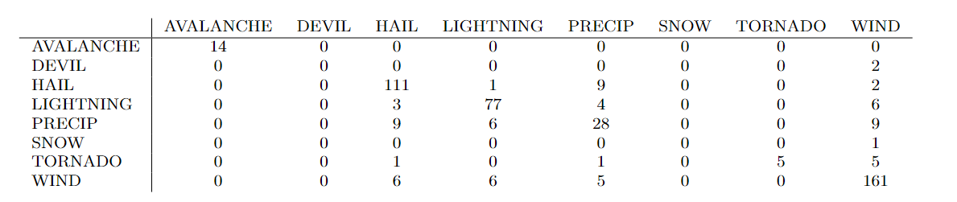
Bag of Words (RF confusion matrix)

Slide 23
Most misclassified
Actual: WIND Predicted: PRECIP
Reference: [’Orages’, ’Saint-Etienne’, ’Gier’, ’2618’, ’impact’, ’foudre’, ’relever’, ’progrès’, ’22’, ’JUL’, ’2020’]
Actual: PRECIP Predicted: HAIL
Reference: [’météo’, ’Saône-et-Loire’, ’71’, ’v.’, ’Twitter’, ’09’, ’JUN’, ’2021’, ’Panique’, ’Autun’, ’fort’, ’averse’, ’journal’, ’SAÔNE-ET-LOIRE’, ’09’, ’JUN’, ’2021’]
Actual: WIND Predicted: HAIL
Reference: [’Orages’, ’grêle’, ’faire’, ’casse’, ’au-vergne’, ’Rhône’, ’Alpes’, ’France’, ’Info’, ’3’, ’Jul’, ’2019’]

Slide 24
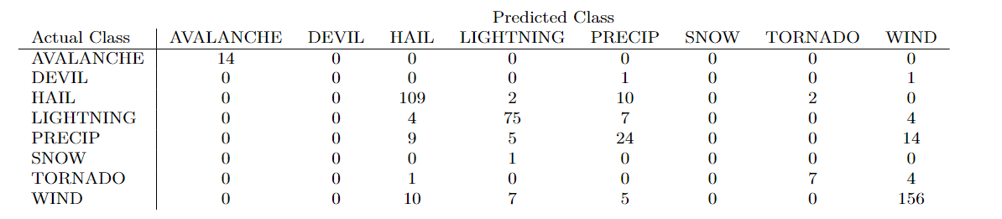
Bag of Words (FCNN confusion matrix)

Slide 25
Most commonly misclassified
True prediction: WIND Predicted prediction: PRECIP
Reference: [’Orages’, ’Saint-Etienne’, ’Gier’, ’2618’, ’impact’, ’foudre’, ’relever’, ’progrès’, ’22’, ’JUL’, ’2020’]
True prediction: WIND Predicted prediction: HAIL
Reference: [’Orages’, ’grêle’, ’faire’, ’casse’, ’auvergne’, ’Rhône’, ’Alpes’, ’France’, ’Info’, ’3’, ’Jul’, ’2019’]
True prediction: WIND Predicted prediction: LIGHTNING
Reference: [’Orages’, ’savoie’, ’Haute-Savoie’, ’foudre’, ’frappe’, ’transformateur’, ’route’, ’couper’, ’France’, ’Bleu’, ’24’, ’OCT’, ’2022’]
True prediction: PRECIP Predicted prediction: LIGHTNING
Reference: [’fort’, ’in-tempérier’, ’vallée’, ’Rhône’, ’maison’, ’effondrer’, ’ardèche’, ’dauphiné’, ’09’, ’nov’, ’2022’]

Slide 26
TF-IDF
FULLY CONNECTED NEURAL NETWORK
81.6% accuracy
LOGISTIC REGRESSION
83.3 % accuracy
82.3 F1 score
RANDOM FOREST
max depth: None, min samples leaf’: 1, ’min samples split’: 2, ‘n estimators’: 200
83.7 % accuracy
83.0 F1 score
Notes:
They have different inductive biases (linear, trees, neural) so they will learn differently from the data.
Ensembling them together will produce an overall model with better performance than any single method alone.
If one method overfits, the other methods may compensate by generalizing better.
Linear and simpler models act as a baseline, while more complex models may not necessarily perform better.
You get the interpretability benefits of logistic regression, the power of neural networks, and the generalizability of random forests all together.

Slide 27
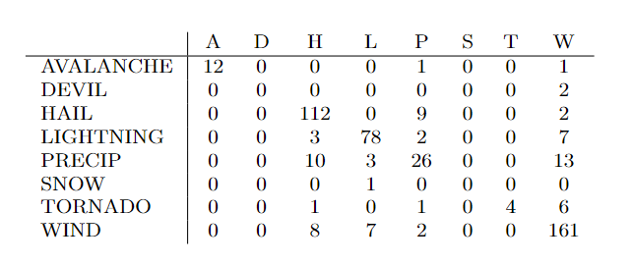
TF-IDF (LR confusion matrix)

Slide 28
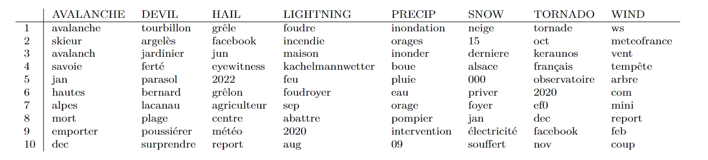
TF-IDF (LR most important features)

Slide 29
Most misclassified
Prediction: HAIL True value: LIGHTNING
Reference: [’Orages’, ’grêle’, ’localiser’, ’Yonne’, ’important’, ’dégât’, ’culture’, ’autour’, ’pont-sur-yonne’, ’200’, ’client’, ’priver’, ’électricité’, ’Puisaye’, ’YONNE’, ’REPUBLICAINE’, ’29’, ’JUN’, ’2021’, ’RAD’]
Prediction: WIND True value: DEVIL
Reference: [’saint-sernin’, ’BOIS’, ’mini-tornade’, ’emmèn’, ’toiture’, ’Creusot’, ’Infos’, ’12’, ’april’, ’2020’, ’colère’, ’Zeus’, ’Facebook’, ’14’, ’april’, ’2020’]

Slide 30
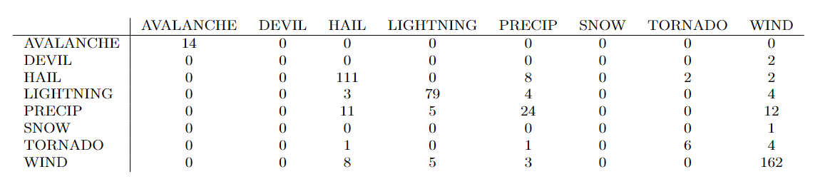
TF-IDF (RF confusion matrix)

Slide 31
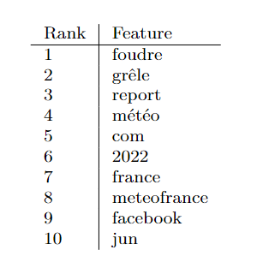
TF-IDF (RF most important features)

Slide 32
Most misclassified
Actual: TORNADO Predicted: WIND
Reference: [’photo’, ’trombe’, ’marine’, ’observer’, ’entrer’, ’Pornic’, ’Noirmoutier’, ’courrier’, ’pays’, ’Retz’, ’29’, ’june’, ’2021’]
Actual: LIGHTNING Predicted: WIND
Reference: [’arbre’, ’foudroyer’, ’Aslonnes’, ’nuit’, ’vendredi’, ’samedi’, ’république’, ’10’, ’may’, ’2020’]
Actual: PRECIP Predicted: WIND
Reference: [’orage’, ’charente’, ’rafale’, ’111.9’, ’kilomètre’, ’heure’, ’semaine’, ’pluie’, ’minute’, ’charente’, ’libre’, ’21’, ’june’, ’2022’]

Slide 33
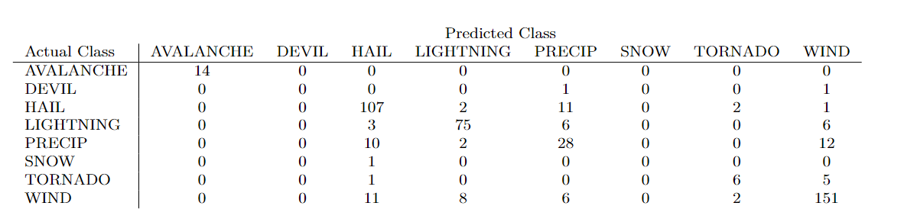
TF-IDF (FCNN confusion matrix)

Slide 34
Most misclassified
True prediction: LIGHTNING Predicted prediction: PRECIP
Reference: [’Orages’, ’grêle’, ’localiser’, ’Yonne’, ’important’, ’dégât’, ’culture’, ’autour’, ’pont-sur-yonne’, ’200’, ’client’, ’priver’, ’électricité’, ’Puisaye’, ’YONNE’, ’REPUBLICAINE’, ’29’, ’JUN’, ’2021’, ’RAD’]
True prediction: LIGHTNING Predicted prediction: WIND Reference: [’toiture’, ’arracher’, ’foudre’, ’Douai’, ’victime’, ’FRANCE’, ’bleu’, ’20’, ’JUN’, ’2021’, ’RAD’]
True prediction: WIND Predicted prediction: PRECIP Reference: [’Orages’, ’Saint-Etienne’, ’Gier’, ’2618’, ’impact’, ’foudre’, ’relever’, ’progrès’, ’22’, ’JUL’, ’2020’]

Slide 35
SBert
FULLY CONNECTED NEURAL NETWORK
81.6% accuracy
LOGISTIC REGRESSION
80.6 % accuracy
78.4 F1 score
RANDOM FOREST
max depth: 20, min samples leaf’: 2, ’min samples split’: 2, ‘n estimators’: 200
78.1 % accuracy
76.1 F1 score
Notes:
They have different inductive biases (linear, trees, neural) so they will learn differently from the data.
Ensembling them together will produce an overall model with better performance than any single method alone.
If one method overfits, the other methods may compensate by generalizing better.
Linear and simpler models act as a baseline, while more complex models may not necessarily perform better.
You get the interpretability benefits of logistic regression, the power of neural networks, and the generalizability of random forests all together.

Slide 36
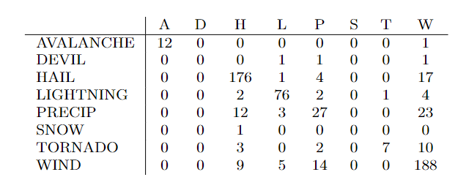
SBert (LR confusion matrix)

Slide 37
Most misclassified
Actual: TORNADO Predicted: WIND
Reference: Tornade à Champsac ()] - //, Ouest Orages, n.d.. Présage des Vents (on Facebook), Jan : Tornade de Champsac () -janvier . Photos by A. Rivet.
Actual: WIND Predicted: HAIL
Reference: Eyewitnesses reports in comments via Météo Sorguaise et Avignonnaise (on Facebook), AUG .
Actual: HAIL Predicted: PRECIP
Reference: Violents orages, pluies diluviennes et inondations du au septembre, Meteo Paris, Sept . RAD. Eyewitness report via Météo42 (on Facebook), SEP

Slide 38
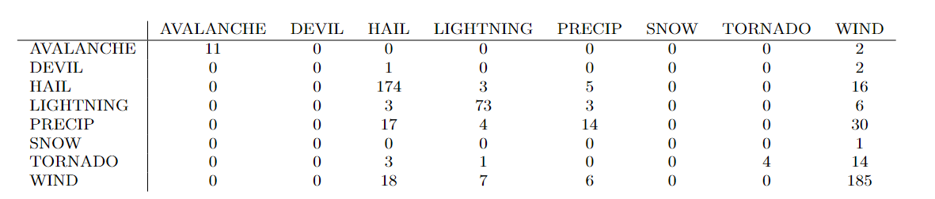
SBert (RF confusion matrix)

Slide 39
Most misclassified
Actual: DEVIL Predicted: WIND Reference: Lacanau quel est ce tourbillon qui a fait senvoler tous les parasols de la plage Sud Ouest Jul
Actual: WIND Predicted: HAIL Reference: Intempéries Record une rafale de vent à kmh enregistrée à Montpellier Actufr June
Actual: WIND Predicted: PRECIP Reference: Un supermarché frappé par la foudre et inondé à Thyez une cinquantaine dinterventions pour les pompiers LE DAUPHINÉ AUG

Slide 40
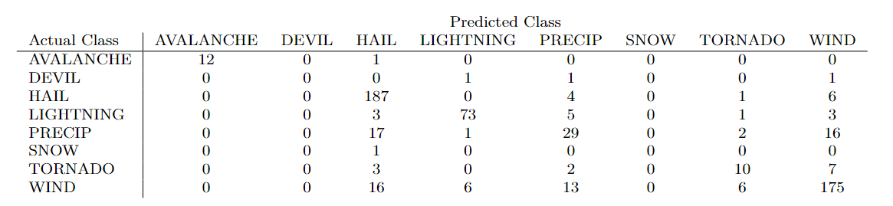
SBert (FCNN confusion matrix)

Slide 41
Most misclassified
True prediction: HAIL Predicted prediction: PRECIP
Reference: Var létat de catastrophe naturelle reconnu à Hyères et au Pradet après les orages du août BFM TV AUG
True prediction: LIGHTNING Predicted prediction: PRECIP
Reference: Orages et inondations en Normandie des centaines dinterventions des pompiers ACTUfr JUN

Slide 42
Best results
Bag of Words with Random Forest: 84.3% accuracy

Slide 43
Distinguishing Severe from non-severe reports

Slide 44
Techniques used
Bag of Words and TF-IDF feature representation
Logistic Regression model
10-fold cross validation
9 folds (90 percent of the data) and test on the held-out fold.
Notes:
Avoid overfitting – 10-fold cross validation, process repeated 10 times.
For that section, remember to tell that the negative examples were obtained from newspapers usually cited in ESWD, looking for frequent keywords related to weather, such as “weather, rain, wind,…”. Also tell the size of the dataset

Slide 45
Data examples
True data:
« Orages grêle lande inquiétude culture Sud Ouest 10 may 2020 »
False data:
« hiver 2020 profil moindre neige »

Slide 46
Results
Bag of Words:
Accuracy: 99.5%
Misclassified:
Predicted: 1 True: 0
Reference: météo 2022 lodévoi ancrée
Predicted: 1 True: 0 Reference: 2022 bien être l ’ année chaude France
TF-IDF:
Accuracy: 99.0%
Misclassified:
Haute-Savoie glissement terrain bloquer route Thyez dauphiner Libéré 15 July 2021 for suscriber only (True label: 1, Predicted label: 0)
grêle sud-est orage l ' Ouest (True label: 0, Predicted label: 1)
météo France surprendre (True label: 0, Predicted label: 1)
Mickael B. observatoir ciel Orageux Tornade Médoc 2018 2019 (True label: 1, Predicted label: 0)

Slide 47
Results
Amazingly good accuracy
Further investigation needed on references
Potentially the data, location
Perhaps an easy task

Slide 48
Conclusions
At least 80% accuracy for each combination
Noisy data with no standard
With proper cleaning/text extraction, better results can be expected
Amazing accuracy for a false data classifier

Slide 49
Outlook
Extract more than an event type from data
If proper text extraction from an article, automatically find fit news for the database
Make the database automatic and more precise
Improve forecasting accuracy and warning systems

Slide 50
Thank you!

