Slide 1
MACHINE LEARNING HDIP IN DAB CCT College Dublin COVID-19
Mijail Fausto Blanco Vargas (2023012)
Lecturer: Dr. Muhammad Iqbal

Slide 2

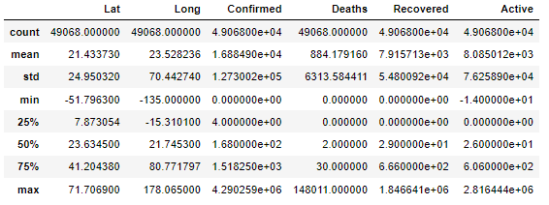
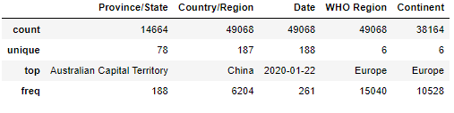
Business understanding and Data Preparation
I explored different datasets, and compared with Emily, and we decided to work in a COVID dataset found by Emily in which I developed:
- Data overview
- characterization
- statistics of the dataset.
- Analysis of duplicates
- Standardizing Null Values

Slide 3
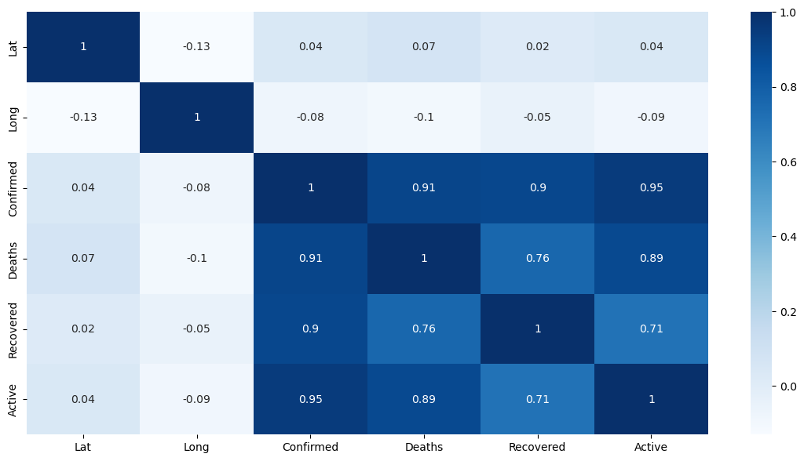
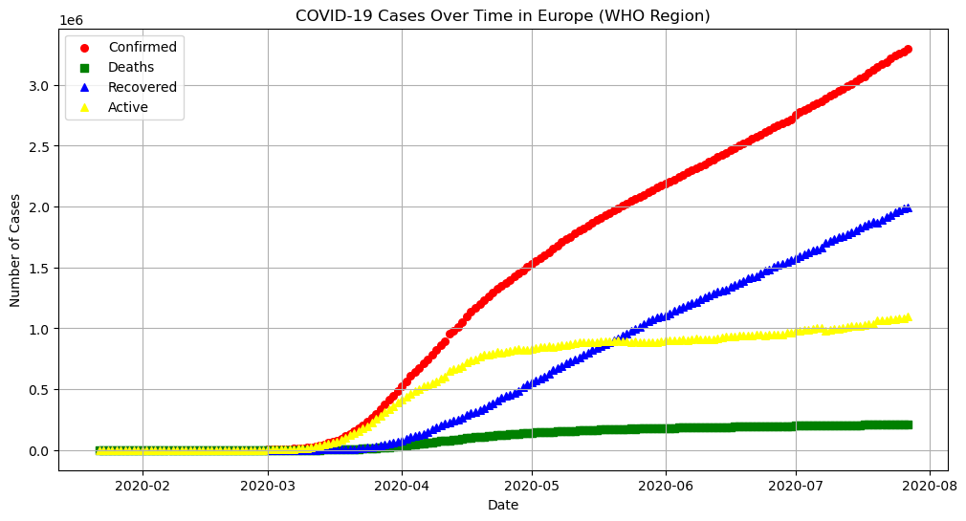
EDA Visualizations and correlation
I analyzed the correlation of the variables with the target variable and between each other.
After analysing the correlation of the variables between each other, I trained the models with each one to see if it created some overfitting in the model and at the end we used it all because it didn’t affect to the results.

Slide 4
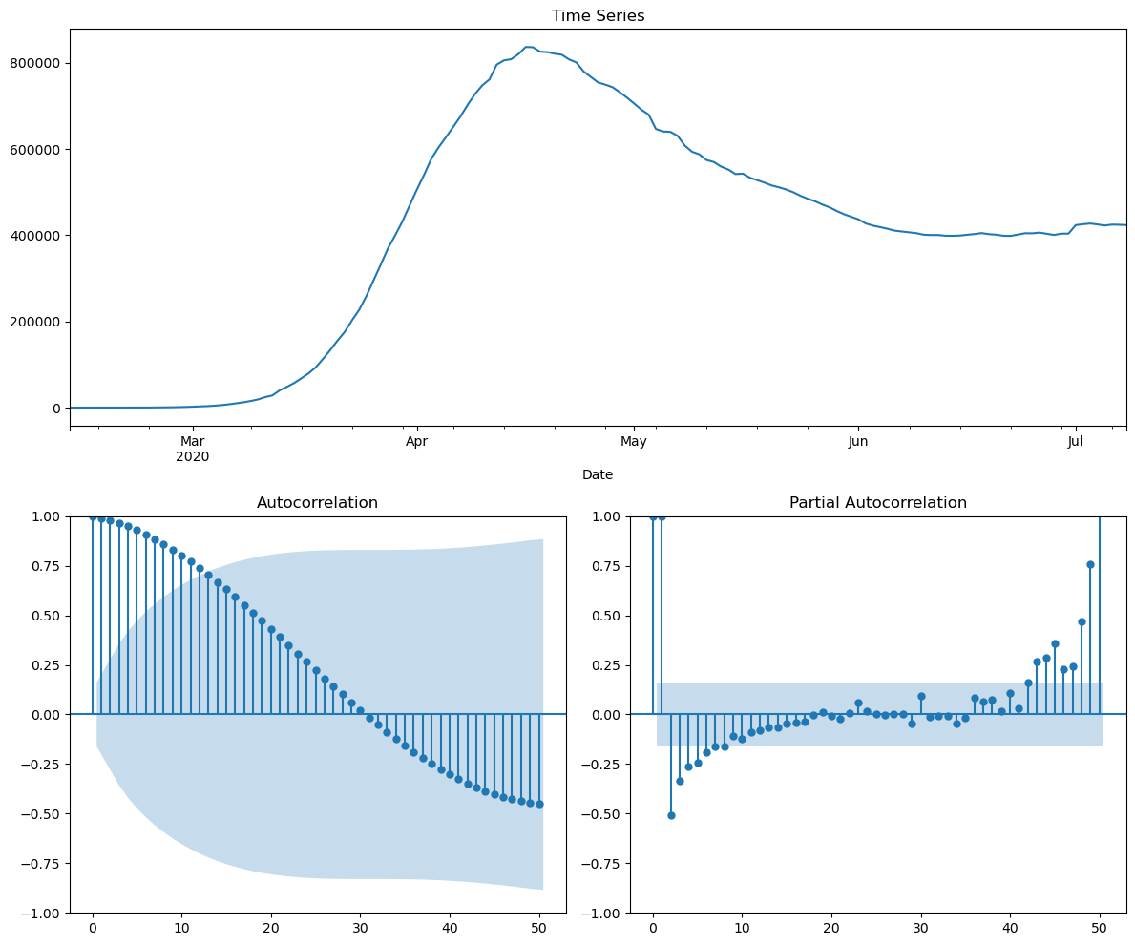
ARIMA Time Series Analysis
I developed Arima Time Series Analysis with 3 different test splits (10, 15, ans 20%), making the data stationary, applying Dickey-Fuller test and finding the best p, d, q values finding AIC and BIC metrics, and calculating the Mean Absolute Error of each one.

Slide 5
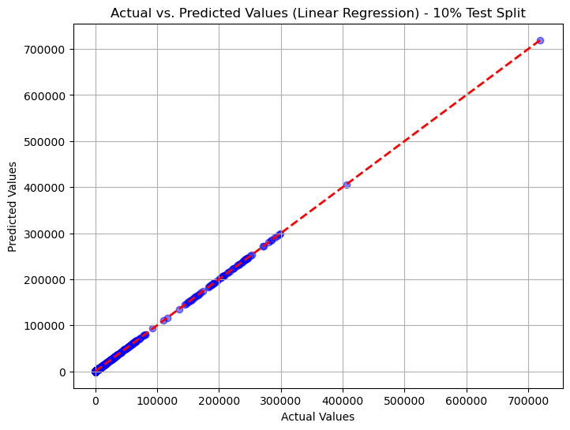
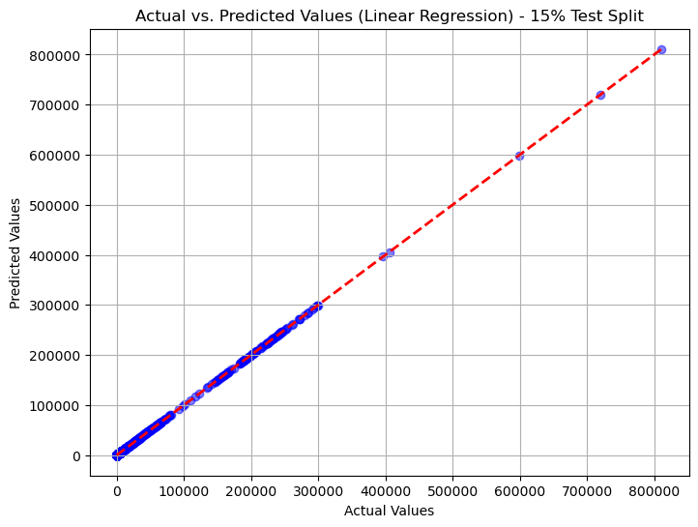
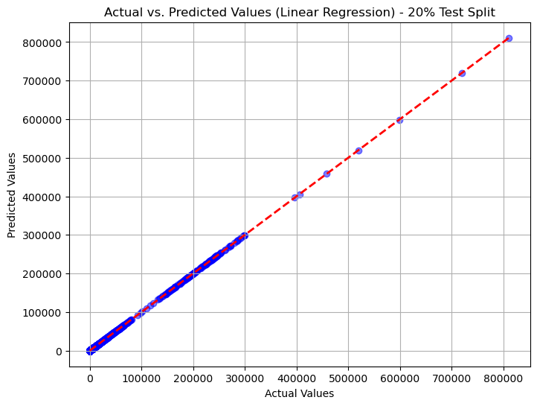
Linear Regression
I applied the Linear regression model and visualizations for Linear Regression and compared the different test splits. Finally with Emily, we wrote the conclutions and results taking the decisión of the best model for our predictions.

