Slide 1
STRATEGIC THINKING HDIP IN DAB CCT COLLEGE DUBLIN
Mijail Fausto Blanco Vargas (2023012)
Emily Cristina Herbas Luizaga (2023100)
Lecturer: James Garza

Slide 2
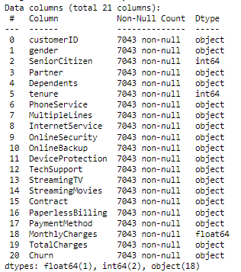
General Goal:
To predict churn cases using as a baseline the models used last semester, improving the analysis of the Machine Learning models to be applied for this prediction.
Data Source:
Kaggle
Characterization of the dataset:
-7043 rows and 21 columns

Slide 3
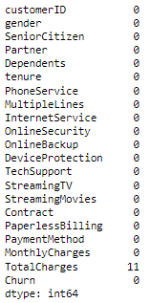

Analysis of Null values:
TotalCharges = Tenure * MonthlyCharges
Exploration of column “OnlineBackup”
Integer Encoding

Slide 4
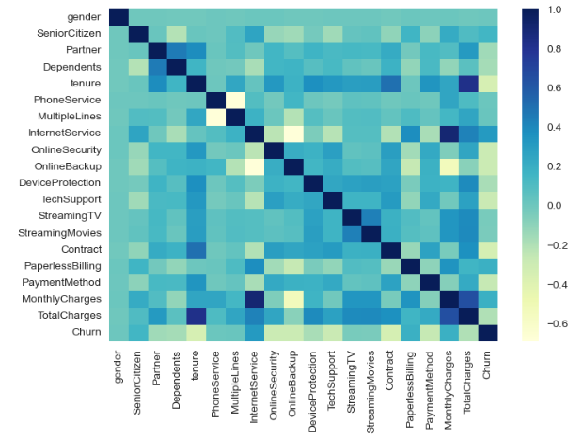
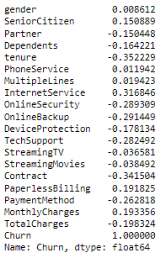
Feature engineering:
- No duplicates
- Integer encoding instead of dummies
Correlation Analysis

Slide 5
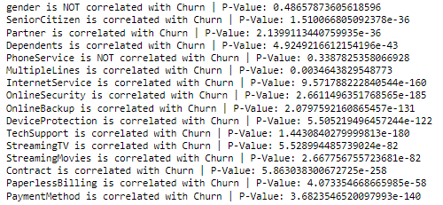
ANOVA Test:
Chi- squared test

Slide 6
Modelling:
- No duplicates
- Integer encoding instead of dummies
Correlation Analysis

Slide 7
SEMESTER 2 RESULTS TABLES
 |  | 10% |  | 20% |  | 30%
 |  | 0 | 1 | 0 | 1 | 0 | 1
PCA and Standard Scaler | precision | 0,86 | 0,72 | 0,86 | 0,68 | 0,85 | 0,69
 | recall | 0,91 | 0,6 | 0,9 | 0,58 | 0,9 | 0,56
 | f1-score | 0,88 | 0,65 | 0,88 | 0,63 | 0,87 | 0,61
Recall | precision | 0,85 | 0,66 | 0,86 | 0,63 | 0,85 | 0,62
 | recall | 0,88 | 0,59 | 0,87 | 0,61 | 0,87 | 0,59
 | f1-score | 0,87 | 0,62 | 0,86 | 0,62 | 0,86 | 0,61
Hyperparameter Tuning LR | precision | 0,73 | 0,77 | 0,79 | 0,73 | 0,75 | 0,79
 | recall | 0,75 | 0,75 | 0,75 | 0,77 | 0,8 | 0,75
 | f1-score | 0,74 | 0,76 | 0,77 | 0,75 | 0,78 | 0,77
Hyperparameter Tuning LDA | precision | 0,73 | 0,77 | 0,78 | 0,71 | 0,76 | 0,78
 | recall | 0,75 | 0,75 | 0,72 | 0,77 | 0,78 | 0,77
 | f1-score | 0,74 | 0,76 | 0,75 | 0,74 | 0,77 | 0,77
Hyperparameter Tuning KNN | precision | 0,74 | 0,75 | 0,8 | 0,69 | 0,73 | 0,72
 | recall | 0,72 | 0,77 | 0,68 | 0,81 | 0,7 | 0,75
 | f1-score | 0,73 | 0,76 | 0,74 | 0,75 | 0,71 | 0,74
 |  | 10% | 20% | 30%
Accuracy | PCA/Standard Scaler | 0,82 | 0,82 | 0,81
 | Recall | 0,8 | 0,8 | 0,79
 | LR | 0,75 | 0,76 | 0,77
 | LDA | 0,75 | 0,74 | 0,77
 | KNN | 0,75 | 0,74 | 0,73

Slide 8
SEMESTER 1 RESULTS TABLES
 |  |  | 10% |  | 20% |  | 30%
 |  |  | 0 | 1 | 0 | 1 | 0 | 1
Logistic Regression | Without Technique | precision | 0,86 | 0,65 | 0,87 | 0,63 | 0,86 | 0,63
 |  | recall | 0,9 | 0,55 | 0,89 | 0,58 | 0,88 | 0,58
 |  | f1-score | 0,88 | 0,6 | 0,88 | 0,6 | 0,87 | 0,6
 | With Smote | precision |  |  | 0,9 | 0,55
 |  | recall |  |  | 0,8 | 0,73
 |  | f1-score |  |  | 0,85 | 0,62
 | With NearMiss | precision |  |  | 0,9 | 0,48
 |  | recall |  |  | 0,73 | 0,76
 |  | f1-score |  |  | 0,81 | 0,59
 | With PCA | precision |  |  | 0,86 | 0,62
 |  | recall |  |  | 0,88 | 0,57
 |  | f1-score |  |  | 0,87 | 0,6
 |  | 10% | 20% | 30%
Accuracy | Without Technique | 0,82 | 0,81 | 0,81
 | Smote |  | 0,78
 | NearMiss |  | 0,74
 | PCA |  | 0,81

Slide 9
CONCLUSIONS
Best model is Logistic Regression with an Accuracy of 76% , 0.81% of recall in 20% test Split. Te recall was improved from last semester (0.57%).
3 best models to perform: Linear Regession, Linear Discrimination Analysis and Kneighbors.
Last semester was applied Smote and NearMiss what introduce Bias and Variance, for this reason we decided to balance the data before applying hyperparameters.
As our data is limited we encode the categorical to numerical values with Label Encoding for not have problems with the course of Dimensionality.
Correlation methods were applied to realice feature engineering with ANOVA and Chis-quared test.
With EDA visualizations we can see that the company needs to analyse a way to change the Month to Month Contract for longer term contracts.

