Slide 1
Consensus

Slide 2
Intro
In a distributed network without authorities, we need a process to reach consensus about what is to be considered as the truth
This is referred to as distributed consensus
How to reach consensus in a hierarchy-free, permission-less and failure-prone network?
This problem is commonly known as the Byzantine generals' problem
Mitigation strategies are known as Byzantine fault tolerance
There is no absolute solution but we can mitigate it enough not to have an impact on our system

Slide 3
Proof-of-Work
A user completes a task of arbitrary difficulty.
This is generally implemented as a search for a random number which when combined with ordered transactions in a block yields a hash function result that matches a criteria such as minimum number of leading zeroes.
Finding such a solution is taken as evidence of considerable effort (or proof that considerable work must have been invested) in the search.
The successful node that announces a solution first receives an economic reward that encourages participation in the process.
Difficulty adjusts to compensate for increasing/decreasing total network problem-solving capacity.

Slide 4
Proof-of-Stake (PoS)
PoS is based on the assumption that those with the most to lose are the most incentivised to safeguard network integrity.
A successful Proof-of-Stake system must address the problem of "nothing at stake."
The burden of detection usually falls on the rest of the network that can either accept or reject the validator's opinion.
Validators place funds at risk (the stake). For any given block, a validator is selected in pseudo-random fashion with preference to validators with the largest stake.
A validator is thus incentivised to generate blocks that are likely to be accepted by the network and faces economic punishment in the case that it fails to do so.

Slide 5
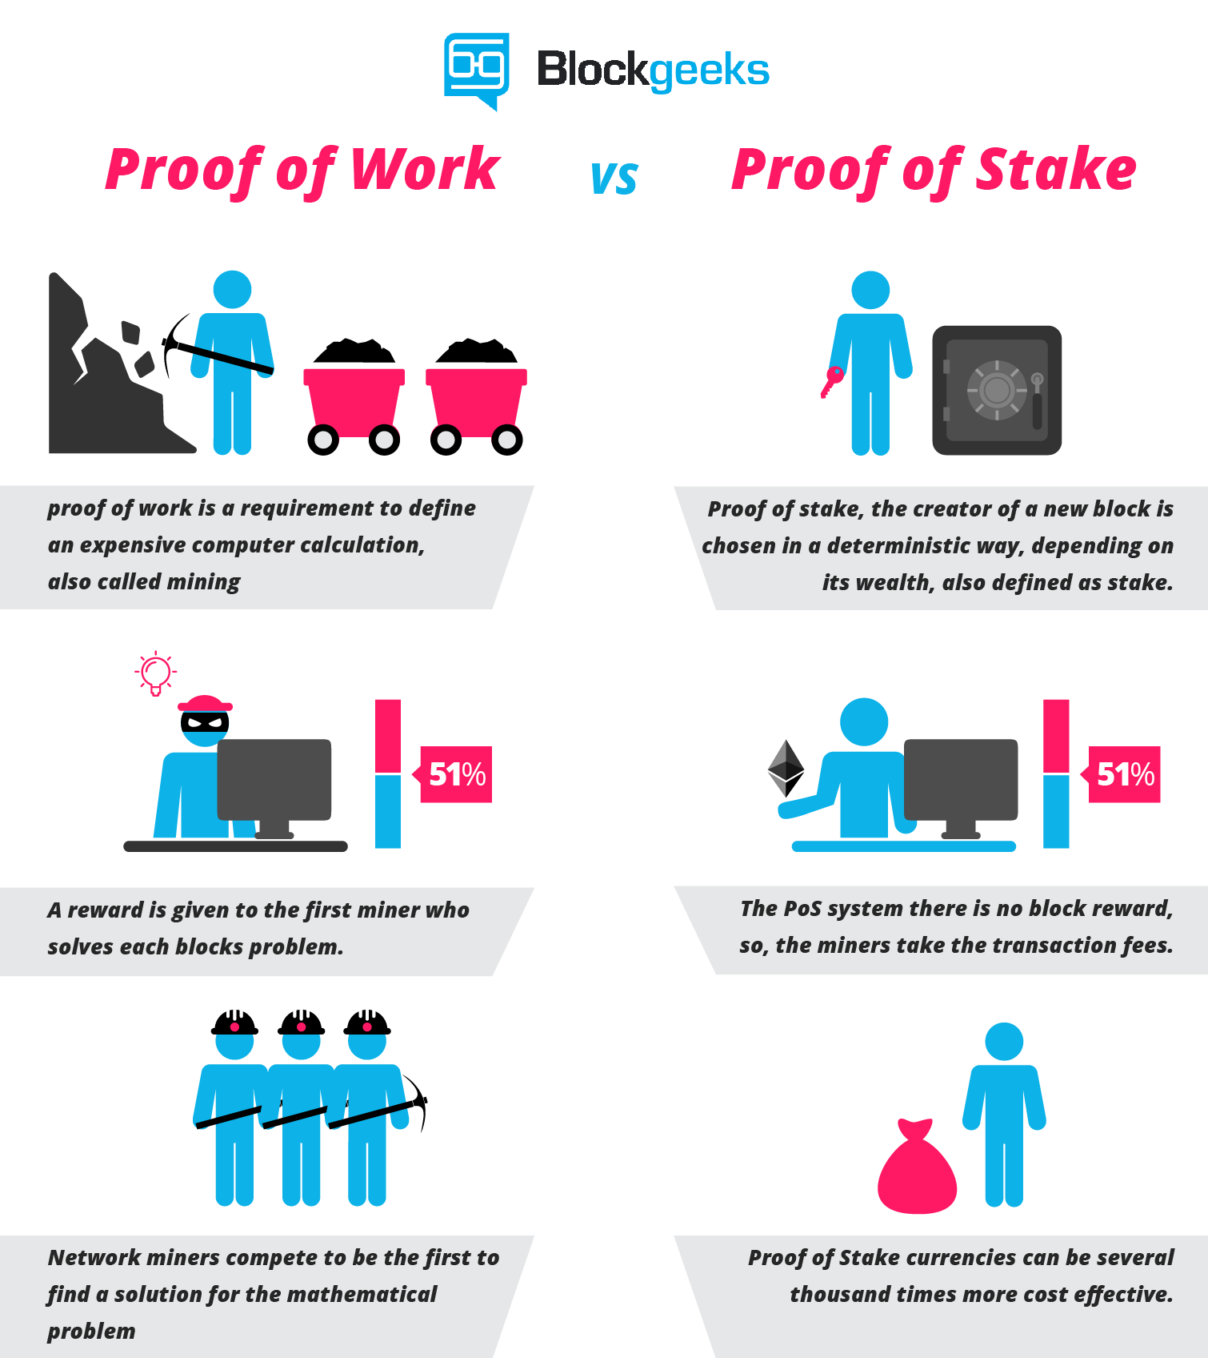

Slide 6
Delegated-Proof-of-Stake
An extension of proof-of-stake algorithms
In this type of consensus mechanism, there are so-called witnesses, which are elected by the stakeholders of the network.
Afterwards, several witnesses are chosen for the block creation in such a manner that they represent at least 50% of the stakeholders’ votes.

Slide 7
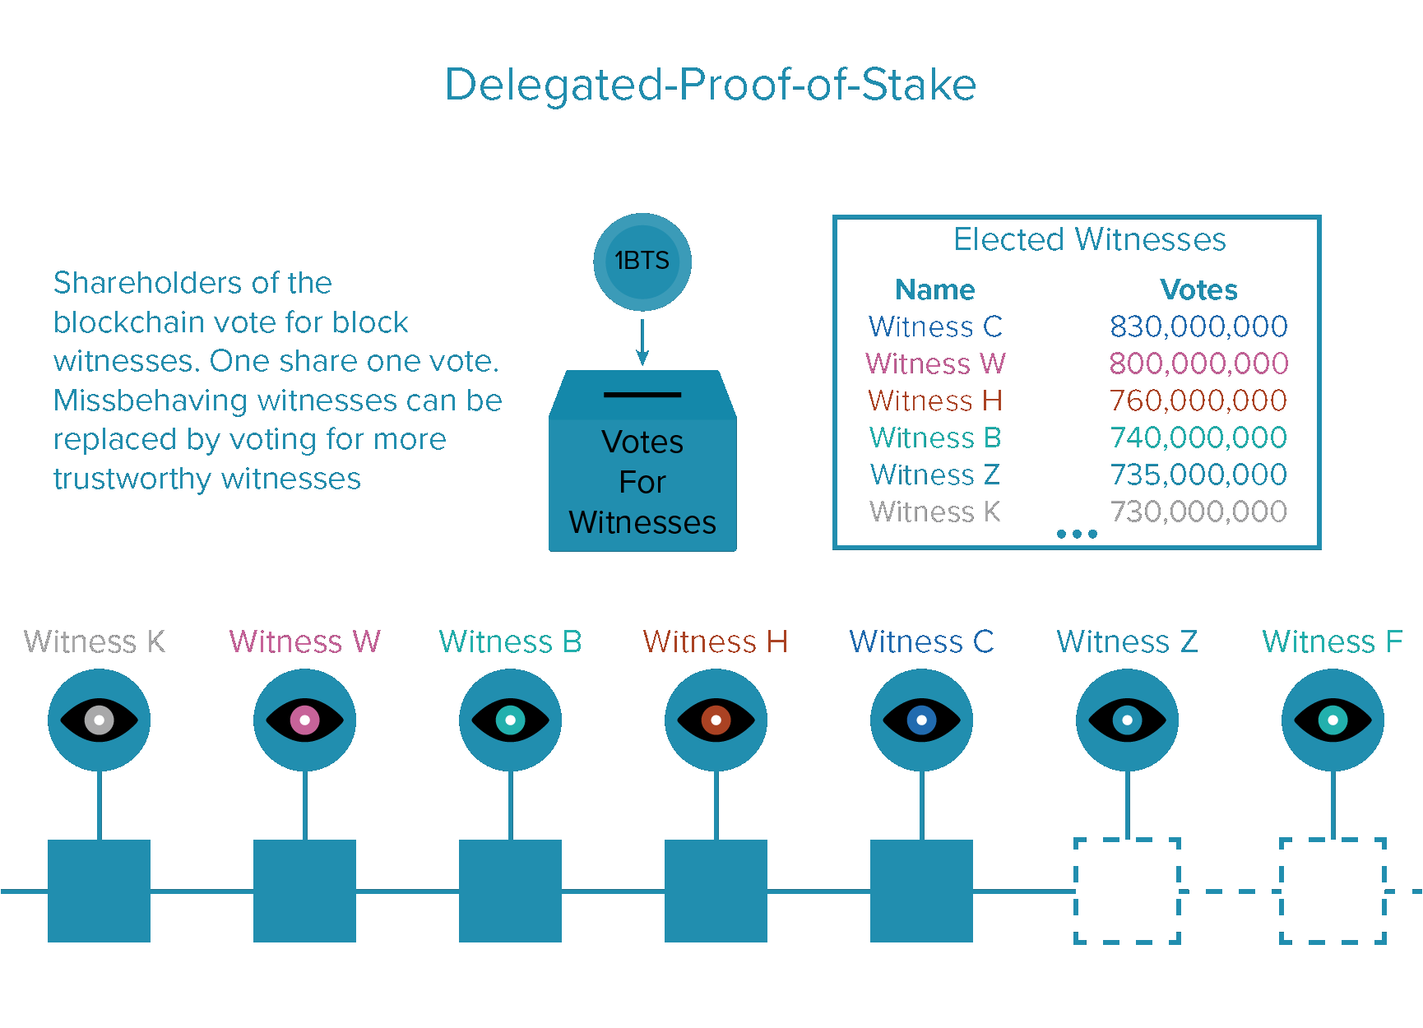

Slide 8
Proof-of-Burn
The idea is that miners should show proof that they burned some coins - that is, sent them to a verifiably unspendable address.
This is expensive from their individual point of view, just like proof of work; but it consumes no resources other than the burned underlying asset.
Proof of burn has been used to add value to many altcoins and cryptocurrencies alike under the belief that burning a particularly valuable token to add the burnt token’s implicit value to a new token that’s to be generated.
For example, on average if it takes 48,800 kw hrs to mine one bitcoin, by burning 10 bitcoins(488,000 kw hrs) and releasing a 488,000 tokens called say, tincoin; each tincoin would considered equivalent result of 1 kw hr of work done.

Slide 9
Proof-of-Importance
The idea here is to solve the “rich man gets richer” problem, which arises in PoS algorithms.
For this reason, the protocol rewards the activity in the network based on the so-called importance score, which is calculated by the graph theory.
This calculation includes the transactions to and from an address. The probability to be chosen to build new blocks increases with the value of the importance score.
Proof-of-importance (PoI) is implemented in NEM.

Slide 10
Practical Byzantine Fault Tolerance (PBFT)
BFT was published in 1999 and arose in academic corners.
It is a three-phase protocol, in which the client sends a request to a so called primary.
In the first phase, the primary broadcasts the request with a sequence number to the replicas. Then the replicas agree on the sequence number and create a message.
If a certain amount of same message is reached, the message is verified and replicas agree on total order for requests within a view.
At the end, the replicas send the reply to the client.
This of course is very simplified.

Slide 11
Proof-of-Activity (PoA)
PoA is a combination of PoW and PoS.
The miner creates a template with the nonce and deploys it to the network.
Then the signers are chosen by the block hash of this template.
If the template is signed by the signers, it becomes a block.
In the end, the reward is shared between the miner and signers.

Slide 12
Proof-of-Capacity (PoC)
PoC uses the memory or HDD of a user to reach consensus.
It creates hashes and stores these.
Then it selects parts of the data, taking into account the last block header in the blockchain.
The selected data is hashed and must fulfill a given difficulty.
PoC is utilised in order to be fairer, because memory access times do not vary as much as CPU power.

Slide 13
Proof-of-elapsed-time (PoET)
PoET elects a leader via a lottery algorithm.
The key point is the lottery and it must be performed in a trusted execution environment (TEE).
The lottery provides every validator with a randomised wait time.
The validator with the shortest time becomes the leader.
The leader is eligible to create a block after the allotted time.
The underlying idea is the same as Bitcoin in that the first node to announce a valid block wins.
Rather than compute-intensive proof-of-work, the system assumes the task of declaring a lottery winner.
PoET is used in Intel’s Hyperledger Project Sawtooth Lake.

Slide 14
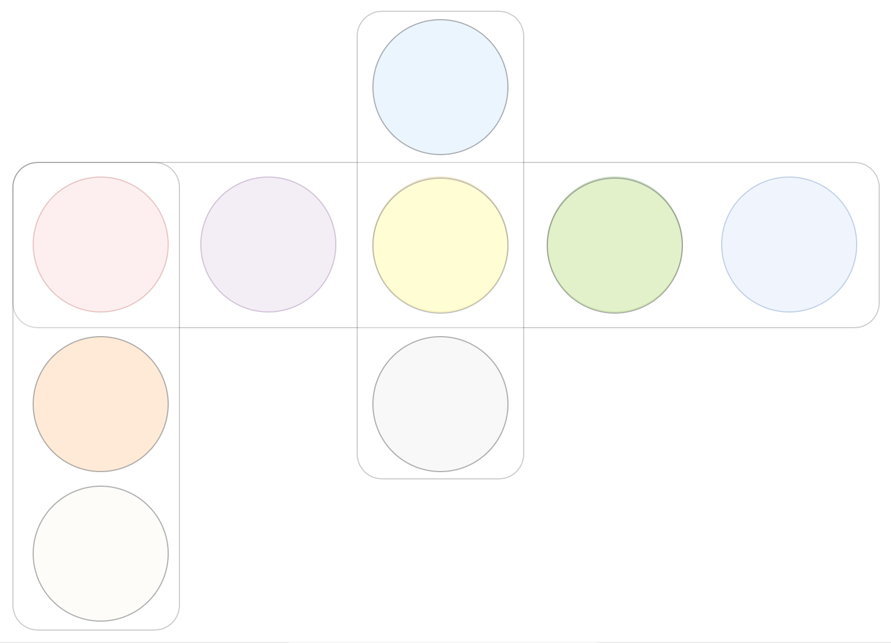
Federated Byzantine agreement (FBA)
Validators are equal but not anonymous, their amount is not fixed
Validators select other validators that they trust and don’t care about the rest
Validators form groups that reach a consensus on transactions
As soon as groups intersect a consensus is reached within the whole set of validators
Stellar and Ripple are examples of blockchains that implemetn FBA

Slide 15
