Slide 1
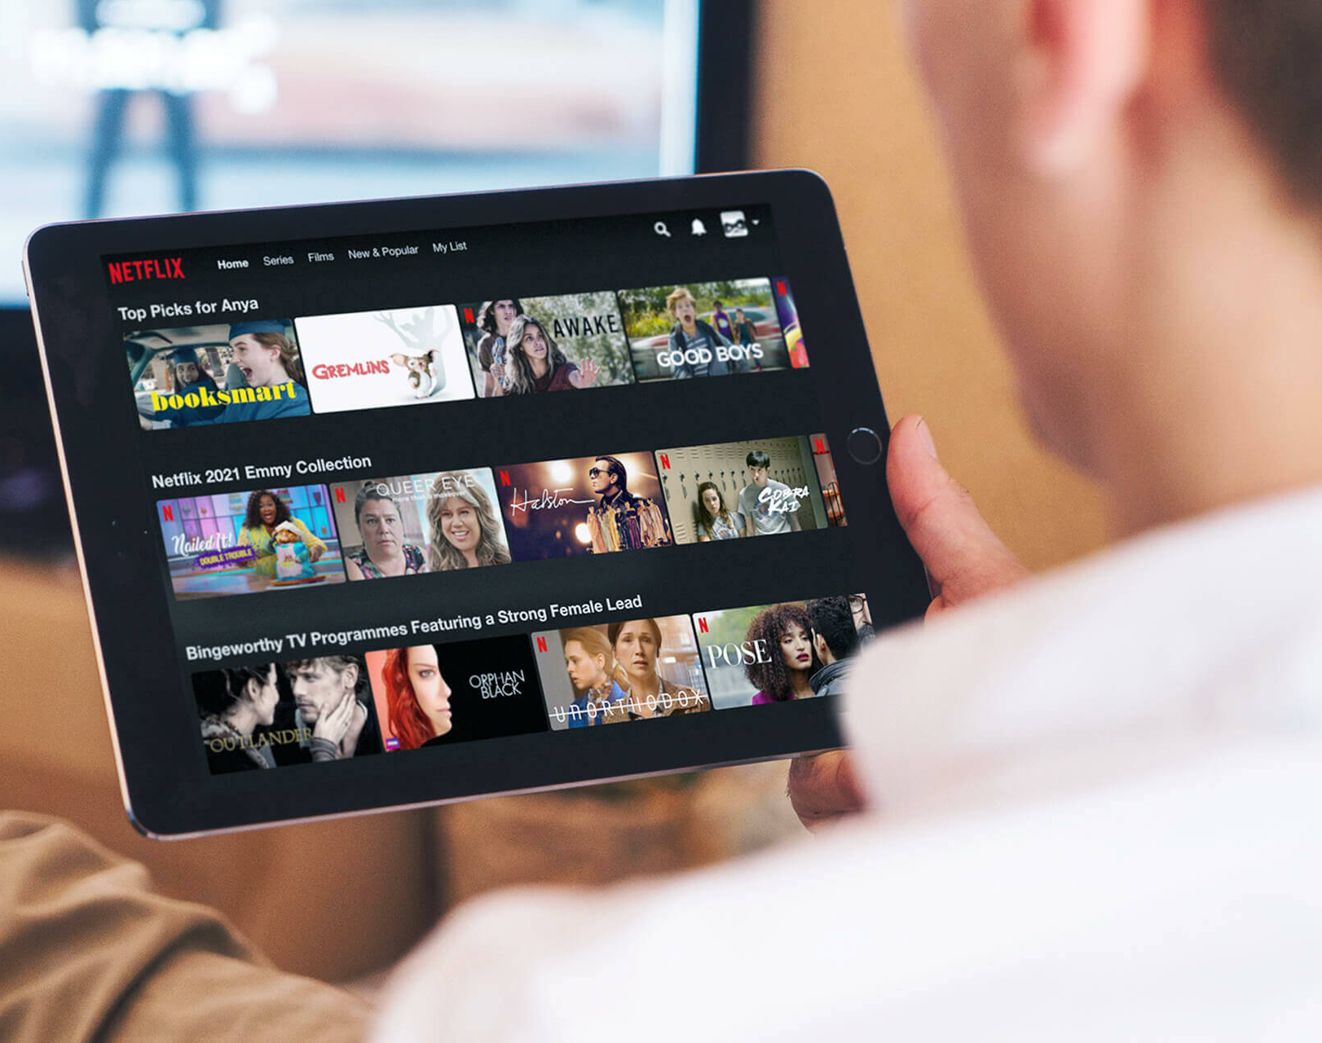
Introduction Overview
Creating customer preference based on movie recommendation
The movie Recommender system is an intelligent system that suggests films to users based on their preferences and ratings. Here we leverage on some advanced machine learning technique such as collaborative filtering which enhances users experience by providing personalized experience.

Slide 2
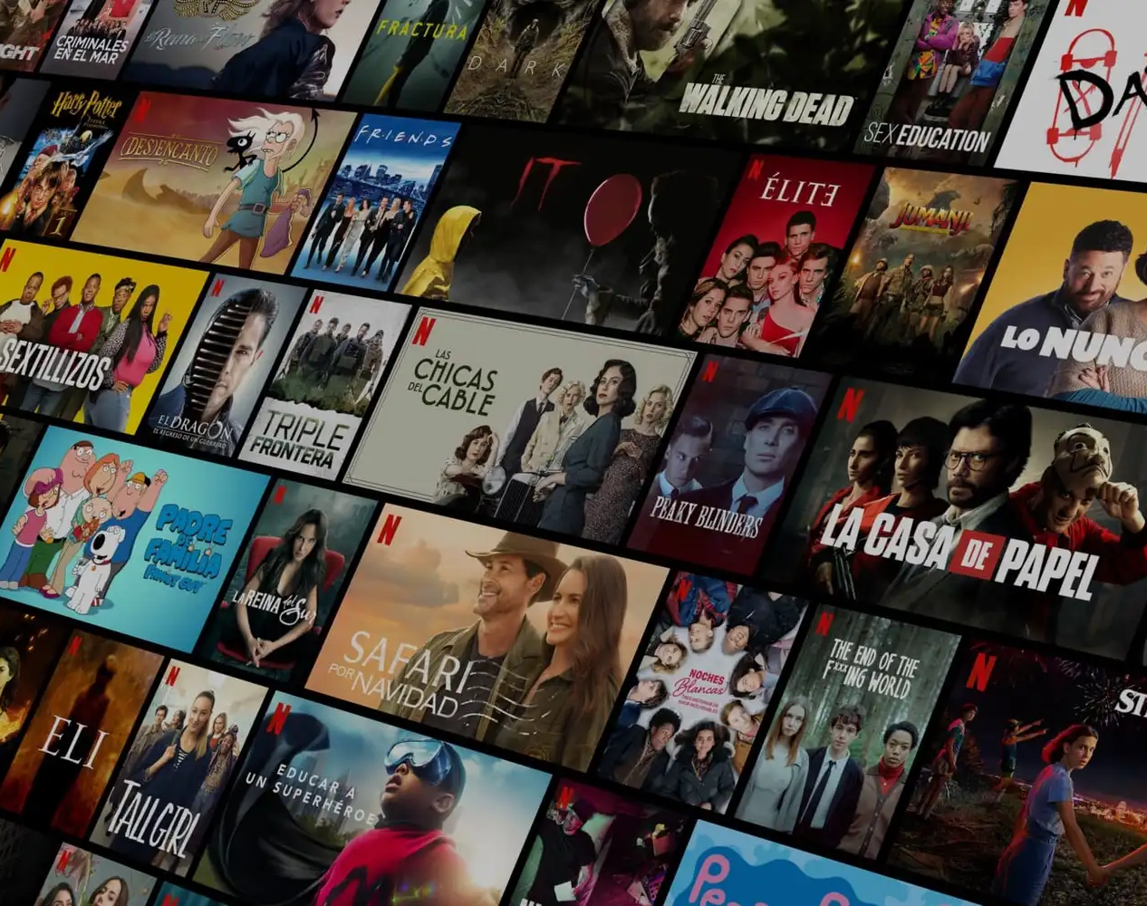
PROBLEM STATEMENT
Netflix movie studio aims to enhance the user engagement and its revenue by implementing an item-based-recommender system that suggest movies which are similar to the other users might have rated. Lets leverage the movie similarities based on the attributes like ratings and title as we seek to improve content and provide a highly personalized experience. The recommender systems built provides top 5 movie recommendations to a user, based on their ratings of other movies.

Slide 3
OBJECTIVES
Retrieve the top 5 movie title recommended to users based on their ratings.
Enable users explore a wide range of the films similar to their performance.
Drive users subscriptions by suggesting appealing content.

Slide 4
METHODOLOGY
Reading the dataset. Here we load the datasets provided.
EDA is a crucial initial step in data analysis. It summarizes dataset features, through visuals, helping to understand trends, identify patterns, and detect missing values in data.
Preparing the dataset for surprise library.
Building an item based collaborative filtering.
Training the collaborative filtering model to get the top 5 recommendations.

Slide 5
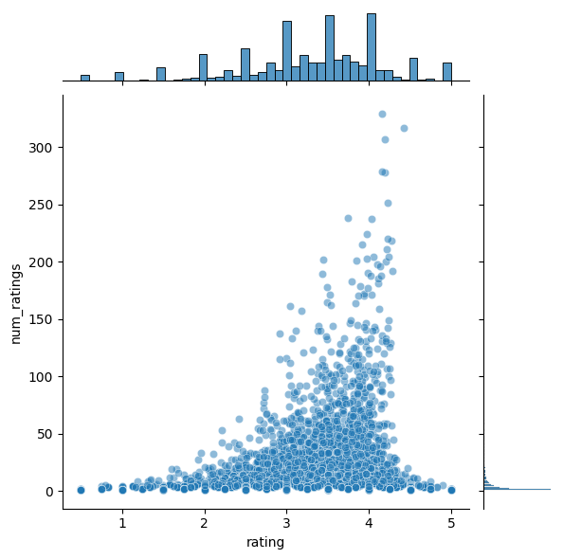
VISUALIZE THE RELATIONSHIP BETWEEN AVERAGE RATING AND NUMBER OF RATINGS

Slide 6
STRATEGIC INSIGHTS
We should enhance our recommendations using Hybrid models that combine content based and collaborative filtering approaches.
We should Regularly update recommendations to reflect the changing user preferences with new movie releases.
We should provide interactive filters such as genres, mood, actors or release year to help users discover new content aligned with their interest.

