Slide 1

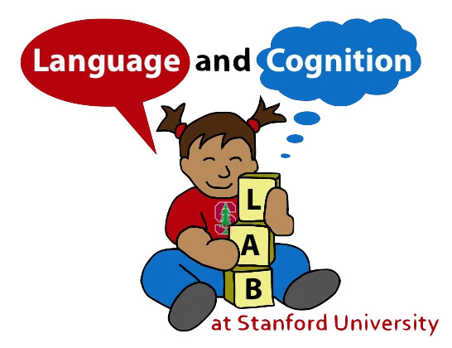
Wordbank
An open database of children's vocabulary development
Mika Braginsky
Shiny Developers Conference

Slide 2
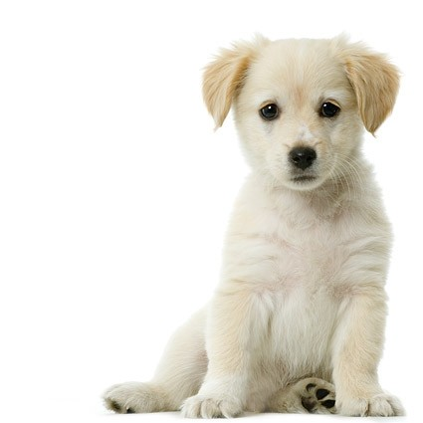
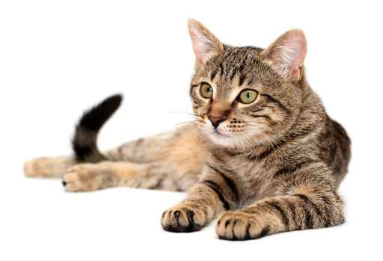
dog
cat

Slide 3
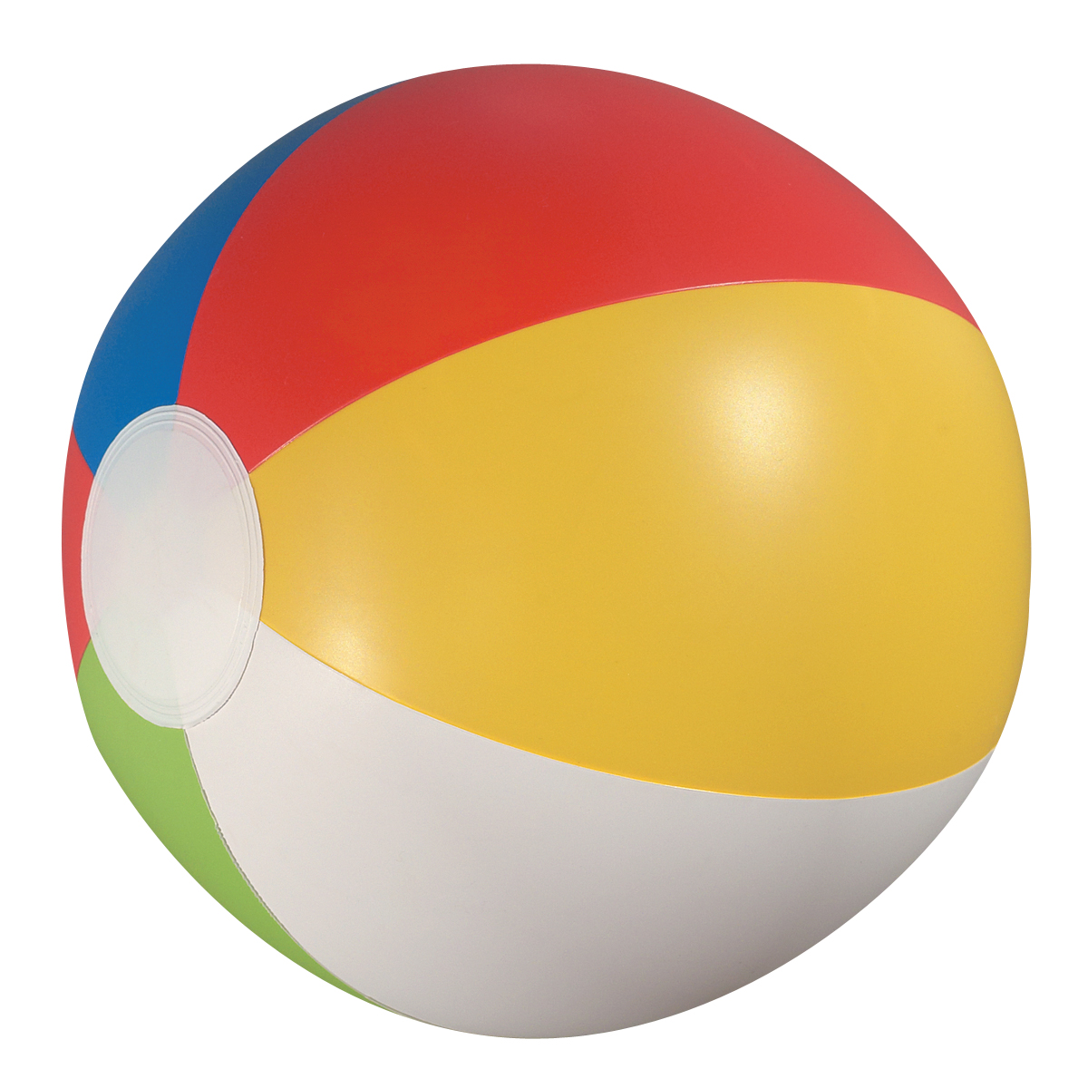

ball
kick

Slide 4
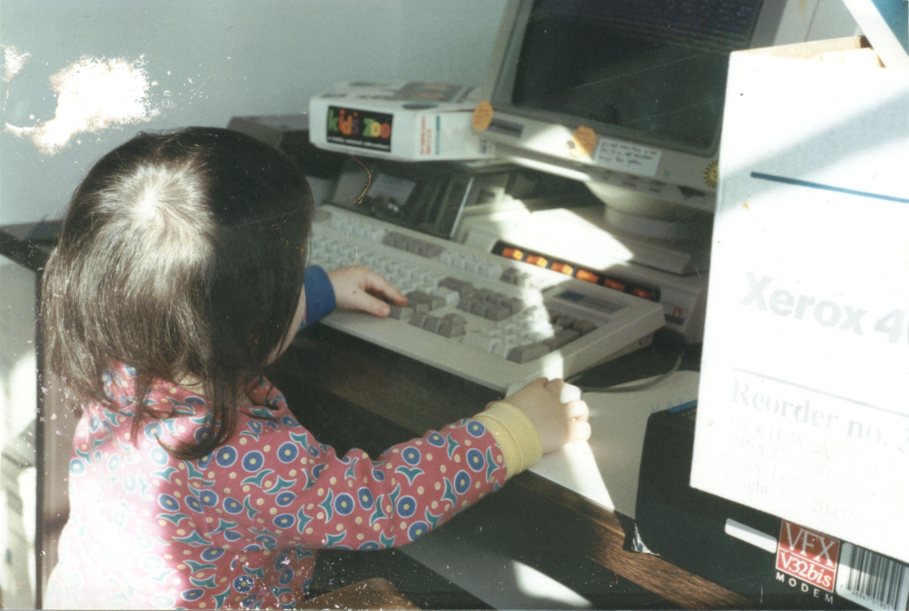

Slide 5
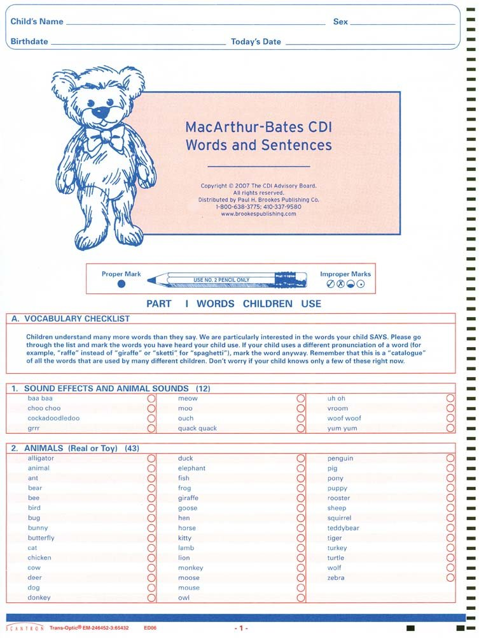

Slide 6
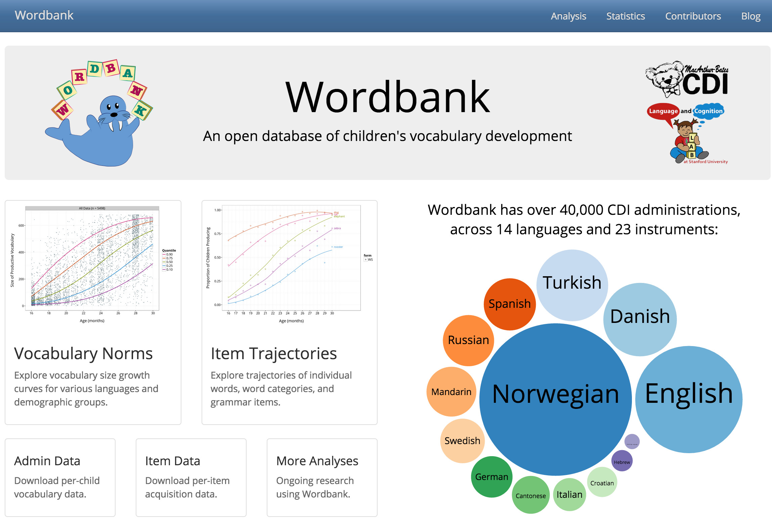
wordbank.stanford.edu

Slide 7

Thanks!
Wordbank team: Michael Frank, Daniel Yurovsky, Virginia Marchman
RStudio and package creators:
    shiny, shinythemes
    shinyBS
    quantregGrowth
    everything hadleyverse
wordbank.stanford.edu

