Slide 1
Citizen Scientist Dashboard for AWRI Muskegon Lake Buoy Data
By: Mikaela Berg

Slide 2
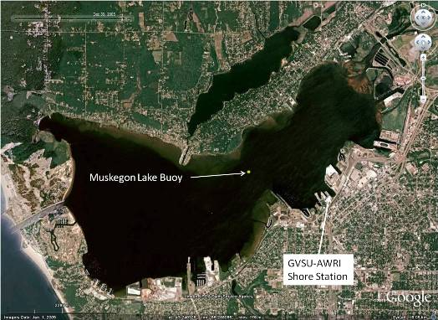
Intro
AWRI: Robert B. Annis Water Resource Institution
Lab: Dr. Bopi Biddanda
Buoy data on Muskegon Lake
Meteorological Data
Lake/Water Data
http://www.gvsu.edu/cms4/asset/0411CEE1-B85B-4C8F-E6A78E12C551C7C0/location_3.jpg

Slide 3
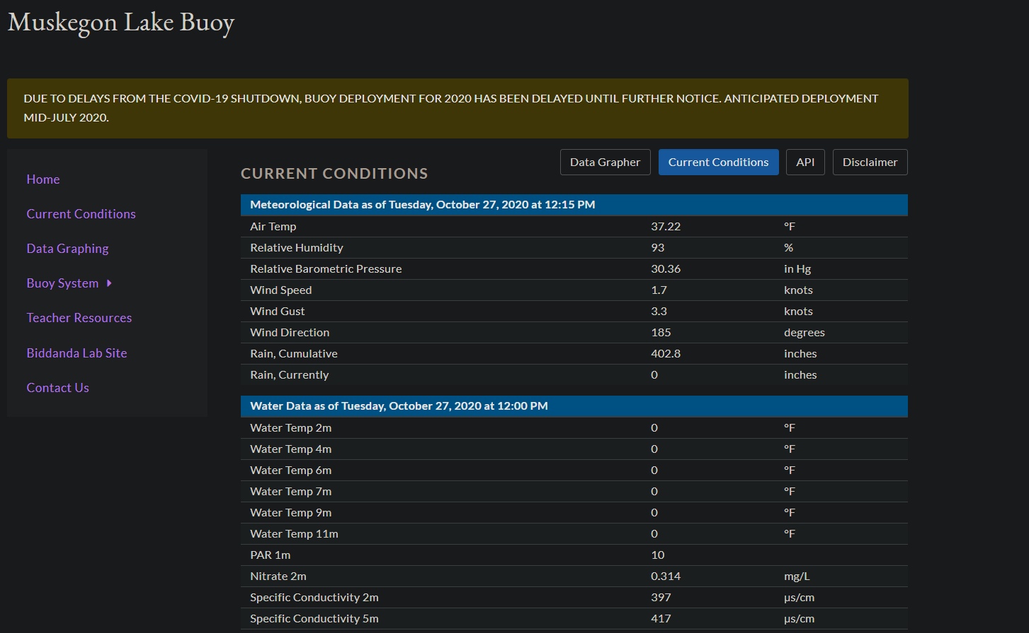
Current Conditions Page

Slide 4
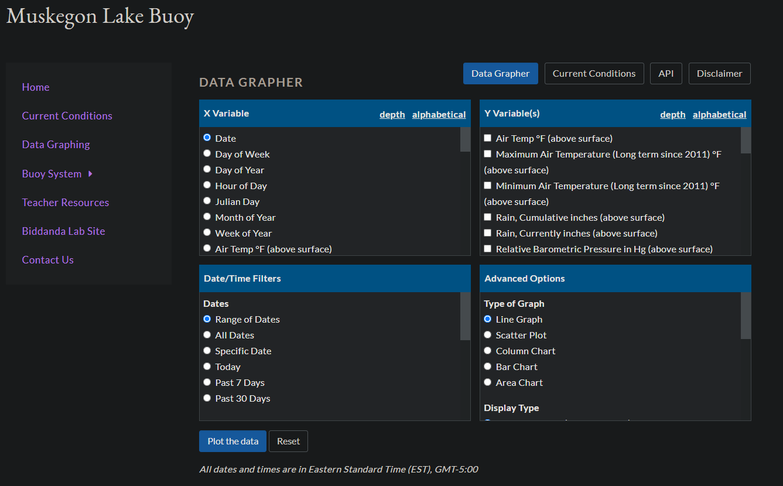
Data Grapher Page

Slide 5
Brainstorm:
What do we have?
Data Grapher
Current Conditions
What is missing?
Data analysis
Place to highlights certain concepts/data points
Who is our audience?:
Citizen Scientist -------to------ Field Scientist

Slide 6
Task
Create a dashboard that is easily readable and that highlights key data show on the current conditions page.

Slide 7
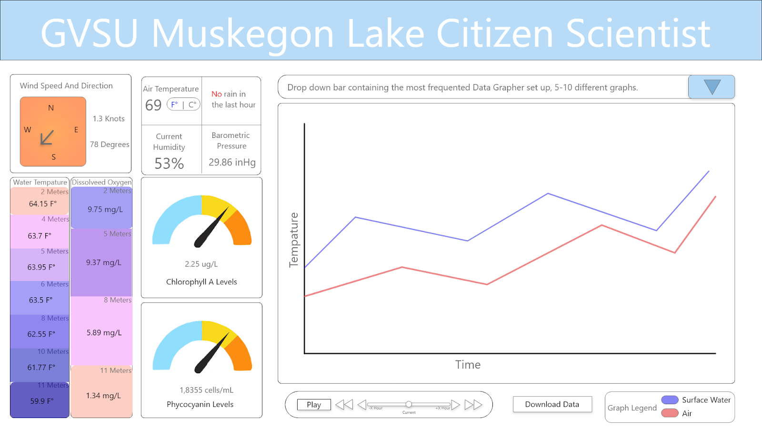

Slide 8
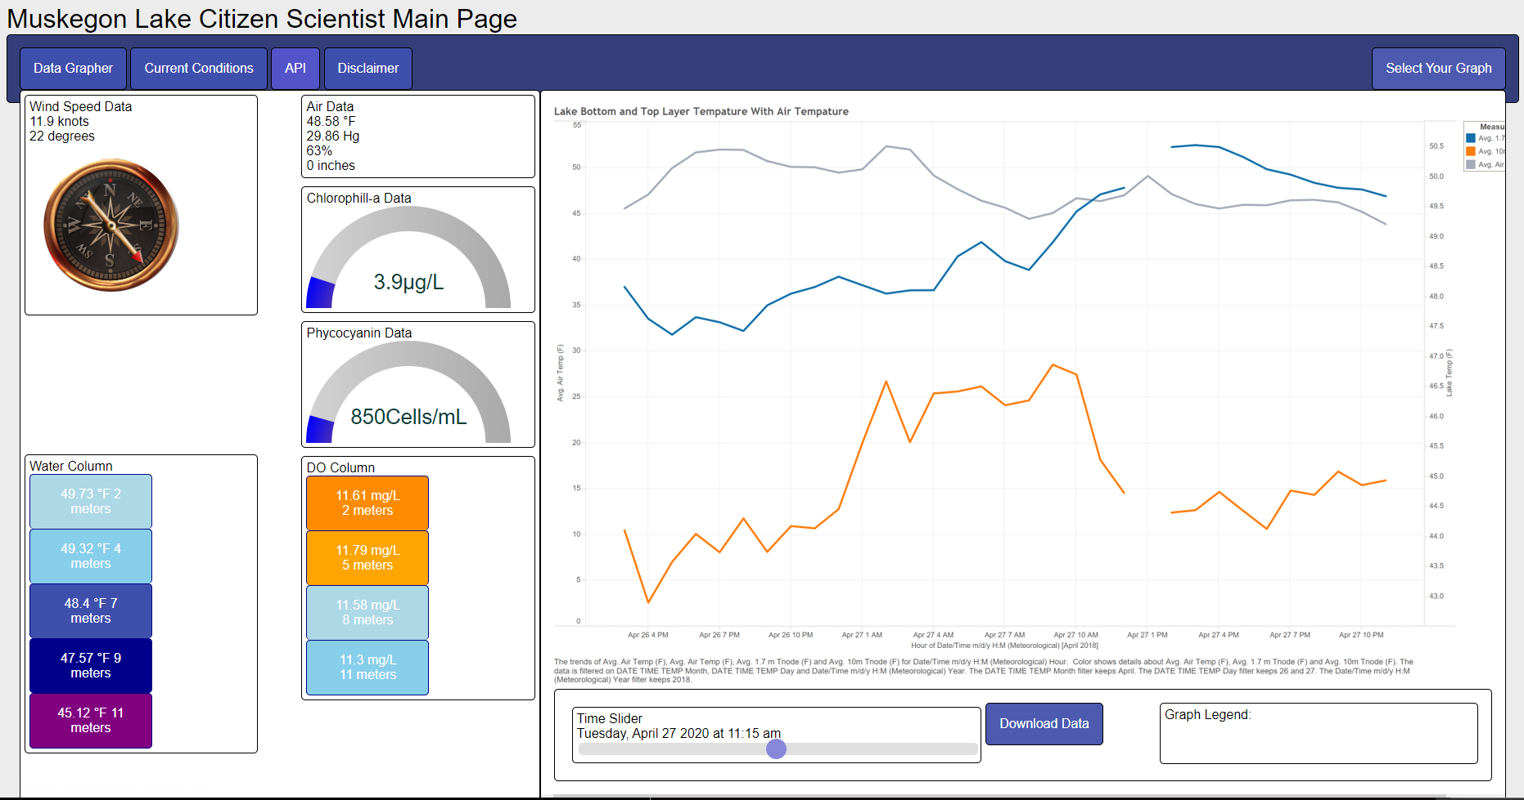

Slide 9





Tools Used:

Slide 10
GitHub Links and Site Link!
GitHub link:
https://github.com/mikaelaberg/GAW21
Site link:
https://cis.gvsu.edu/~bergm/

