Slide 1
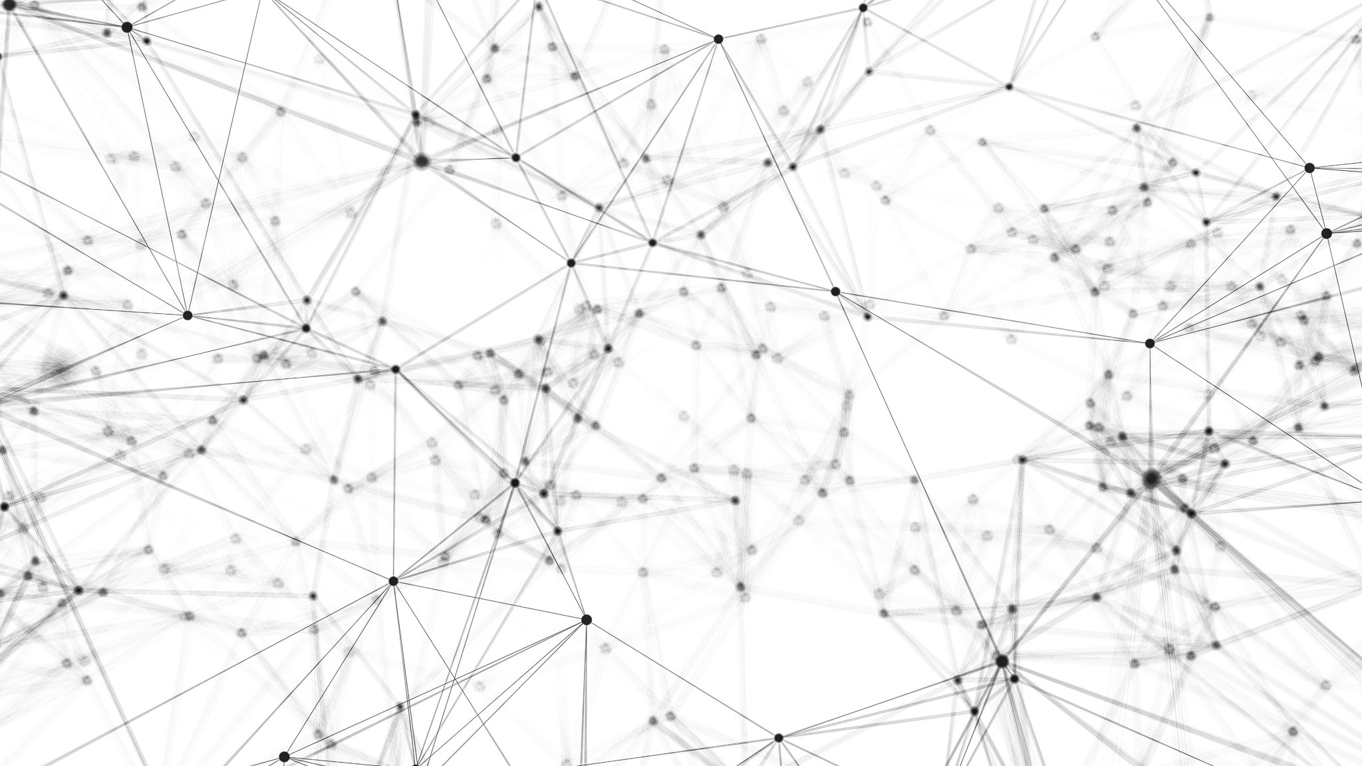
Human-Centered Design in Libraries
Mikaela Slade

Slide 2
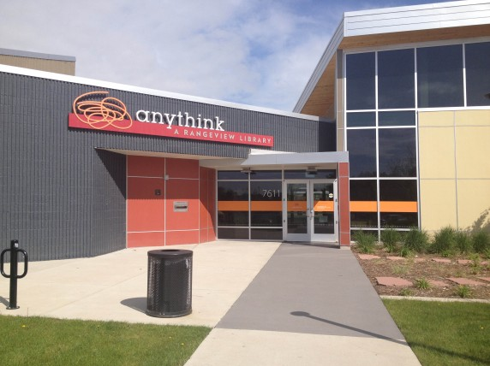

Slide 3

Anythink's Innovation
Librarians
Guides
Dewey Decimal
WordThink
Value Materials
Value People

Slide 4
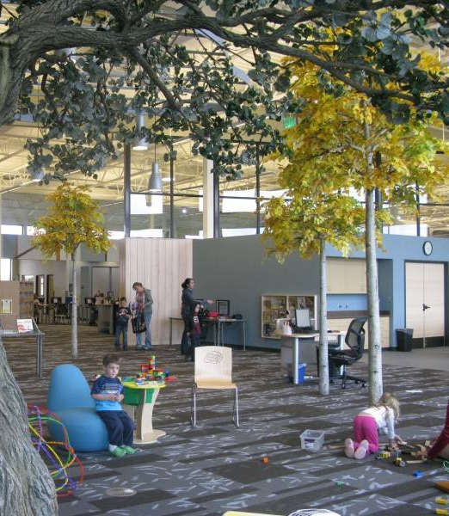
Re-thinking libraries
“Instead of building libraries that organized space around materials, we designed spaces that fit the needs of the people. People need space to think; collaborate; talk; invent; and seek, find and produce information... Our libraries are designed with an intuitive logic and a sense of hospitality. We want people to feel smart, not intimidated.”
-P. Smith, Director of Anythink

Slide 5
Definitions
Human-Centered Design
Design Thinking
An approach & philosophy that focuses on fully understanding the perspectives of the people the design is for in each step of the process
A non-linear, iterative process which seeks to understand users, challenge assumptions, redefine problems and create innovative solutions to prototype and test

Slide 6
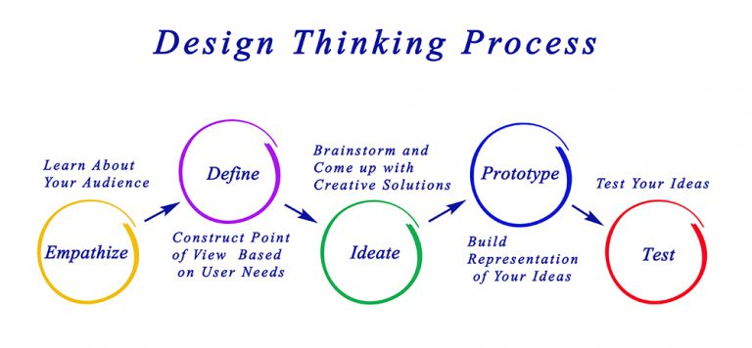
This Photo by Unknown author is licensed under CC BY-SA.

Slide 7
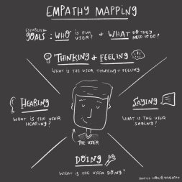
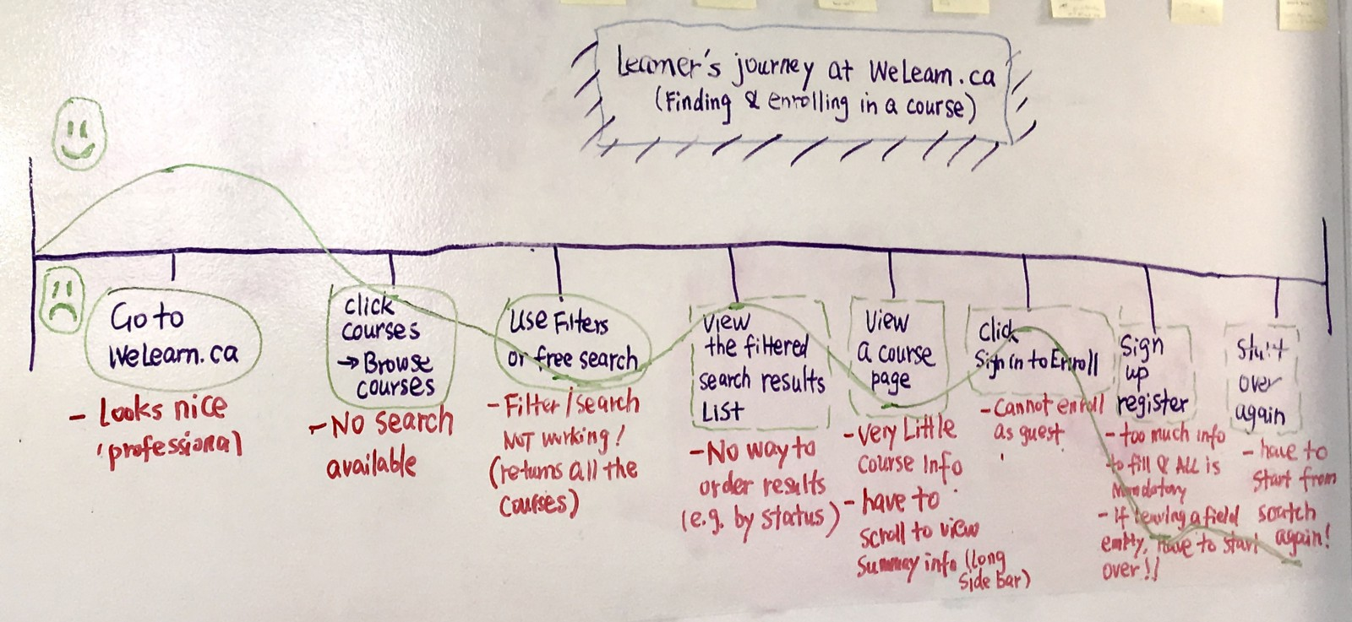
Empathize
Goal: gather information about your user(s)
Strategies:
Personas
Interviews
Surveys
Journey Mapping

Slide 8
What problems did Anythink address?
What emotions might be tied to these issues?

Slide 9
An Iterative, Non-Linear Process
Define
Ideate
Prototype
Test
Empathy

Slide 10
A Growing Field
ALA UX interest groups
Design-focused library conferences
Peer-reviewed journal of library user experience: “Weave”
Hiring of UX-specific roles in libraries
UXlib.org community & annual conference

Slide 11
Thank You!

