Slide 1
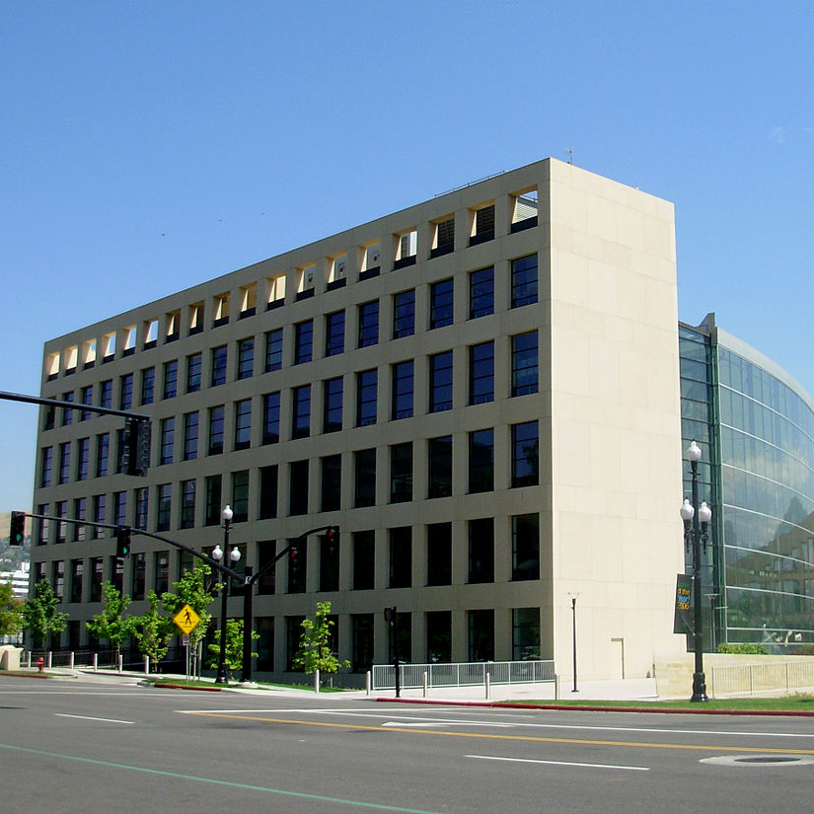
Design Thinking Project Proposal for SLCPL
Presented by Mikaela Slade for consideration of the Circulation Manager position
This Photo by Unknown Author is licensed under CC BY-SA

Slide 2
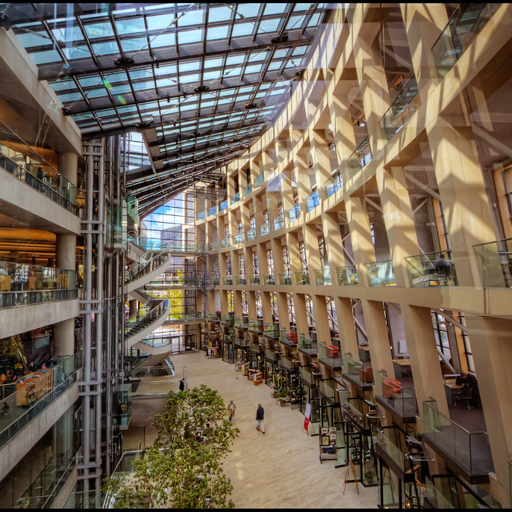
Project Idea – Library Website Orientation Tutorial
Incentivized walkthrough of library website’s offerings
Potential Benefits
Aid discovery & navigation
Empower patron to explore website independently
Increase use of resources
Increase patron satisfaction
This Photo by Unknown Author is licensed under CC BY-SA-NC

Slide 3
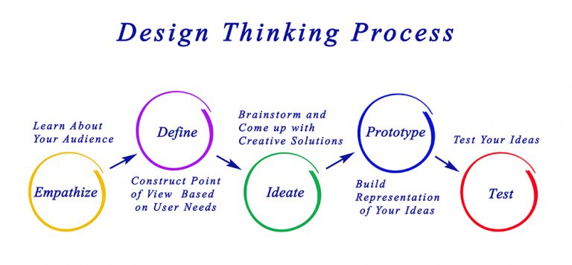
Design Thinking Principles
Boisvenue-Fox, Michelle and Meyer, Kristin, "Not what you expected: Implementing design thinking as a leadership practice" (2019).Books and Contributions to Books. 17.https://scholarworks.gvsu.edu/library_books/17
This Photo by Unknown Author is licensed under CC BY-SA

Slide 4
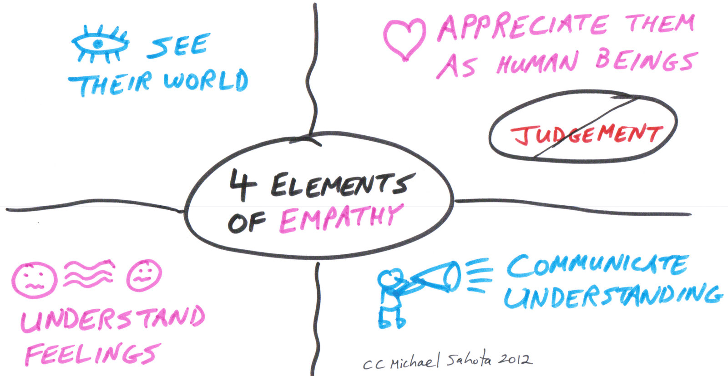
Step 1 – Research / Understand / Empathize
How well do new and current users understand the website?
What are users’ attitudes towards the website when accomplishing tasks?
Have other libraries/institutions done something similar? What were their takeaways?
What are the options available?
This Photo by Unknown Author is licensed under CC BY

Slide 5
Step 2 - Define
Defined Statement:
How might the library familiarize patrons with the library website to increase user confidence and improve database discovery?
Measures of Success
After the tutorial, users will feel more confident
After the tutorial, users will be able to navigate successfully to databases, calendar, etc
How does this project fit into SLCPL’s mission statement?
“The City Library is a dynamic civic resource that promotes free and open access to information, materials and services to all members of the community to advance knowledge, foster creativity, encourage the exchange of ideas, build community and enhance the quality of life.”

Slide 6
Step 3 - Ideate
Would making the tutorial interactive instead of a video make it more likely to survive website changes and updates?
Would offering a free tote bag or pin motivate first time users to spend time on the product?
Can the tutorial be concise and still useful?

Slide 7

Step 4 - Prototype
a quick and inexpensive representation of the final product to test
Moving forward after the prototype
Implement as is
Make improvements and test again
Reject and move back to ideation

Slide 8
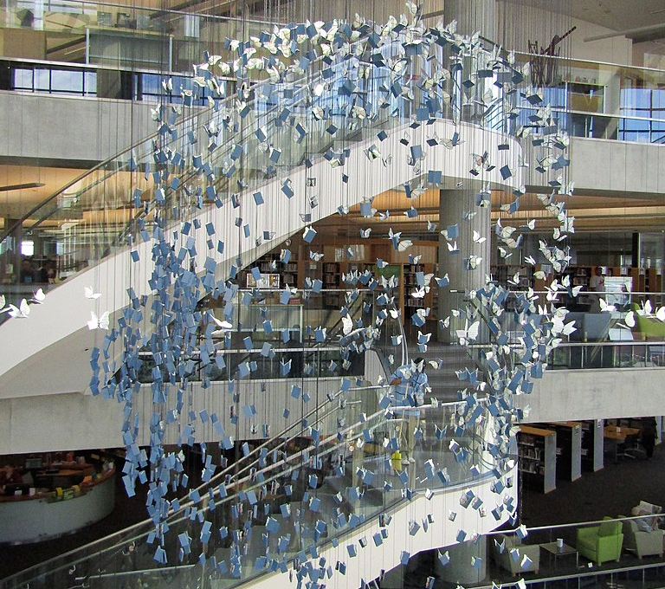
Step 5- Implement / Evaluate
Who will be affected?
Who among the circulation staff must be trained on the tutorial before administering it?
Who must be notified? How?
Will the marketing team publicize this service?
How will success be measured and who will track it?
Time and budget management
This Photo by Unknown Author is licensed under CC BY-SA

Slide 9
Thank You!

