Slide 1
Clustering
Unsupervised analysis

Slide 2
Clustering types
K-means clustering
Hierarchical clustering
Mixture model clustering

Slide 3
Clustering: definition
Unsupervised classification
Separating or clustering observations
Intuitive but vague definition
Given an underlying set of points, partition them into a collection
of clusters so that points in the same cluster are close together,while points in different clusters are far apart

Slide 4
Clustering: purpose
Seeing structure in data
I Gaining understanding
Dimensionality reduction
Outlier detection

Slide 5
Clustering: similarities and dissimilarities
In what sense are points close in one cluster and far from points in another cluster?
Similarity takes a large value when points are close.
Dissimilarity takes a large value when points are far apart. This reflects the distance between observations.

Slide 6
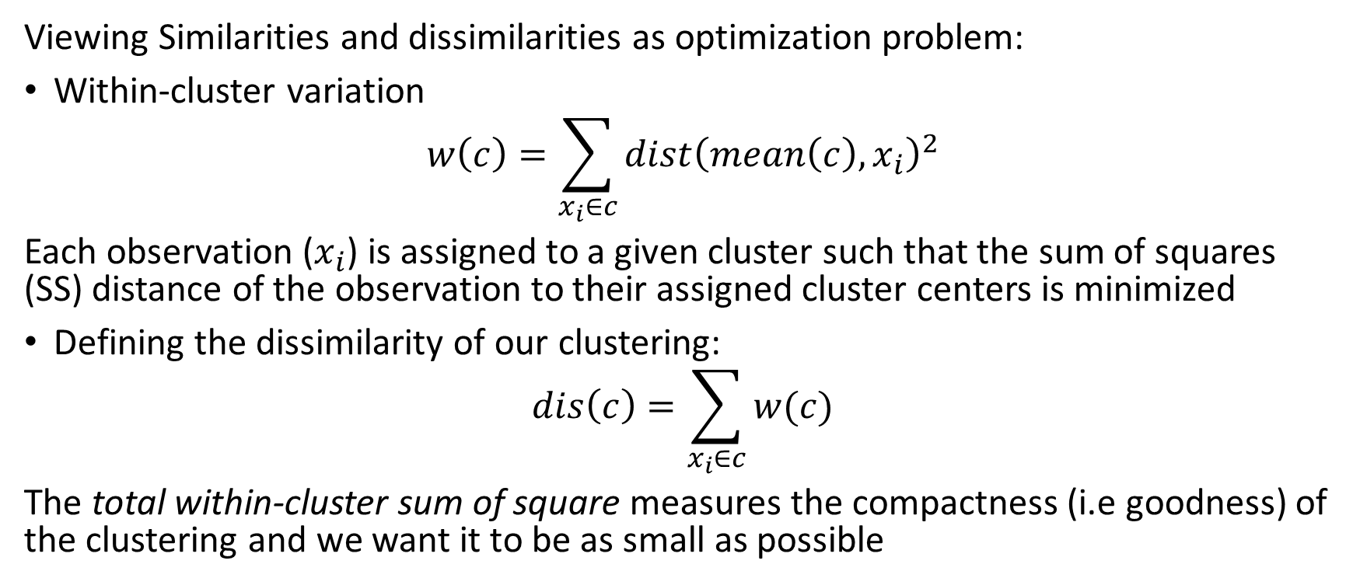
Clustering: similarities and dissimilarities
Viewing Similarities and dissimilarities as optimization problem:
Within-cluster variation
$$w\left(c\right)=\sum_{x_{i}∈c}{dist{\left(mean\left(c\right),x_{i}\right)}^{2}}$$
Each observation ($x_{i}$) is assigned to a given cluster such that the sum of squares (SS) distance of the observation to their assigned cluster centers is minimized
Defining the dissimilarity of our clustering:
$$dis\left(c\right)=\sum_{x_{i}∈c}{w(c)}$$
The total within-cluster sum of square measures the compactness (i.e goodness) of the clustering and we want it to be as small as possible

Slide 7
Clustering distance measures
There are many different measures of distance
Mahalanobi
Manhattan
Euclidean
Tanimoto
There are many more than these – which one should you choose?

Slide 8
K-means clustering
Simple algorithm
Specify the number of clusters (K) to be created (by the analyst)
Select randomly k objects from the data set as the initial cluster centers or means
Assigns each observation to their closest centroid, based on the Euclidean distance between the object and the centroid
For each of the k clusters update the cluster centroid by calculating the new mean values of all the data points in the cluster. The centroid of a Kth cluster is a vector of length p containing the means of all variables for the observations in the kth cluster; p is the number of variables.
Iteratively minimize the total within dissimilarity. That is, iterate steps 3 and 4 until the cluster assignments stop changing or the maximum number of iterations is reached.

Slide 9
Hierarchical clustering
Generates a tree of observations (dendrogram)
Each level of the tree reflects one number of clusters
From all data in one cluster down to one observation in each
cluster

Slide 10
Hierarchical clustering bottom up or top down?
Agglomerative clustering: It’s also known as AGNES (Agglomerative Nesting). It works in a bottom-up manner. That is, each object is initially considered as a single-element cluster (leaf). At each step of the algorithm, the two clusters that are the most similar are combined into a new bigger cluster (nodes). This procedure is iterated until all points are member of just one single big cluster (root)
Divisive hierarchical clustering: It’s also known as DIANA (Divise Analysis) and it works in a top-down manner. The algorithm is an inverse order of AGNES. It begins with the root, in which all objects are included in a single cluster. At each step of iteration, the most heterogeneous cluster is divided into two. The process is iterated until all objects are in their own cluster
AGNES: good at small clusters
DIANA: good at larger clusters

Slide 11
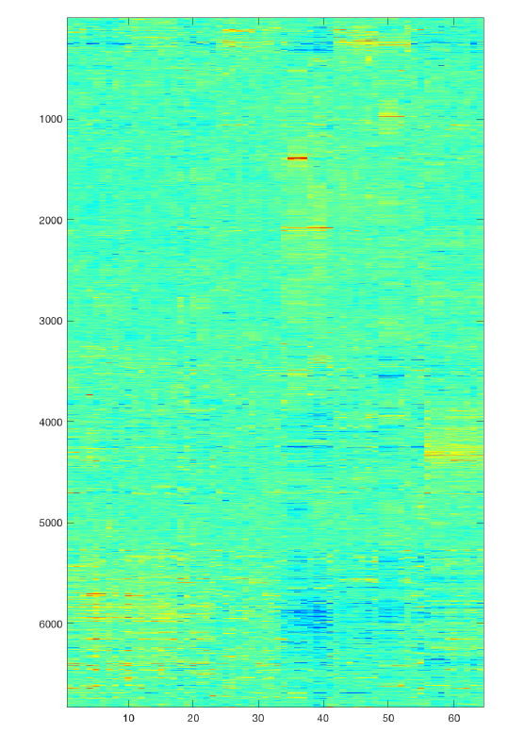
Hierarchical clustering: Distances
Sample to sample distances : same as k-means clustering
Cluster to cluster distances: linkages
There are many types of linkages
Each type is situational
Trial and error
Example from ESL book, micro-array data:
Samples from cancer tumors
6830 genes
64 samples
Question:
Which samples are most similar to each other, in terms of their expression profiles across genes
Do similar samples share the same form of cancer?

Slide 12
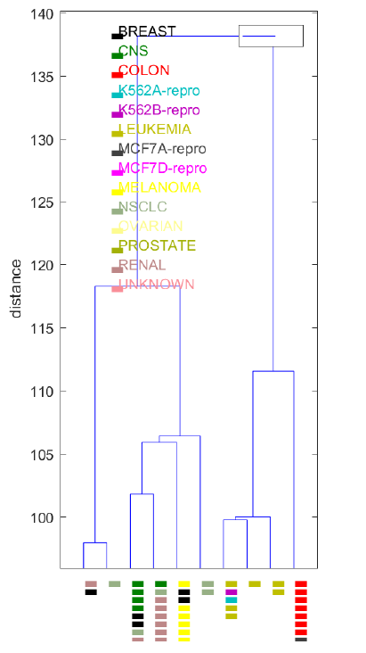
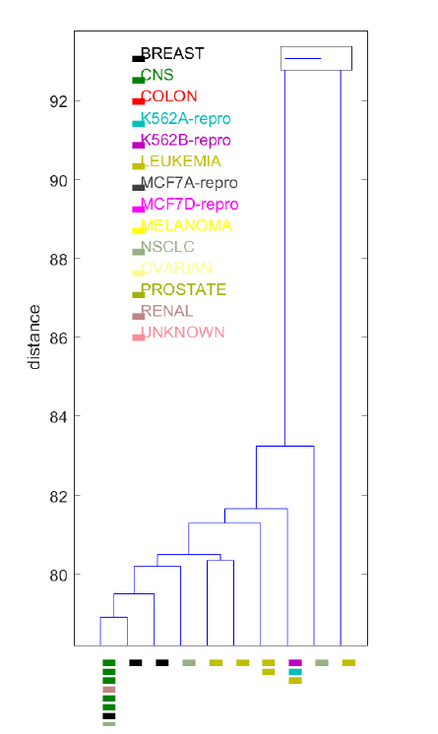
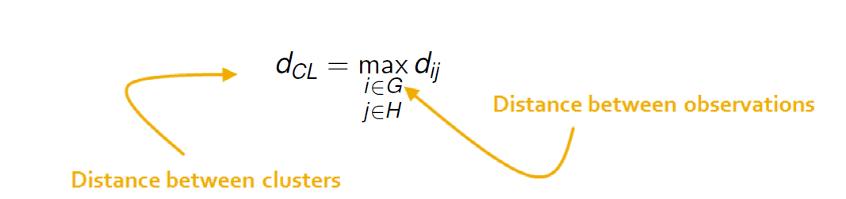
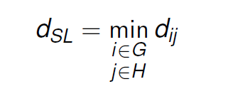
Hierarchical clustering :Two types of linkages
Cluster-cluster distance measured as the distance from the furthest pair of points (i; j) from the clusters (G;H) respectively.
Cluster-cluster distance measured as the distance of the closest pair of points (i; j) from the clusters (G;H) respectively.
Tends to give balanced trees
independent of data
Chaining - a problem
A dendrogram consists of many U-shaped lines connecting objects in a
hierarchical tree
Which linkages to chose?
Agglomerative coefficient to the rescue! (sometimes)
The height of each U represents the
distance between the two objects
being connected.

Slide 13
Hierarchical clustering: Warning
Hierarchical clustering will always generate a dendrogram even when data are completely random
Be careful with the interpretation
It is the application that tells if the structure is relevant (use your domain knowledge)

Slide 14
Selection of Clusters
Gap-statistics
Goodness-of-fit measures (when a distribution is assumed)
Elbow method

Slide 15


Gap statistic
Compares the log criterion value with K clusters to the expected log criterion value for uniformly distributed data (20 simulations)
Uk within cluster dissimilarity, simulated data - mean over 20 samples
Wk within cluster dissimilarity, actual data
The gap statistic measures the deviation of the observed value from its expected value under the null hypothesis. The estimate of the optimal clusters will be the value that maximizes G(K). This means that the clustering structure is far away from the uniform distribution of points.

Slide 16
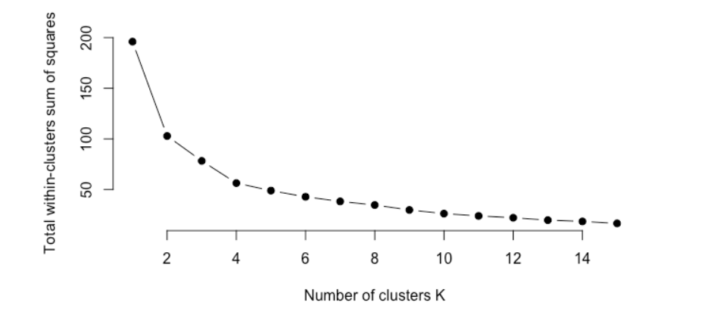

Elbow method
Seeks to minimize the total within-cluster variation
$$\min_{k}{[dis\left(c\right)=\sum_{x_{i}∈c}{w\left(c\right)}}]$$

Slide 17
Mixture model clustering (optional)
Gaussian Mixture Modeling
Data belong to one of several Gaussian distributions
An un-observed (latent) random variable selects which distribution
the observation comes from.
This gives a complicated likelihood function
Easily solved using the EM algorithm

Slide 18
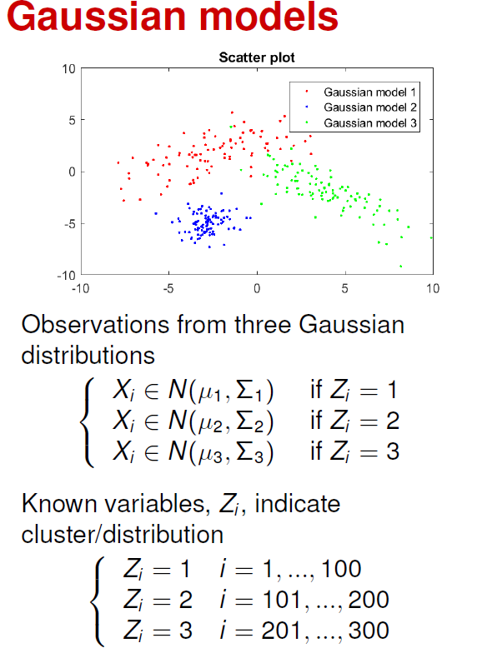
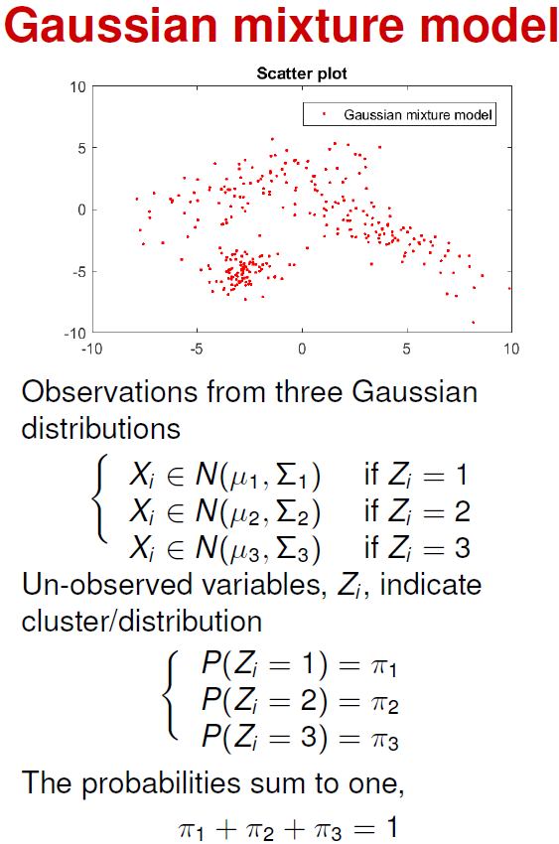
Mixture model clustering (optional)
One whishes to assign an unknown number Gaussian of clusters to data presumed to be belonging to different Gaussian distributions.
How to do it: use the EM-alogorithmn

Slide 19
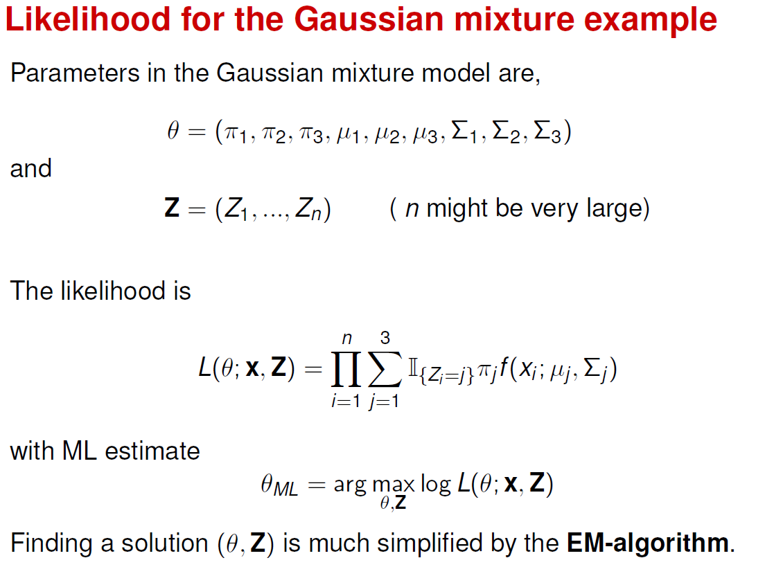
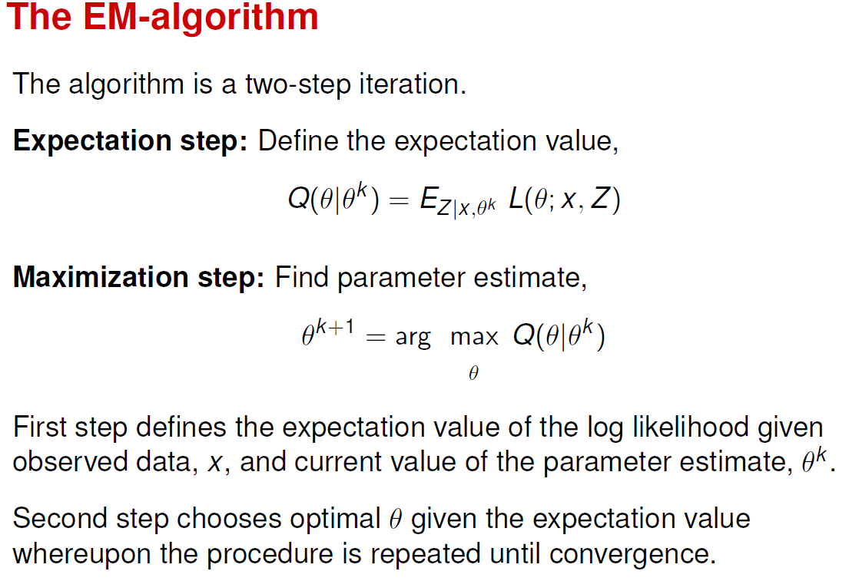
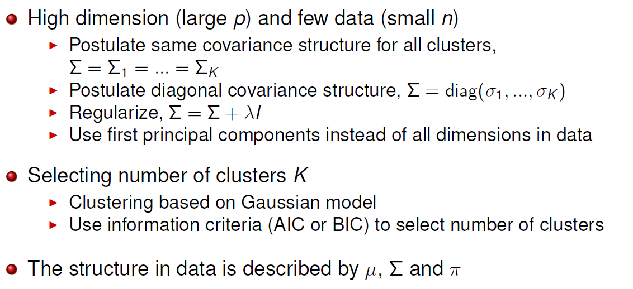
Mixture model: likelihood and EM algorithmn

