Slide 1
Multidimensional Scaling
Metric and non-metric

Slide 2
Definition
A visual representation of distances or dissimilarities between sets of objects
Usually done in 2d
Projection from high dimensional data
Challenge is to select the ”correct” distance measure
Vegan package may assist in finding the distance
Correct data preprocessing is also a very real challenge
Can be used should regular PCA fail - Euclidean distance does not make sense

Slide 3

Classic MDS
Critrion to minimize
Stress : godnees of fit measure, based on differences between predicted and actual distances
Stress above 0.2 is considered poor
Princple coordinate analysis
This is a linear critrion – does not work on all data, but some

Slide 4
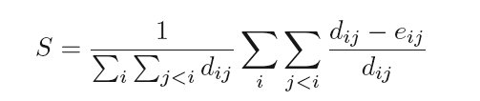
Sammon mapping
Works well with extreme distances by normalizing the criterion
Algorithmn work by gradient descent optimization
Local minima can be hit
Step size can be reduced to aviod this (magic in R)

Slide 5
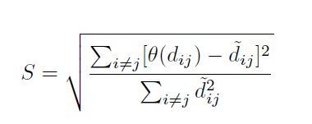
Non-metric MDS
Axis of the NMDS is meaningless as oppsed to PCA.
The vegan pack uses PCA roation on ordinations : Axis 1 contains the greatest ordination
Benefits: good with non-linear data
Drawback: based on gradient descent – can hit a local minimum

Slide 6
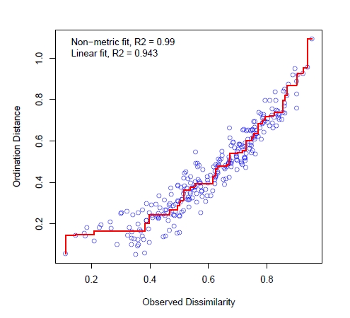
Comparing the MDS types
Best data representation can be compared by stress
The lower the stress the better
Visual comparaison
Shepard diagram (ordinal space vs observed space)
The higher dims, the less stress, but more difficult to interpret

Slide 7
MDS important
Important!!! MDS is not a model or proof of anything it is for visualization and data understanding
Supervised modelling is needed to see if groups are different ect

