Slide 1

Using a Gaze Tracking System to Analyze Various Paces of Computer Games
Author Mikael Zammit & Mentor Dr Mario Mallia-Milanes
Institute of Information & Communication Technology
MCAST, Paola, Malta

Slide 2
Problem Definition
Balance between fast-paced and slow-paced games are crucial.
Player’s feedback on games that they tested are hard to gather, therefore it is not easy to conduct an analysis.
Gaze tracking devices often have a restricted field of vision, which means they can only capture eye movements within a specific range.

Slide 3
Hypothesis & Questions
Aim of Study:
The aim of this study is to gather information from the eye gaze tracking prototype, that its usage is to test on different types of players while playing different types of game paces, so that the data required is recorded and from the interview process with the players, the data gathered will be handed to the game developers to help improving games.
Hypothesis:
The hypothesis of this study is that using eye gaze tracking as a computer vision technology, it is possible to accurately identify an eye gaze and be able to tracking the user looking direction, while playing two different paces of computer games.
Research Questions:
Did the data set work properly for gaze tracking?
Was the eye gaze tracker accurate while testing?
Was the intended result retrieved from the gaze tracking?
Notes:
Therefore, this research intends to focus on the recognition and catering of accents within the English spoken language and we hypothesise that…
To address the hypothesis, we ask these 3 research questions to identify the determining factors of accents and how ASR can be enhanced with our research

Slide 4
Literature – Computer Games
Computer games, particularly fast-paced ones, are extremely beneficial to players. According to them, gaming has a direct and indirect impact on players’ cognitive behavior, primarily because the human brain is malleable, which means it learns and adapts (Computer Games, NTU)
A game’s various activities provide a lot of mental stimulation. The game’s various stimuli necessitate high levels of intentional coordination, visually, and physically.
Fast-paced games also help to improve problem-solving skills, which are a byproduct of critical thinking.
Slow-paced games can be highly beneficial to players, also these games stimulate the release of stress. It also provides rewards, which can cause stress hormones, to be released (Bavelier et al, 2009)

Slide 5
Literature – Computer Vision
Computers can accurately recognize and categorize objects that use digital images from cameras and videos and algorithms for deep learning and afterwards react toward what they observe stated (Nolan 2021).
Computer vision can be a powerful interface for computers because of its potential for sensing body position, head orientation, direction of gaze, pointing commands, and gestures.
Gaze trackers have also been presented as video games controllers, allowing players to interact with video games simply by gazing at them. (Navarro & Diego, 2014)
Eye Gaze tracking can reveal information about how players interact with a game, such as where they look on the screen.

Slide 6
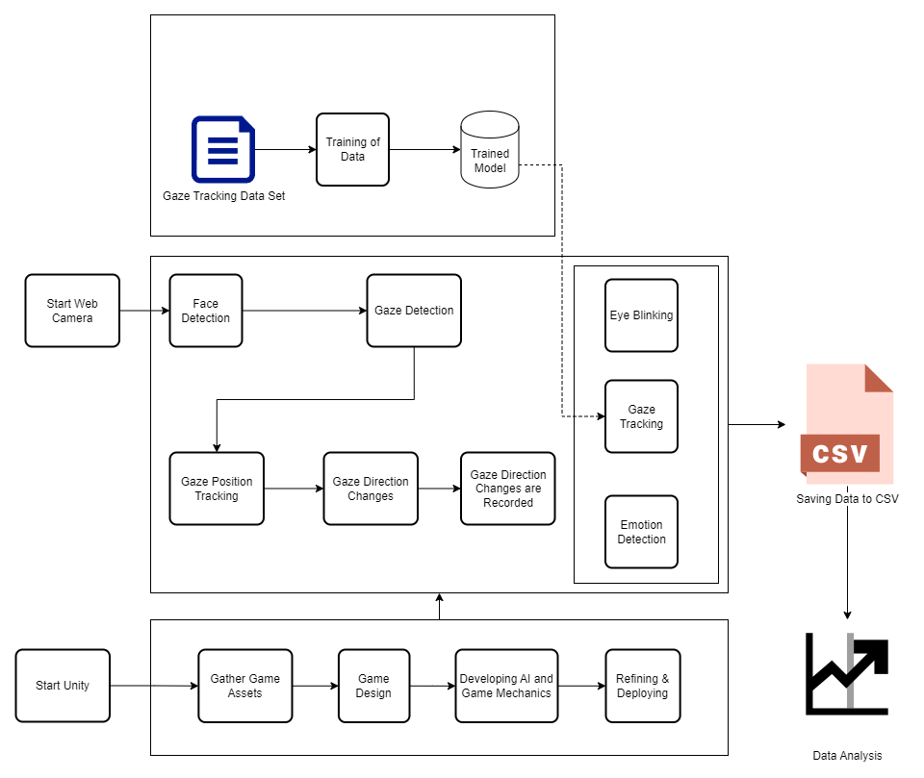
Methodology Research Pipeline
Starting with the data set specifically selected for gaze tracking, the data set was processed to training, and after the training period, the data set trained was transformed into a trained model.
the trained model could lead to several types of vision, such as eye blinking, gaze tracking, and emotion recognition.
The web camera is set up and turned on in the prototype when the face is detected and the gaze is recognized by the trained model.
After the trained model recognized the face, eye, and gaze direction, the gaze tracking data was displayed.
Fig. 1. The prototype’s Research Pipeline

Slide 7

Methodology Research Pipeline
Based on these results, the prototype is displaying an output on the screen, and data on the screen is being recorded in the background writing to a CSV file and after the prototype program finish running the data is saved into the CSV file, which its purpose is the organize the data in graphs and tables.
The game prototype development, on the other hand, is done using unity. First, game assets were obtained from the unity assets store, and then the game design process began.
The assets gathered were utilized to create two distinct types of games: one was made as a first-person shooting game, representing the fast-paced game, while the other was designed as a modest prototype of an open-world game, containing objectives and NPC's, representing the slow-paced game.
Furthermore, the game rules were established, and the AI development process began, employing ML agents and Pathfinding technology.

Slide 8
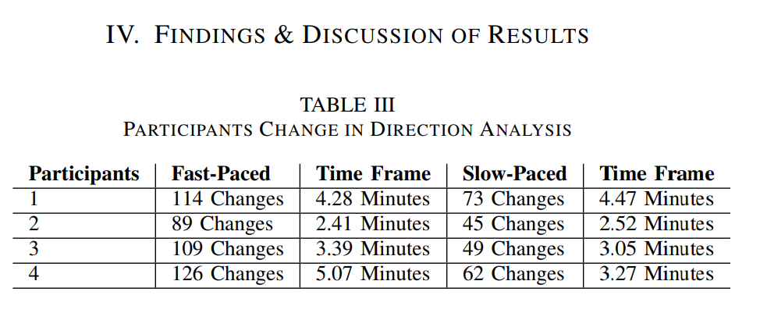
Results

Slide 9
Results
Participant One's metrics show 114 gaze direction changes between the left and right sides of the screen; the participant completed the game in 4.28 minutes; in the slow-paced game, less changes were recorded because it is more of an exploration game; the game was completed in 4.47 minutes.
On the other hand, participant two's metrics show that in the fast-paced game, less changes in direction were recorded, and the game was completed quickly, indicating that a more professional and experienced player was playing the game.
In the slow-paced game, participant two used the same time frame as the fast-paced game, and less changes were recorded.
The same constant evaluation was performed for the remaining two participants, because the metrics propose that there were more changes in the fast-paced game than in the slow-paced game.

Slide 10

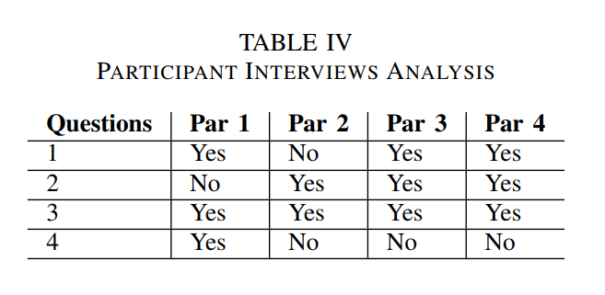
Results
The following are the Interview questions that this study would like to address to the participants:
1. Was the first game more hectic than the second game? 2. Was the feeling of the second game relaxing? 3. Was the first game tougher than the second game? 4. Was the second game sufficiently explorative?

Slide 11
Results
During the interview, Participant One stated that the fast-paced game was hectic than the slow-paced game. This finding was supported by quantitative data from the eye gaze tracking system, which revealed more variations in eye gaze direction.
Participant One also claimed that the slow-paced game was not relaxing since it was little unclear and the participant was also confused what to start with however participant one felt that the fast-paced game was definitely tougher to complete, and that the slow-paced game was explorative enough.
One the other hand participant two during the interview felt comfortable playing the fast-paced game and did not find it hectic at all, he found the slow-paced game relaxing, but not explorative enough, although participant two did not find the fast-paced game hectic, still found it tougher to complete than the slow-paced game.
The participants that were chosen for an interview were of diverse types, some of the participants have different age gaps and also different experiences in playing computers games.

Slide 12
Conclusions
The results indicate that players notice a big difference when playing a fast-paced game which keeps the users on the edge of their seats to explore and complete the next step in the game.
Also results indicate that players ought to choose a slow-paced game to calm down and explore step by step a game world peacefully, although it may be challenging as well.
This result addresses research question one, as a correct and appropriate data set was chosen to develop a well functioned gaze tracking prototype, also the result addresses research question two, which did a good job with the accuracy of the gaze tracking prototype, as all changes in directions were recorded and saved successfully in the CSV file.
The result associated with research question three show that the expected and intended result from the gaze tracking was a success as all the data needed was recorded and analyzed.

Slide 13
Future Recommendations
Recommendations for future research include games with a broader range of features, such as more objectives to complete.
a larger and more broadened map for the player to explore various parts of the map, and dynamic game difficulty in the fast-paced game, which is a technology used to change a game’s difficulty based on a player’s skill. If a player is losing a game, the difficulty adjustment strategy may help them win. In some situations, it can make it more difficult for a player to win a match.
Another recommendation would be to host the eye gaze tracking prototype online, so other users can test their game ability

Slide 14
References
[5] S. Almeida, A. Veloso, L. Roque, and ́O. Mealha, “The eyes and games: A survey of visual attention and eye tracking input in video games,” Proceedings of SBGames, vol. 2011, pp. 1–10, 2011.
[6] Indeed, “Types of Research Methodologies,” https://au.indeed.com/ career-advice/career-development/types-of-research-methods, [Accessed 02-04-2024].
[7] M. Collage, “Academic vs Non-Academic Articles — midmich.edu,” https://www.midmich.edu/services/lls/library/articles/ academic-vs-non-academic-articles, [Accessed 02-04-2024].
[8] K. K. Khatri, “Research paradigm: A philosophy of educational research,” International Journal of English Literature and Social Sciences, vol. 5, no. 5, pp. 1435–1440, 2020.
[9] “philarchive.org,” https://philarchive.org/archive/MGARPGv1#:∼: text=At%20the%20core%20of%20every,how%20it%20can%20be% 20obtained., [Accessed 28-03-2024].
[1] NTU, “Computer games.”
[2] G. Living, “Benefits of video games for kids adults — living.geico.com,” https://living.geico.com/home/technology/ 9-reasons-to-give-video-games-a-try/, [Accessed 22-May-2023].
[3] A. Pilon, “21 relaxing games for relieving stress — small- biztrends.com,” https://smallbiztrends.com/2022/04/relaxing-games.html? utm content=cmp-true, 2022, [Accessed 22-May-2023].
[4] W. T. Freeman, D. B. Anderson, P. Beardsley, C. N. Dodge, M. Roth,C. D. Weissman, W. S. Yerazunis, H. Kage, I. Kyuma, Y. Miyake et al.,“Computer vision for interactive computer graphics,” IEEE ComputerGraphics and Applications, vol. 18, no. 3, pp. 42–53, 1998.

Slide 15
Thank you Mikael Zammit, Dr Mario Mallia-Milanes

