Slide 1

Group 3 (David Lee) (Mike Hoang) (Greg Mercer) (Hank Chang)

Slide 2

What is ODEN?
ODEN unifies dataset applications for all the cities by developing a standard datasets.
Reduce cost and time for cities store datasets.
Now used for cities of New Westminster, Edmonton, or New York.

Slide 3

What is JSON????
Normal Person who doesn’t know how to program
ODEN uses JSON Schema to store datasets.
Non-developers who wants to store data does not know what JSON is!

Slide 4
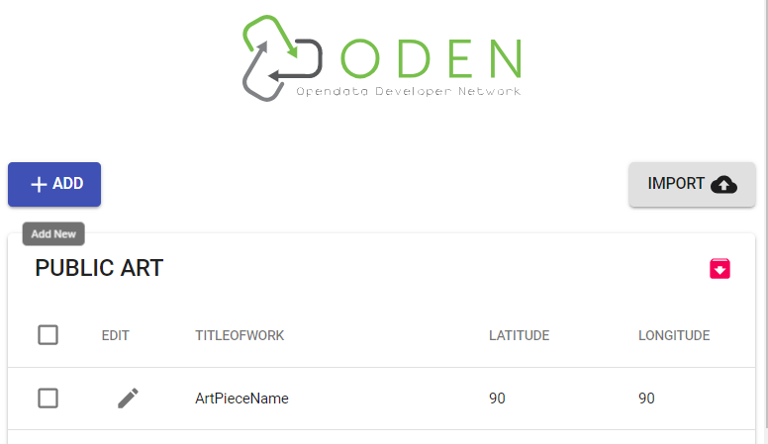
Our Project on ODEN
Develop a React web app to help non-developer to enter data.
Live visualization of dataset structures so that non-developers can understand how datasets work.
Use ODEN’s API to convert data into JSON datasets.
Develop a better version of JSON Schema dataset.
Apply new JSON Schemas to our web app.

Slide 5
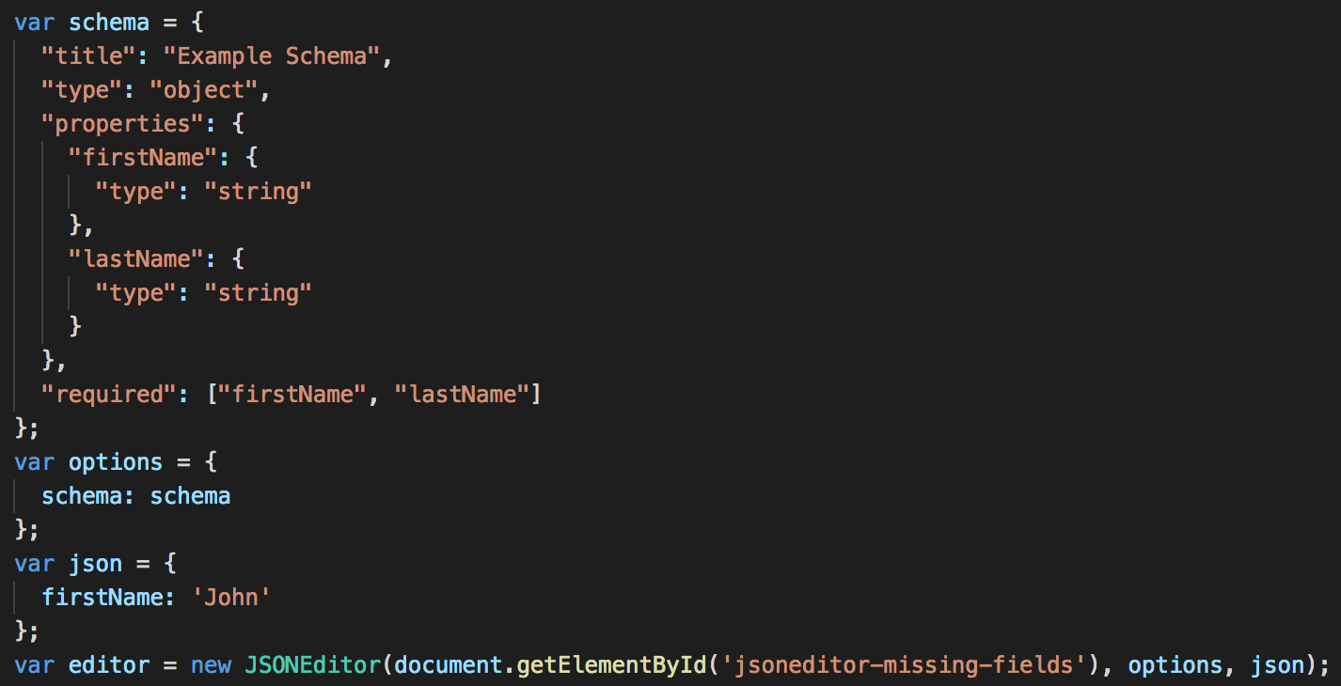

Lessons Learned
What ODEN is, and it is already used and demanded in numerous cities.
Gained insights on React, JSON Schemas.
Learned there are many useful data lying on the web in an unsuitable format. Depending on how people use them, it can worth more.
Teamwork makes the project more juicy and fun.

Slide 6

Did We Do What is Required?
Web App for Non-developers to create standard datasets.
Visualize the datasets so the non-developers can understand how their data is stored.
Datasets to fit in the provided JSON Schemas.
Improve 3 JSON Schemas of Public Art, Bus Route, School Sites.
All of them completed.

Slide 7

Future Steps
Update more JSON schemas
Test the application with real-life data and get feed back from the users.
Improve the app based on the feedback and encourage users to use our app to create our standard dataset.
Data to be stored in the database.

Slide 8

DEMO

Slide 9
Thank you for listening to our presentation
Group3
David Lee, Mike Hoang, Hank Chang, Greg Mercer

