Slide 1

Group 3 SKT (David Lee) (Mike Hoang) (Greg Mercer) (Hank Chang)

Slide 2

Group 3 SKT (SKy Technologies)
We code in the different level.
Our goal is way above the ground level.
Worked in the ODEN project for TerraTap Technologies.

Slide 3

What is ODEN?
ODEN unifies dataset applications for all the cities by developing a standard datasets.
Reduce cost and time for cities store datasets.
Now used for cities of New Westminster, Edmonton, or New York.

Slide 4

What did we have to do for ODEN?

Slide 5
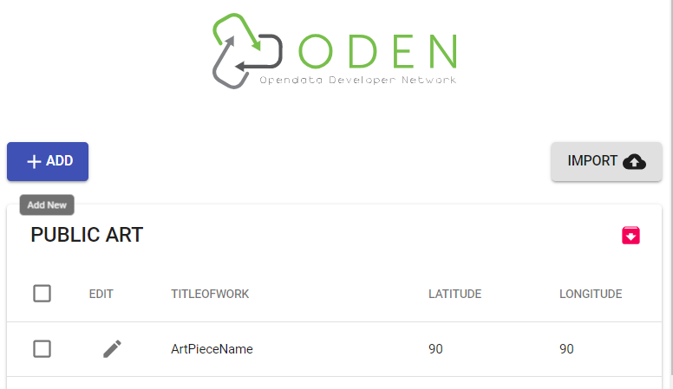
Our Project on ODEN
Develop a React web app to help non-developer to enter data.
Live visualization of dataset structures so that non-developers can understand how datasets work.
Use ODEN’s API to convert data into JSON datasets.
Develop a better version of JSON Schema dataset.
Apply new JSON Schemas to our web app.

Slide 6

What is JSON????
Normal Person who doesn’t know how to program
ODEN uses JSON Schema to store datasets.
Non-developers who wants to store data does not know what JSON is!

Slide 7
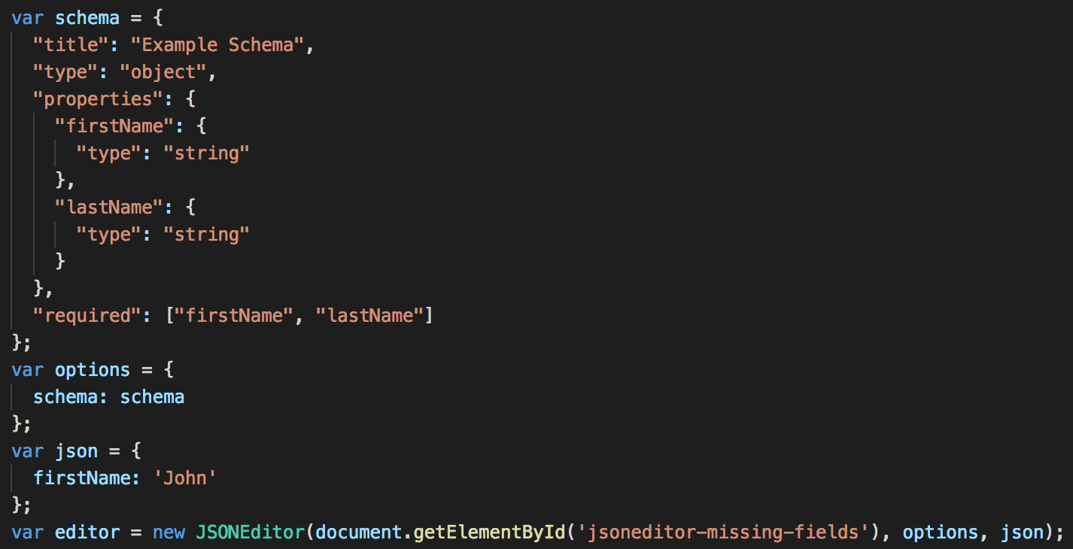


How We Did It
Web app was built with React framework
JSON Schema were modified and used for datasets

Slide 8

Did We Do What is Required? Yes
Web App for Non-developers to create standard datasets.
Visualize the datasets so the non-developers can understand how their data is stored.
Datasets to fit in the provided JSON Schemas.
Improve 3 JSON Schemas of Public Art, Bus Route, School Sites.
All of them completed.
https://skytech-8ce24.firebaseapp.com/

Slide 9

Our Demo is a Role Play Which Will Show How Our Web App is Useful

Slide 10

Role Play Summary
This is Meredith! She was given an excel file of datasets from her boss and she has to store them in the dataset.

Slide 11
Roles in the Demo, Greg: Meredith, Mike : Meredith’s boss, David : User, Hank : Developer

Slide 12
DEMO

Slide 13
Lessons Learned
Learned what ODEN is, and it is already used and demanded in numerous cities.
Gained insights on React, JSON Schemas.
Learned there are many useful data lying on the web in an unsuitable format. Depending on how people use them, it can worth more.
Teamwork makes the project more juicy and fun.

Slide 14

Future Steps
Update more JSON schemas
Test the application with real-life data and get feed back from the users.
Improve the app based on the feedback and encourage users to use our app to create our standard dataset.
Data to be stored in the database.

Slide 15
Thank you for listening to our presentation
Group3
David Lee, Mike Hoang, Hank Chang, Greg Mercer

