Slide 1
From simulated to experimental : PCR Melt Curve Prediction with Random Forest Regressor

Slide 2
Introduction
Objective: Predict experimental melt curve from simulated melt curve in a given experimental setting
Experimental melt curve data from
Moniri, Ahmad et al. “High-Level Multiplexing in Digital PCR with Intercalating Dyes by Coupling Real-Time Kinetics and Melting Curve Analysis.” Analytical chemistry vol. 92,20 (2020): 14181-14188. doi:10.1021/acs.analchem.0c03298
Simulated melt curve obtained with uMelt
Using target sequences and primers provided in the aforementionned paper

Slide 3
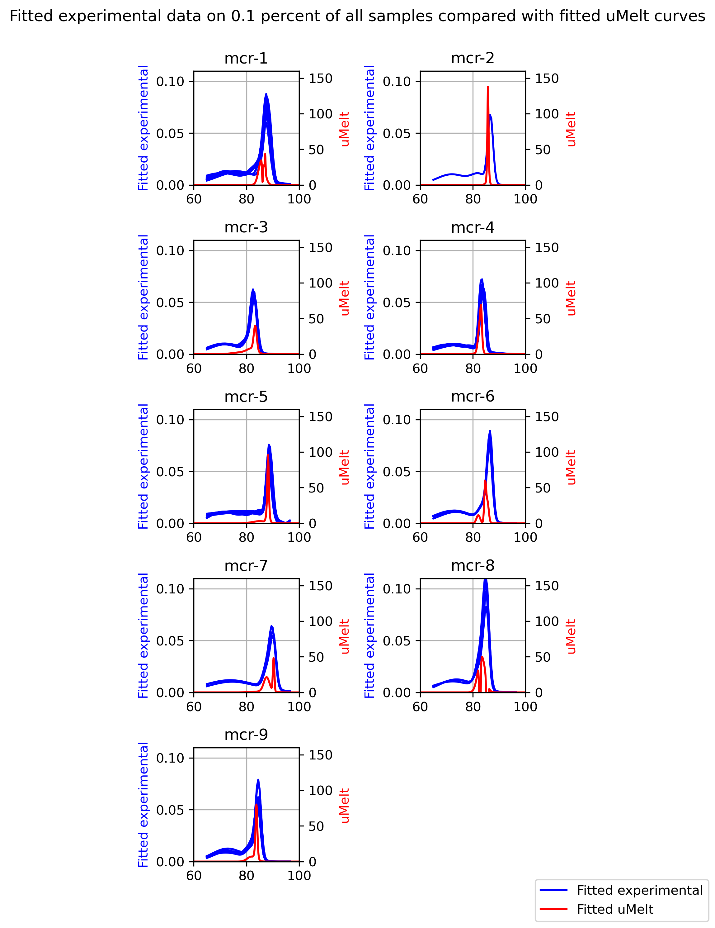
Simulated Melt Curves vs Experimental Melt Curves
Experimental curves compared with uMelt simulated curves
uMelt simulated curve peak close to experimental peak
Issue with scales for data standardization
uMelt melt curve is given by the inverse derivative of helicity
Experimental melt curves have been scaled in an unknown way
The overall similarity between experimental and uMelt curves suggests that a simple regressor should be able to predict the experimental curves from the uMelt curve

Slide 4
The three steps
Feature extraction
Fit melt curves to a gaussian
Data preprocessing
Outlier removal Standardize and preprocess the data
Multilayer Perceptron
Hyperparameter estimation
Training
Testing

Slide 5
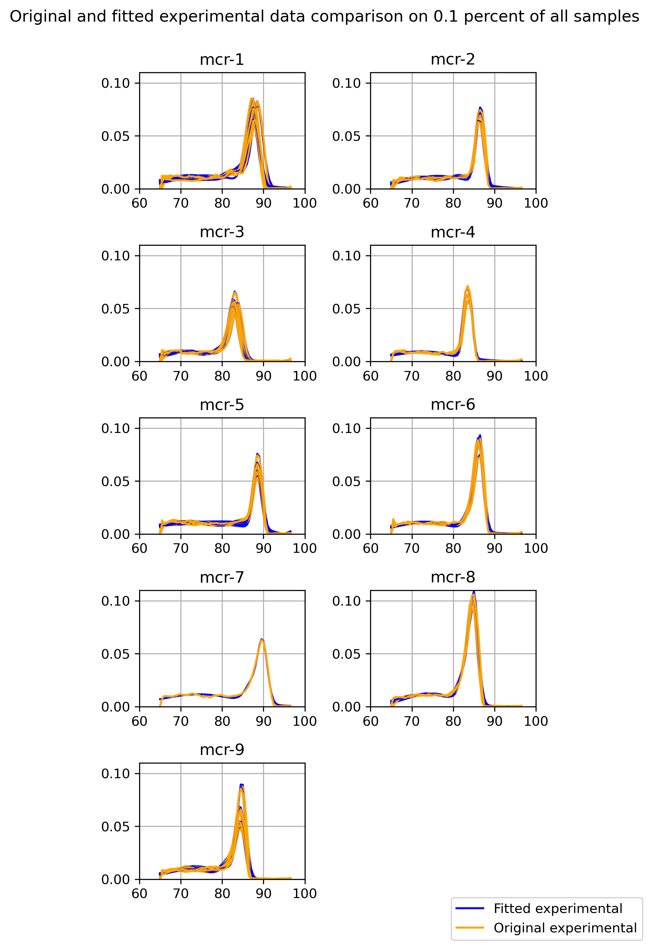
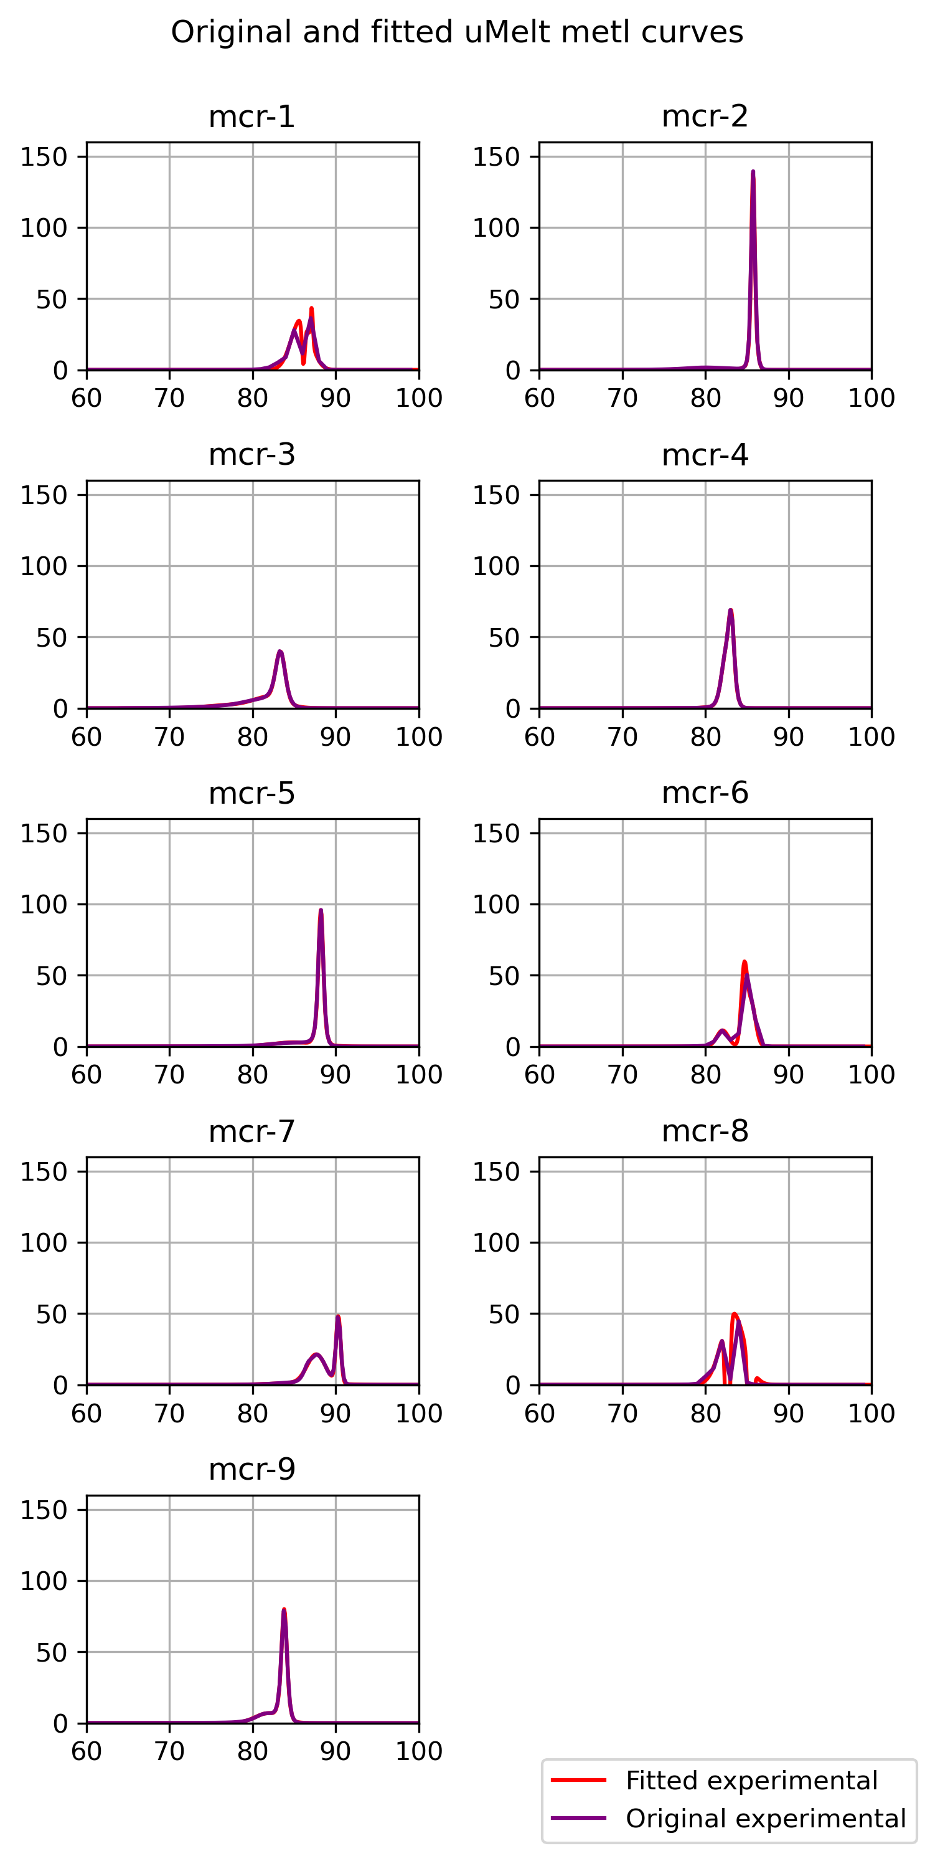
Fitting Experimental and Simulated Curves to Gaussian Functions
All curves are fitted to the sum of 3 gaussians to reduce the number of features (40 to 160 depending on the resolution to 9)
The features are ordered so that the first gaussian has the largest amplitude and the last one the smallest
The fittings are very satisfactory
The uMelt curves for targets mcr-1, mcr-6 and mcr-8 are limited to a lower resolution (1 point per degree) since the amplicons are longer than 500 bases.

Slide 6
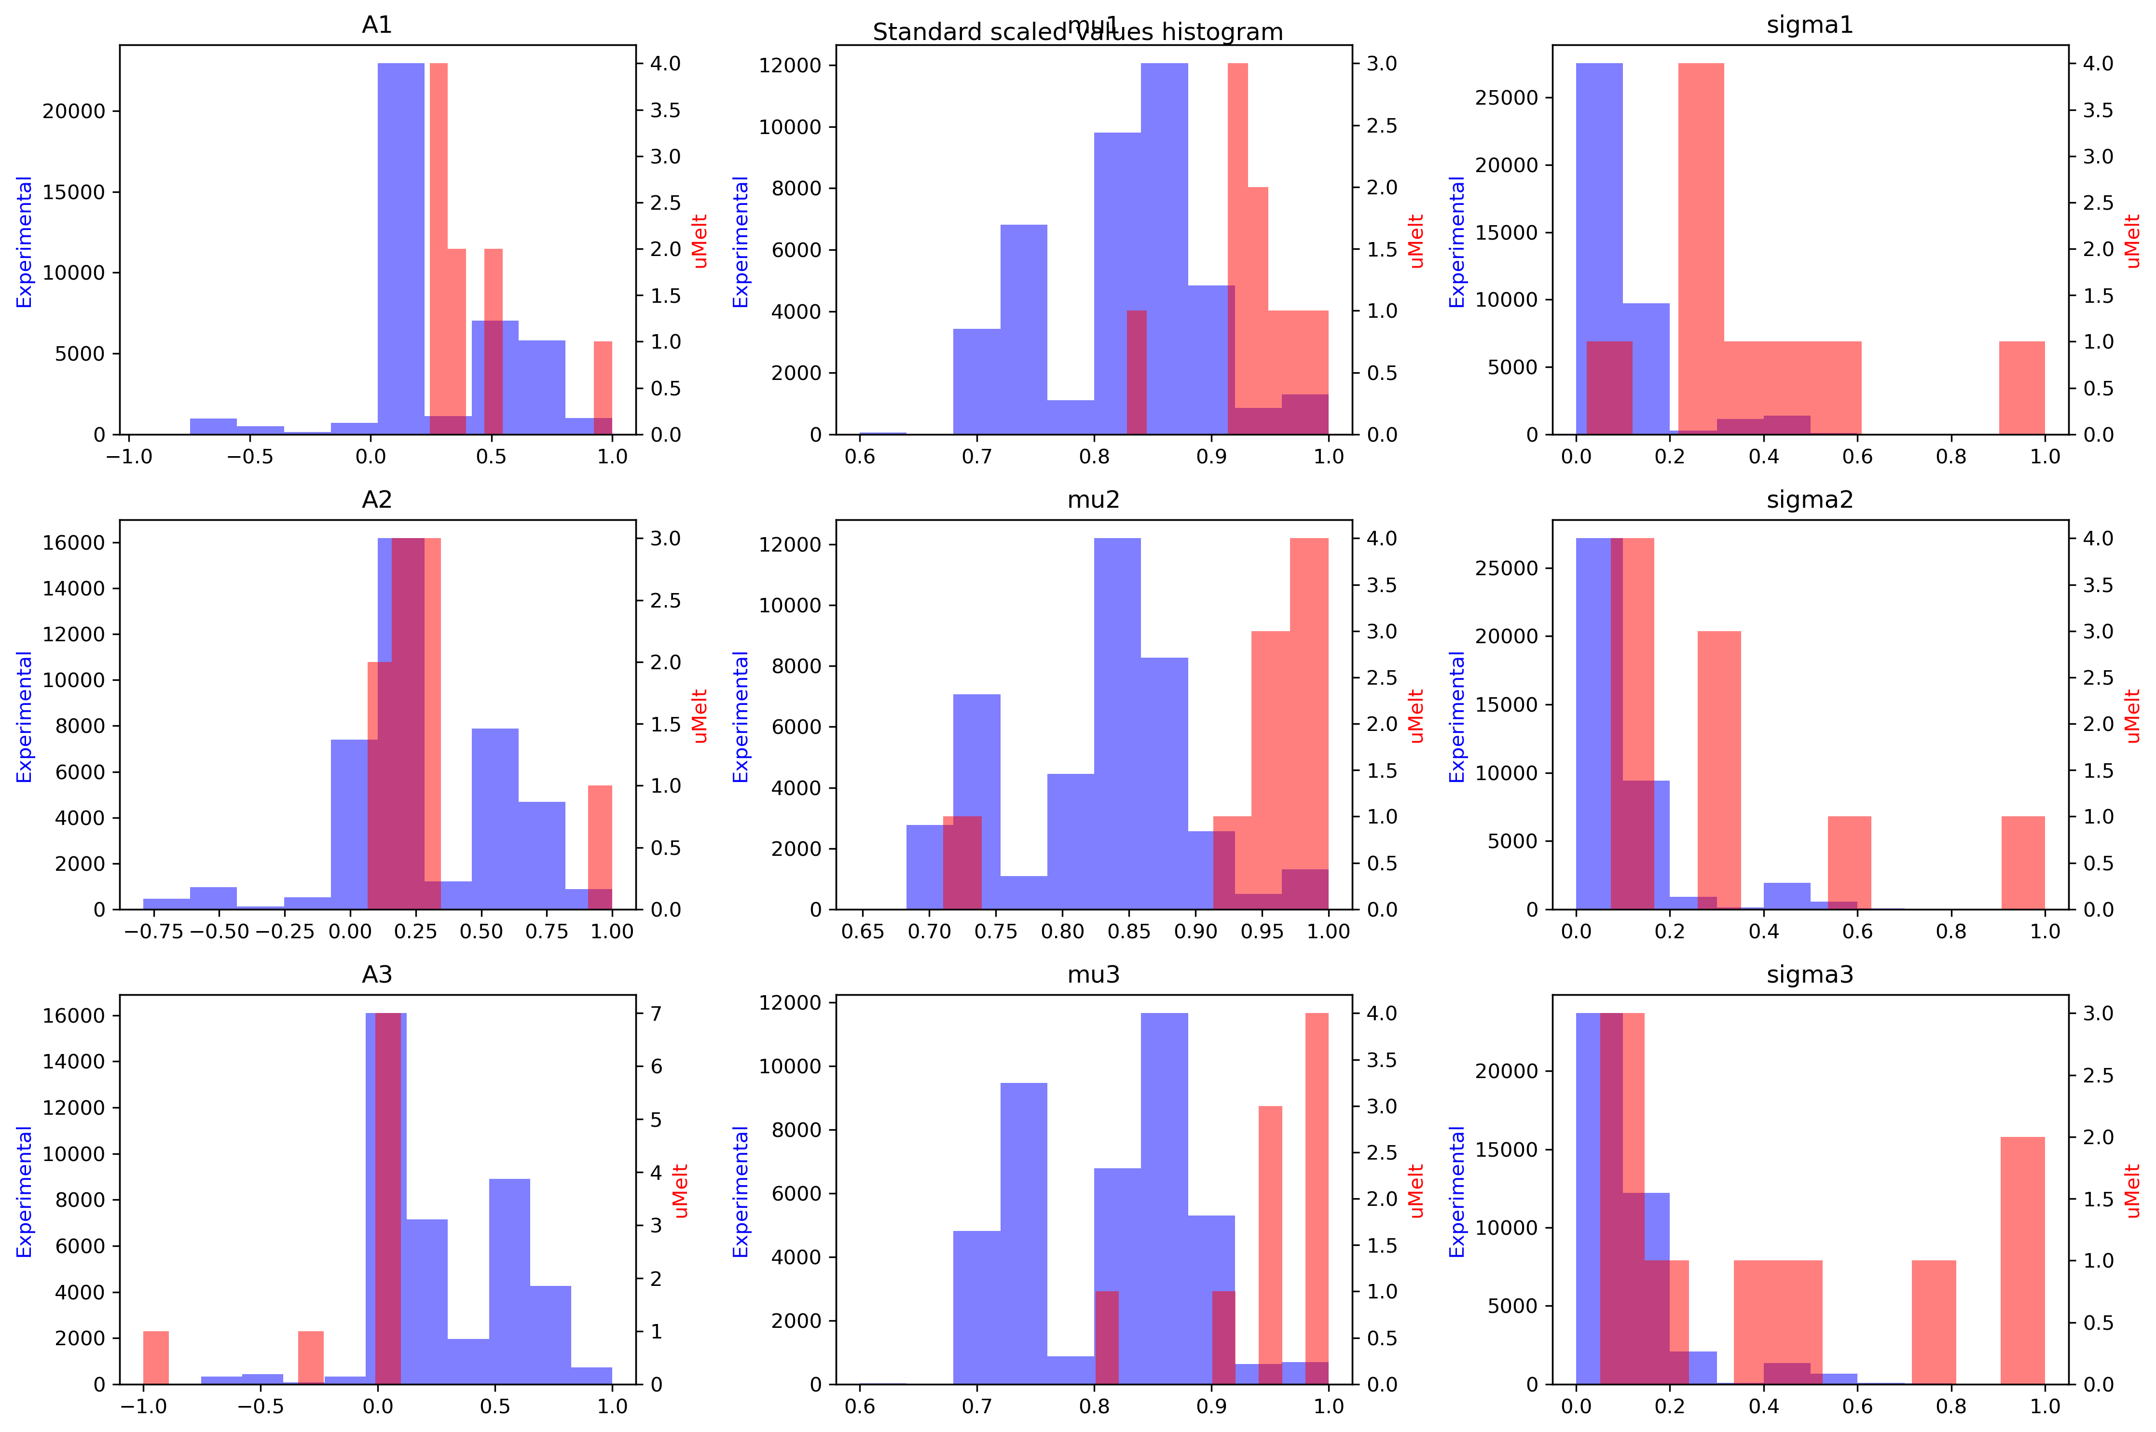
Preprocessing the data
A max abs scaler is applied to all the previously extracted features (divide by maximum absolute value)
3 amplitudes (A1, A2, A3)
3 means (mu1, mu2, mu3)
3 variances (sigma1, sigma2, sigma3)
One scaler is used for input data, one for the output data.
Amplicon length and GC content added to uMelt features
11 features of the uMelt curves as Input and 9 features of the experimental curves as output of the MLP

Slide 7

Tuning and training the MLP regressor
Two strategies were tested:
1. The test data is comprised of one target.
The best parameters for the training data is estimated and then evaluated on the data set that the random forest has never seen.
2. The test data is taken randomly as 20% of the overall data (usually from all targets), used to check if MLP is learning correctly
The best parameters for the training data is estimated and then evaluated on the testing data set.
Parameters tuned:
Number of estimators: number of trees
Max depth: maximum depth of the tree
Max features: The number of features to consider when looking for the best split
Visualization of the random forest tuning
https://scikit-learn.org/stable/modules/cross_validation.html

Slide 8
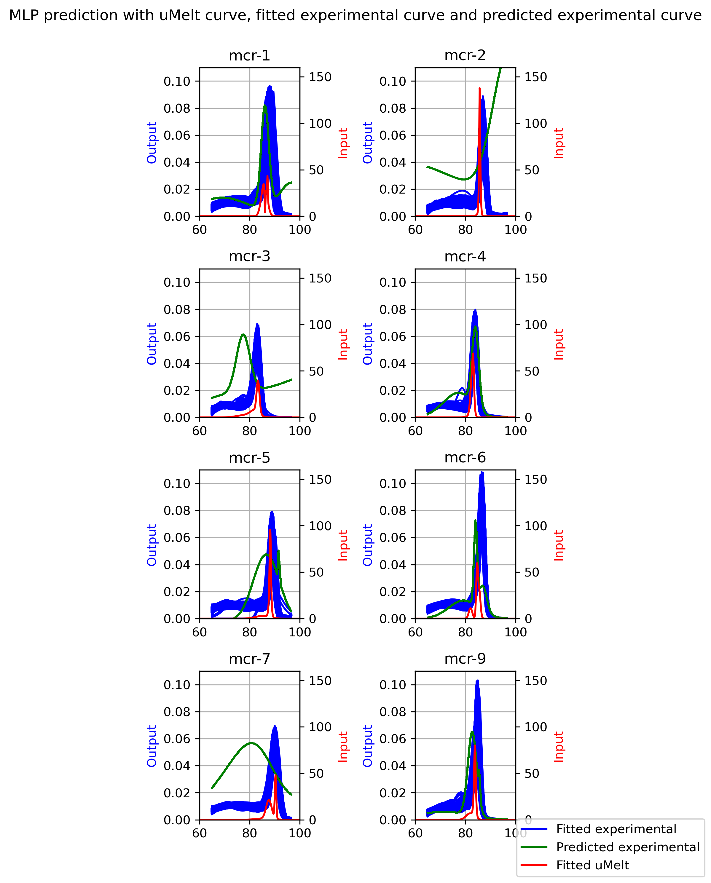
Strategy 1 The test data is comprised of one target, i.e no data leakage

Slide 9
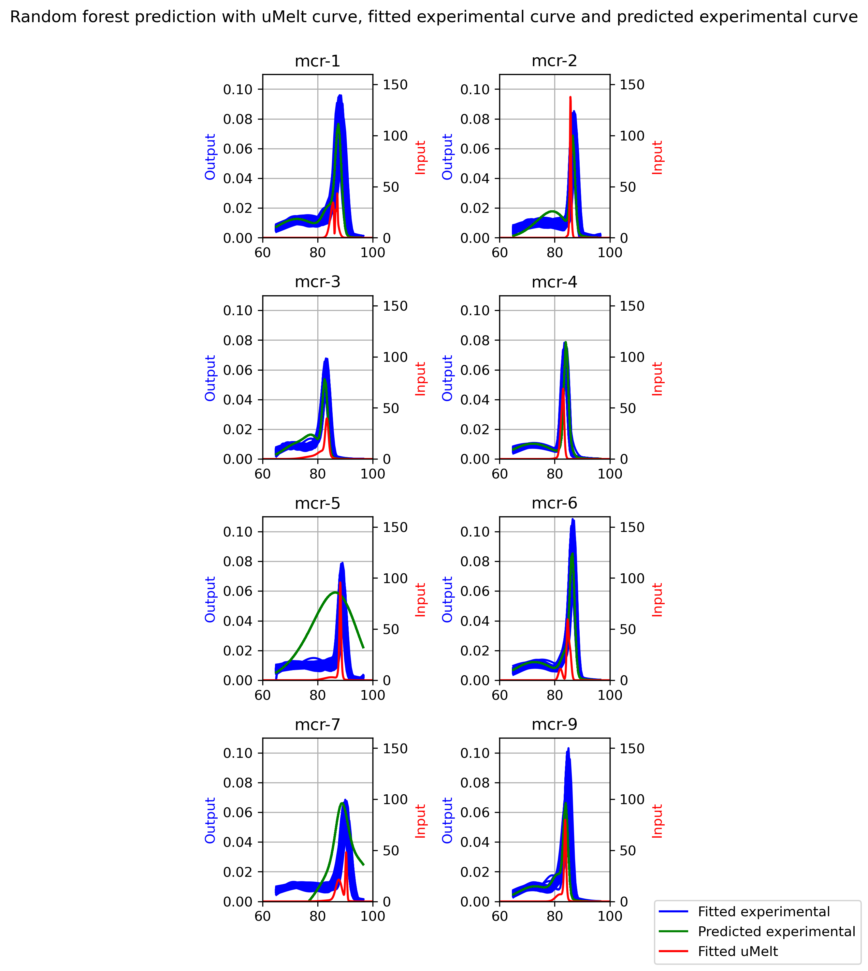
Strategy 2 The test data is taken randomly as 20% of the overall data (usually from all targets)
Remark: mcr-5 and mcr-7 shows a problem with the MLP’s learning

Slide 10
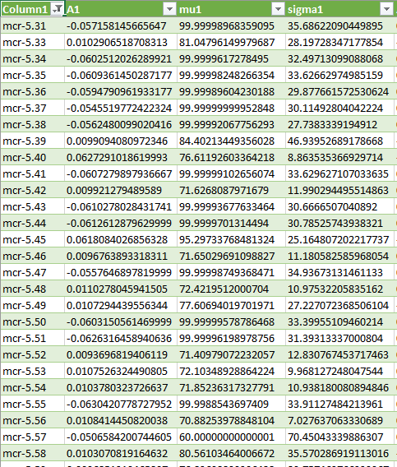
Identified issue
Example shown on the right:
Variability of sigma is too big
Remark: this is due to using the amplitude of the gaussians as feature arranging method
Try other feature arranging methods:
By gaussian mean and gaussian variance

Slide 11
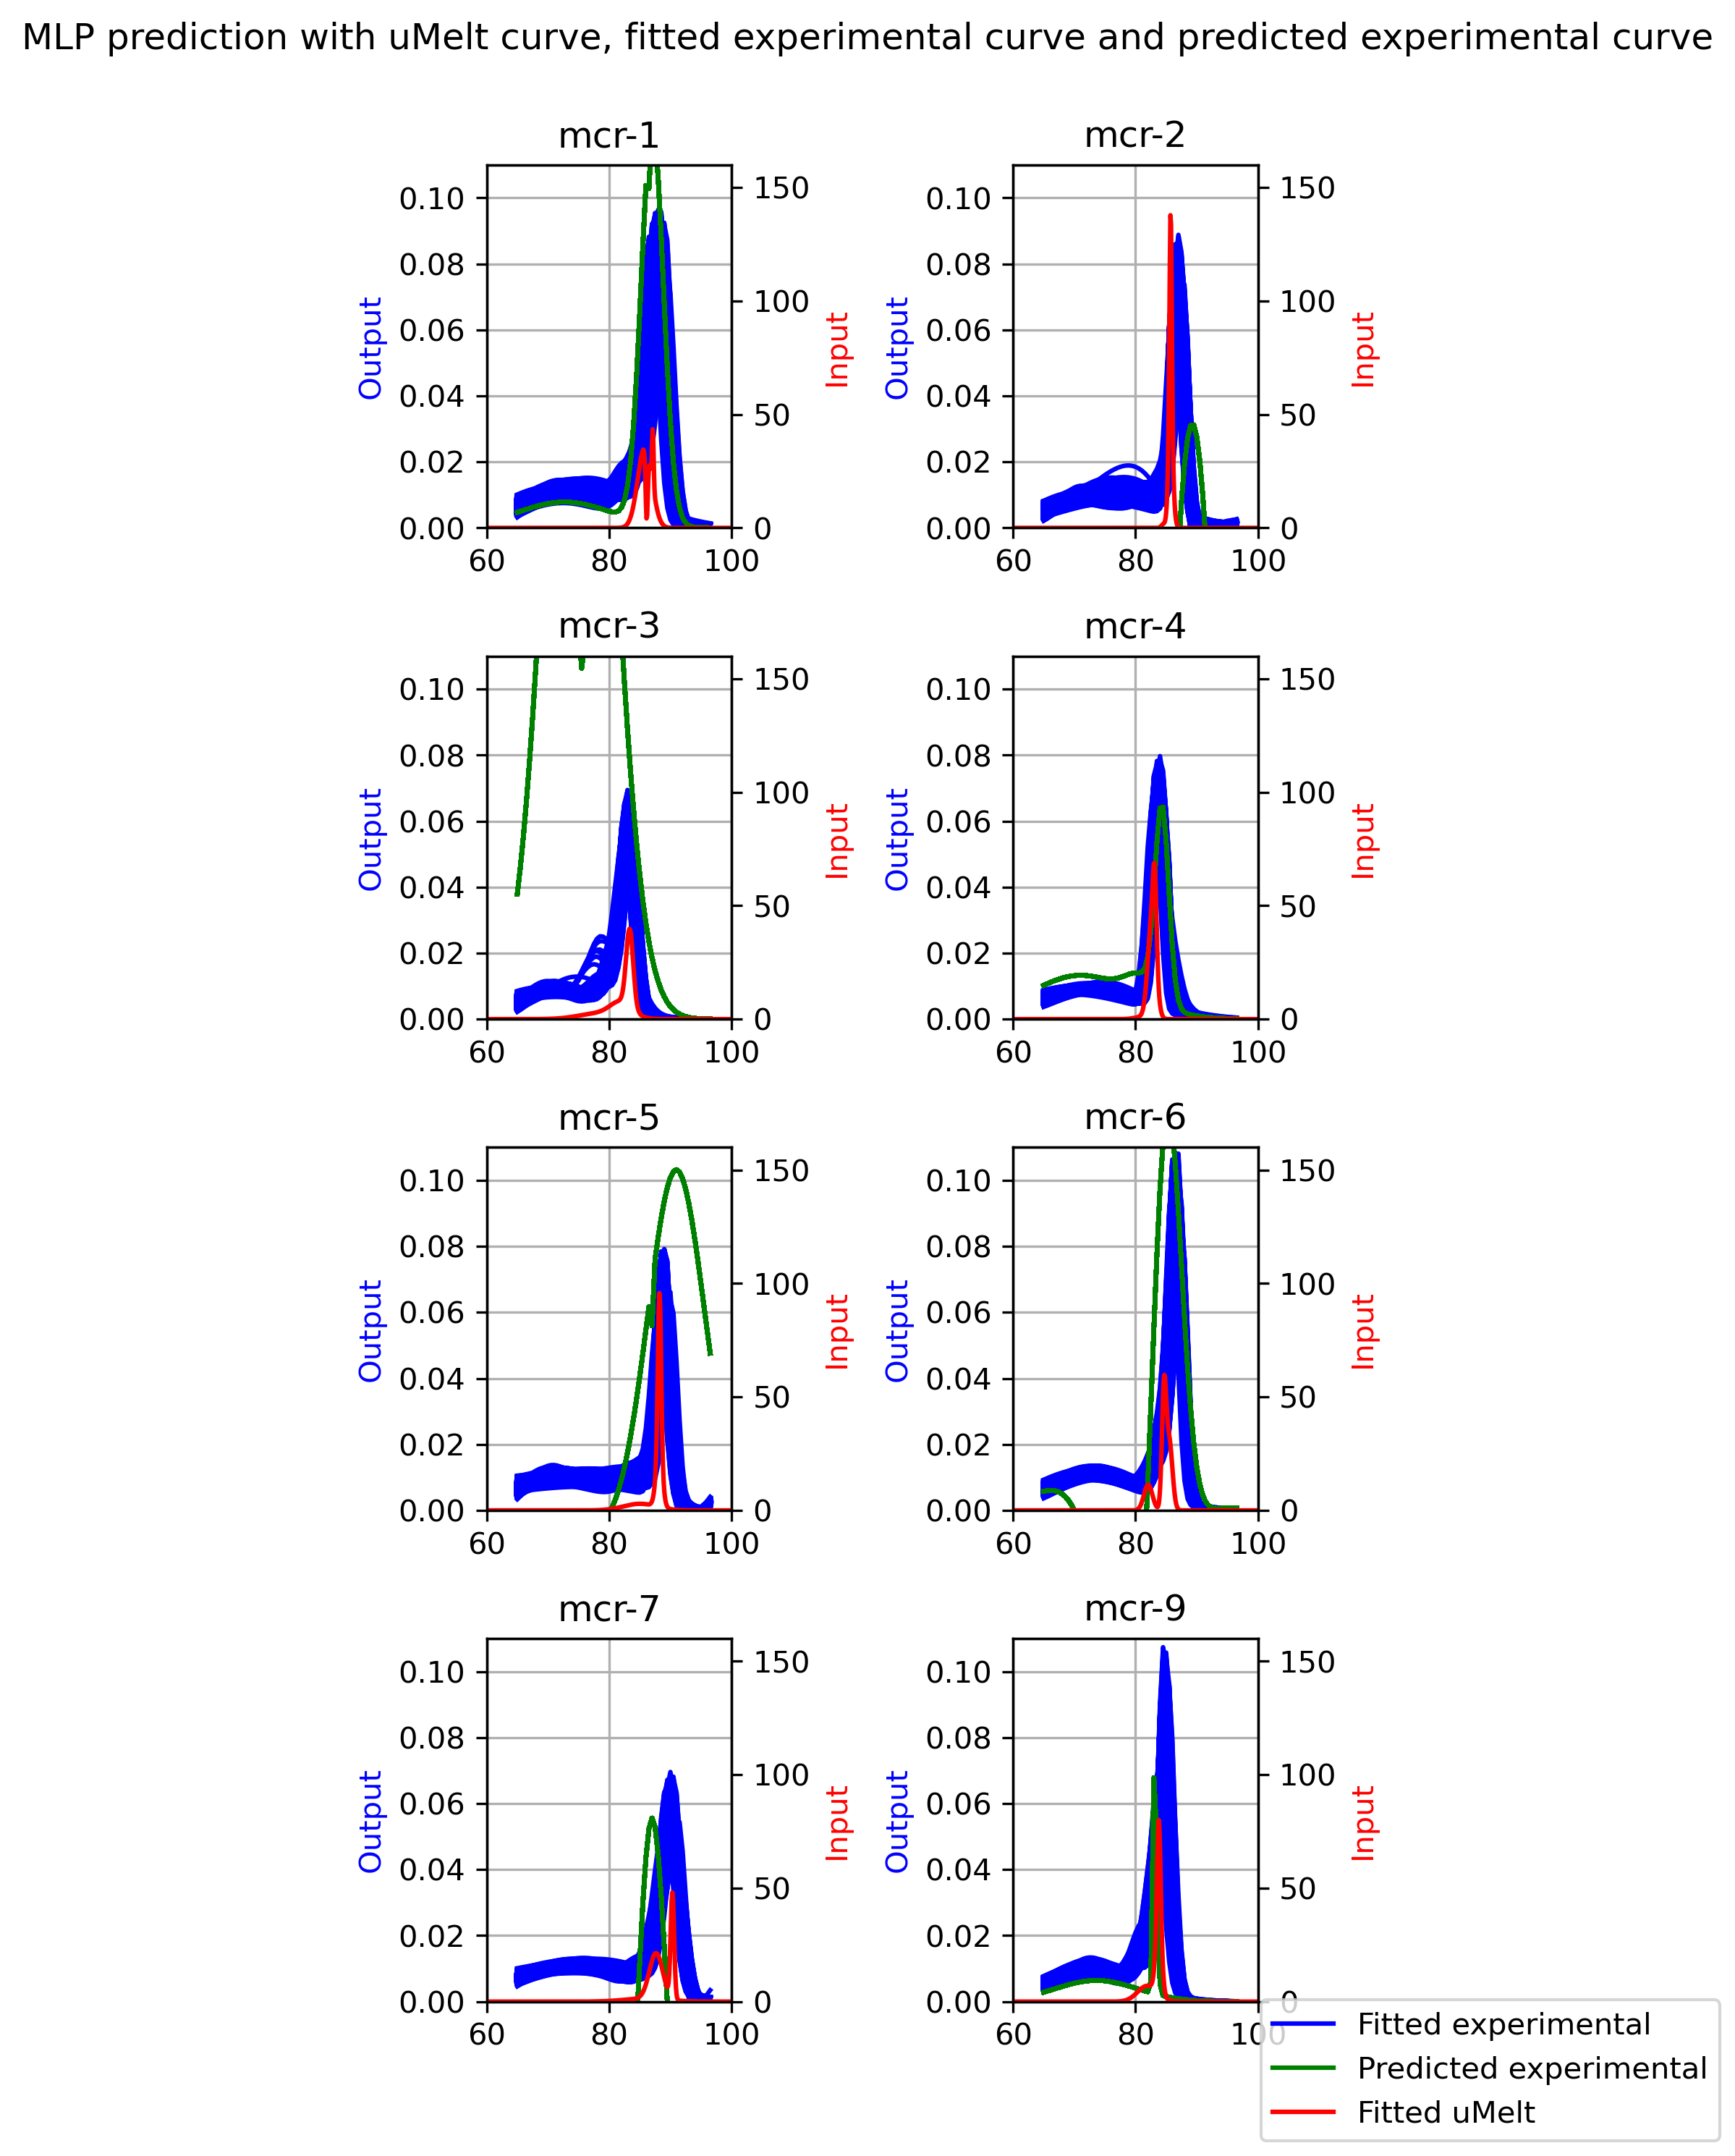
Strategy 1 variance arranged features The test data is comprised of one target, i.e no data leakage
Remark : Variance arrangement gives the best result with data leakage (strategy 2)
Result without data leakage still very lacking

Slide 12
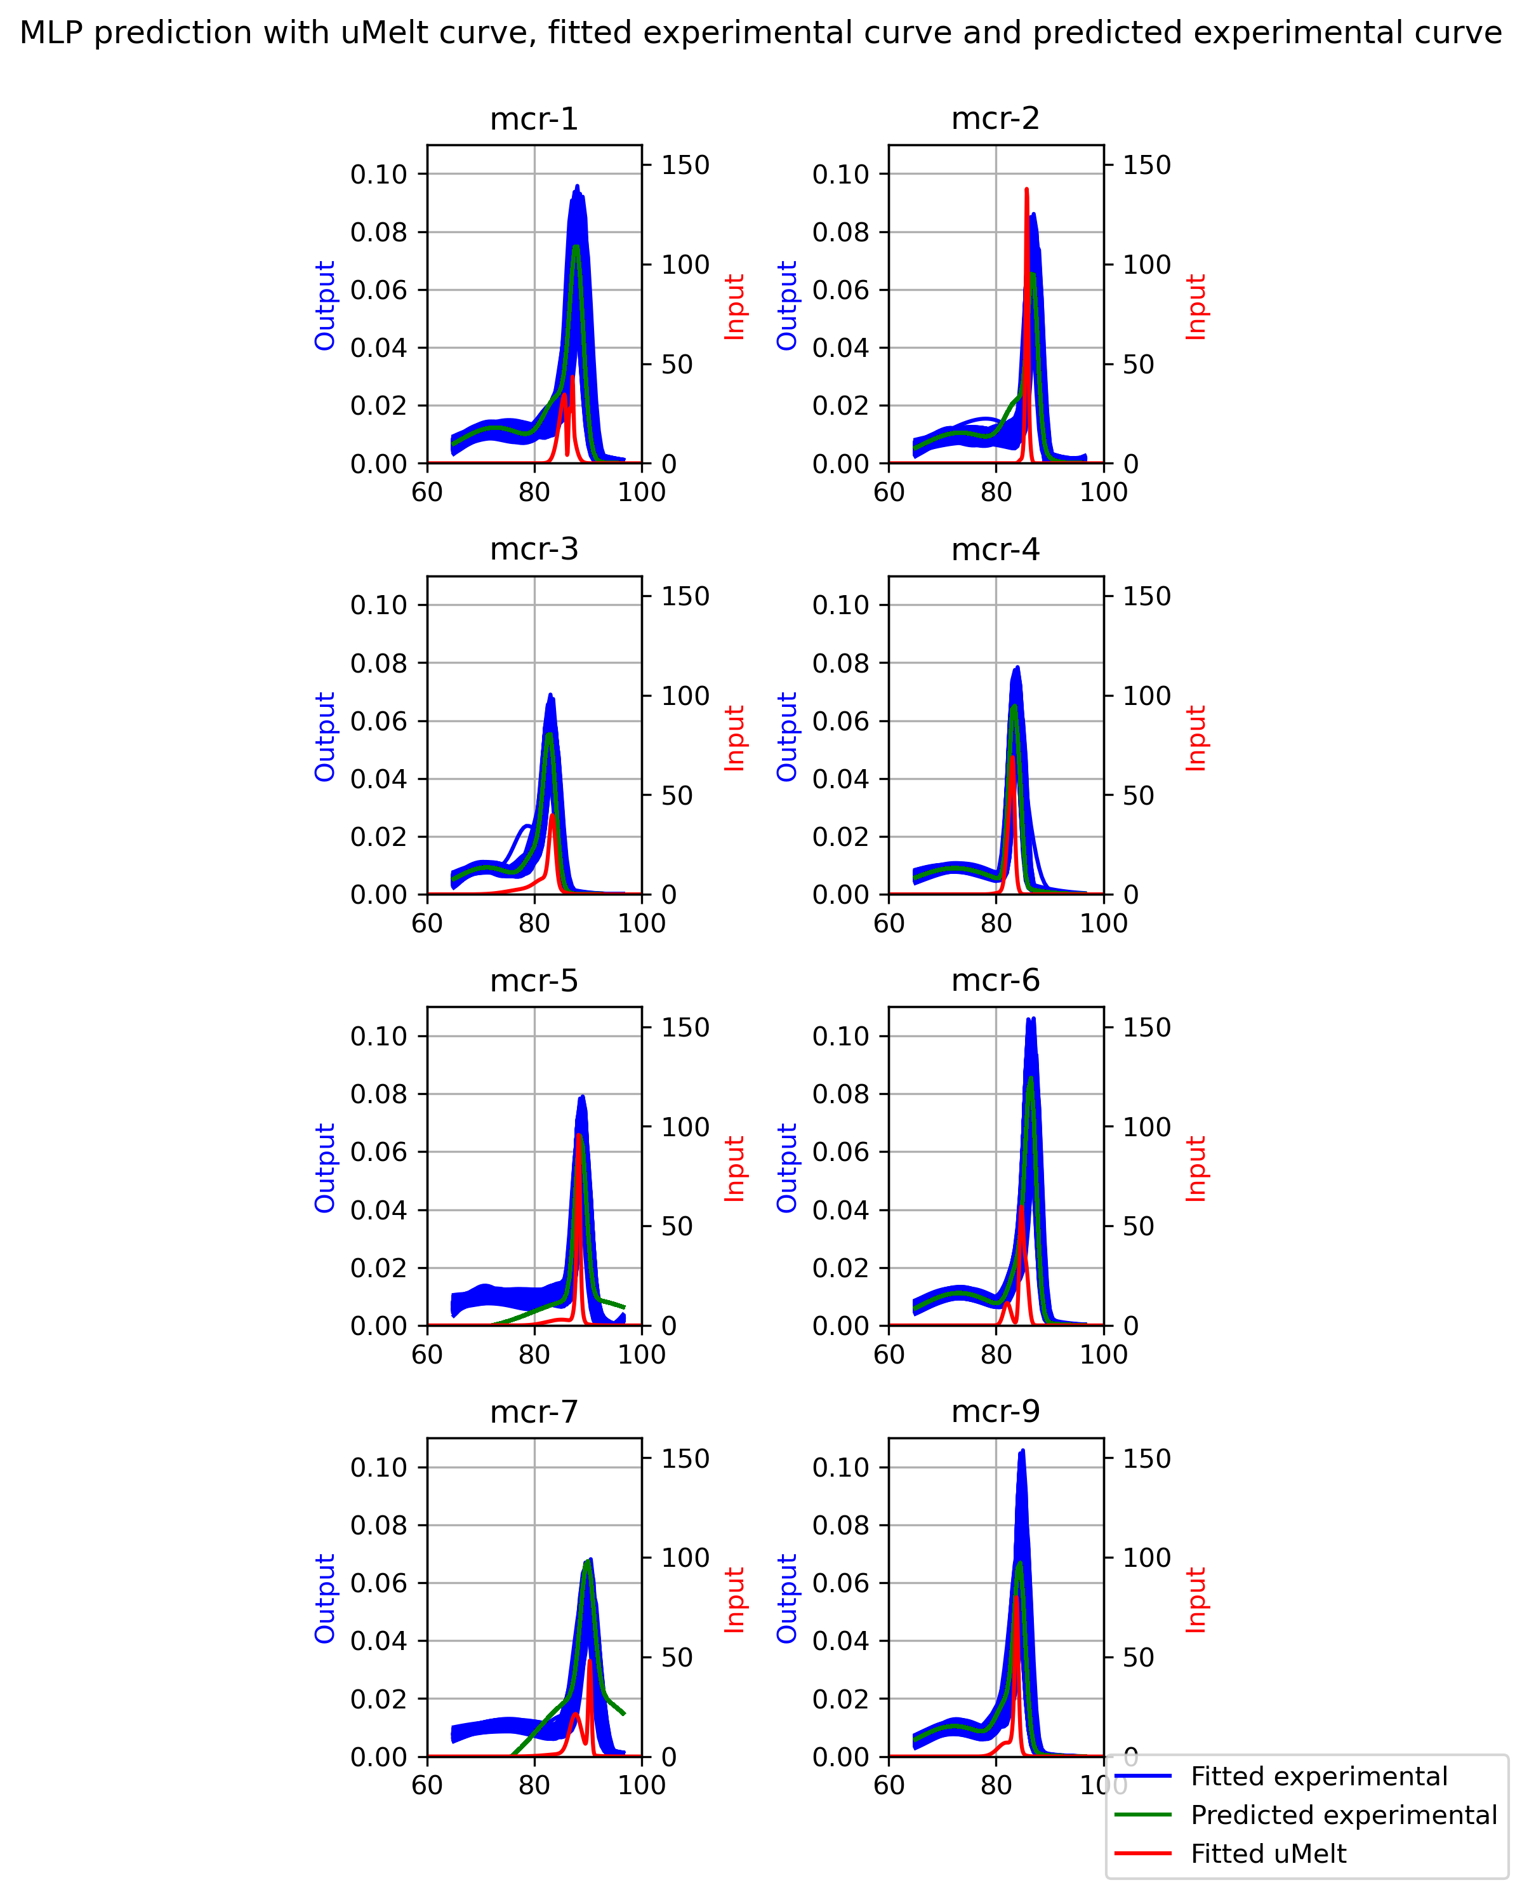
Strategy 2 variance arranged features The test data is taken randomly as 20% of the overall data (usually from all targets)

Slide 13
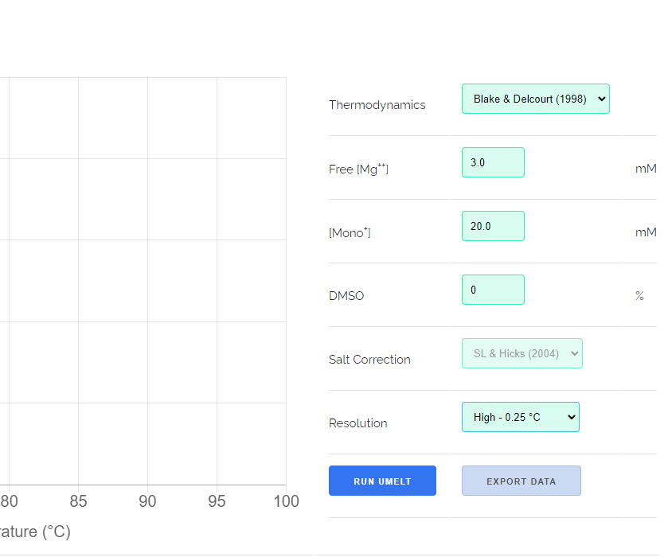
Next step
Introduce variability in uMelt prediction
Free [Mg+]
[Mono+]
DMSO
Separate the experimental data by unique pannel and experiment id combination (exp setting id)
Reasoning: each different pannel and experiment id combination refers to one specific experimental setting
Match the most similar uMelt prediction with the group of exp setting id for training
uMelt user interface (cropped)

Slide 14
Next step (in parallel)
Simplify the model:
Use one gaussian as fitting function
Fitting the original melt curve to a sigmoid then either use these features or derive them and use these
Fix uMelt resolution problem
uMelt only provide low resolution curves for sequences above 500 bp, (1 point per degree), thus creating weird double peaks (mcr-1, mcr-6 and mcr-8)
Use sigmoid to fit the original MC curve

