Slide 1
Global Student Network Generator
By Aron Lin, Rita Chen, Htoo Naing, Zhasmin Tuiachieva
Notes:
Htoo

Slide 2
Introduction
Notes:
Htoo

Slide 3
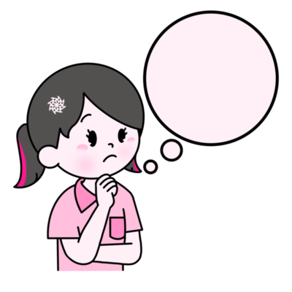

Problem
International students can feel uncomfortable and alienated when they arrive on campus for the first time.
This prevents them from building valuable social relationships and circles during college
Notes:
Htoo
..gonna add visuals later. Just having text on the screen is absolutely not good for a presentation lolol

Slide 4
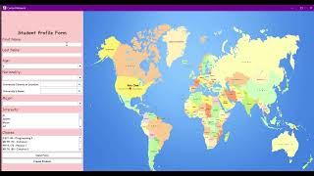
Product
Notes:
Htoo

Slide 5


Solution
Create a user friendly interface for students to connect with fellow peers.
Allows students to connect with peers with similar attributes (ex. Nationality, Major, Class, etc).
Notes:
Htoo

Slide 6





Aron Lin
Rita Chen
Maintained and organized the GitHub repository
Produced both Flow and UML Diagrams
Handled error debugging during testing
Implemented multiple integral functions relating to the map window
Catalogued countries with numerous sample universities
Simulated user profile locations
Htoo Naing
Zhasmin Tuiachieva
Authored the documentation in full
Designed and refined presentation slides
Provided graphical visualization of integers
Organized project design
Implemented data handling through File I/O
Created fundamental classes and more
Notes:
Everyone
Introducing the group members and showing general responsibility
Should elaborate within presentation that more specific contributions are present within documentation

Slide 7
Process

Slide 8
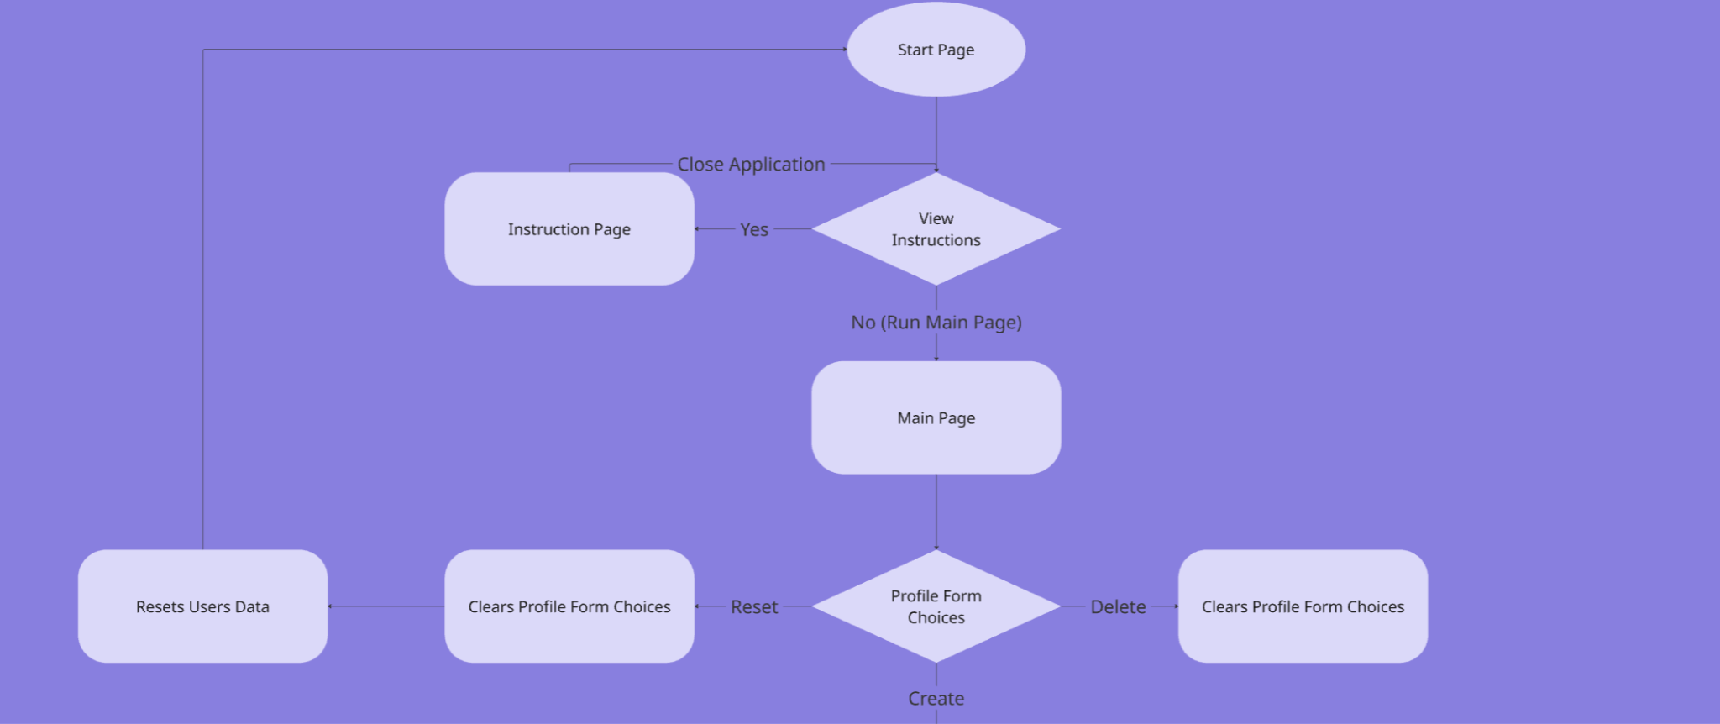
Flow Diagram
Notes:
Aron Lin
So lets start on how our application primarily functions. I’m not gonna bore you with the details so I’ll get to the most interesting part, the Main Page! So our main page as you saw has the student form but there are certain actions depending on what button you press. During development, we were only able to get 2 buttons which were the reset and the create button. The delete button acts the same as the reset button with the exception that the reset button clears the users data and returns the user to the start page. If you press the create button however…

Slide 9
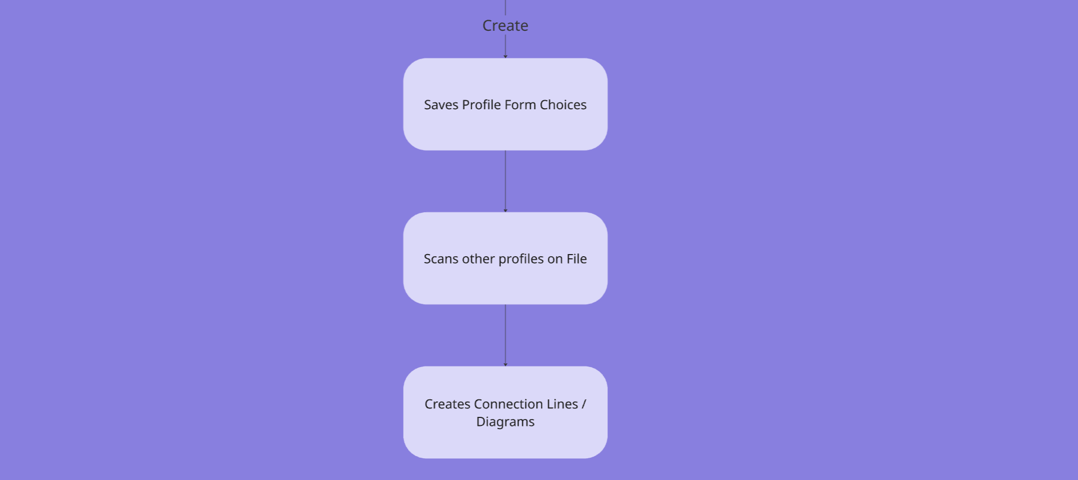
Flow Diagram
Notes:
Aron Lin
It will create a pin of you on the map based on the location of the university and it will save into a file full of other students to load the scenario. Initially, the group wanted to scan other students that were on file and create lines that determine how well connected the students are. Unfortunately we didn’t have enough time to create them so we sticked to the basics and started simple for now.

Slide 10
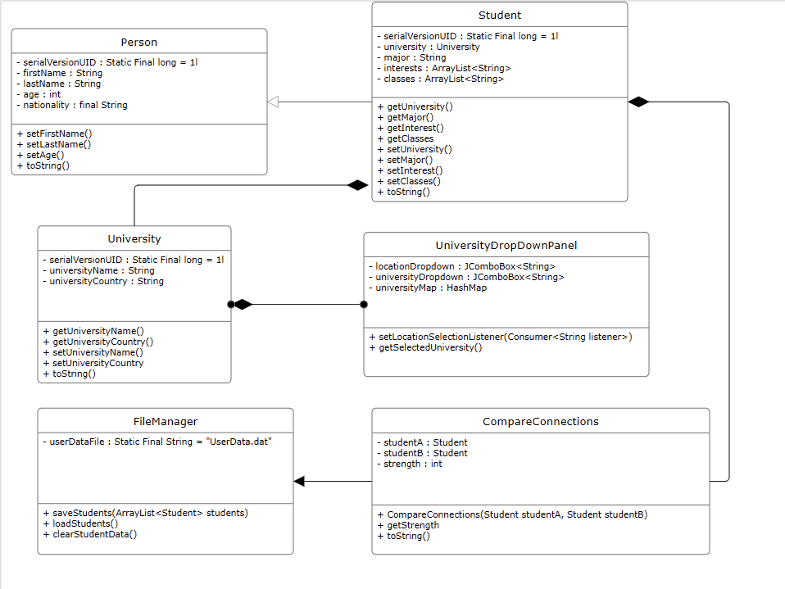
UML Diagram
Notes:
Zhasmin
Unsure how much should we be spending time here. Probably will figure that out on scripting.

Slide 11




Resources Used
Stack Overflow
Oracle
Youtube Tutorials
AI (GPT & Gemini)
Notes:
Aron Lin
Mention websites and tutorials (considering most of our work was found off libraries and etc). Additionally b/c listing all of them would take up a LOT of space. All resources used will be listed in documentation.

Slide 12


Issue #1: Time Constraints
Caused by an abrupt second midterm along with the two-week notice for the final
Forced the scrapping of certain ideas within the original design of the project (random student events, node connectors)
Limited the type of project that we could make within the timeframe
Notes:
Zhasmin
Time constraints

Slide 13
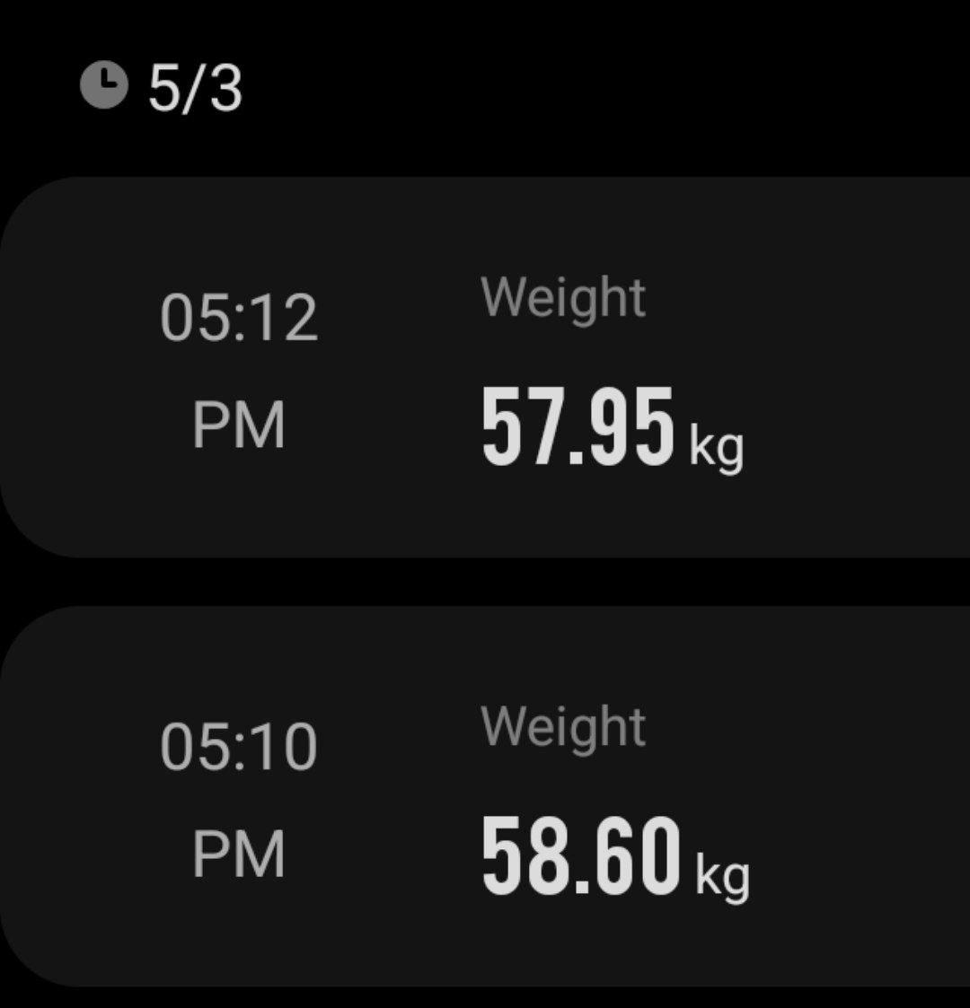
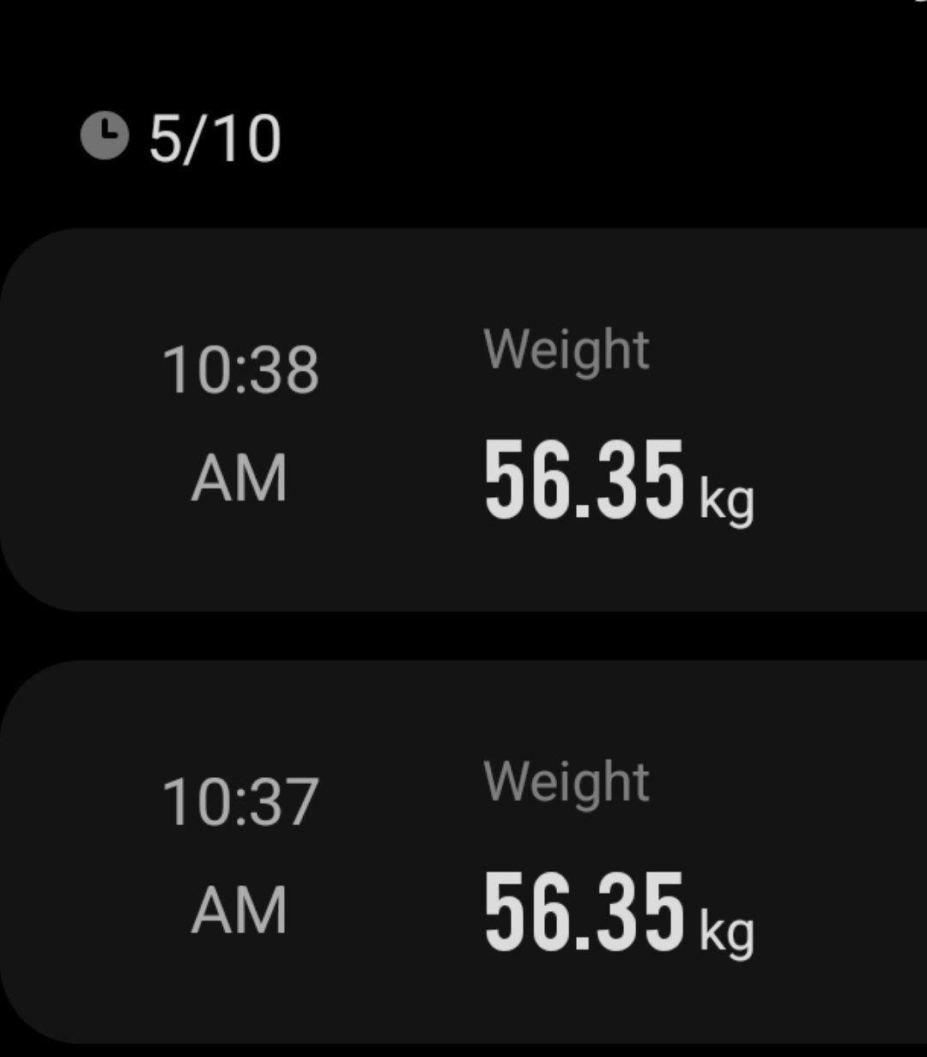
Project doubled as my my weight loss program
Thank you, project! I’m ready for summer!
Notes:
For Zhasmin
I lost 4 pounds moment

Slide 14


Solution
Declared a “MVP” (Minimum Viable Product) as our set goal
We set our expectations early and what we should prioritize first for the project
Decided upon a partly complex, but simple project that we could set up within a two week deadline
Notes:
Zhasmin
Create a “MVP” (as Aron mentioned), setting expectations early and what should be prioritized.

Slide 15


Issue #2: Resources
Many components within the project had concepts or functions not taught in class
Produced some additional constraints on time as members needed some time to figure out what they needed for their specific portion
Notes:
Rita Chen
Refined this towards miscommunication.
Finding the resources and etc to do what we need to do for the project

Slide 16


Solution
Online resources relating to coding forums were utilized heavily
Group members found and actively utilized documentation as they went about their group work, eliminating some prep time constraints
Notes:
Rita Chen

Slide 17


Issue #3: Integration
Merging each member’s group work to the GitHub required additional work
Group members usually required classes or specific portions of another member’s work in order to complete their part
Notes:
Aron Lin
Our work primarily used Github to allow us to collaborate seamlessly. Initially, I thought there weren’t gonna be major issues regarding the repository use. However, throughout development, the group faced multiple merge conflicts (Primarily due to members using multiple branches and initiating pull request) and stalls in development where some members cannot work on their tasks until the other members have completed their tasks.

Slide 18


Solution
A member was appointed to handle merging conflicts within the main branch, allowing for seamless integration
Team members often utilized stand-in variables and produced flexible classes that could be modified easily
Notes:
Aron Lin
So the best solution the group comes up with to solve the merge conflicts is to have a middle man (Me :D) that will handle the merge conflicts and pull requests. I would help members pull and commit their changes into the main branch so that they don’t have to worry about the repository side of things. As for the stalls in development, we have members initiate temporary variables or methods until the other members have completed their work. Once that was done, the group member can easily complete their work with minimal effort (Assuming everything goes well)

Slide 19
Closing Thoughts

Slide 20


Achievements
Most of our project’s original design had been completed (network simulation, student connections, etc.)
We were able to navigate through and resolve most of the issues that appeared throughout the project

Slide 21


Shortcomings
Certain functions from the original design had to be scrapped (random events, multiple student node comparisons, etc.)
Our original vision for the project was not fully realized due to time constraints
Group coordination was scrambled throughout the project

Slide 22
Thank you!
Have a good summer break!
Notes:
Everyone

