Slide 1
Population dynamics Group 07
Exam INF200 - June 2020
Astrid Hæve Sedal
Mikal Breiteig

Slide 2
Our approach
Planning prosess and time management
Flowchart and overall structure of project
Created the framework
Files, classes and methods
Simple tests based on requirements
Code and further tests
Debugging, documentation and prioritizing

Slide 3
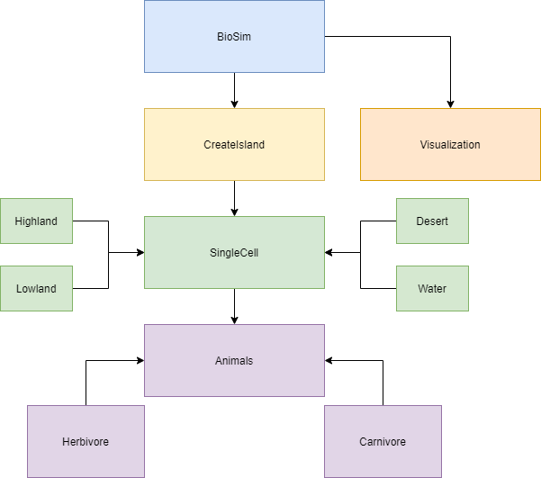
Overview of classes

Slide 4
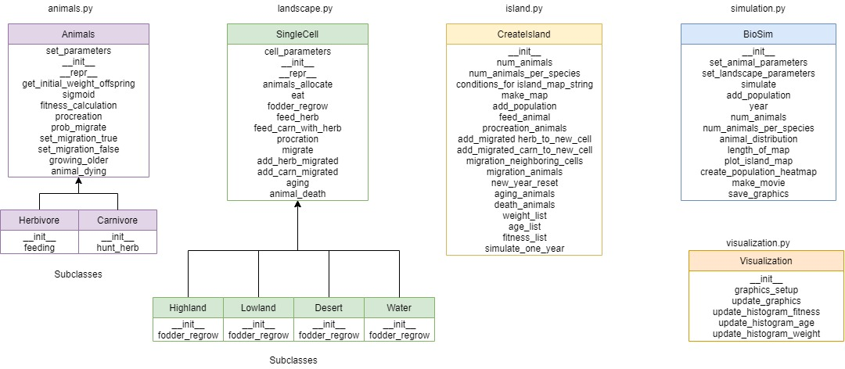
Detailed overview of file and structure

Slide 5
The code quality
Tests based on task requirements
PEP8
Readable code using clearifying methods and variable names
Simplified code
Documentation
NumPy
Unittests
Mocker
Statistical test

Slide 6
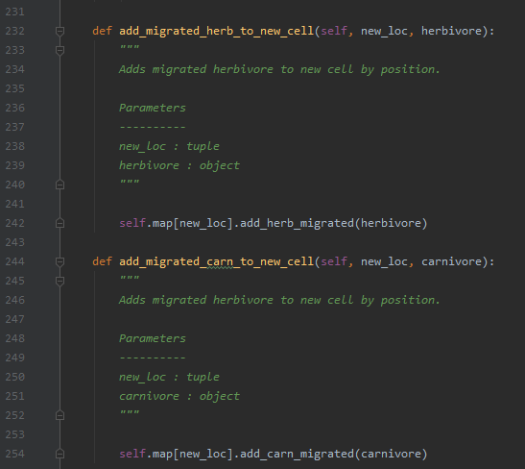
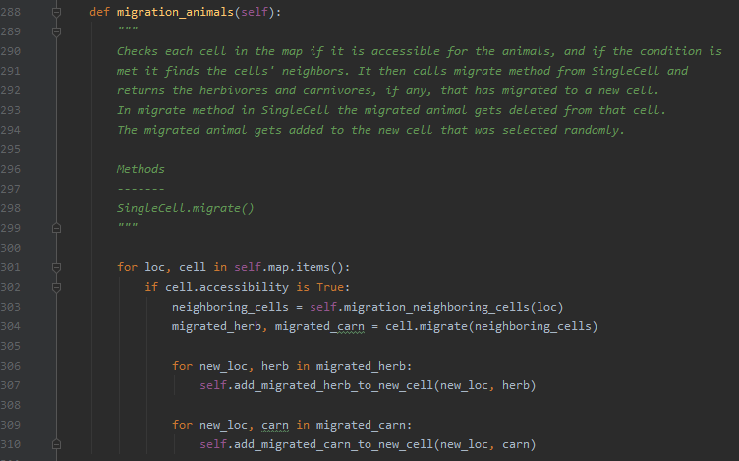
Simplify and increase of usability

Slide 7
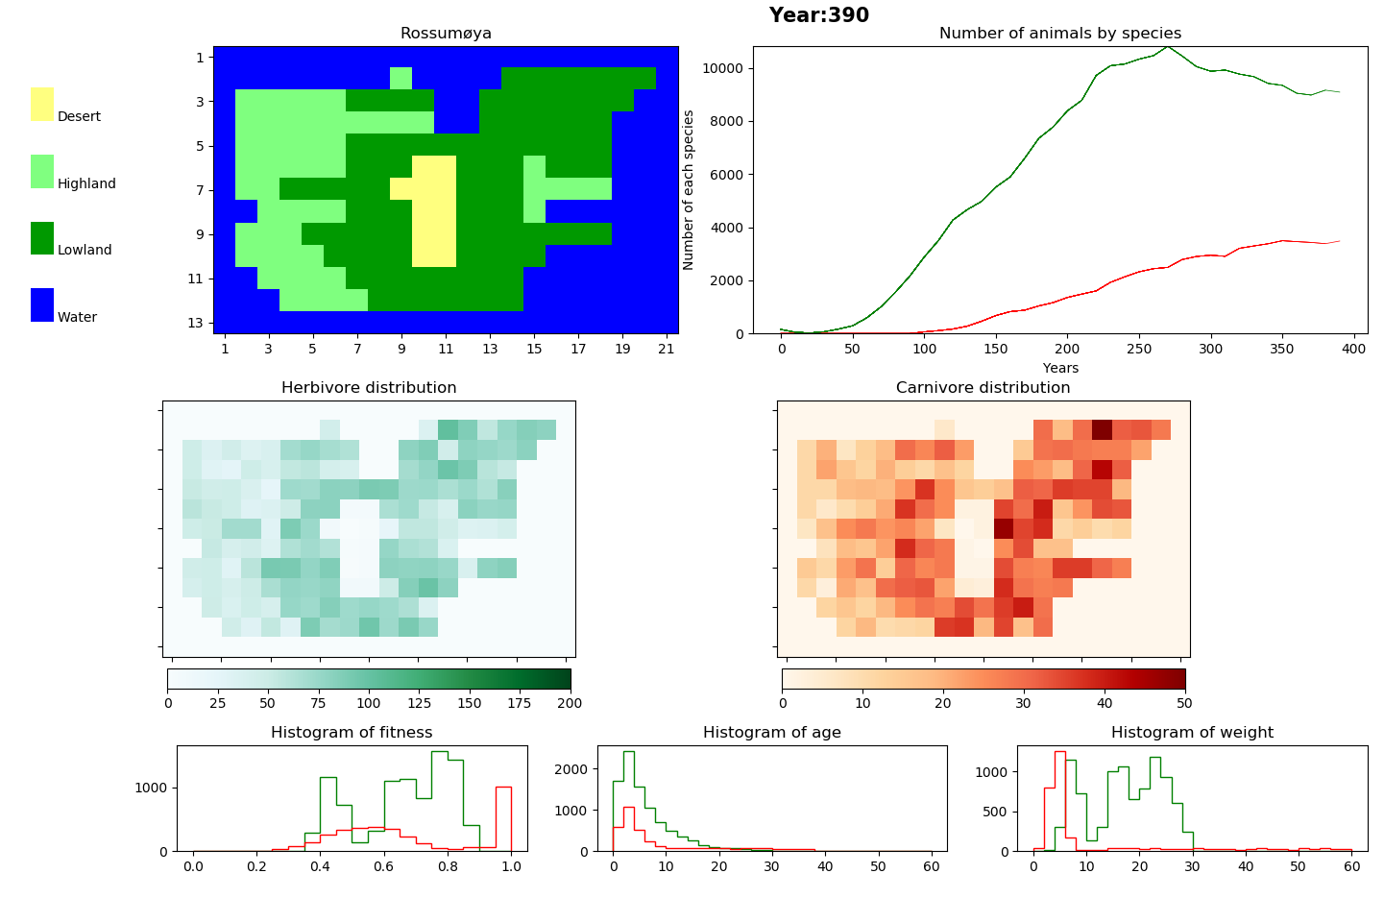
Simulation over 390 years

Slide 8
Improvements of the project
Locate the bug and achieve more accurate graphs.
Increase test coverage.
Simplify code and decrease the runtime.
Overview of costly computation and decrease it.
Retrieve and store data to gather more detailed information about the ecosystem on Rossumøya.

Slide 9
Play movie Thank you for your attention!

