Slide 1


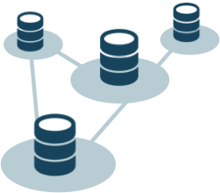

Client
Dispatcher
Uses consistent hashing to map Actor ID to Machine ID. All the client requests are routed to Root Actor of the Actor System. Other messages are routed to the Machine ID generated from the Actor ID by the Router. Records all the messages to the Journal DB that are exchanged through it.
Actor System
Collection of nodes identified by an unique Machine ID and each containing a collection of Actor instances. Message are exchanged between the Actor instances through the dispatcher.
Actor Pool
Collection of Actor instances within a node of the Actor System. Actor instances are mapped to the Actor ID. After the message from the dispatcher reaches a particular node it is sent to an Actor instance from the Actor Pool as identified by the Actor ID.
DB Service
All the Actor requests to the Application DB goes through this layer. Updates the status of message in the Journal DB after every database operation is completed.
Journal DB
Maintains the status of the messages that are internally exchanged between the actors or sent by a client into the system. Updated by Dispatcher and DB Service.
Application DB
Maintains application data. Updated by DB Service on the behalf of Actor System.
Actor ID
Consistent Hashing
Machine ID
Dispatcher
Router
Actor System
Journal DB
Node-1
Node-2
Node-n
Actor Pool
Actor Pool
Actor Pool
DB Service
Application DB
 | Application Server Cluster
 | Application Server
 | DB Cluster

