Slide 1




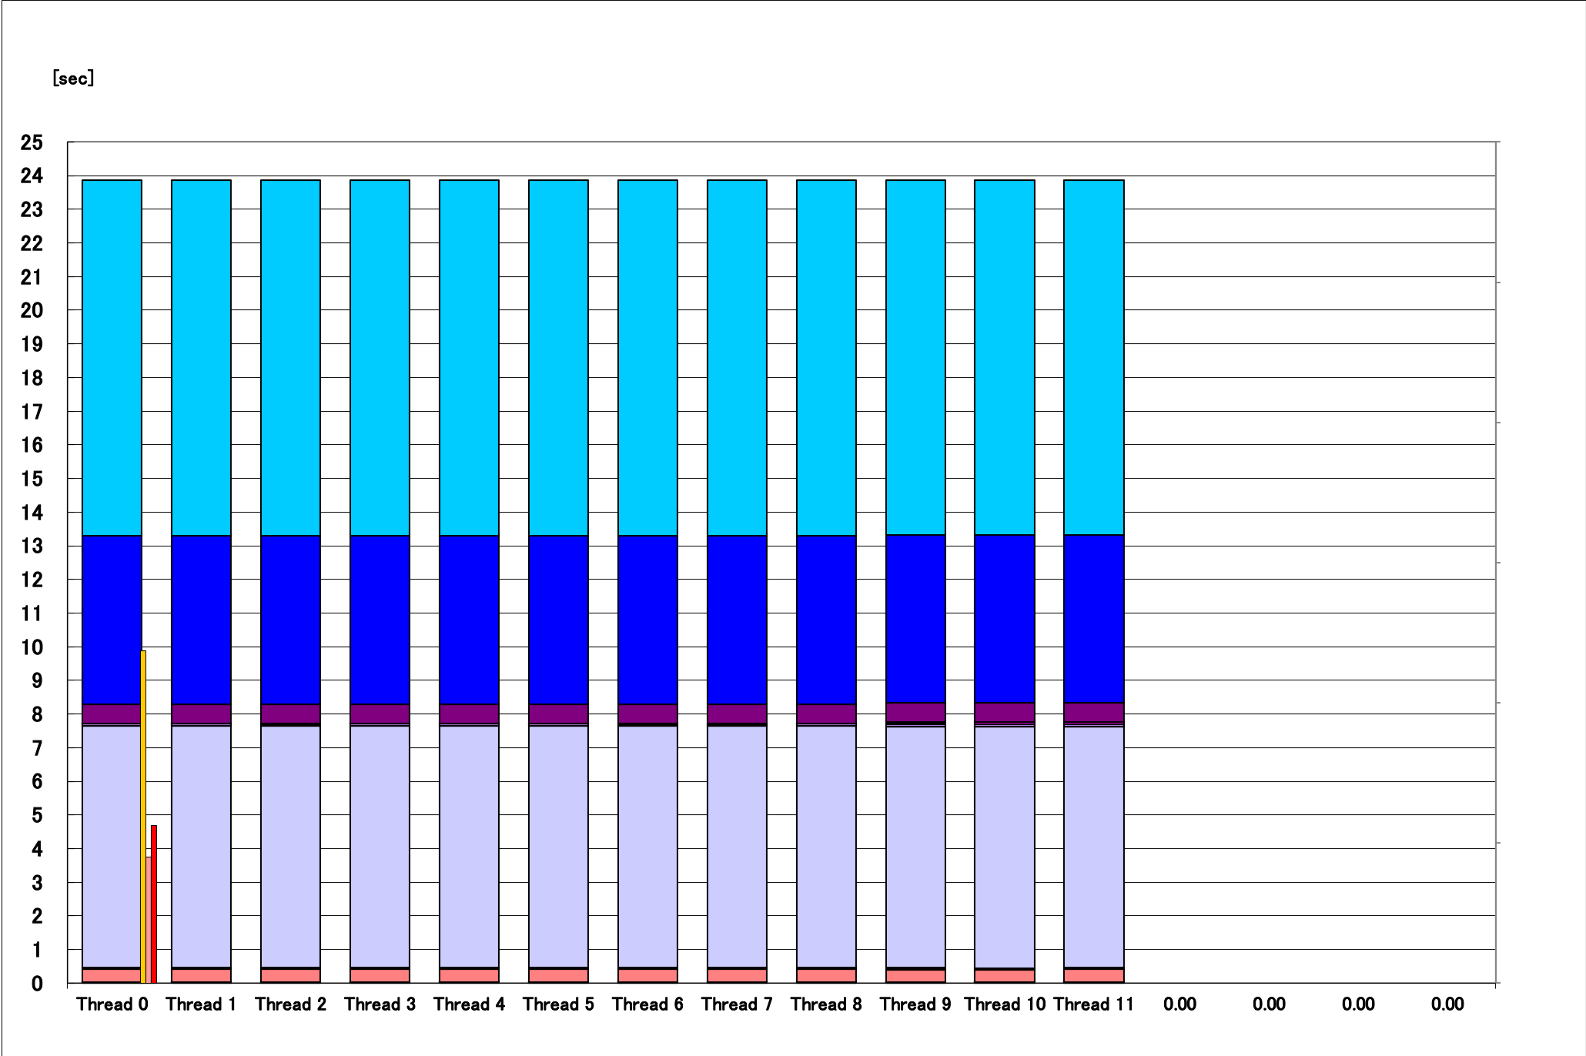
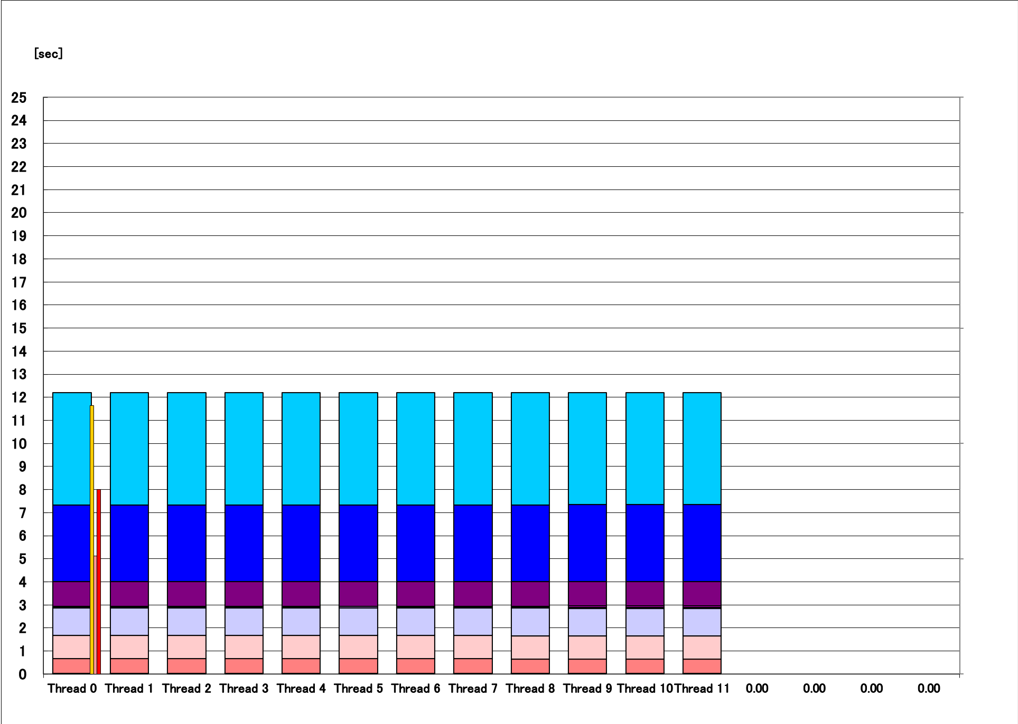
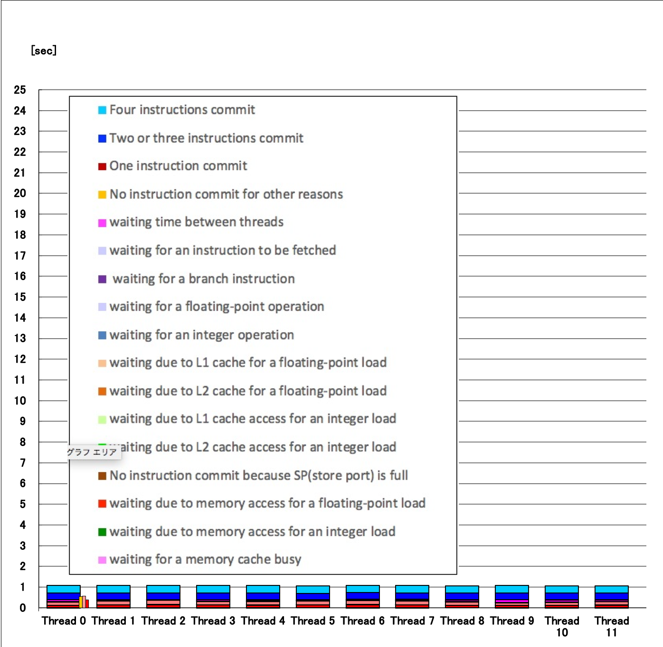
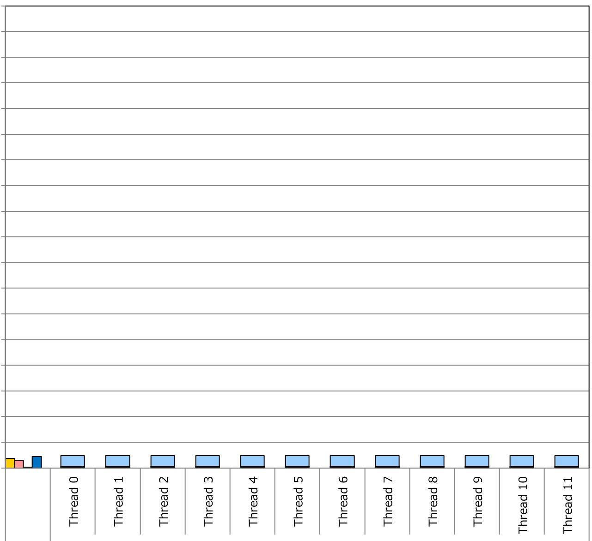
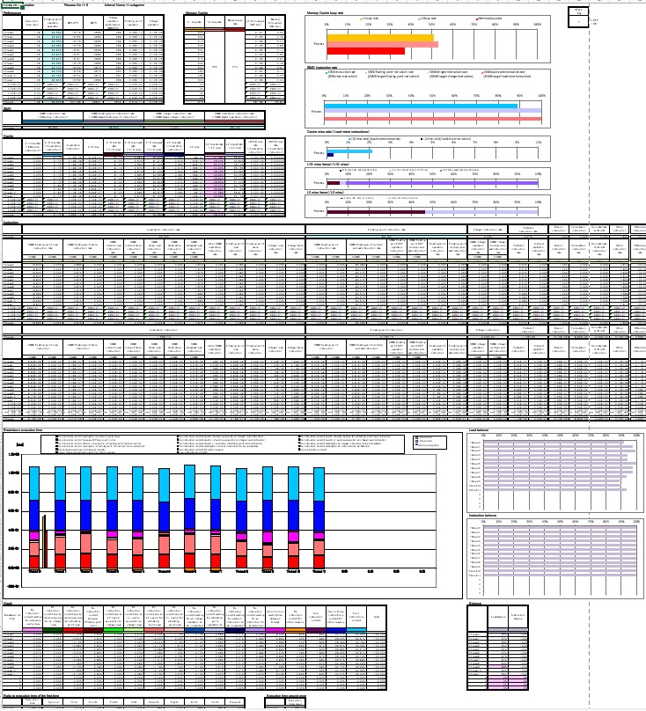
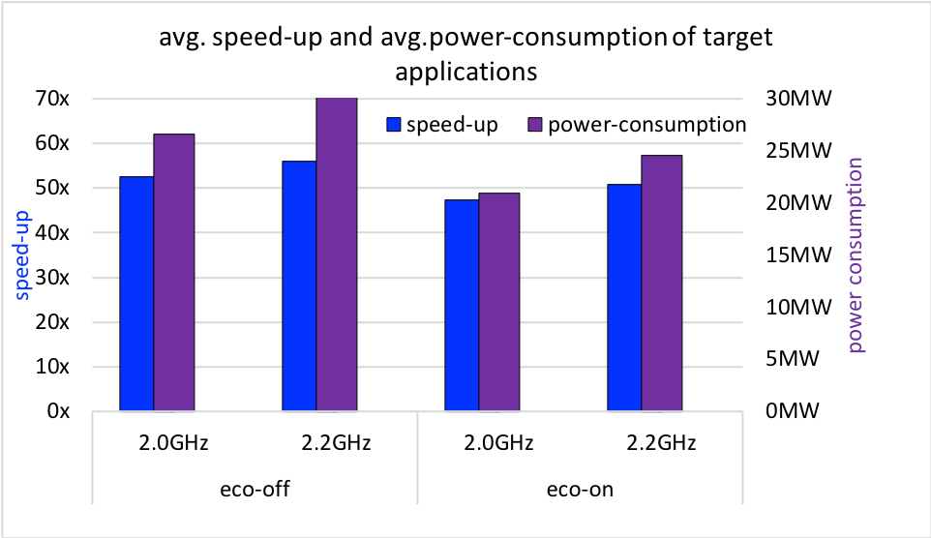
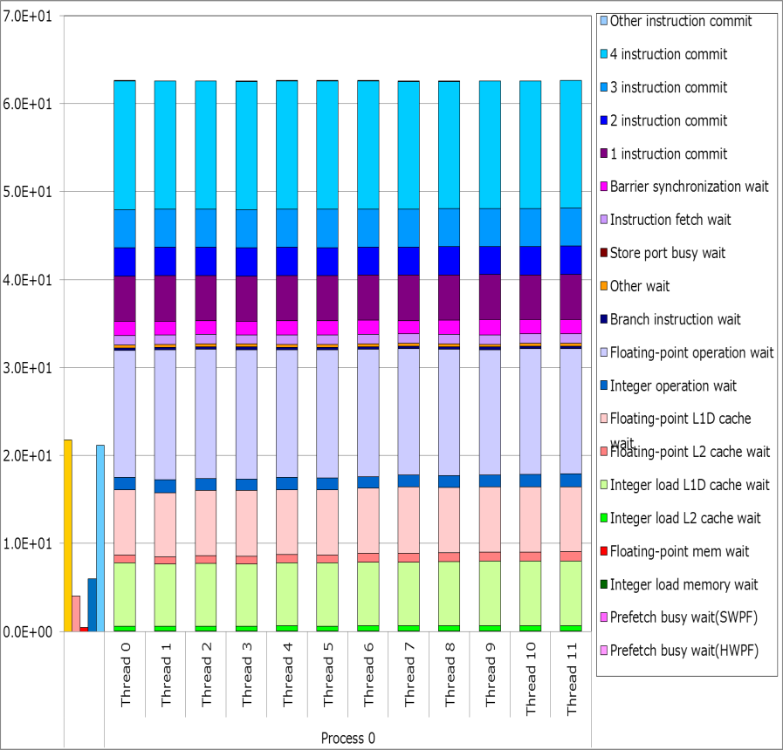
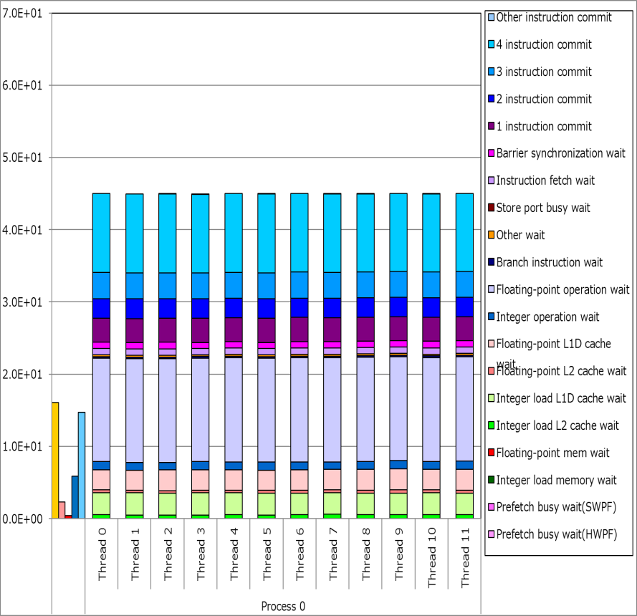
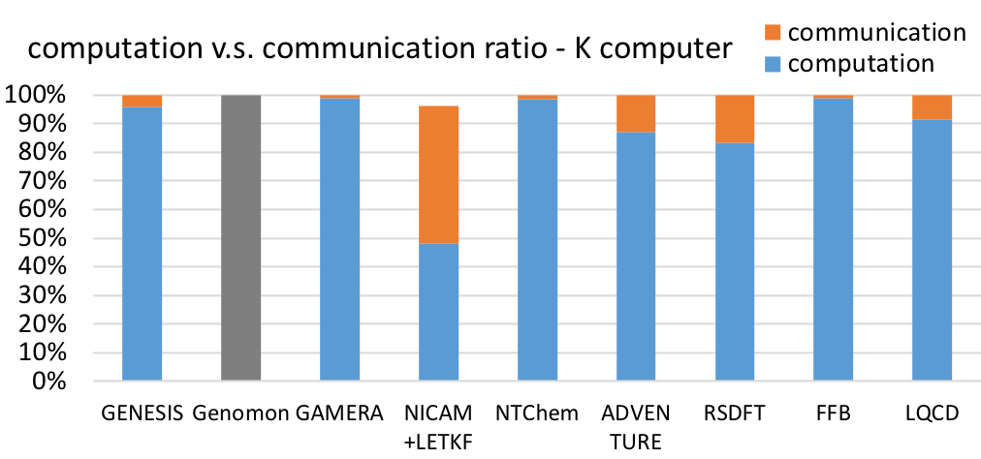
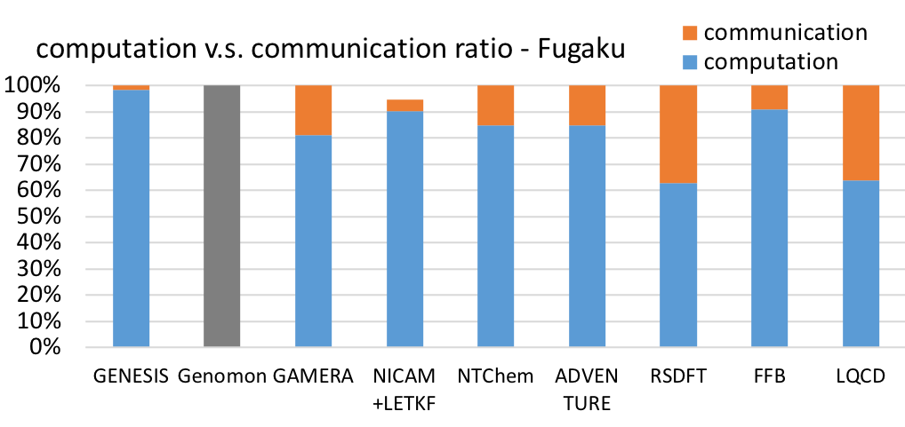
Codesign Supercomputer Fugaku
and Target Applications
through Performance Optimization
Kazunori Mikami, Hirofumi Tomita, Kazuo Minami
RIKEN Center for Computational Science
Supercomputer Fugaku
the flagship supercomputer of Japan
development started in FY2014, due production service in FY2020
Target applications
represent the social/scientific priority issues selected by the ministry
use different numerical schemes, grid structures, data types
cover typical applications workload in total
Codesign goal
complete Fugaku making it deliver the efficient computing capability for a range of applications
modernize target applications to achieve expected performance on Fugaku, and on similar HPC systems
Target application | Type of algorithm | #nodes /job | structured grid | unstructured grid | particle method | dense matrix (local) | dense matrix (dist.) | comm. latency | comm. B/W | neighbor comm. | global comm. | heavy I/O
GENESIS | Molecular dynamics for proteins | 1 |  |  | ☑️ |  |  |  |  | ☑️ | ☑️
Genomon | Genome data analysis | 96 |  |  |  |  |  |  |  |  |  | ☑️
GAMERA | Earthquake simulation using hybrid grid FEM | entire |  | ☑️ |  |  |  | ☑️ | ☑️ |  | ☑️
NICAM+LETKF | Weather prediction using structured FVM + LETKF | 131072 | ☑️ |  |  | ☑️ |  |  | ☑️ | ☑️ |  | ☑️
NTChem | Electron correlation energy using molecular orbital method | 20732 |  |  |  | ☑️ | ☑️ |  | ☑️ | ☑️ | ☑️
ADVENTURE | Structure analysis FEM | 4096 |  | ☑️ |  | ☑️ | ☑️ | ☑️ |  | ☑️ | ☑️
RSDFT | Electronic-structure calculations using density functional theory | 10368 | ☑️ |  |  | ☑️ |  |  | ☑️ | ☑️ | ☑️
FFB | Thermal fluid flow using FEM | entire |  | ☑️ |  |  |  |  |  | ☑️ | ☑️
LQCD | Lattice QCD simulation using grid Monte Carlo method | 147456 | ☑️ |  |  |  |  | ☑️ | ☑️ | ☑️ | ☑️
Codesign approach
simultaneous development of the system and applications using performance measures, under power constraint
Codesign from target application’s view
Repeat optimizing the application, interacting with system development
identify the performance bottleneck utilizing performance tools
optimization effort in applications
alternative algorithm, source level manual tuning
system design improvement request for feasibility study
rerun the cycle with new source code and new design parameters
look for further optimization possibility from different angles
Optimization in system software
incorporate the tuning capability into compilers as much as possible
automatic optimization feature, additional fine control directives, useful compiler messages for performance consideration
compiler’s automatic optimization feature
seq. and serial inner prod.
unrolling
aggressive optimization
Fugaku
compiler aggressive optimization
loops restructured,
SVE SIMD instructions,
software pipelining
Optimization in system hardware
enhance CPU architecture to resolve bottleneck indicated by applications
A64FX instruction handling mechanism in L1 cache
combined gather mechanism
reduce the gather overhead in 128B address space
cache eviction reducing mechanism
mitigate cache refill penalty for codes needing lots of load streams
Performance bottleneck analysis using tools
tools for analysis on existing platform
general profilers(fipp/fapp) statistics
precise PA (HWPC) for detail component analysis
flops, intops, B/W, SIMD rate, cash hit/miss, ..
tools for Fugaku performance prediction
PA prediction tool using FX100 precise PA : static, interpolation, quick
instruction simulators : dynamic, accurate, expensive
Fugaku prototype test vehicle
prediction tools are private ,except for RIKEN simulator available at https://github.com/RIKEN-RCCS/riken_simulator
do i=1,n
a(i) = b(index(i))
end do
precise PA snapshot
do i=1,n
a(i,j) = (b(i,j)+b(i+1,j)+b(i,j+1)) * (c(i,j)+c(i+1,j)+c(i,j+1)) + ..
end do
User option in performance and power balance
users can choose the combination of:
CPU frequency mode (2GHz/2.2GHz) and economy mode (on/off)
administrators can deploy a policy to promote the intended operation
NTChem power profile example, same job, same # of nodes/job
speed and power axes are both relative to eco off normal mode
Average of Target applications
The results obtained on the evaluation environment in the trial phase do not guarantee the performance, power and other attributes of the supercomputer Fugaku at the start of its operation.
Addressing bottlenecks
discuss how the bottleneck should be improved – apps, system S/W, H/W
applications: tuning effort in applications is essential
system S/W: enhancing compilers and libraries
System H/W: specification design and implementation enhancement
speed
power
(W)
speed x time = const.(job)
the shorter time, the better
power x time = energy (Wh)
the smaller area, the better
time
time
Optimization in applications
manual tuning is required in many situations
choose good algorithm, most importantly
simplify the code structure, rewrite code for better instruction mix
existing HPC tuning tactics are usually effective
optimization effort in communication bound app
NICAM+LETKF deployed new frame work adopting global alltoall among all members, instead of sequential gather/scatter from every ensemble member, which resulted in dramatic performance improvement
Codesign achievements
numerous optimization cycles resulting in:
Target applications production ready from day 1 on Fugaku
optimized performance on Fugaku, also efficient on modern HPC systems
in depth programming guide for succeeding applications
Fugaku hardware and software oriented to HPC applications demand
60+ codesign requests were reflected in the system development phase
early stage codesign contributes to the systems architecture:
processor and memory specification, data mechanism
later stage codesign contributes to the system software:
compiler optimization feature, numerical library, MPI/network library
time in vertical axis
Color represents the architectural components where the instructions are handled and are busy.
Scalar code example
Loop fusing for longer loop
Dimension exchange for shorter memory access stride
The effect
reduced data access wait time (lower green and flesh color)
still long f.p. ops wait time (violet) because of sequential(non-SVE) ops
NICAM+LETKF
1024 ensemble members x
128 nodes/member

