Slide 1
Definition of Sequential Labeling Task: Given a binary image with several foreground objects (‘1’ pixels) in a black background (‘0’ pixels), mark all pixels belonging to the same object with a unique label.

Slide 2
Main Ideas of Sequential Labeling Algorithm: Scan through the image only twice. 1st scan: Determine object labels. 2nd scan: Fix cases where more than 1 label appears in an object. During 1st scan: Find the label of pixel ‘A’ based on the labels of pixels ‘B’, ‘C’, and ‘D’:
D
C
B
A

Slide 3
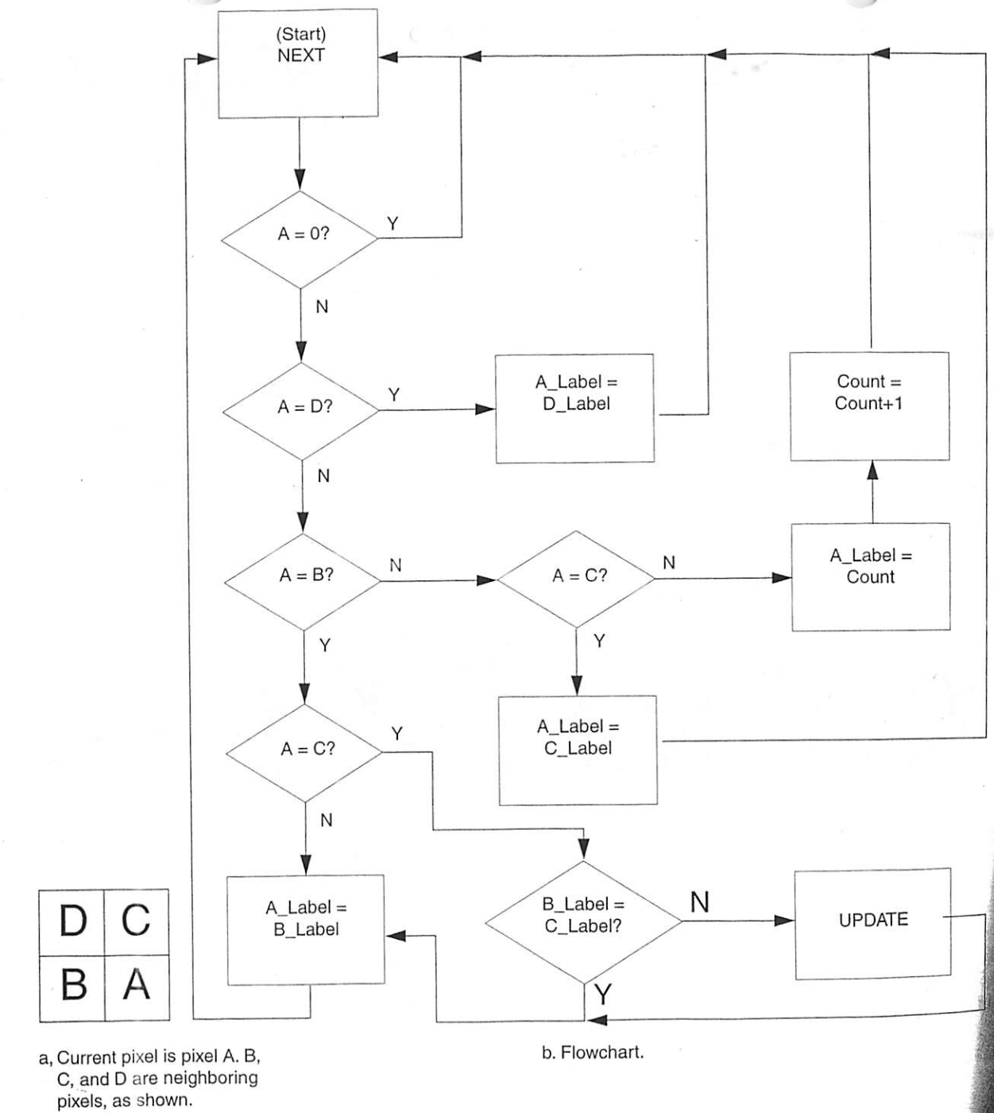

Slide 4
Sequential Labeling Algorithm
D
C
B
A
Case 1:
Neither
B,C, or D
labeled
Case 2:
D labeled
B, C not
Case 3:
Either
B or C
labeled
Case 4:
B, C
labeled
same
different
D
C
L
C
D
L
D
C
D
L
D
L
B
A
B
A
B
A
L
A
L
A
L’
A
D
C
L
C
D
L
D
C
D
L
D
L
B
L
B
L
B
L
L
L
L
L
L
L

