Slide 1
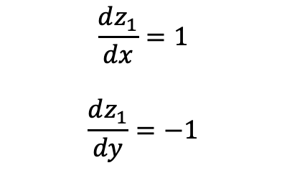

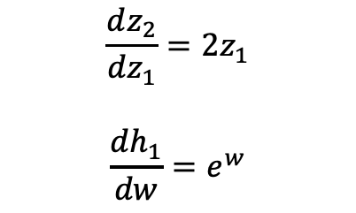
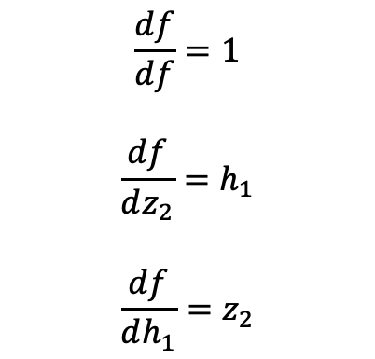



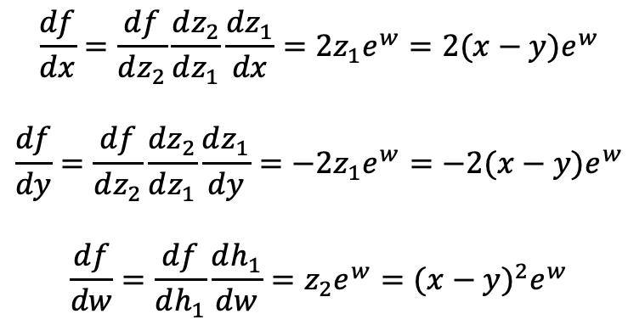
x
$$z_{1}=x−y$$
$$z_{2}=z_{1}× z_{1}$$
$$f=h_{1}×{ z}_{2}$$
y
w
$$h_{1}=e^{w}$$
$$\frac{df}{df}=1$$
$$\frac{df}{dz_{2}}=h_{1}$$
$$\frac{df}{dh_{1}}=z_{2}$$
$$\frac{df}{dx}=\frac{df}{dz_{2}}\frac{dz_{2}}{dz_{1}}\frac{dz_{1}}{dx}=2z_{1}e^{w}=2(x−y)e^{w}$$
$$\frac{df}{dy}=\frac{df}{dz_{2}}\frac{dz_{2}}{dz_{1}}\frac{dz_{1}}{dy}=−2z_{1}e^{w}=−2(x−y)e^{w}$$
$$\frac{df}{dw}=\frac{df}{dh_{1}}\frac{dh_{1}}{dw}=z_{2}e^{w}={(x−y)}^{2}e^{w}$$
$$\frac{dz_{2}}{dz_{1}}=2z_{1}$$
$$\frac{dh_{1}}{dw}=e^{w}$$
$$\frac{dz_{1}}{dx}=1$$
$$\frac{dz_{1}}{dy}=−1$$

