Slide 1
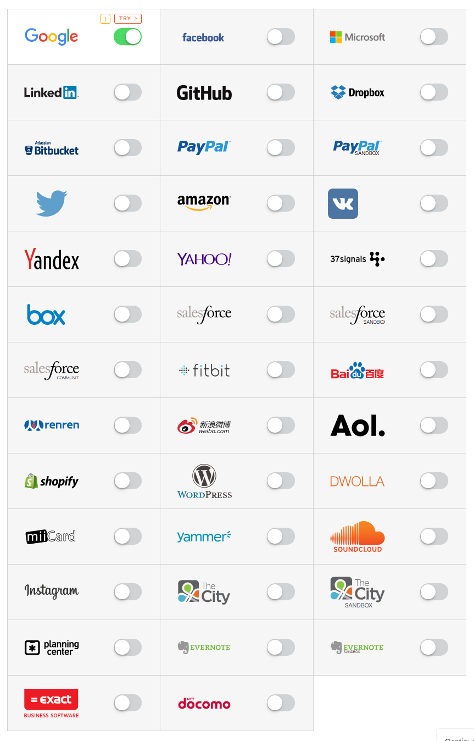


Access
Login
+
oauth2_proxy
Callback
Callback

