Slide 1


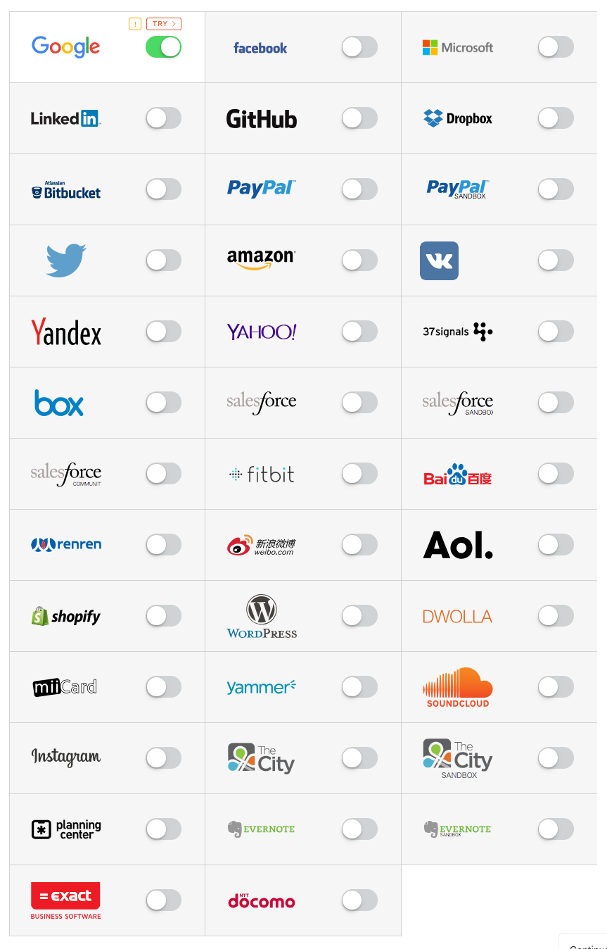

and/or
Access
Login
+
oauth2_proxy
Callback
Callback

Slide 2
