Slide 1




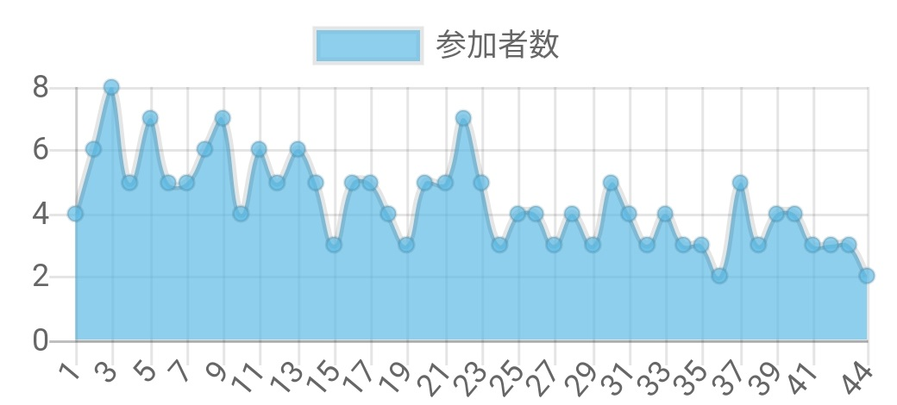
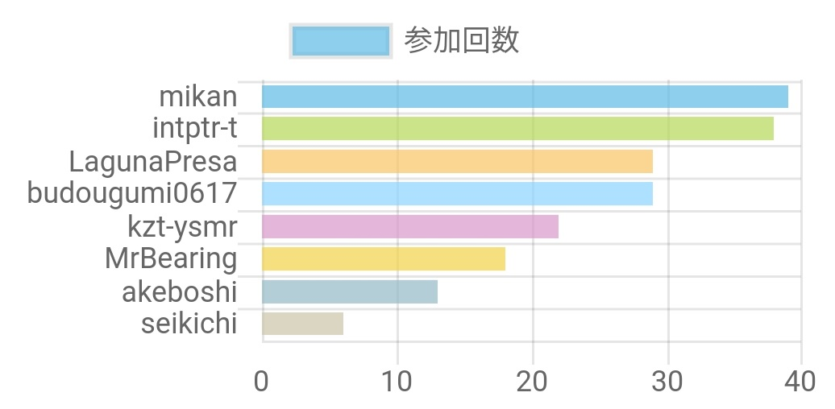
GitHub
API Gateway
Lambda
S3
git push
Webhook
.md
jekyll build
GET
.json
XHR
JSON.parse()
Chart.js
.html
<script>

