Slide 1
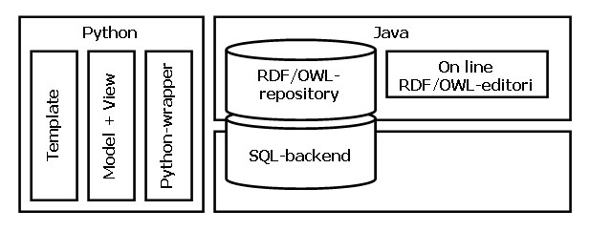

A Semantic Web Application Framwork

