Slide 1


3rd EAI International Conference on Intelligent Systems and Machine Learning (ICISML-2024)
Organized
By
G H RAISONI COLLEGE OF ENGINEERING & MANAGEMENT, WAGHOLI, PUNE,5th-6th January 2024
Paper Title: An Effective Machine Learning based Diagnosis system for Multiple Disease Prediction
Authors: Adith Sreeram A S, VIT-AP University, Andhra Pradesh, India
Pappuri Jithendra Sai, VIT-AP University, Andhra Pradesh, India
Deepthi Godavarthi, VIT-AP University, Andhra Pradesh, India
Camera-ready Paper id: 32521

Slide 2
Plan of Presentation
Introduction
Related work
Methodology
Results & Discussion
Future scope
Conclusion
References

Slide 3
Introduction
Our research taps into vast medical data through advanced mining, revealing insights from complex datasets.
We specialize in methods that dissect disease-specific datasets, enhancing predictive reliability in medical data.
Utilizing various algorithms, our research benchmarks accuracy to identify optimal models for disease detection.
Rigorous testing ensures precision, comparing algorithms for each disease to deliver reliable forecasts.
Our web application simplifies disease prediction, integrating top-performing algorithms for accurate detection in diabetes, cancer, heart disease, chronic kidney disease, and stroke.

Slide 4
Related work
1. MS P Keerthi et al.[1]:
Presented a Streamlit interface embedding three disease prediction models (heart disease, diabetes, and pneumonia) utilizing logistic regression, SVM, and CNN. Enables user-friendly input for early intervention predictions.
2. Rayan Alanazi [3]:
Proposed a system utilizing CNN for disease prediction and KNN for prognosis, with comparative analysis showcasing superior performance. Includes Naïve Bayes, decision tree, and logistic regression.
3. K. Arumugam et al.[4]:
Demonstrated the decision tree model's superiority in accurately forecasting heart disease likelihood in diabetic individuals. Emphasized optimization for accessibility and usability in a disease-predicting web app using flask.
4. Nazin Ahmed et al. [6]:
Developed accurate ML models for diabetes diagnosis using diverse algorithms, integrated into a Flask web application for predicting diabetes based on clinical data.
5. Gazi Mohammed Ifraz et al. [7]:
Utilized logistic regression, decision tree classification, and KNN algorithms to train models for predicting kidney disease, with logistic regression achieving the highest accuracy.

Slide 5
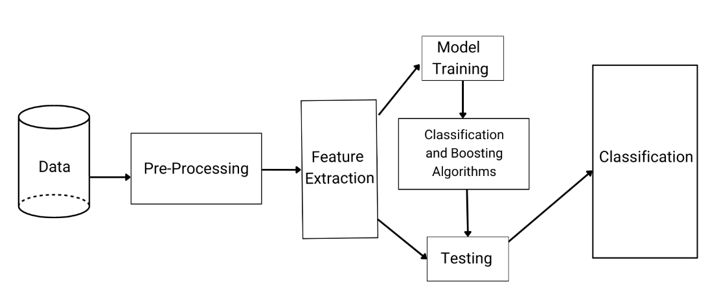
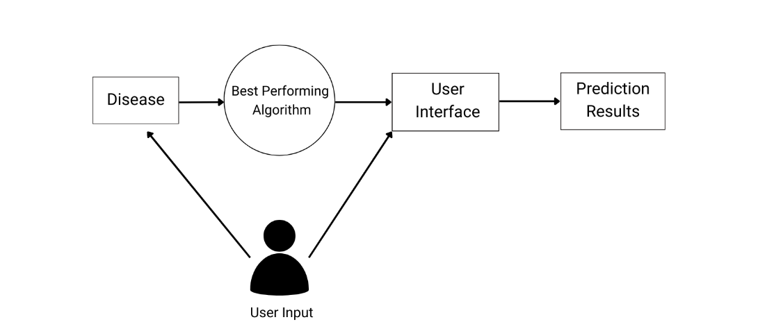
Methodology
Fig. a. System Architecture of proposed work.
Fig. b. System Design for Interface flow

Slide 6
Results & Discussion
Disease | Machine Learning Algorithms
 | Logistic Regression | Decision Trees | Random Forest | KNN | SVM | GNB | Gradient Boosting | XGBoost | AdaBoost
Diabetes | 79.87% | 69.48% | 87.01% | 82.46% | 73.37% | 80.51% | 87.01% | 85.06% | 83.11%
Heart Disease | 82.44% | 79.02% | 89.26% | 95.12% | 81.46% | 78.53% | 88.78% | 92.5% | 100%
Chronic Kidney Disease | 95.83% | 95.83% | 97.50% | 63.33% | 40.83% | 65.00% | 97.50% | 97.50% | 100%
Stroke | 77.20% | 73.38% | 94.53% | 81.50% | 71.91% | 74.85% | 93.83% | 94.71% | 92.75%
Cancer | 95.74% | 93.61% | 96.27% | 94.14% | 90.95% | 93.61% | 95.74% | 97.34 | 94.14%

Slide 7
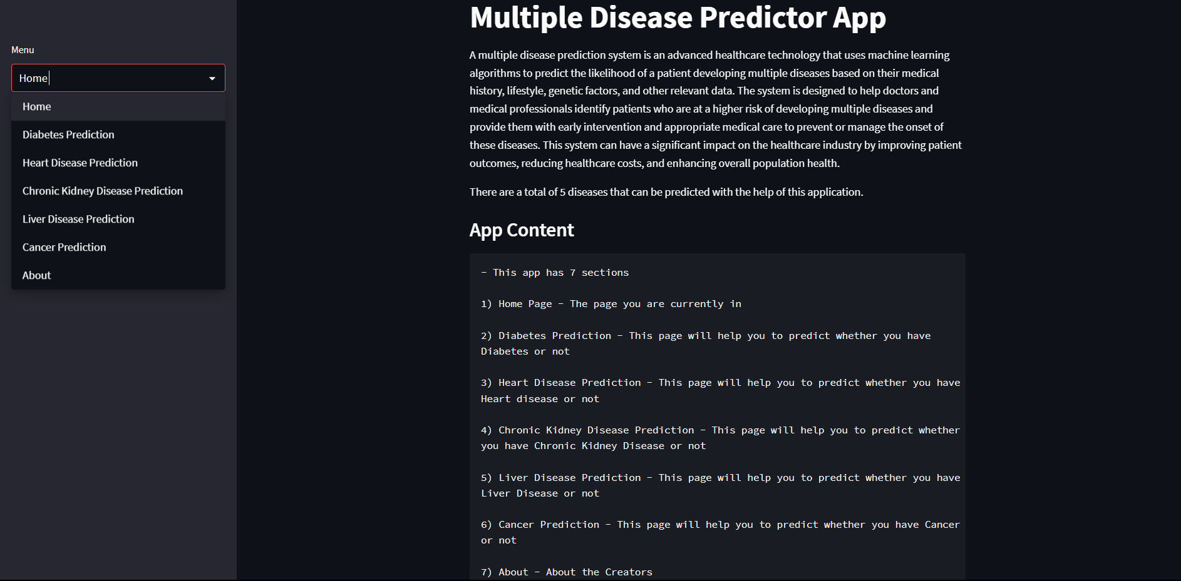
Results & Discussion
Fig. h. Home page Output

Slide 8
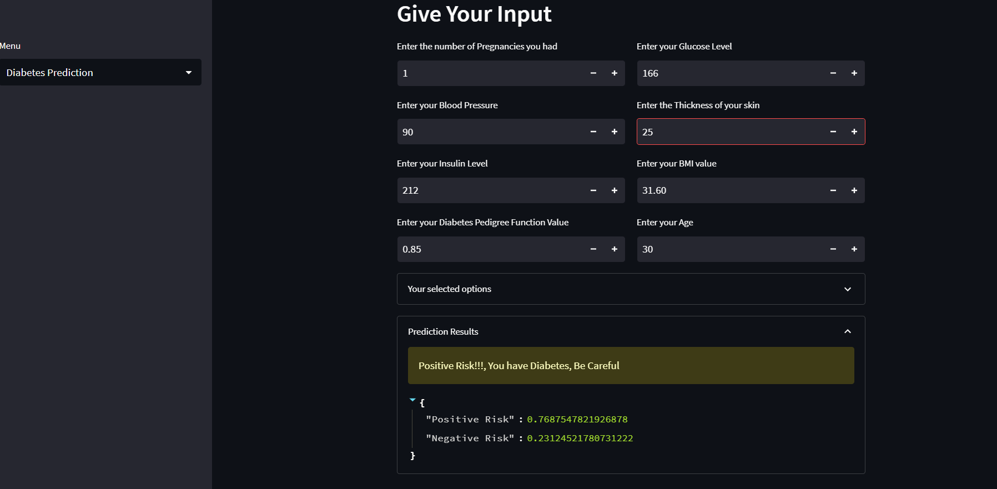
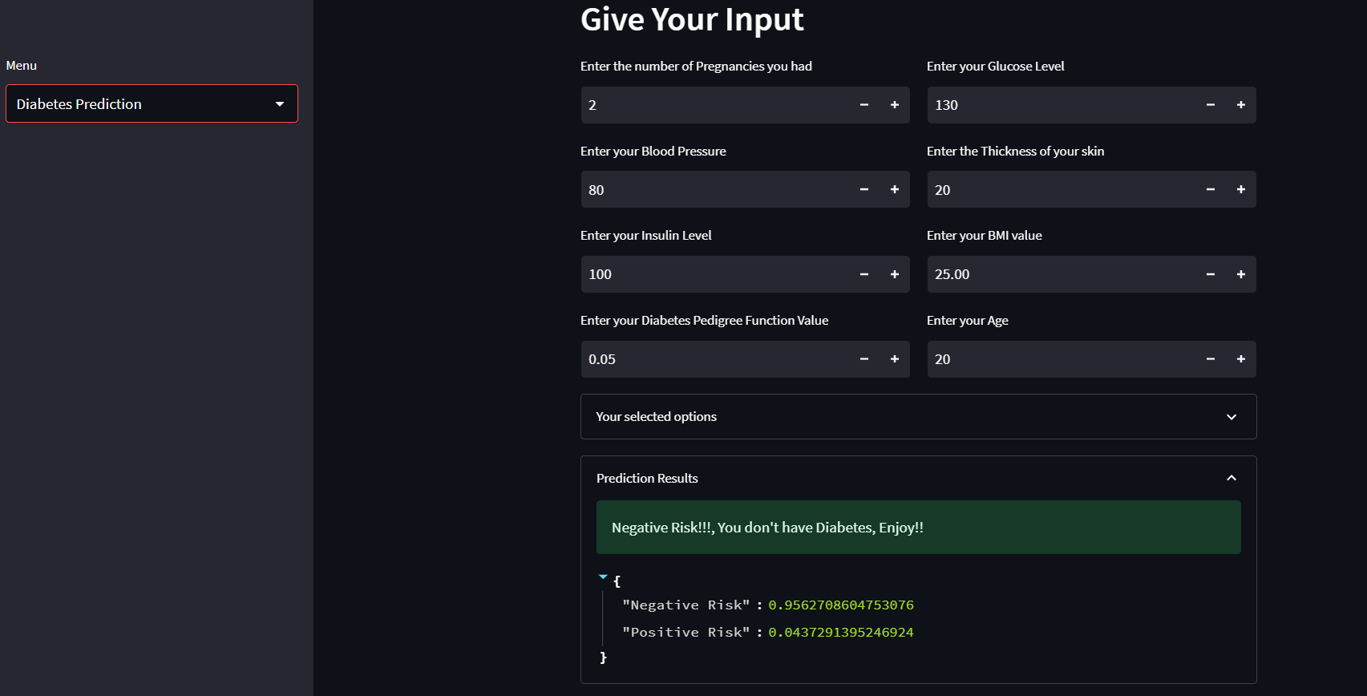
Output for diabetes for
positive and negative case

Slide 9
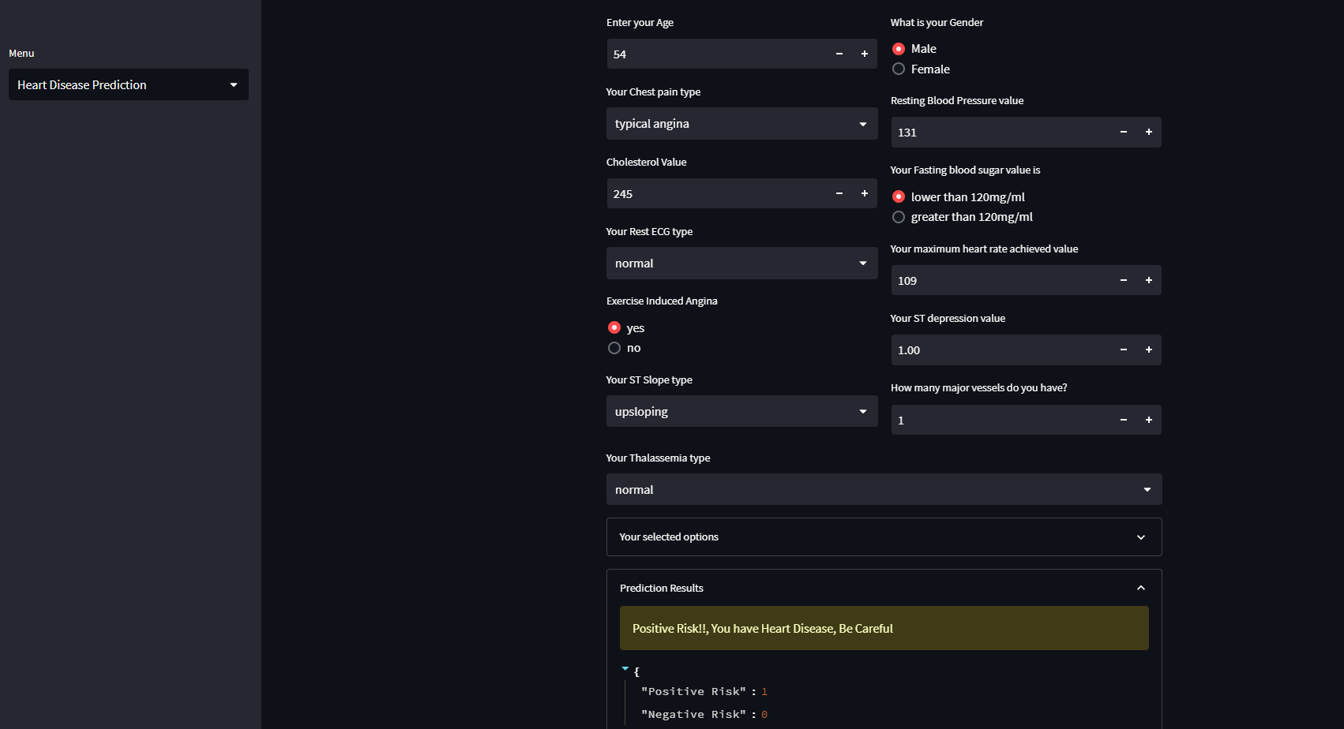
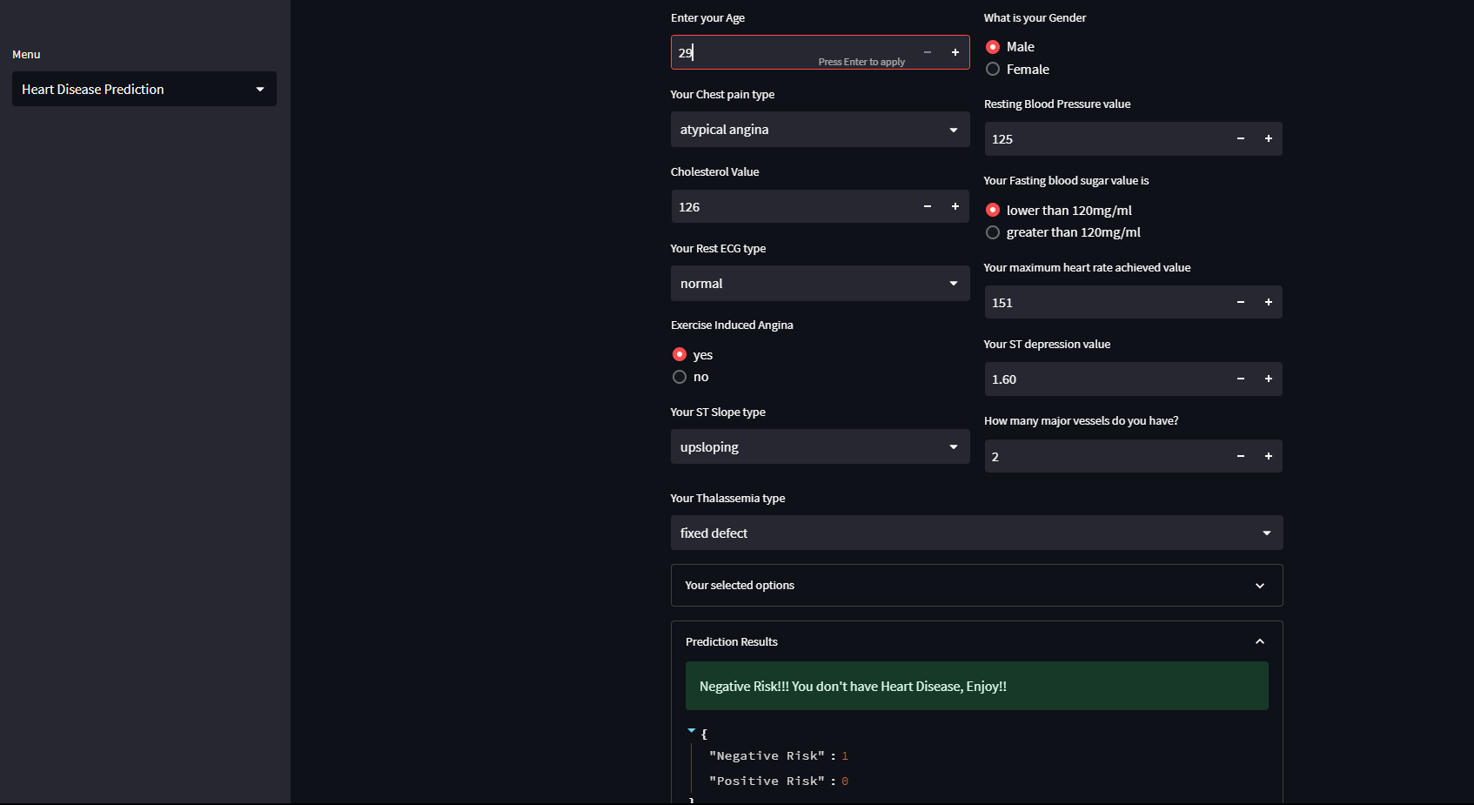
Output for Heart disease for
positive and negative case

Slide 10
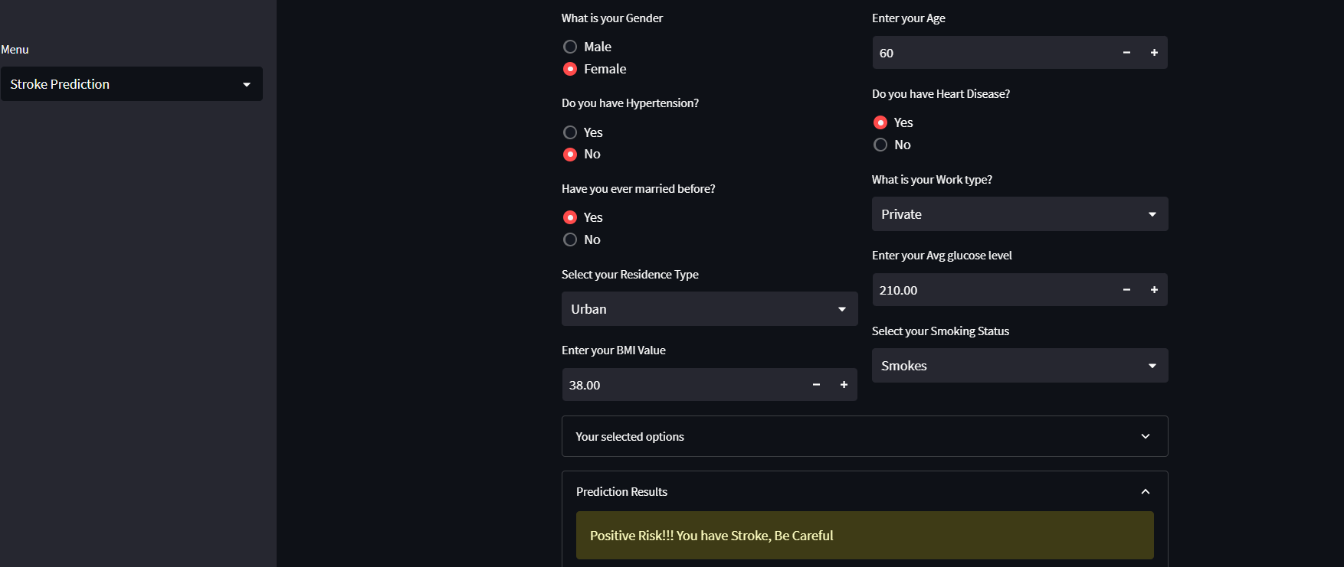
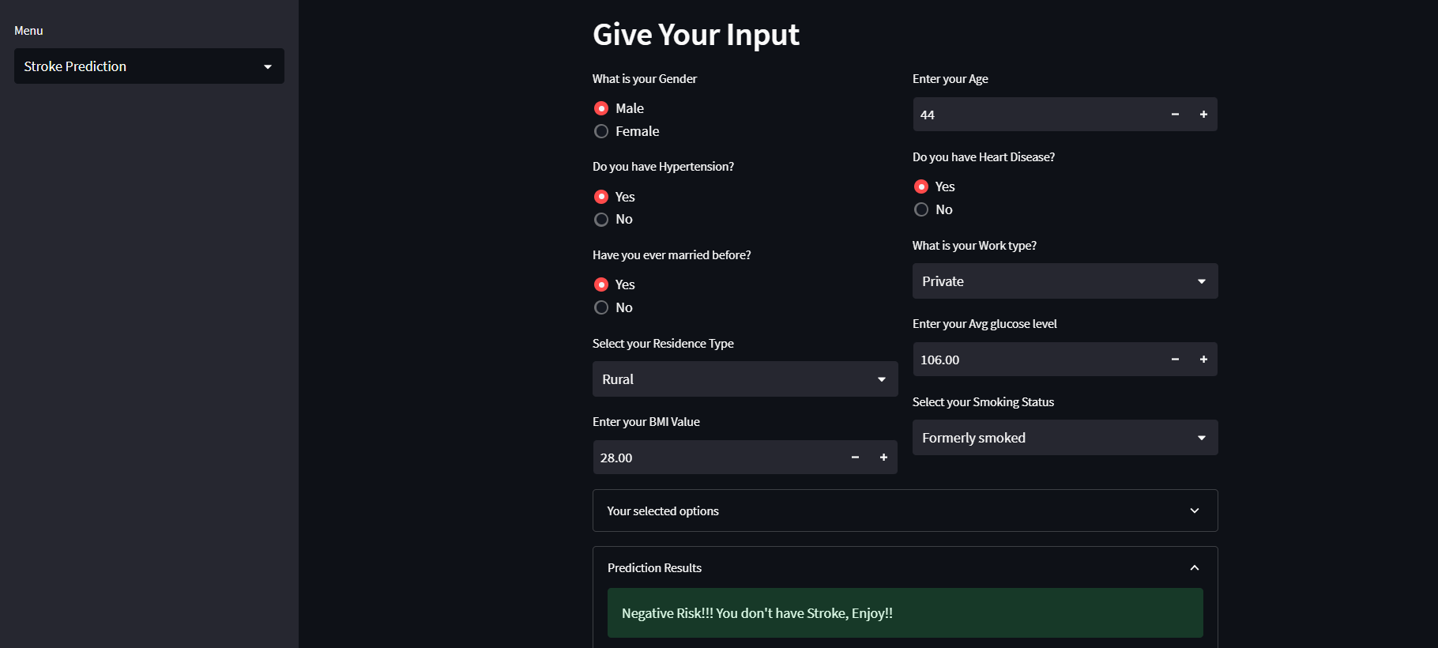
Output for stroke for
positive and negative case

Slide 11
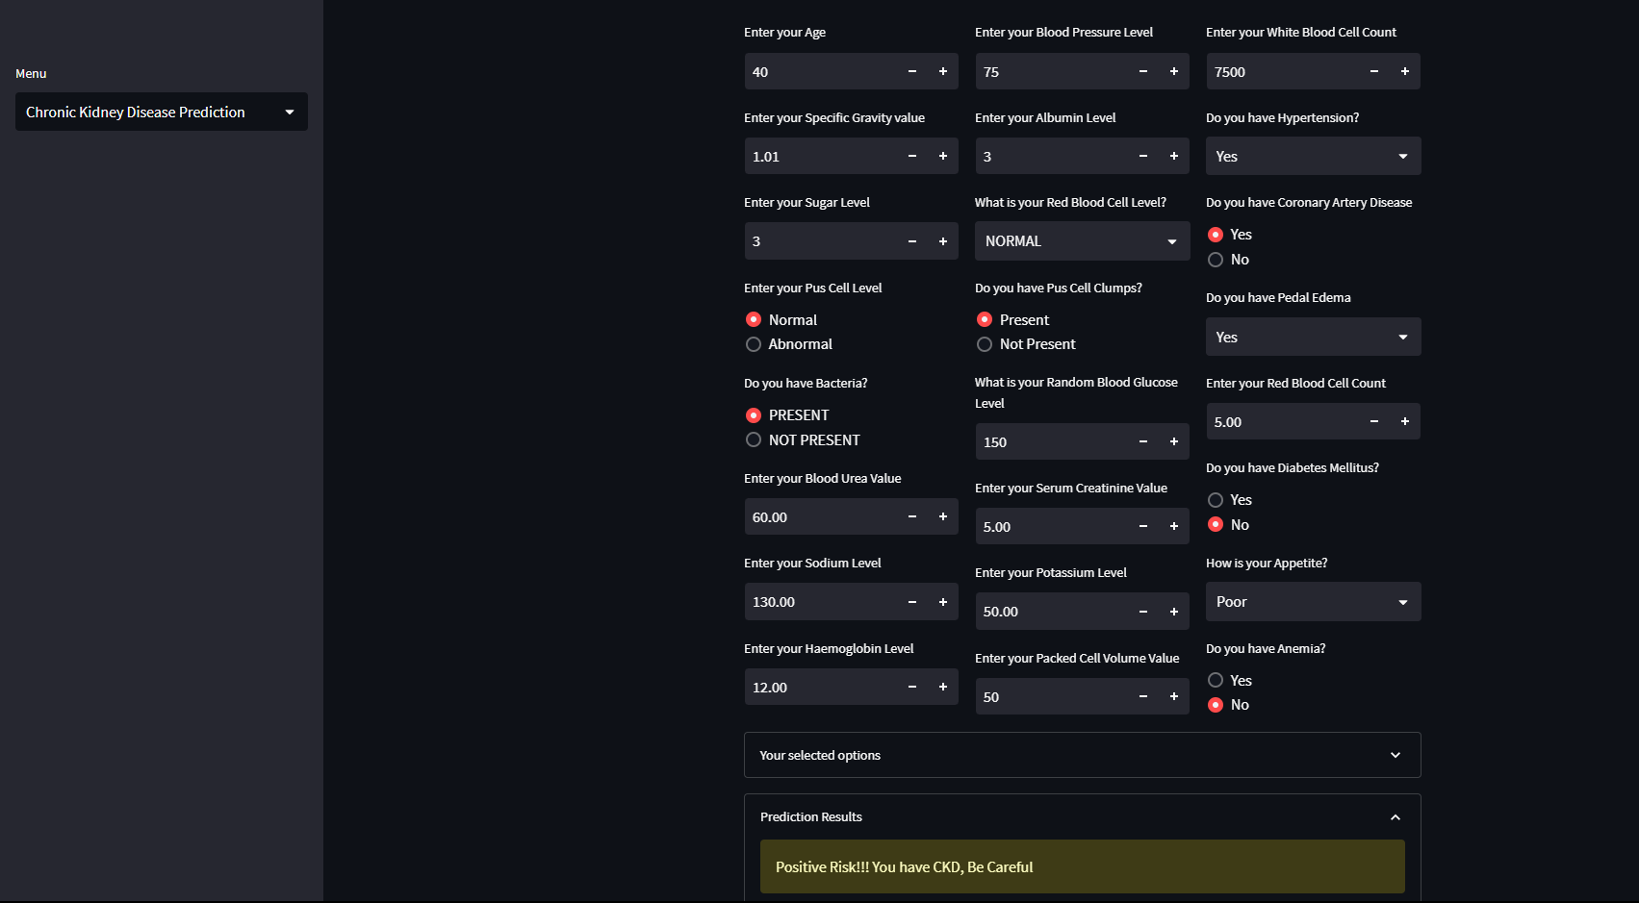
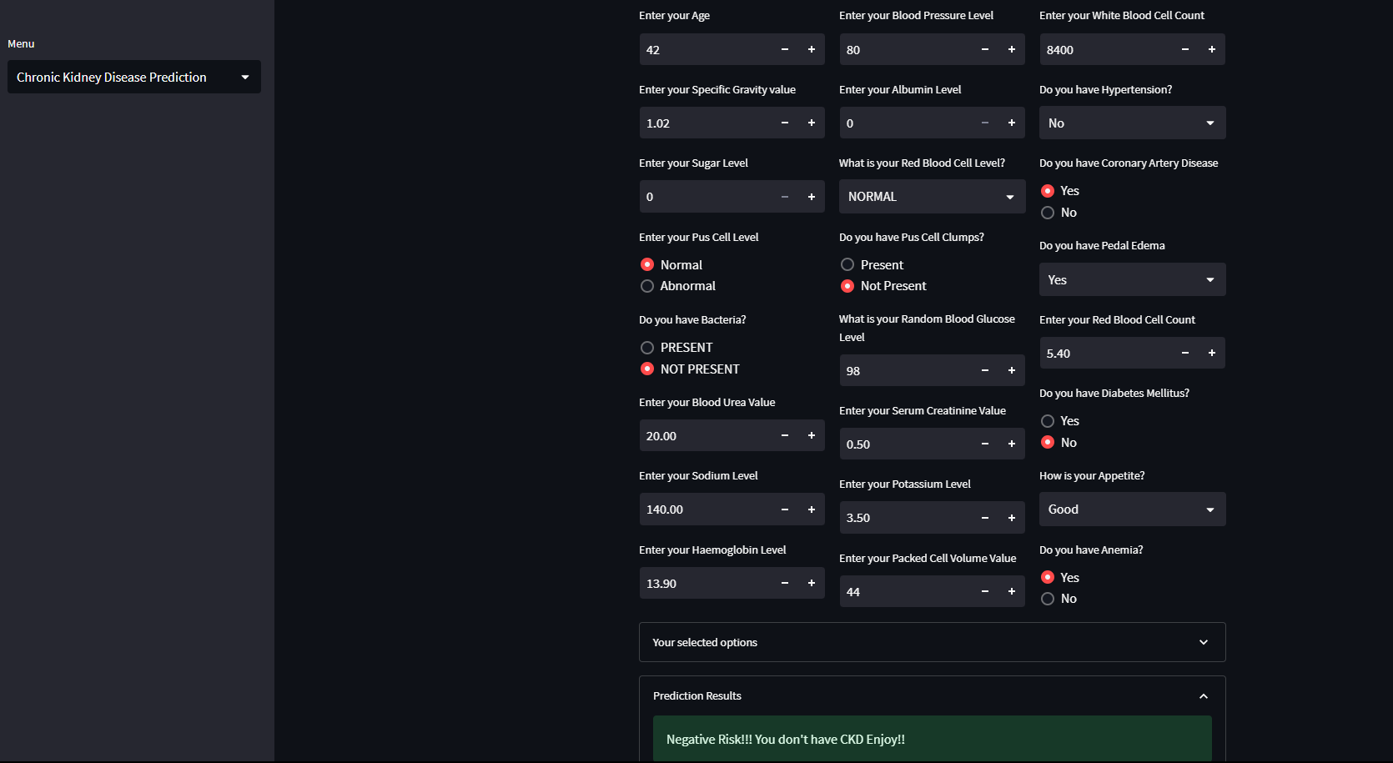
Output for Chronic Kidney Disease for positive and negative case

Slide 12
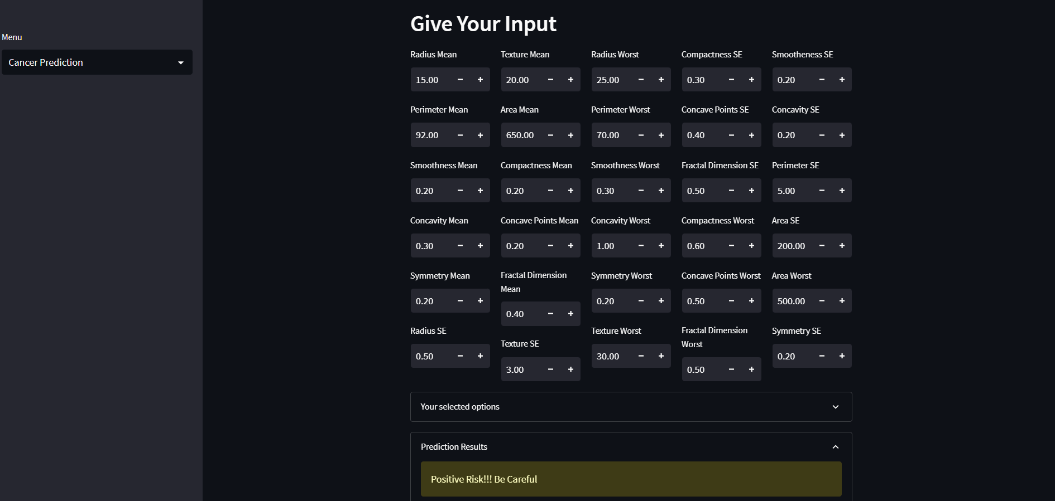
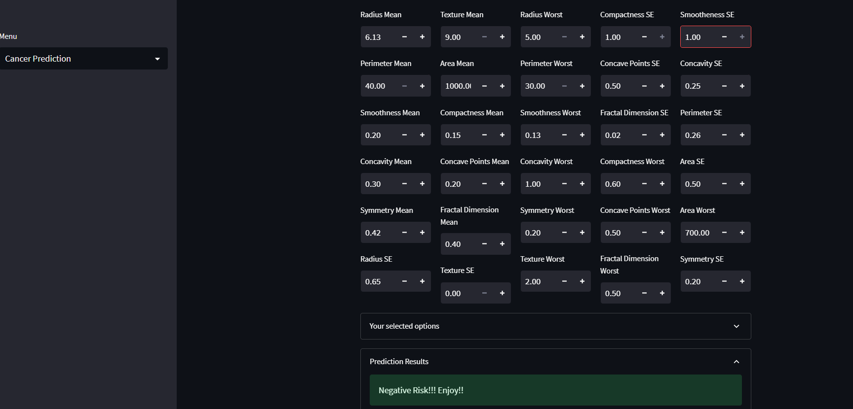
Output for Cancer for positive and negative case

Slide 13
Future scope
The presented machine learning-based diagnosis system for multiple diseases offers substantial potential for future advancements.
Integration of emerging classification and boosting algorithms, continual refinement of dataset curation, and incorporation of real-time health data streams can enhance predictive accuracy. Collaboration with healthcare institutions to access diverse and extensive datasets would further strengthen the model's robustness.
Additionally, expanding the web application's features to include personalized health recommendations and educational resources can empower users in proactive healthcare management.
Moreover, exploration of potential collaborations with telemedicine platforms can extend the system's reach, providing timely predictions and guidance to a broader population.

Slide 14
Conclusion
Integrating multiple disease models into a unified interface enhances accuracy, surpassing existing algorithms and improving diagnostic outcomes.
Leveraging machine learning, our approach prioritizes early detection, aiming to curb the prevalence of chronic diseases and mitigate their long-term impact.
Beyond diagnostics, our method not only contributes to a healthier society but also alleviates the financial burden associated with prolonged illness by emphasizing early intervention.

Slide 15
References
[1] M. P. Keerthi, G. S. Reddy, V. S. Raghava, and K. B. Reddy, “Streamlit Interface for Multiple Disease Diagnosis,” Int. J. Res. Appl. Sci. Eng. Technol., vol. 11, no. 2, pp. 1159–1164, 2023, doi: 10.22214/ijraset.2023.49166.
[2] F. J. Shaikh and D. S. Rao, “Prediction of Cancer Disease using Machine learning Approach,” Mater. Today Proc., vol. 50, no. April, pp. 40–47, 2021, doi: 10.1016/j.matpr.2021.03.625.
[3] R. Alanazi, “Identification and Prediction of Chronic Diseases Using Machine Learning Approach,” J. Healthc. Eng., vol. 2022, 2022, doi: 10.1155/2022/2826127.
[4] K. Arumugam, M. Naved, P. P. Shinde, O. Leiva-Chauca, A. Huaman-Osorio, and T. Gonzales-Yanac, “Multiple disease prediction using Machine learning algorithms,” Mater. Today Proc., no. August, 2022, doi: 10.1016/j.matpr.2021.07.361.
[5] I. Mohit, K. S. Kumar, A. U. K. Reddy, and B. S. Kumar, “An Approach to detect multiple diseases using machine learning algorithm,” J. Phys. Conf. Ser., vol. 2089, no. 1, 2021, doi: 10.1088/1742-6596/2089/1/012009.
[6] N. Ahmed et al., “Machine learning based diabetes prediction and development of smart web application,” Int. J. Cogn. Comput. Eng., vol. 2, no. December, pp. 229–241, 2021, doi: 10.1016/j.ijcce.2021.12.001.
[7] G. M. Ifraz, M. H. Rashid, T. Tazin, S. Bourouis, and M. M. Khan, “Comparative Analysis for Prediction of Kidney Disease Using Intelligent Machine Learning Methods,” Comput. Math. Methods Med., vol. 2021, 2021, doi: 10.1155/2021/6141470.
[8] B. Shiva Shanta Mani and V. M. Manikandan, “Heart disease prediction using machine learning,” Handb. Res. Dis. Predict. Through Data Anal. Mach. Learn., no. April, pp. 373–381, 2020, doi: 10.4018/978-1-7998-2742-9.ch018.
[9] H. Jindal, S. Agrawal, R. Khera, R. Jain, and P. Nagrath, “Heart disease prediction using machine learning algorithms,” IOP Conf. Ser. Mater. Sci. Eng., vol. 1022, no. 1, 2021, doi: 10.1088/1757-899X/1022/1/012072.
[10] R. A. Godse, S. S. Gunjal, K. A. Jagtap, N. S. Mahamuni, and S. Wankhade, “Multiple Disease Prediction Using Different Machine Learning Algorithms Comparatively,” Int. J. Adv. Res. Comput. Commun. Eng., vol. 9, no. 4, pp. 140–144, 2020, doi: 10.17148/IJARCCE.2020.9423.
[11] D. A. Debal and T. M. Sitote, “Chronic kidney disease prediction using machine learning techniques,” J. Big Data, vol. 9, no. 1, pp. 4971–4976, 2022, doi: 10.1186/s40537-022-00657-5.
[12] Z. Wang, J. Won Chung, X. Jiang, Y. Cui, M. Wang, and A. Zheng, “Machine Learning-Based Prediction System For Chronic Kidney Disease Using Associative Classification Technique,” Int. J. Eng. Technol., vol. 7, no. 4.36, p. 1161, 2018, doi: 10.14419/ijet.v7i4.36.25377.
[13] https://docs.streamlit.io/

Slide 16
Thank you

