Slide 1
MATERNAL HEALTH CLASSIFICATION CAPSTONE
MamaCare
RECORDS
INPUTS
CLASSES
1,014
6
3
A complete, reproducible project for classifying maternal-health records as Low, Mid or High Risk.
Downloaded CSV
Routine measures
Risk categories
Final problem statement
Predict RiskLevel using six measurements, evaluated primarily by Weighted F1 on an untouched group-separated test set.
Academic screening-support demonstration only
Not a diagnosis, treatment tool, triage system or emergency assessment.
Population represented: UCI records from rural Bangladesh; not Kenyan clinical validation data.
Collins Mikaye | August 2026
MamaCare Capstone | Collins Mikaye
1

Slide 2
DATA AND APPROACH
The model was evaluated without duplicate leakage
The data-quality audit shaped every modelling decision.
1
Inspect
→
2
Audit
→
3
Group split
→
4
Model
→
5
Evaluate
EXACT DUPLICATES
CONFLICTING SIGNATURES
ROWS IN CONFLICTS
Models compared
562
35
215
Kept in one split
Same inputs, different labels
Hard learning limit
Baseline • Logistic Regression • Decision Tree • Random Forest • SVC • Gradient Boosting • XGBoost • Shallow MLP • Deep MLP • Soft Voting
Why group separation matters
Identical six-measurement signatures never cross train, validation and test partitions. This prevents duplicate copies from inflating the final score.
Primary metric: Weighted F1
MamaCare Capstone | Collins Mikaye
2

Slide 3
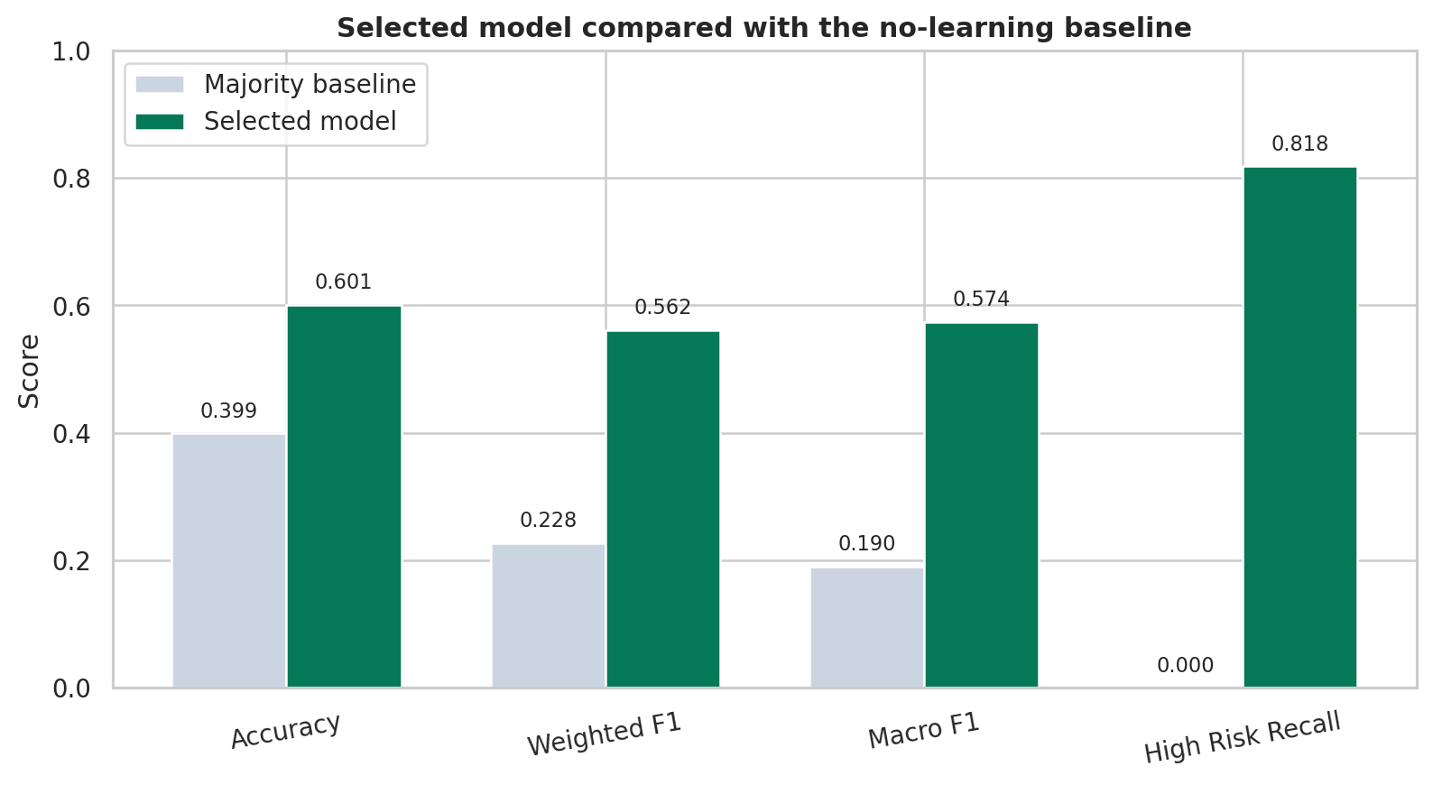
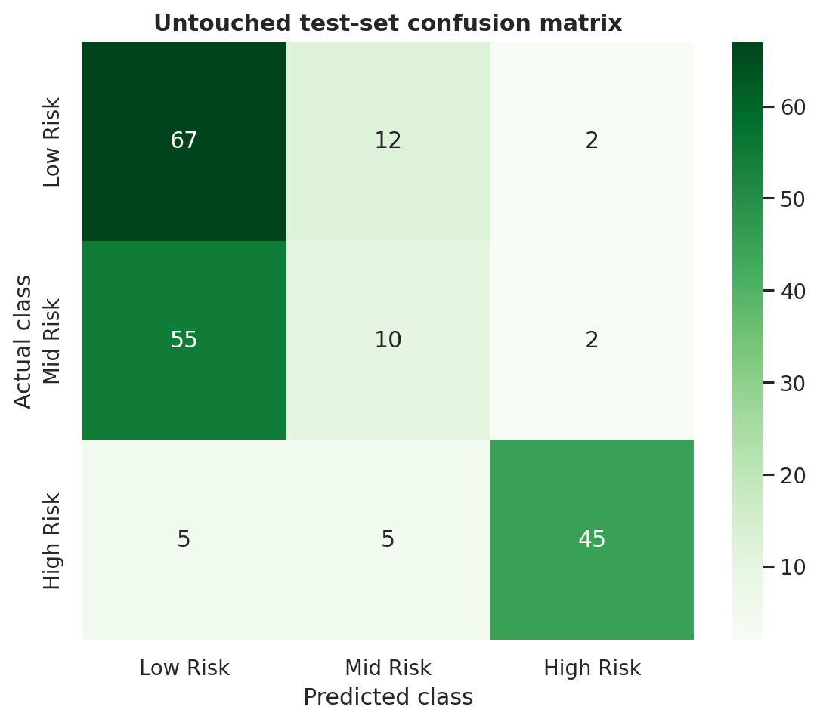
RESULTS
ShallowMLP won on validation Weighted F1
The model beats the baseline, but the three classes are not equally reliable.
WEIGHTED F1
MACRO F1
HIGH RISK RECALL
MID RISK RECALL
ACCURACY
0.562
0.574
0.818
0.149
0.601
Baseline 0.228
Equal class weighting
45 of 55 identified
Major weakness
Untouched test set
Honest finding
Most Mid Risk records were predicted as Low Risk. MamaCare is not ready for clinical use.
Strong High Risk recall does not cancel the weak middle-class performance.
MamaCare Capstone | Collins Mikaye
3

Slide 4
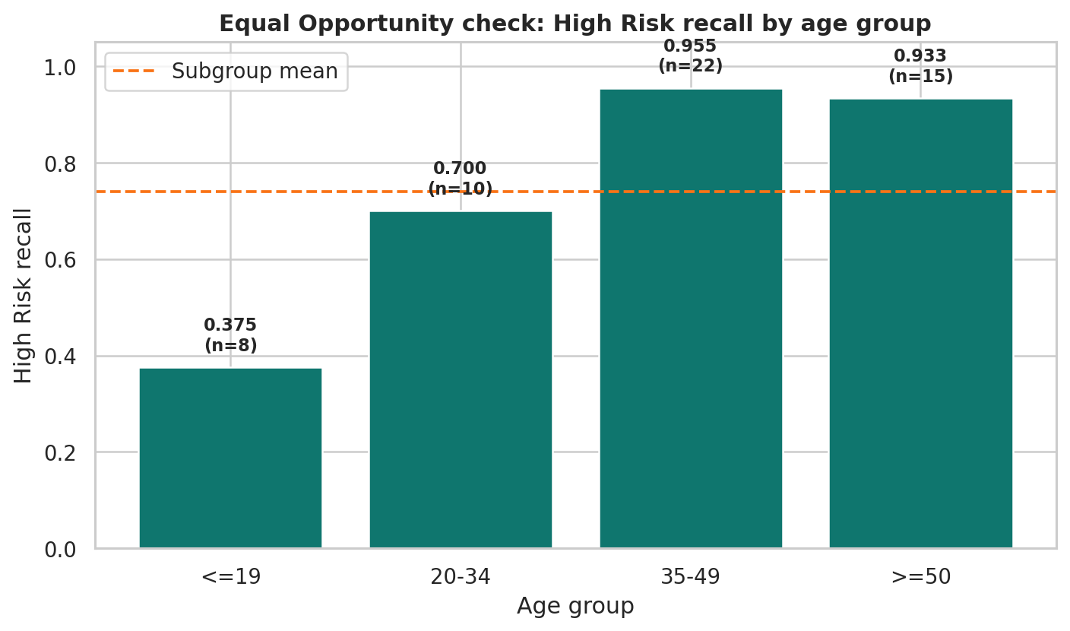
LIMITATIONS AND RESPONSIBLE USE
Age-group performance is not equal
Equal Opportunity was assessed through High Risk recall by age group.
Fairness gap
58.0%
difference between the best and worst age-group High Risk recall
Professional integrity
•
Dataset is small, duplicated and not Kenyan clinical data.
•
Contradictory labels limit what any model can learn.
•
No diagnosis, treatment, triage or emergency decisions.
•
Real use would require human review, redress and monitoring.
MamaCare Capstone | Collins Mikaye
4

Slide 5
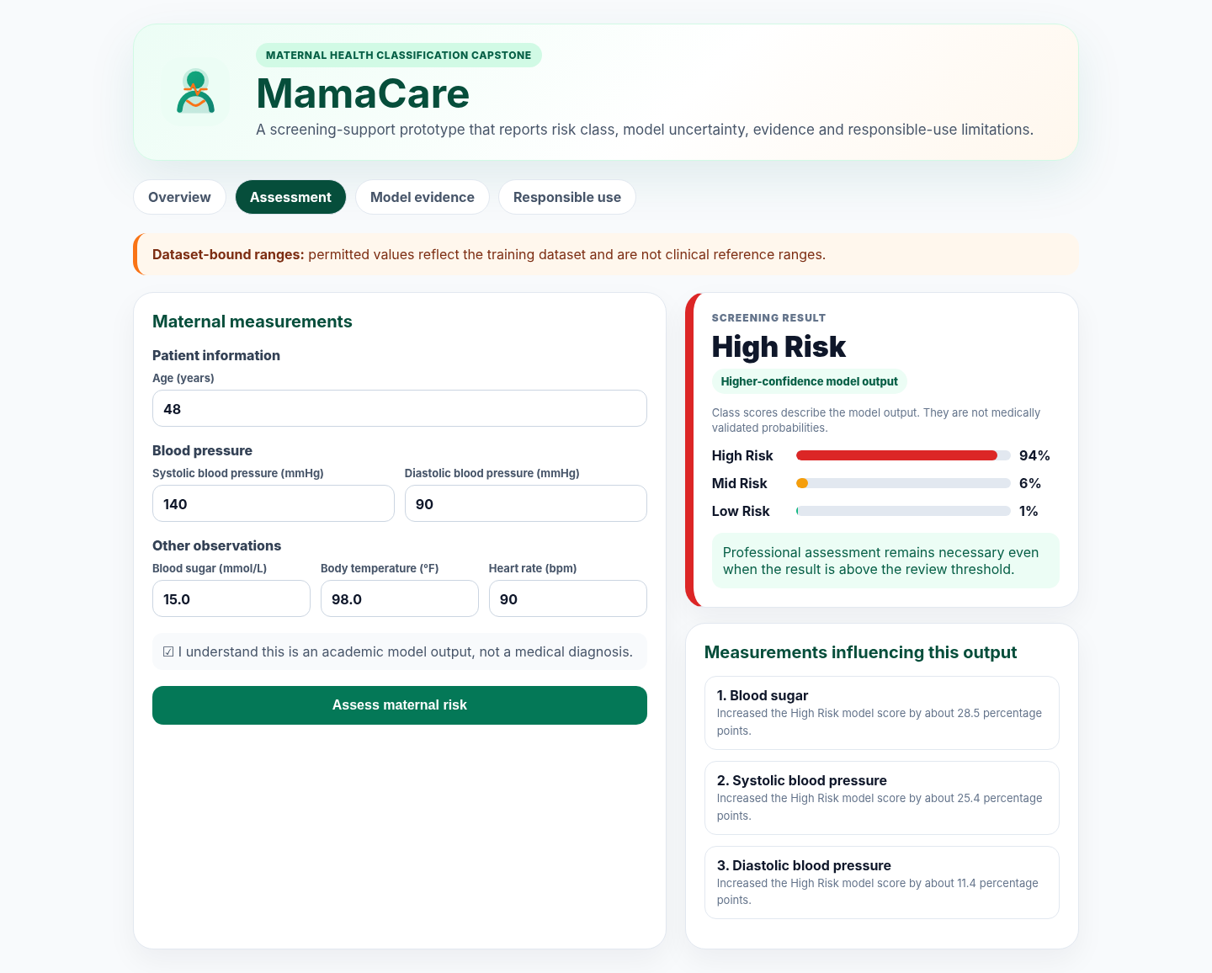
CONCLUSION AND DEMONSTRATION
MamaCare is a complete portfolio artefact
The final repository combines code, evidence, documentation and a polished interface.
Three findings
1
ShallowMLP beat the no-learning baseline.
2
High Risk recall reached 81.8%, but Mid Risk recall was only 14.9%.
3
Leakage-resistant evaluation exposed the real effect of duplicates and conflicting labels.
Next step: locally validated maternal-health data and prospective clinical review.
Live demo: load a demonstration case, assess the record, explain the model scores, then show the fairness and limitations tabs.
MamaCare Capstone | Collins Mikaye
5

