Slide 1
Presentation: Fixing the Incorrect Code

Slide 2
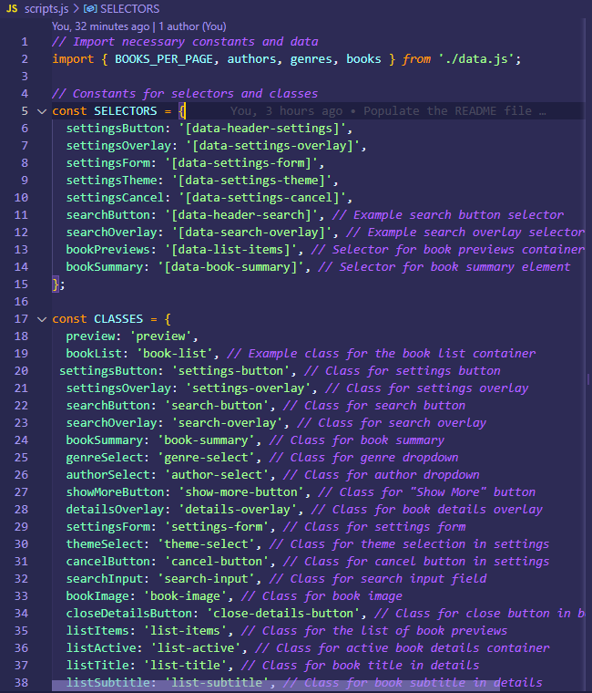

Provided Code
Corrected Code
No declaration of variables

Slide 3
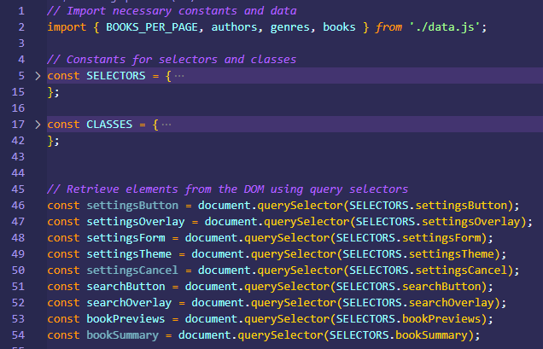
Variables
- I have introduced imports to access constants and data from an external module (data.js).
-Constants for selectors and classes have been defined for better organization.
-Proper variable declarations are used for DOM element retrieval.

Slide 4
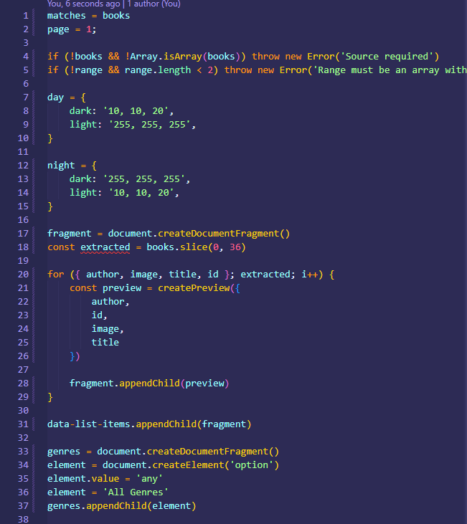
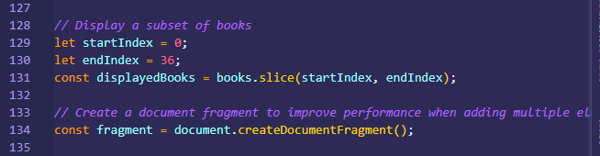
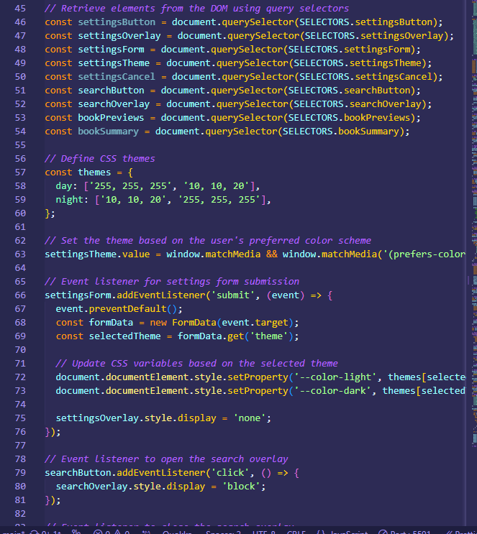
Provided Code
Corrected Code
Theme and book list display

Slide 5
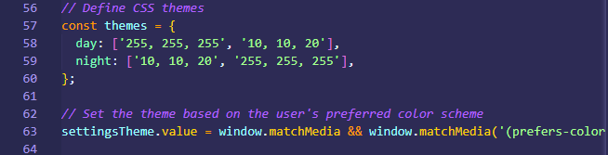
Theme
- CSS themes are now defined as an object for better management.
-The theme selection logic is improved to set the theme based on the user's preferred color scheme.

Slide 6
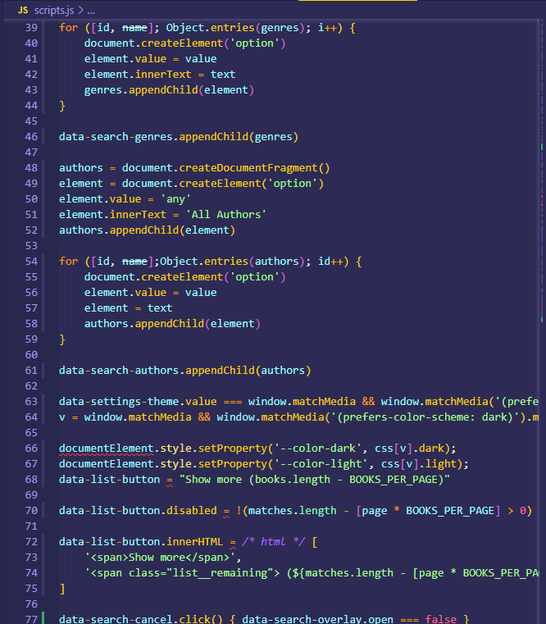
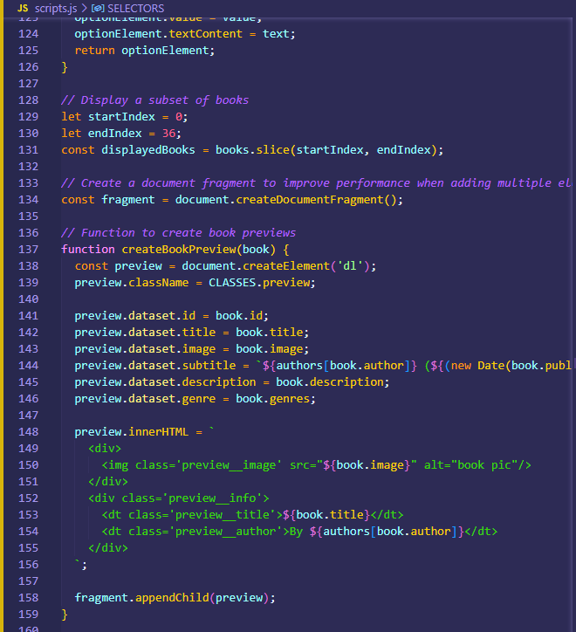
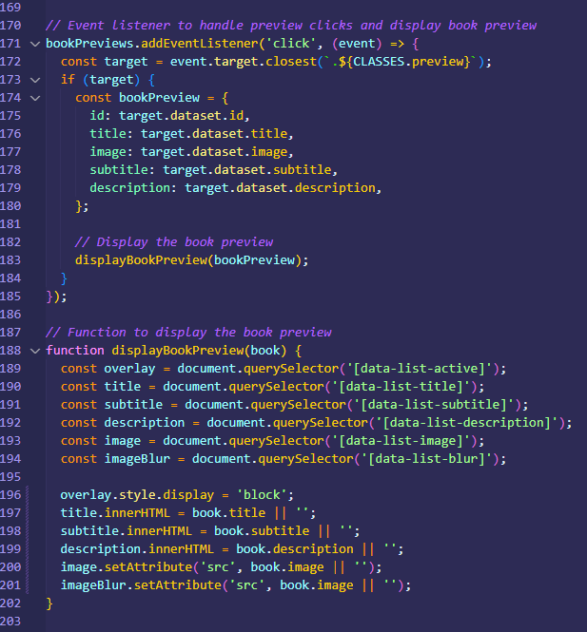
Provided Code
Corrected Code
Incorrect function to dsiplay previews

Slide 7
Book Previews
I added an event listener for handling preview clicks and displaying book previews.

Slide 8
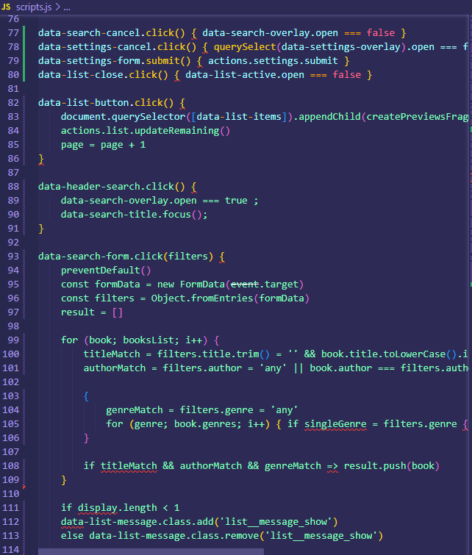
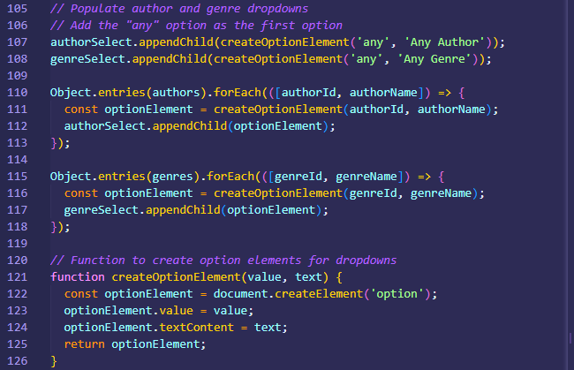
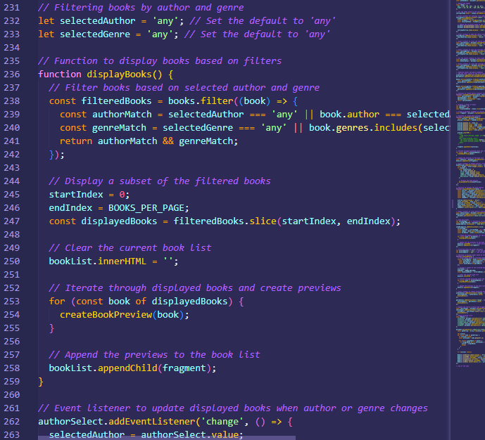
Provided Code
Corrected Code
Incorrect function to filter book list

Slide 9
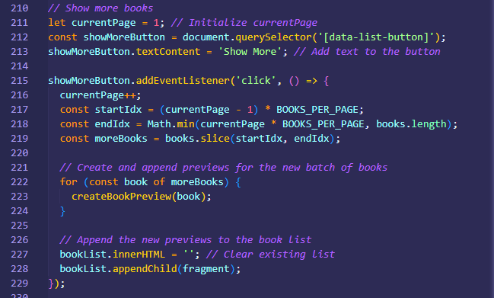
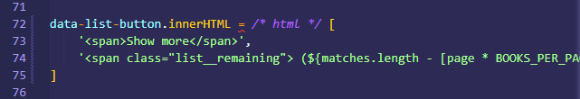
Provided Code
Corrected Code
Incorrect setup of the show-more button

Slide 10
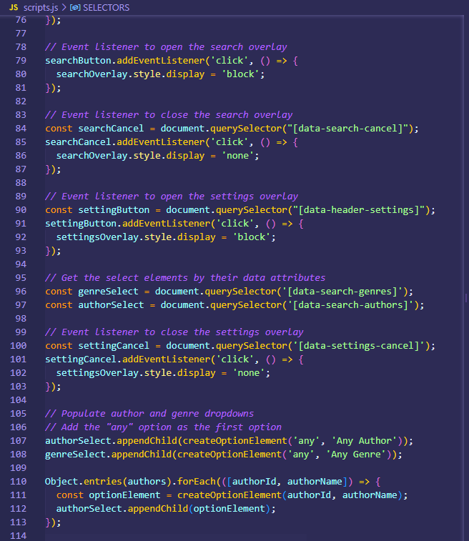
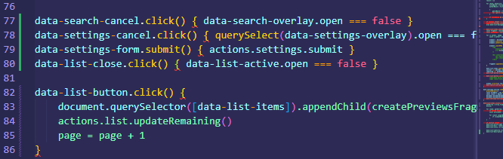
Provided Code
Corrected Code
Incorrect syntax and setup for event listeners

Slide 11
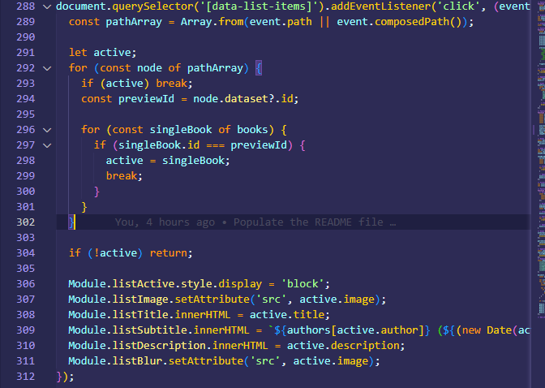
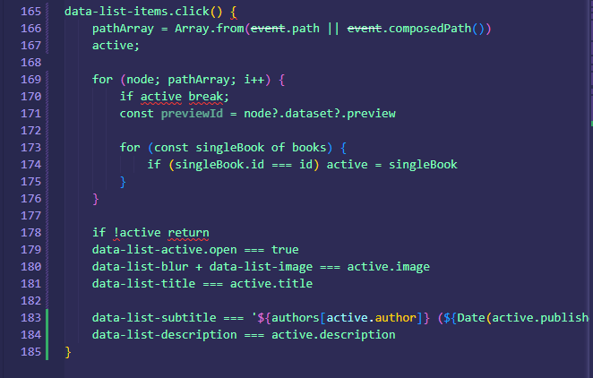
Provided Code
Corrected Code
Incorrect function to disolay the list of books

