Slide 2
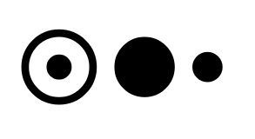

MODEL
VIEW
PROJECTION

⬇
✓
Left to Right || Right to Left

Slide 4

Model
Coordinates
Model Matrix
World
Coordinates
View Matrix
Camera
Coordinates
separate the transformation to screen area
(viewport)
Projection Matrix
Homogeneous
Coordinates

