Slide 1
Neural Nets for Data Science
Why neural nets?
  Make “intelligent” decisions.
  Reduces amount of feature engineering.
    NNs figure out what is important.
  Ex. Image classification is based off of each pixels value as an input feature

Slide 2
Neural Nets in Python
Neural Net Libraries
High Customization (Explicit) | Easy API (Development Speed)
TensorFlow Theano | Keras Lasagne
There are more!

Slide 3
Neural Net Architecture
Input Layer
Hidden Layer
Output Layer
Feature 1
Feature 2
y
Feature 3
Feature 4
Input Vector (x)
Weight Matrix (W1)
Weight Matrix (W2)
x * W1 * W2 = y

Slide 4
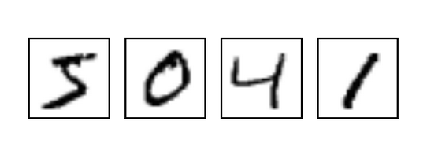
“Hello World” of Deep Learning
Hand written digit recognition
  55,000 training images
  10,000 test images
  State of the art performance 99.8% accuracy!

