Slide 1

Data Analysis and Visualization of Developer Trends
Michal Bando

Slide 2



OUTLINE
1. Executive Summary,
2. Introduction,
3. Methodology,
4. Language & Database Trends,
5. Dashboards,
6. Insights & Conclusions.

Slide 3

EXECUTIVE SUMMARY
Core Finding: JavaScript remains the most utilized language, but Python and Rust show the highest growth in future interest.
Database Shift: Traditional SQL databases (PostgreSQL/MySQL) dominate current usage, while NoSQL and Cloud-native solutions see rising future demand.
Demographics: The workforce is primarily composed of individuals aged 25-34, highlighting a young, tech-savvy global demographic.

Slide 4

INTRODUCTION
Purpose: To analyze and visualize current and future technology trends within the global developer community.
Target Audience: CTOs, IT Recruitment Managers, and Software Architects.
Value: Provides data-driven insights for strategic technology stack selection and talent acquisition planning.

Slide 5

METHODOLOGY
Data Sources: Stack Overflow Annual Developer Survey.
Collection Methods: Data was retrieved using Web Scraping (BeautifulSoup) and REST APIs.
Wrangling Steps:
Removed duplicate entries based on ResponseId.
Handled missing values to ensure statistical integrity.
Normalization: Transformed multi-select columns (e.g., Languages) into a long format using Pandas explode for accurate frequency analysis.

Slide 6
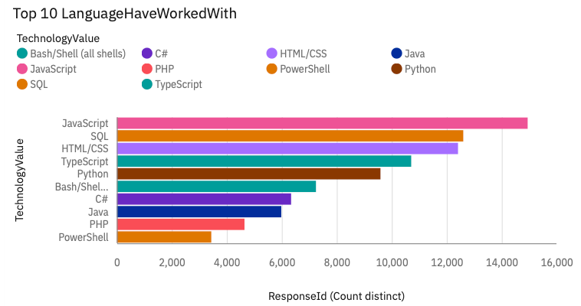
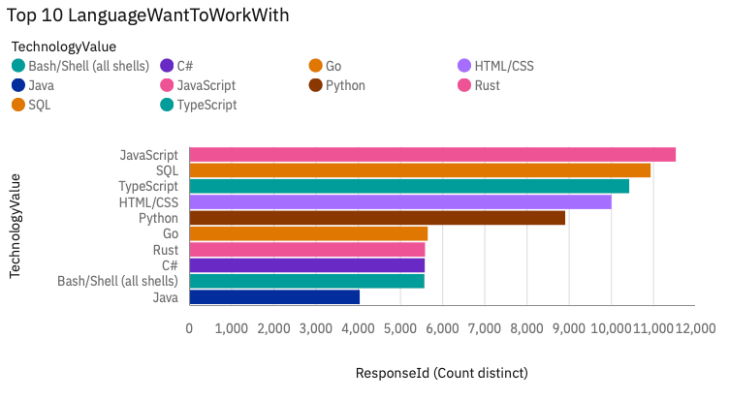
PROGRAMMING LANGUAGE TRENDS
Current Year
Next Year

Slide 7
PROGRAMMING LANGUAGE TRENDS - FINDINGS & IMPLICATIONS
Findings: JavaScript continues to lead in current deployment, but Python is the most "Desired" language for the upcoming year.
Implications: Organizations should focus on Python-related upskilling to align with developer interests and the rise of AI/Data Science.

Slide 8
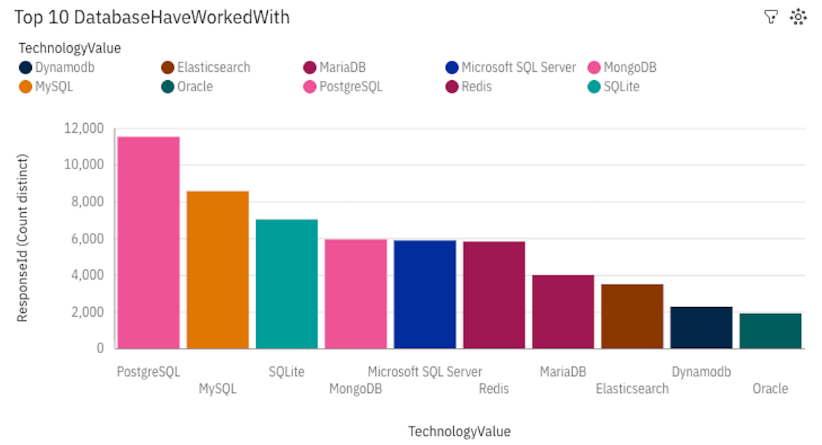
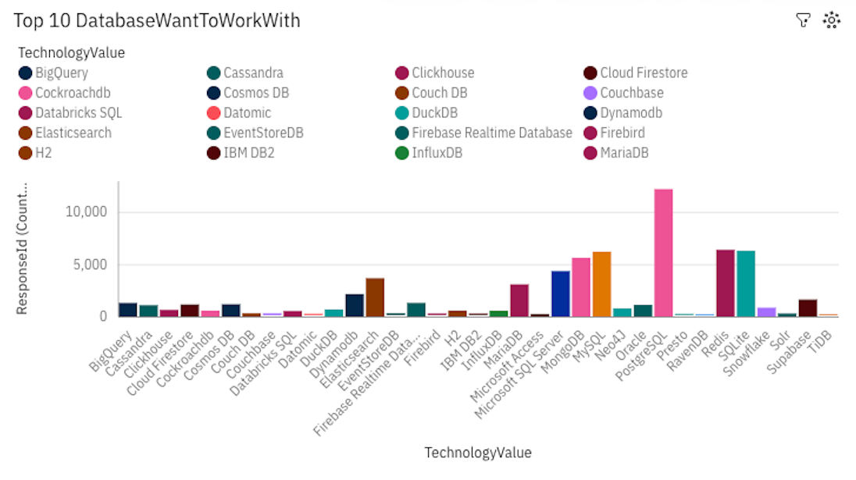
DATABASE TRENDS
Current Year
Next Year
< Ba chart of top 10 databases for the next year goes here.>

Slide 9
DATABASE TRENDS - FINDINGS & IMPLICATIONS
Findings: PostgreSQL and MySQL are the current industry standards, but there is significant growth in interest for MongoDB and Redis.
Implications: The move toward NoSQL suggests a trend toward more flexible, scalable data architectures for modern applications.

Slide 10

DASHBOARD
<Please present your dashboard in the following slides.>

Slide 11
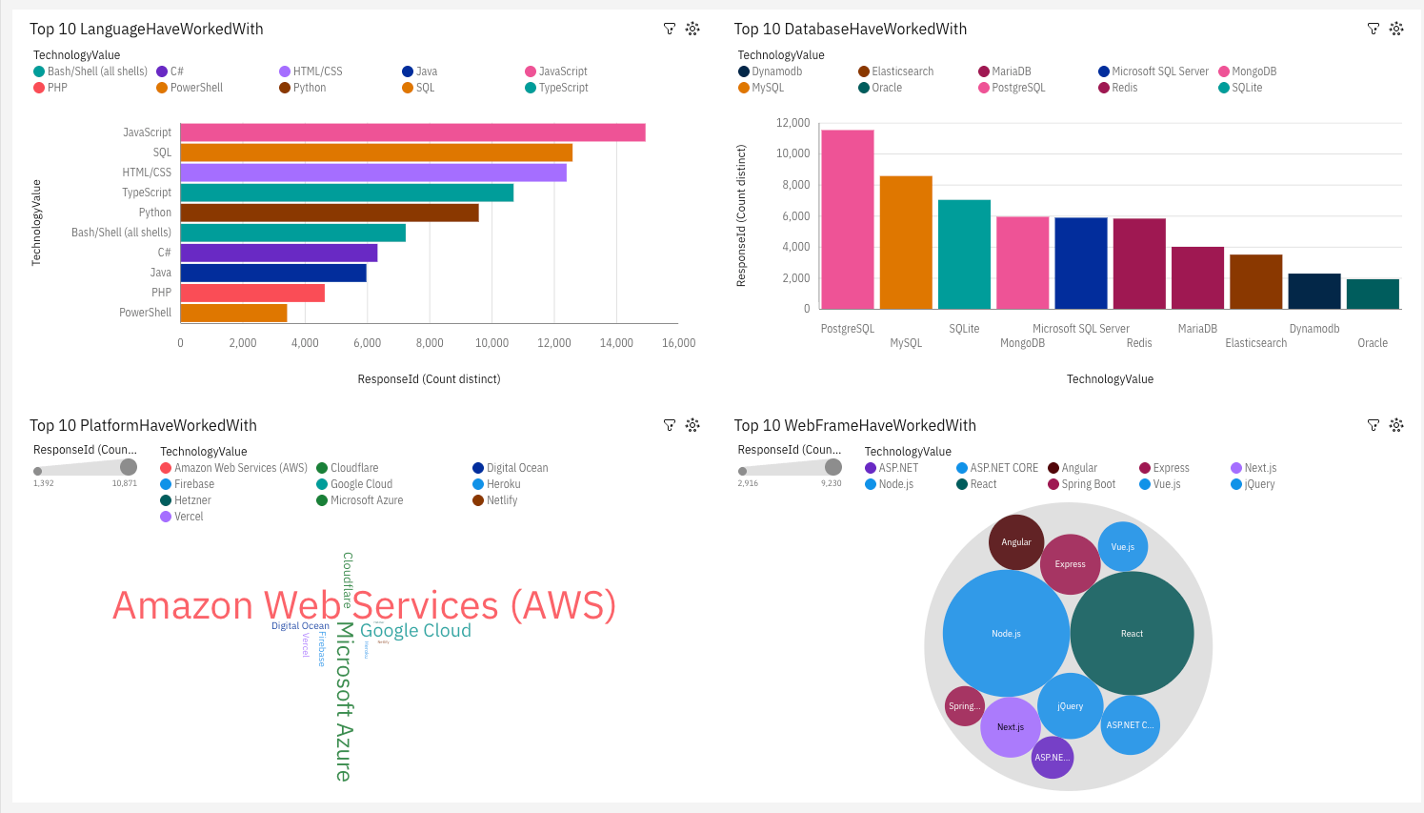
DASHBOARD TAB 1

Slide 12
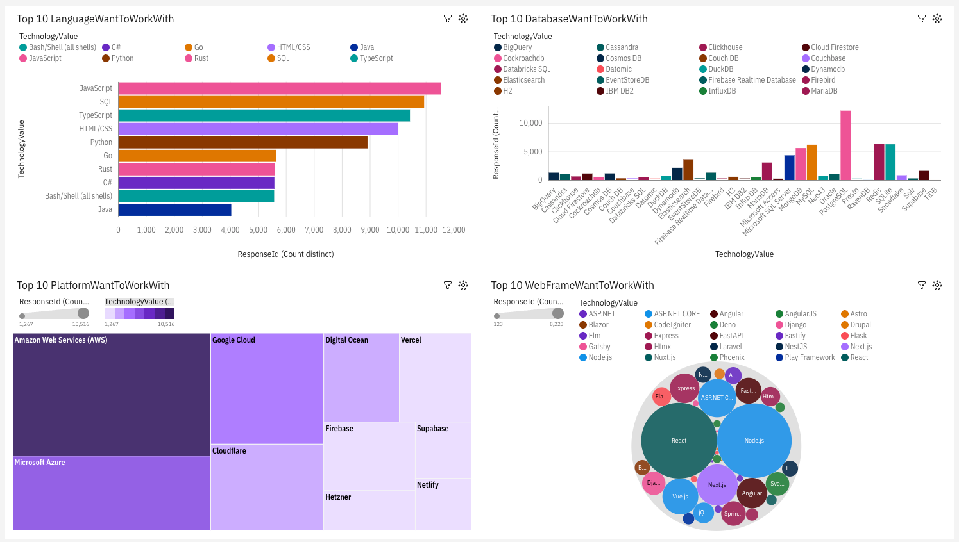
DASHBOARD TAB 2

Slide 13
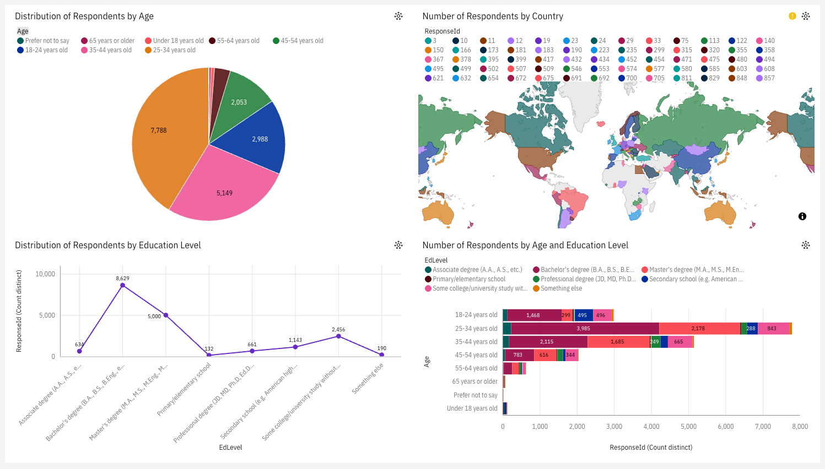
DASHBOARD TAB 3

Slide 14
DISCUSSION
Tech Stack Evolution: There is a clear transition from monolithic "standard" stacks toward diversified, specialized tools.
Demographic Alignment: Most developers are early-to-mid career professionals, indicating a high potential for rapid adoption of new tools.
Geographic Concentration: Major hubs in North America, Europe, and India continue to drive global technology standards.

Slide 15
OVERALL FINDINGS & IMPLICATIONS
Skill Gap: The gap between "Worked With" and "Want to Work With" suggests an upcoming shift in the talent market toward AI and Cloud-native technologies.
Strategic Growth: Companies leveraging the most "desired" technologies will likely have higher employee retention and recruitment success.

Slide 16

CONCLUSION
JavaScript and SQL remain foundational to the current IT landscape.
Python and NoSQL are the primary drivers of future technological interest.
Effective data normalization and visualization are essential for translating raw survey data into actionable business intelligence.

Slide 17

APPENDIX
Focus: Explaining the technical "heavy lifting" done in Python.
The Challenge: The raw Stack Overflow dataset stores multi-select responses (e.g., "Python;SQL;Java") as a single semi-colon-separated string. Standard BI tools cannot count these individual instances accurately.
The Solution: Utilized the Python Pandas library and the $explode()$ function. This process split strings into individual rows, creating a "long-format" dataset.
The Impact: This normalization ensures 100% accuracy in the "Top 10" charts. Without this step, unique technologies would be hidden within combined strings, leading to significant undercounting.

Slide 18
APPENDIX
Focus: Demonstrating attention to data integrity.
Deduplication: Performed rigorous data cleaning by removing duplicate records based on the unique $ResponseId$.
Handling Missing Values: Implemented filtering to exclude null or "None" responses in technology columns to prevent "empty" categories from appearing in the dashboard.
Data Casting: Converted string-based salary and age data into numerical types (floats/integers) to enable mathematical aggregations and "Count Distinct" measures.

Slide 19
APPENDIX
Text: "Implementation of the Normalization Pipeline using Python:
# Splitting strings and exploding to long format
df['Languages'] = df['Languages'].str.split(';') df_final = df.explode('Languages’)
Value-Add: This snippet demonstrates the transition from raw data to a visualization-ready state.

Slide 20
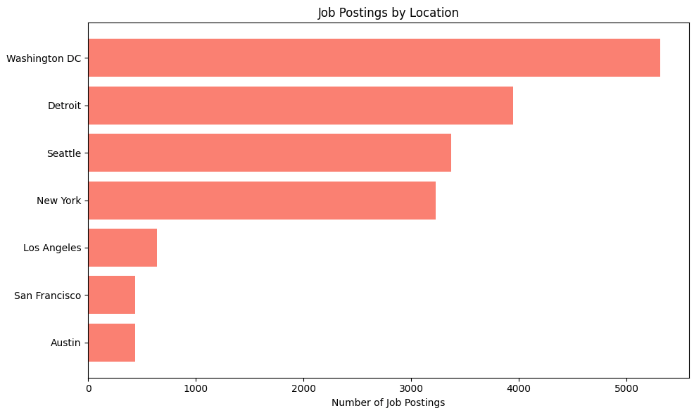
JOB POSTINGS
In Module 1 you have collected the job posting data using Job API in a file named “job-postings.xlsx”. Present that data using a bar chart here. Order the bar chart in the descending order of the number of job postings.

Slide 21
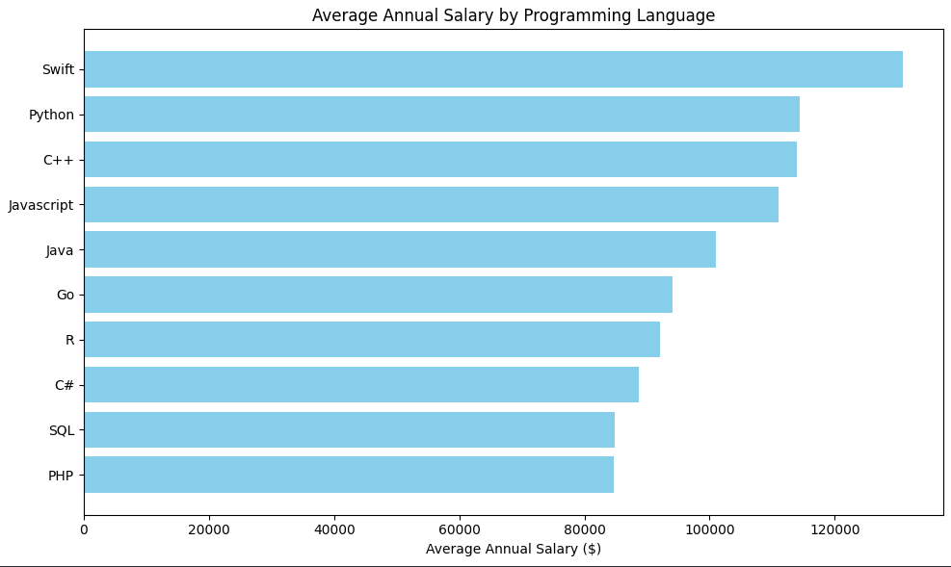
POPULAR LANGUAGES
In Module 1 you have collected the job postings data using web scraping in a file named “popular-languages.csv”. Present that data using a bar chart here. Order the bar chart in the descending order of salary.

