Slide 1
Final Project Graphs
Michael Ding

Slide 2
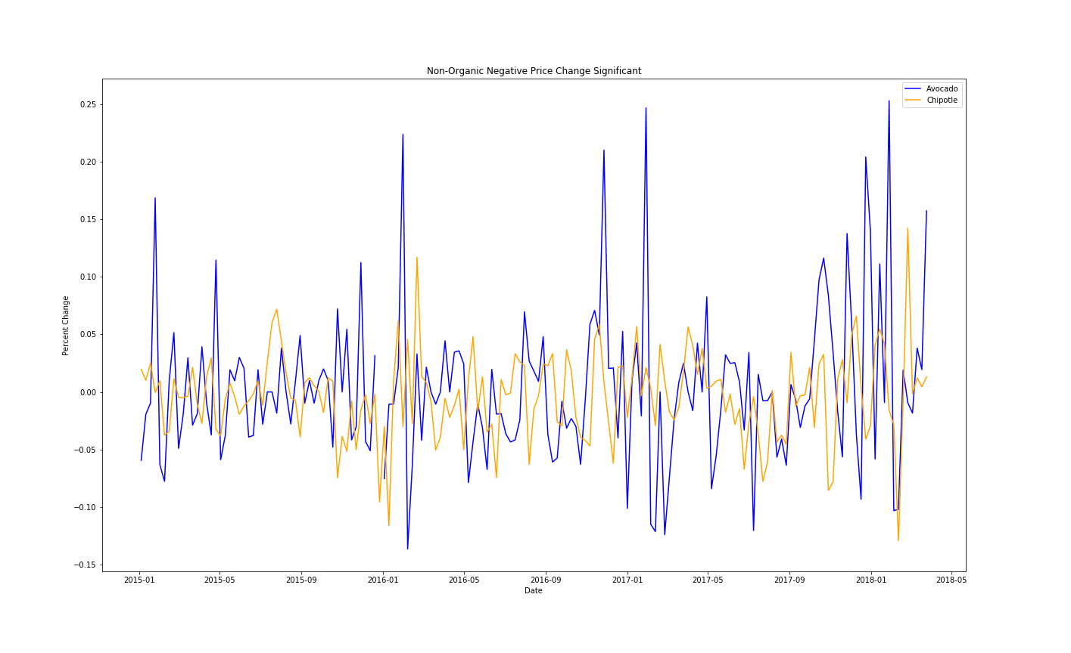
Avocado Price v. Chipotle Share Price

Slide 3
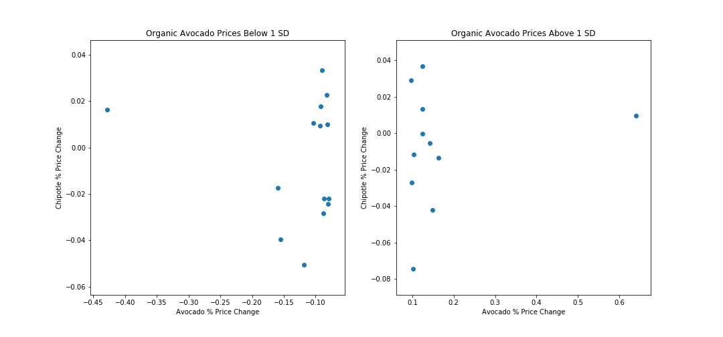
Avocado Price v. Chipotle Share Price

Slide 4
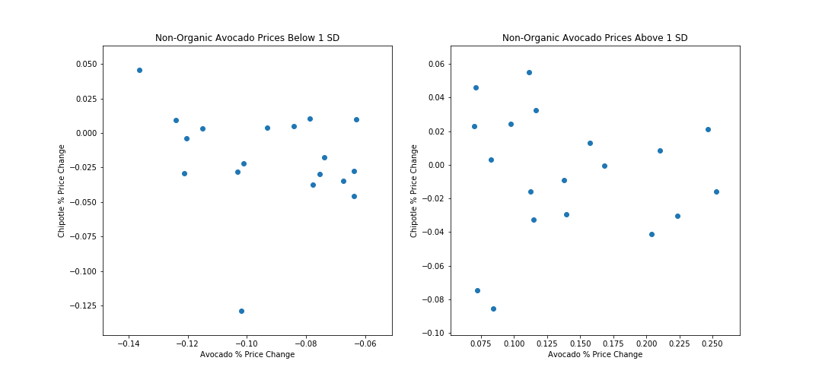
Avocado Price v. Chipotle Share Price

Slide 5
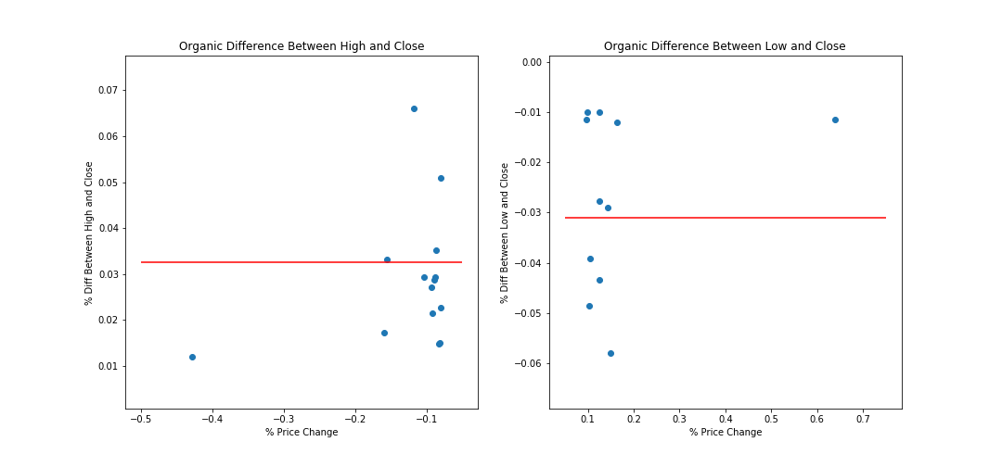
Avocado Price v. Diff between Avg and Hi/Lo Price

Slide 6
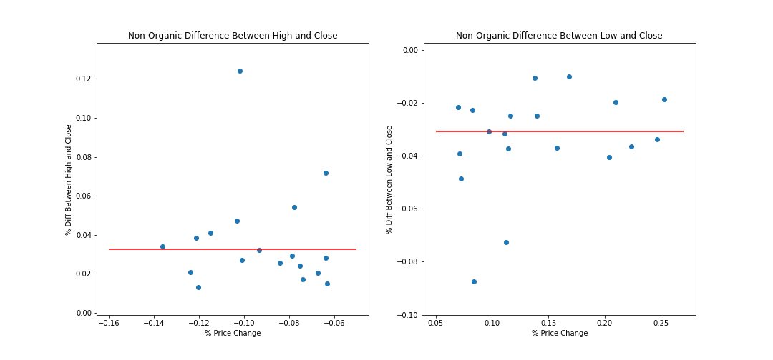
Avocado Price v. Diff between Avg and Hi/Lo Price

Slide 7
Transactions

