Slide 1



Towards a Constrained Understanding of Europa’s Subsurface Driven by Magnetic Induction Sounding
mhaynes@eas.gatech.edu
C. Michael Haynes
EAS 6134
Notes:
Get atmosphere in the verbal title

Slide 2


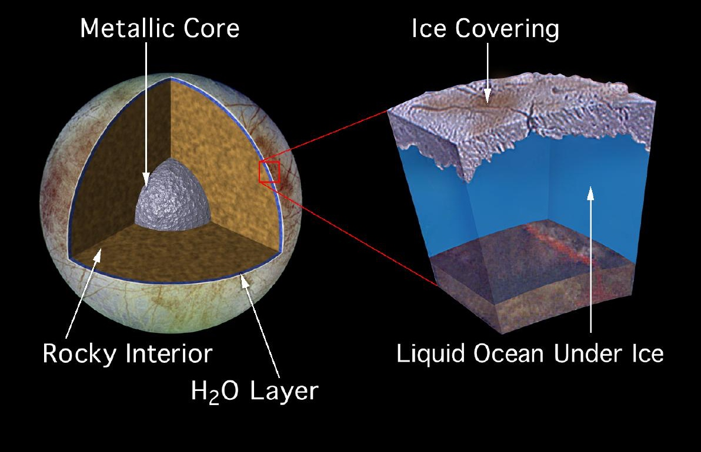
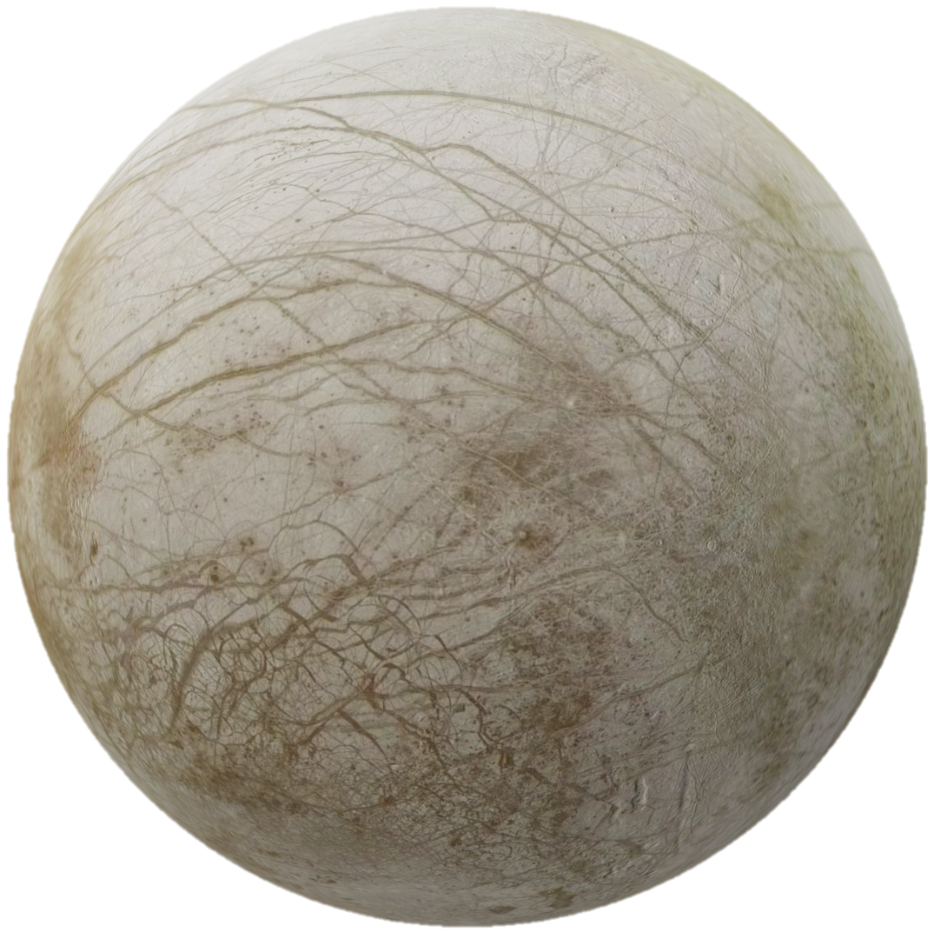

Europa: Background
mhaynes@eas.gatech.edu
Europa: $R_{E}=1561 km$
Possesses tenuous, O₂ rich atmosphere
Embedded within Jupiter’s magnetospheric / plasma environment
Target of the upcoming JUICE and Europa Clipper missions
Favorable candidate for habitable qualities (tremendous water content)
NASA/JPL
Notes:
Introduce C/E, atmospheres get partially ionized, ionospheres, etc
Quick sentence on draping/pileup
Introduce figure
Alfvén wing sentence (maybe omit)

Slide 3
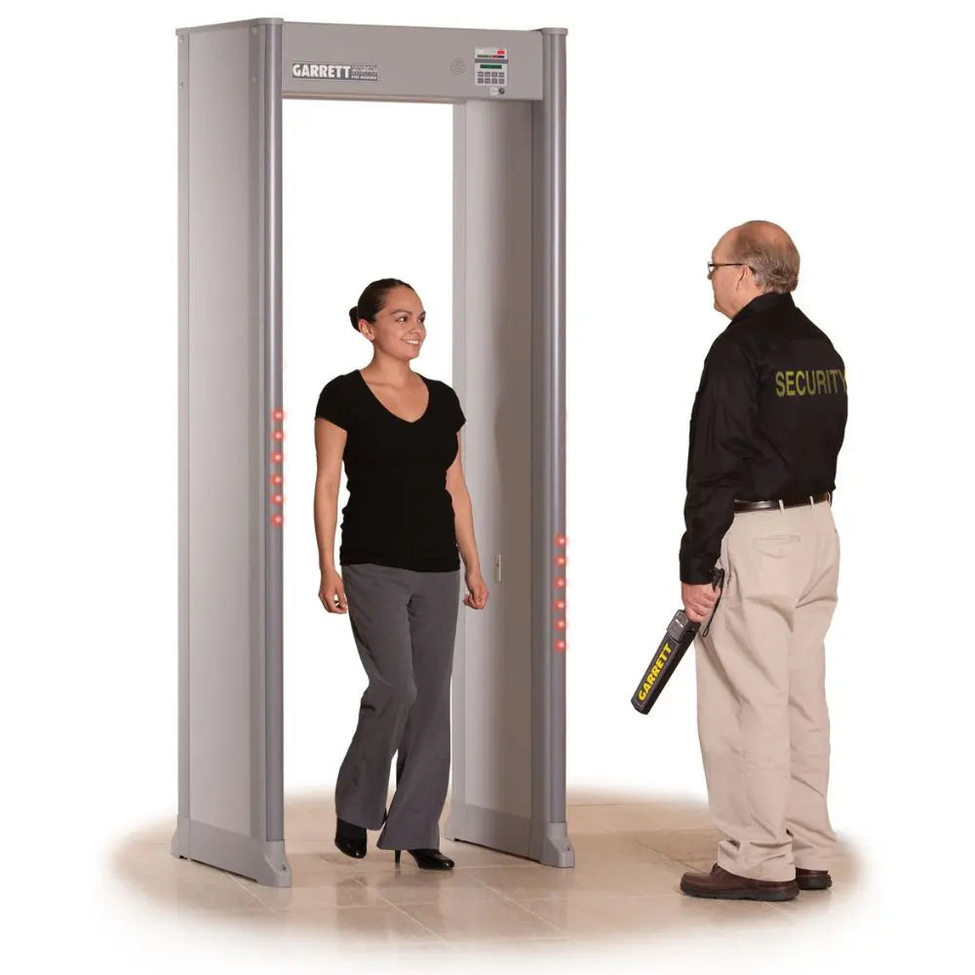
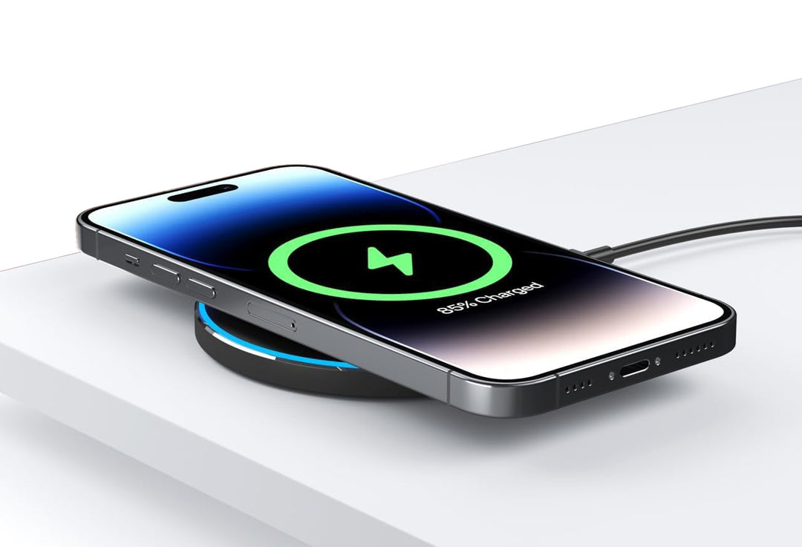
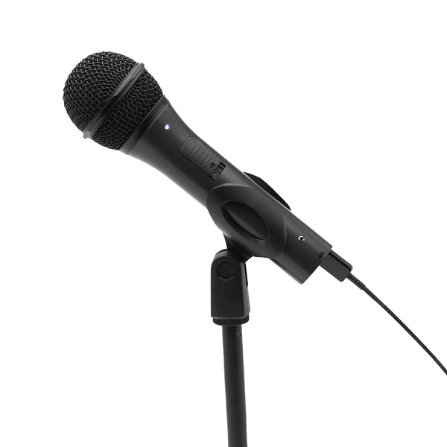
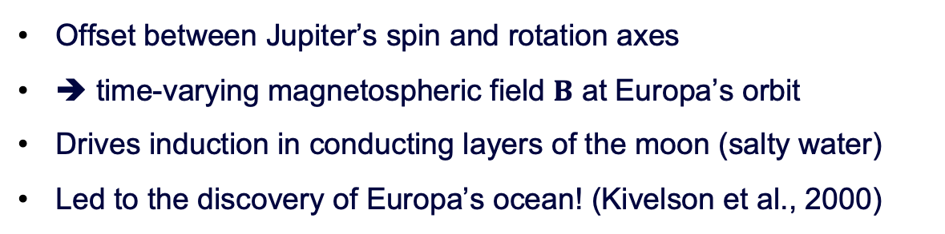
Europa: Background
mhaynes@eas.gatech.edu
M: Magnetic Axis
Ω: Rotation Axis
Plasma Sheet
Analogs:
Offset between Jupiter’s spin and rotation axes
➔ time-varying magnetospheric field $B$ at Europa’s orbit
Drives induction in conducting layers of the moon (salty water)
Led to the discovery of Europa’s ocean! (Kivelson et al., 2000)
Notes:
Introduce C/E, atmospheres get partially ionized, ionospheres, etc
Quick sentence on draping/pileup
Introduce figure
Alfvén wing sentence (maybe omit)

Slide 4
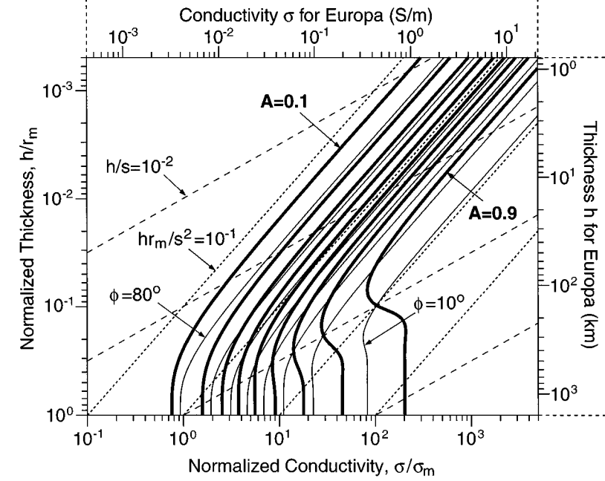
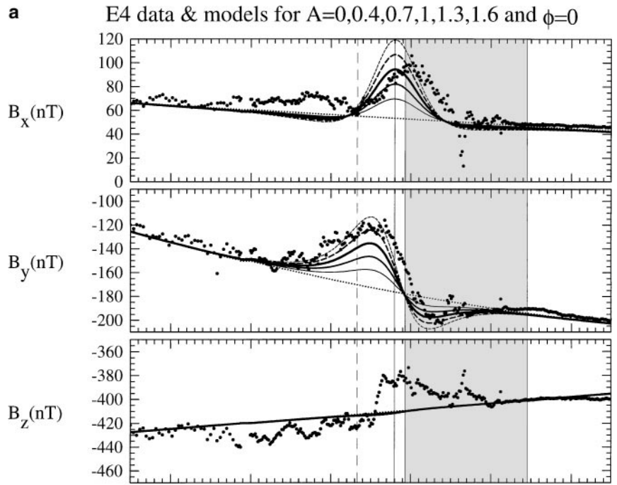
Science Question
mhaynes@eas.gatech.edu
However, even today Europa’s subsurface stratification remains poorly constrained
Studies have applied various methods to obtain the depth/conductivity profile
Often the nature of Europa’s local environment is not considered, and the choice of inversion strategy is inspection or L-S (e.g., Weber et al., 2022)
Zimmer et al. (2000)
Notes:
As the energetic ions impinge towards the moon’s interaction region, they experience a probability for undergoing charge exchange
If singly charged, the ion is subsequently neutralized

Slide 5
Science Question
mhaynes@eas.gatech.edu
However, even today Europa’s subsurface stratification remains poorly constrained
Studies have applied various methods to obtain the depth/conductivity profile
Often the nature of Europa’s local environment is not considered, and the choice of inversion strategy is inspection or L-S (e.g., Weber et al., 2022)
Our goal: tighter constraints on Europa’s subsurface conductivity profile
To do so, we use magnetometer data from Europa’s environment, and:
- more robust inversions (truncated SVD, nonlinear methods)
- highly selective pre-processing data analysis routine (background prevention & subtraction)
Notes:
As the energetic ions impinge towards the moon’s interaction region, they experience a probability for undergoing charge exchange
If singly charged, the ion is subsequently neutralized

Slide 6
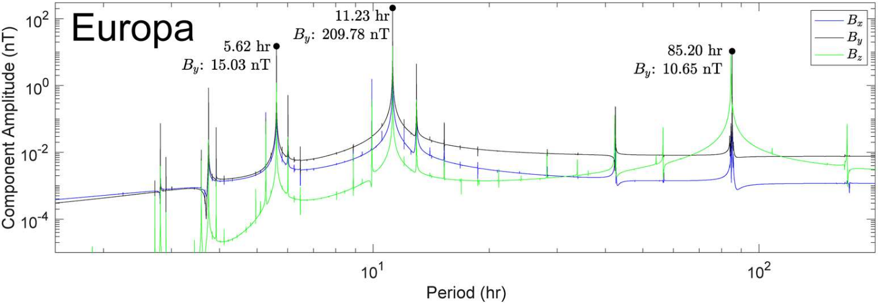
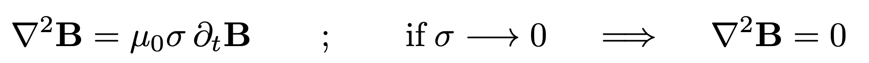
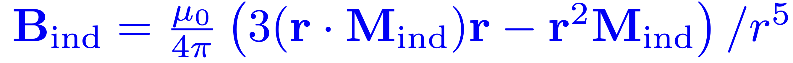

Forward Operator: Induction Physics
mhaynes@eas.gatech.edu
Dominant harmonic: synodic rotation period of Jupiter
Other inducing harmonics
Induction described by:
$$1/T_{s}$$
Vance et al. (2021)
➔ spherical harmonic decomposition assuming spherical symmetry isotropic shape
For a prescribed subsurface conductivity profile, the inductive response is:
Notes:
As the energetic ions impinge towards the moon’s interaction region, they experience a probability for undergoing charge exchange
If singly charged, the ion is subsequently neutralized

Slide 7
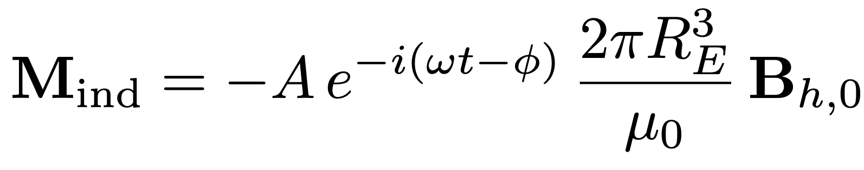
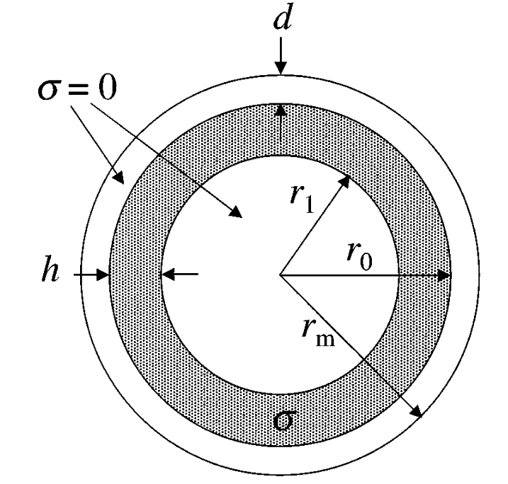
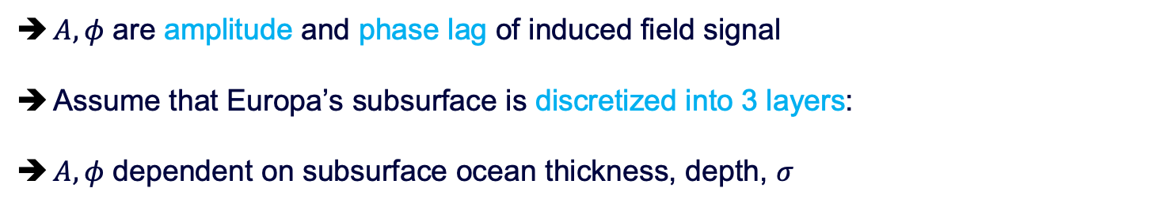
Forward Operator: Induction Physics
mhaynes@eas.gatech.edu
(Zimmer et al., 2000)
$A,φ$ are amplitude and phase lag of induced field signal
Assume that Europa’s subsurface is discretized into 3 layers:
$A,φ$ dependent on subsurface ocean thickness, depth, $σ$
Notes:
As the energetic ions impinge towards the moon’s interaction region, they experience a probability for undergoing charge exchange
If singly charged, the ion is subsequently neutralized

Slide 8
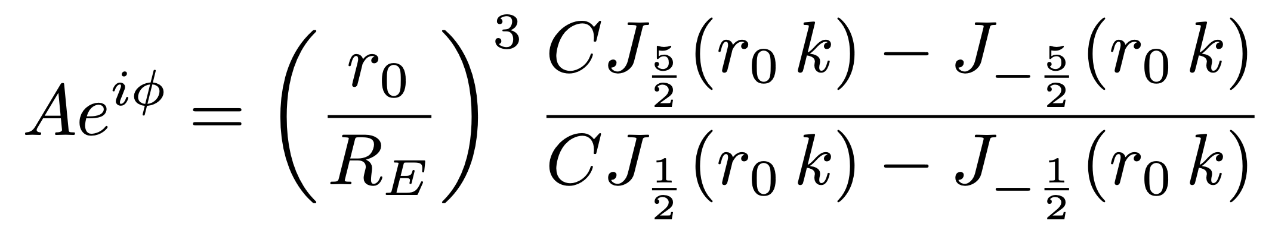
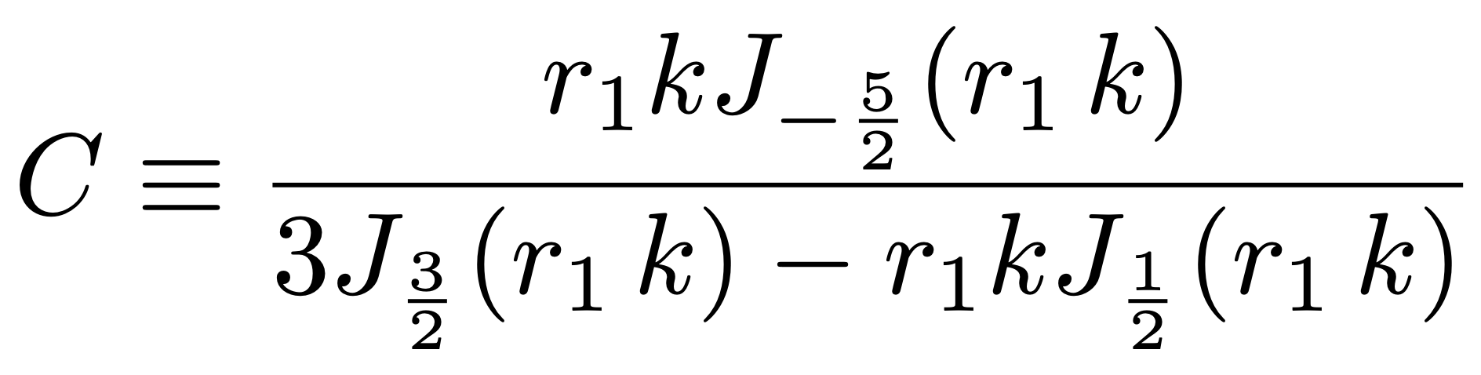
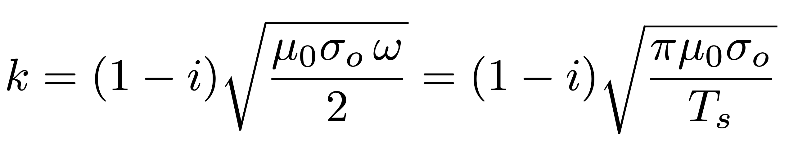
Forward Operator: Induction Physics
mhaynes@eas.gatech.edu
Amplitude, phase lag dependence
(Zimmer et al., 2000)
coefficient dependent on ocean depth
complex wavenumber dependent on conductivity value
Notes:
As the energetic ions impinge towards the moon’s interaction region, they experience a probability for undergoing charge exchange
If singly charged, the ion is subsequently neutralized

Slide 9
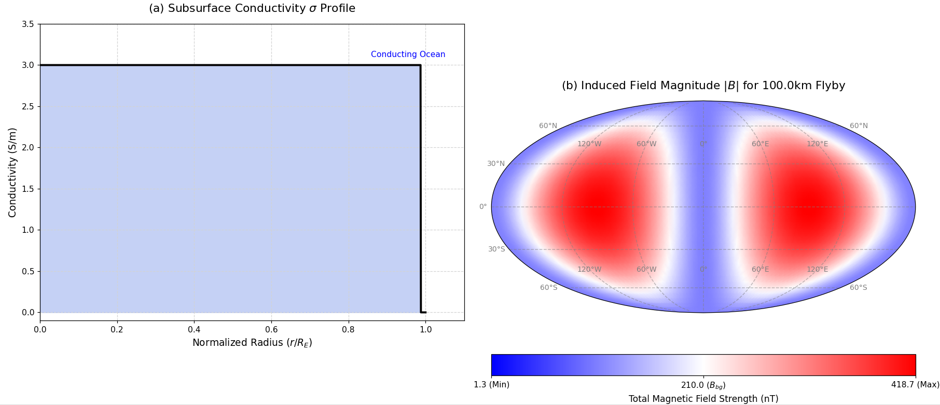


Inductive Response: Perfect Conductor
mhaynes@eas.gatech.edu
In the most coarse treatment, Europa is considered a perfect spherical conductor
➔ $A→1,φ→0º$
$$∞$$
Notes:
As the energetic ions impinge towards the moon’s interaction region, they experience a probability for undergoing charge exchange
If singly charged, the ion is subsequently neutralized

Slide 10
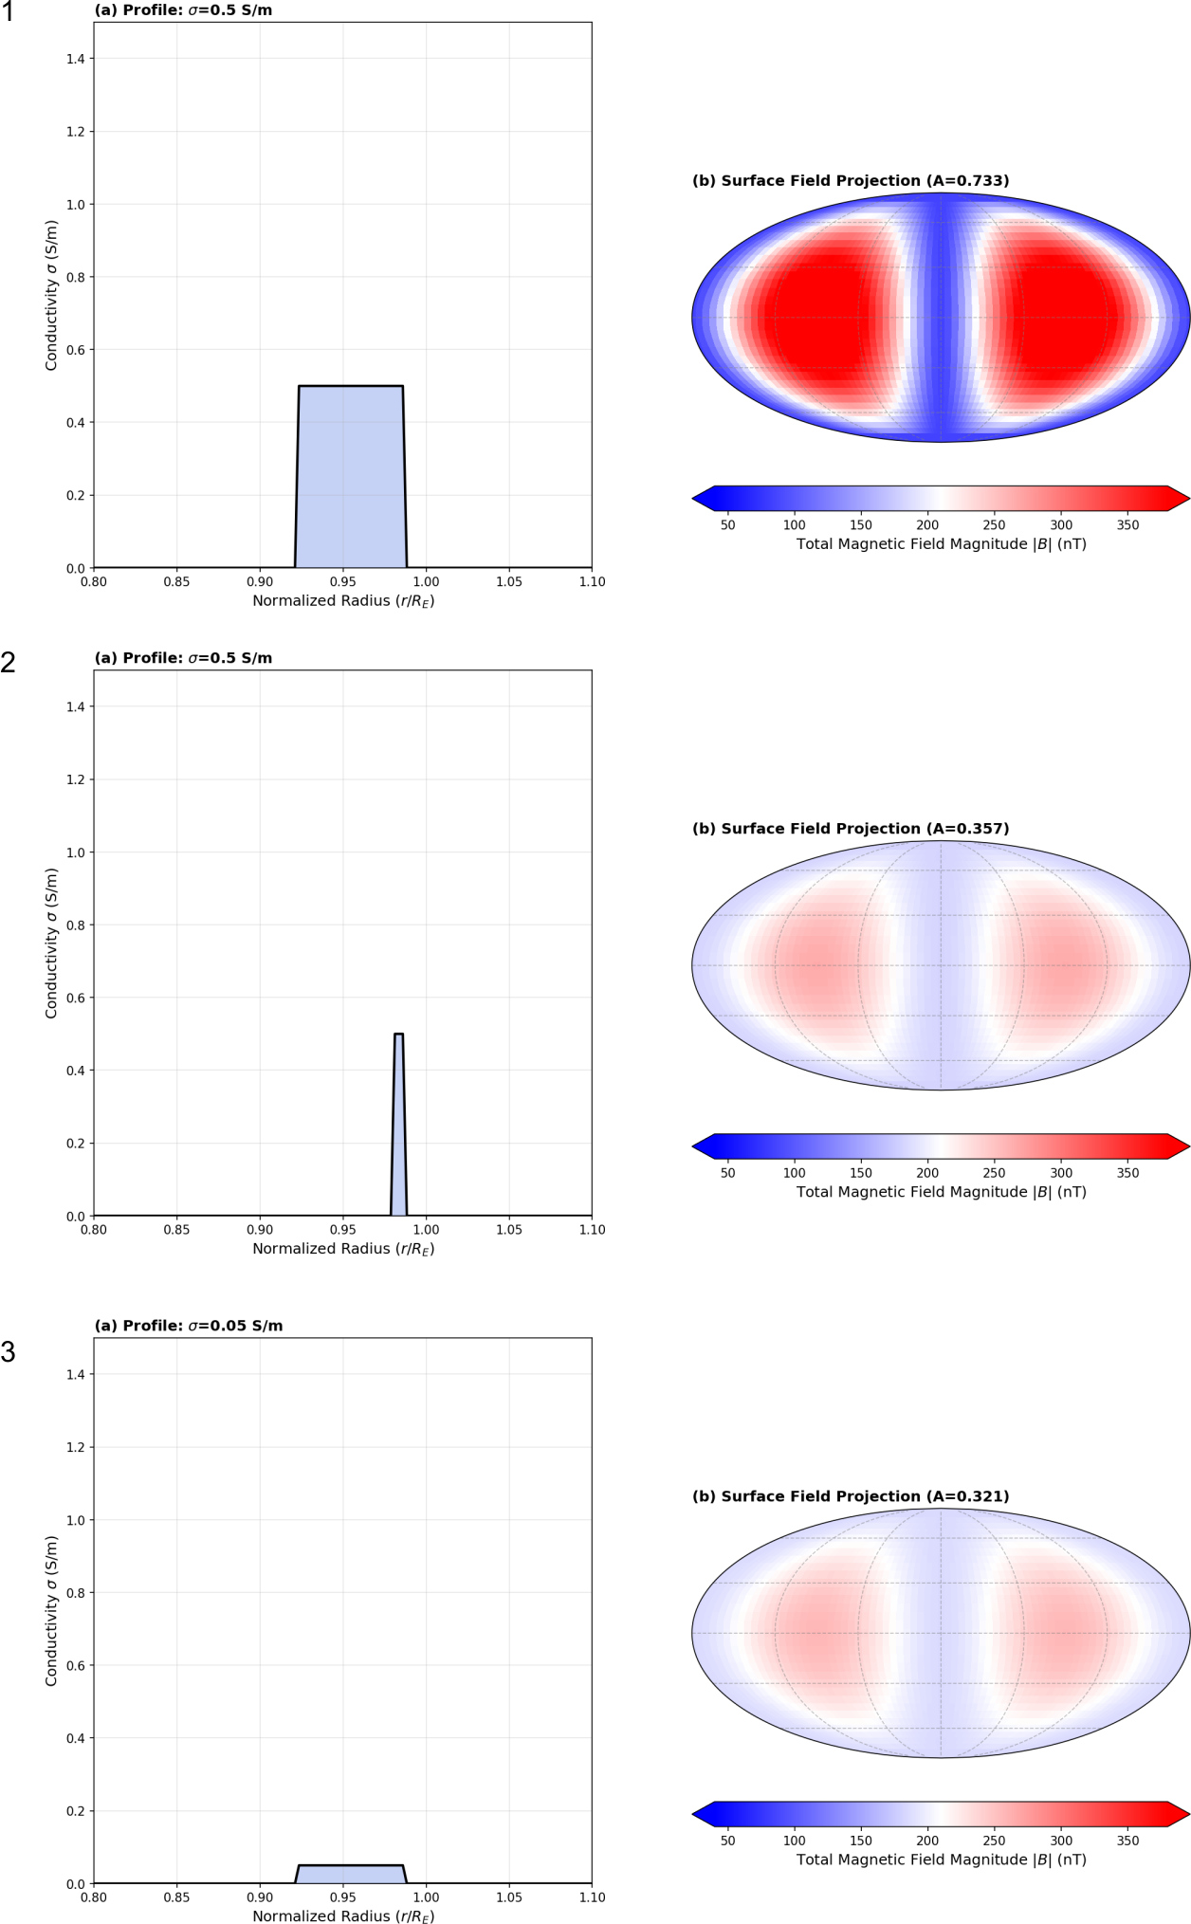
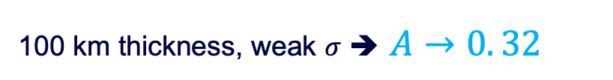
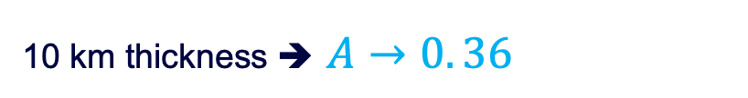


Inductive Response: 3-Layer Approximation
conductivity profile
surface $\left|B\right|$
mhaynes@eas.gatech.edu
100 km thickness ➔ $A→0.73$
10 km thickness ➔ $A→0. 36$
100 km thickness, weak $σ$ ➔ $A→0. 32$
Notes:
As the energetic ions impinge towards the moon’s interaction region, they experience a probability for undergoing charge exchange
If singly charged, the ion is subsequently neutralized

Slide 11
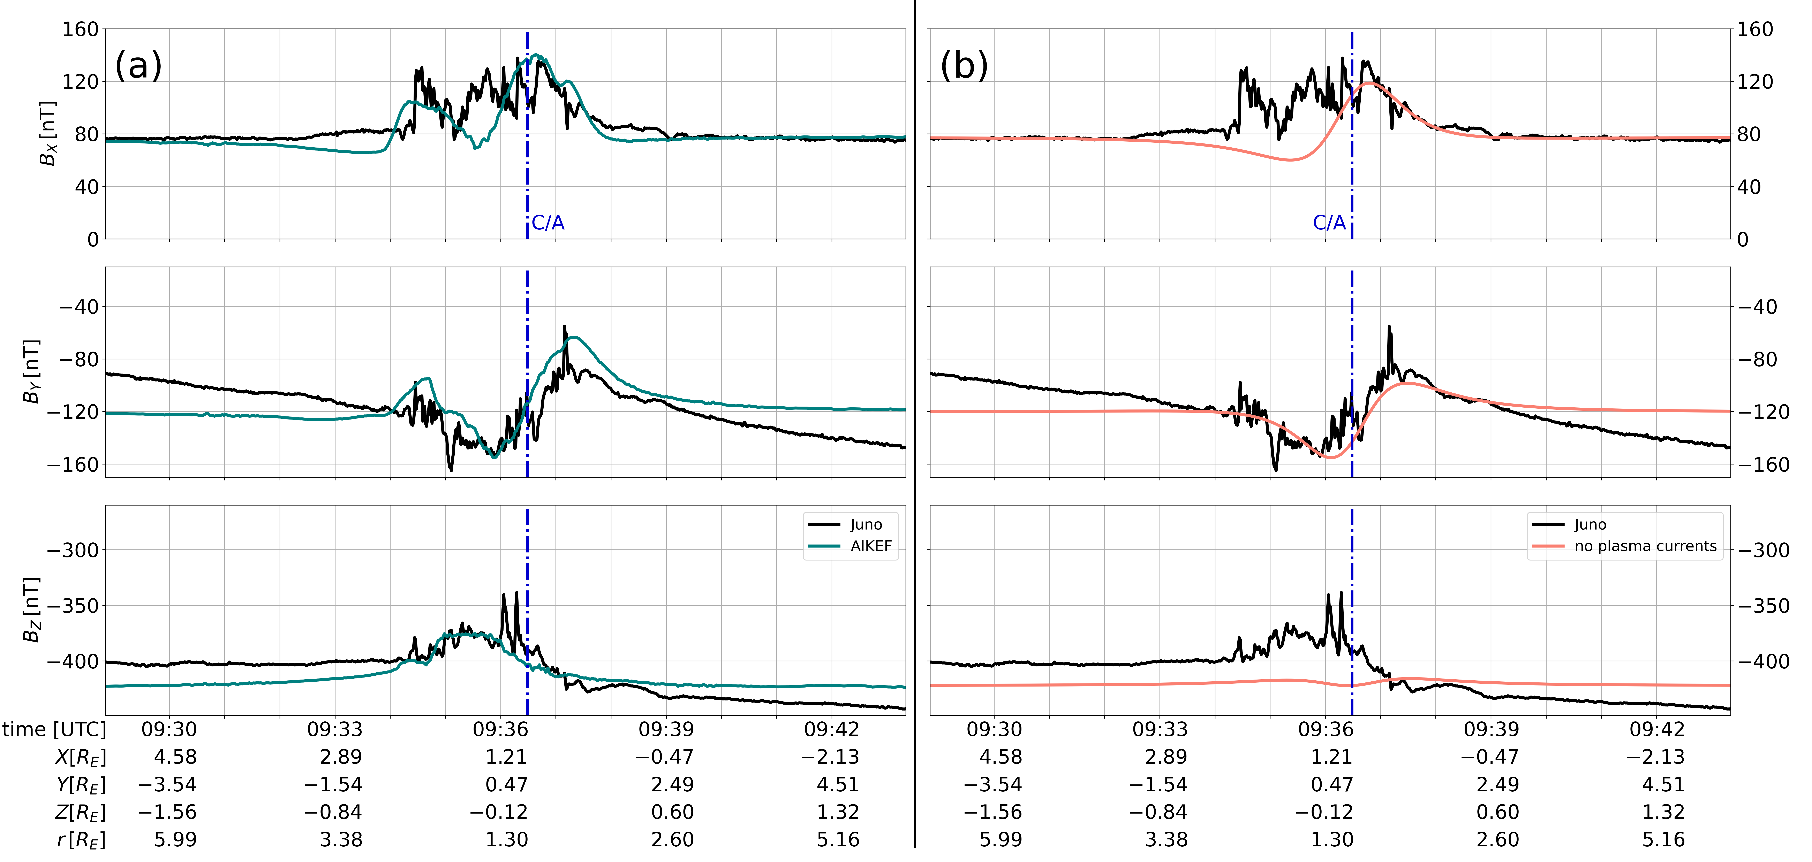
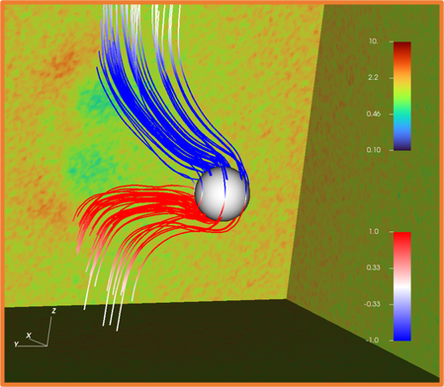
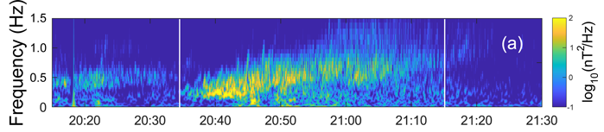
Contaminating magnetic “Noise”
mhaynes@eas.gatech.edu
Europa possesses a rich, dynamic plasma interaction with Jupiter’s magnetosphere:
Pile-up, draping, Alfvén Wings:
Plasma wave modes:
(Addison, Haynes et al., 2024)
Notes:
As the energetic ions impinge towards the moon’s interaction region, they experience a probability for undergoing charge exchange
If singly charged, the ion is subsequently neutralized

Slide 12
Summary: Magnetic Induction Sounding at Europa
mhaynes@eas.gatech.edu
Goal: Constrain the subsurface stratification of Europa
Notes:
Results: While Ganymede’s internal field controls its ENA morphology, draping creates a discernible effect at Europa, Ganymede, and Callisto

Slide 13
Summary: Magnetic Induction Sounding at Europa
mhaynes@eas.gatech.edu
Goal: Constrain the subsurface stratification of Europa
Method: Combine in-situ magnetometer observations, context-driven data filtration and assumption of a salty, symmetric liquid layer
Notes:
Results: While Ganymede’s internal field controls its ENA morphology, draping creates a discernible effect at Europa, Ganymede, and Callisto

Slide 14
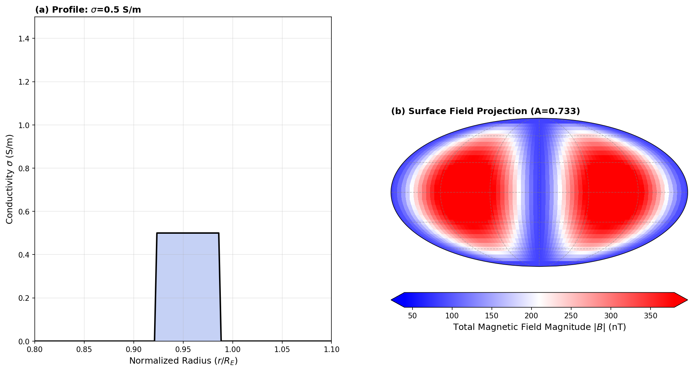
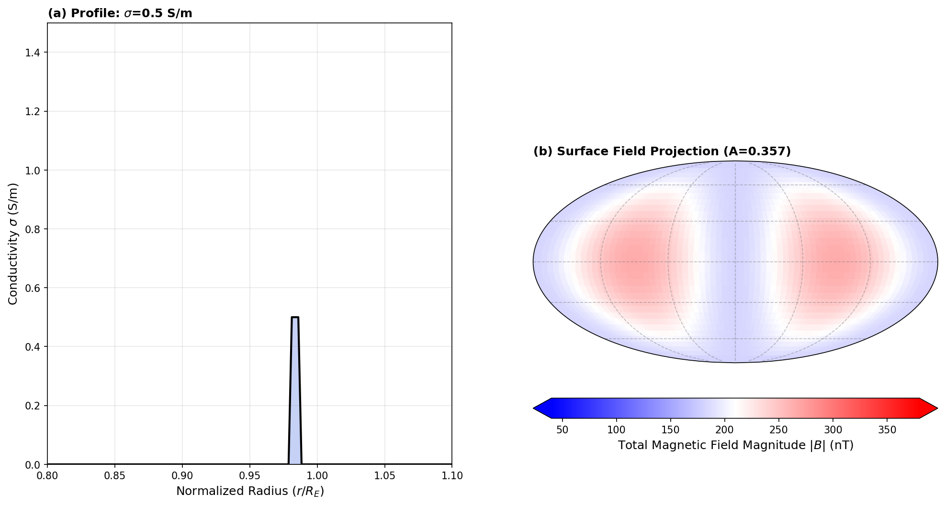
Summary: Magnetic Induction Sounding at Europa
mhaynes@eas.gatech.edu
Goal: Constrain the subsurface stratification of Europa
Method: Combine in-situ magnetometer observations, context-driven data filtration and assumption of a salty, symmetric liquid layer
Results: Improved constraints on the depth, thickness, and bulk conductivity of Europa’s subsurface liquid water ocean
Notes:
Results: While Ganymede’s internal field controls its ENA morphology, draping creates a discernible effect at Europa, Ganymede, and Callisto

Slide 15
Thank you

