Slide 1



Towards a Constrained Understanding of Europa’s Subsurface Driven by Magnetic Induction Sounding
mhaynes@eas.gatech.edu
C. Michael Haynes
EAS 6134 Term Project
Notes:
Get atmosphere in the verbal title

Slide 2


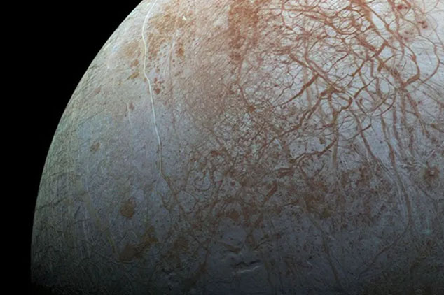
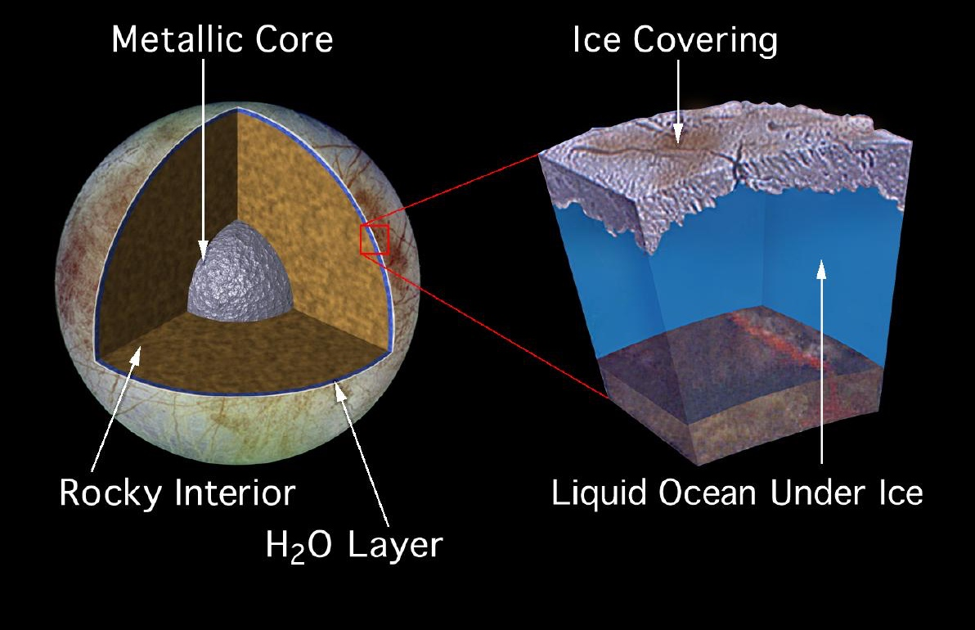

Europa: Background
mhaynes@eas.gatech.edu
Europa: $R_{E}=1561 km$
NASA/JPL
Embedded in Jupiter’s magnetosphere
Target of the upcoming JUICE and Europa Clipper missions
Possesses many habitable qualities (water, active geochemistry)
Notes:
Introduce C/E, atmospheres get partially ionized, ionospheres, etc
Quick sentence on draping/pileup
Introduce figure
Alfvén wing sentence (maybe omit)

Slide 3

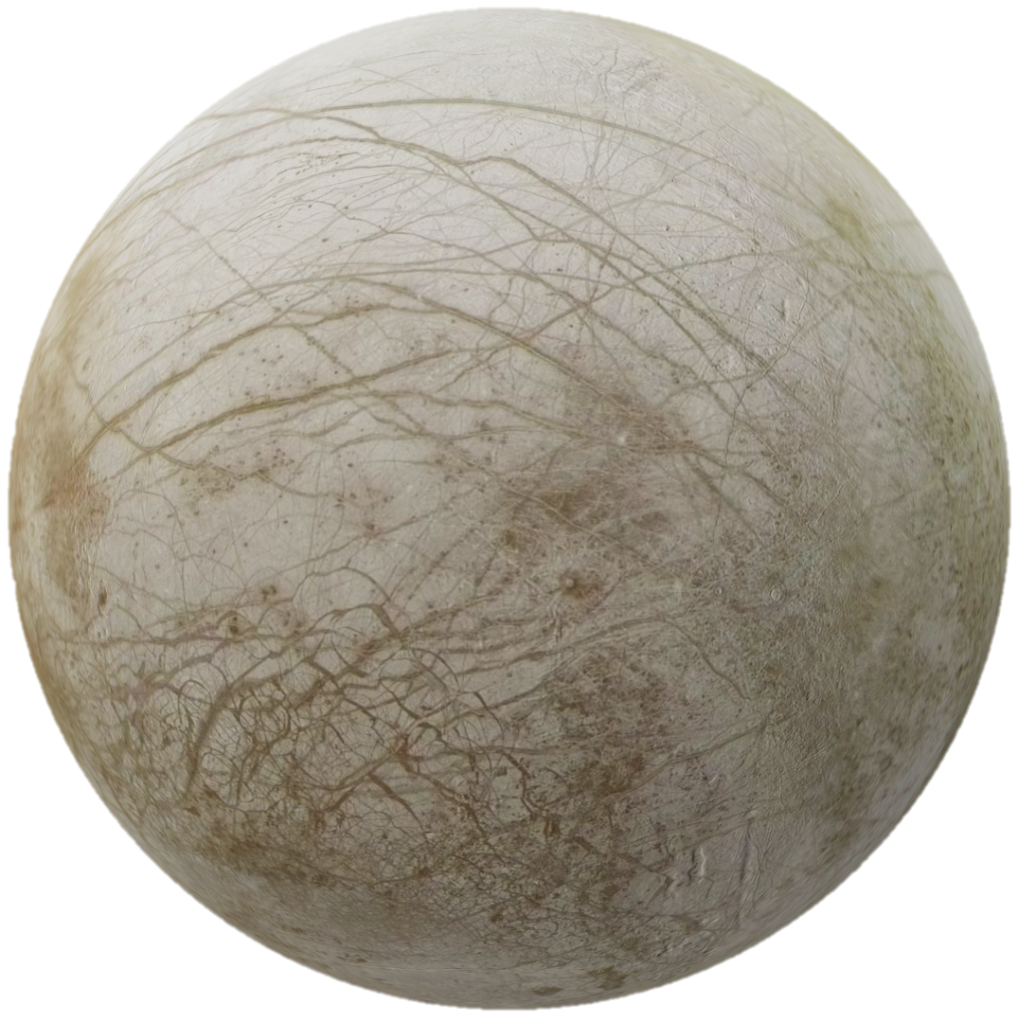


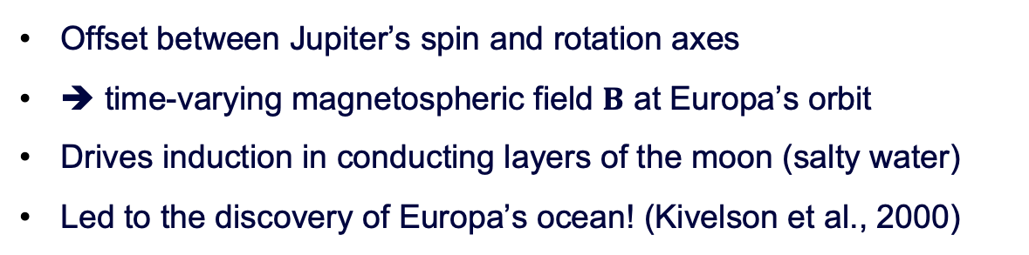
Europa: Background
mhaynes@eas.gatech.edu
M: Magnetic Axis
Ω: Rotation Axis
Plasma Sheet
Analogs:
Offset between Jupiter’s spin and rotation axes
➔ time-varying magnetospheric field $B$ at Europa’s orbit
Drives induction in conducting layers of the moon (salty water)
Led to the discovery of Europa’s ocean! (Kivelson et al., 2000)
Notes:
Introduce C/E, atmospheres get partially ionized, ionospheres, etc
Quick sentence on draping/pileup
Introduce figure
Alfvén wing sentence (maybe omit)

Slide 4
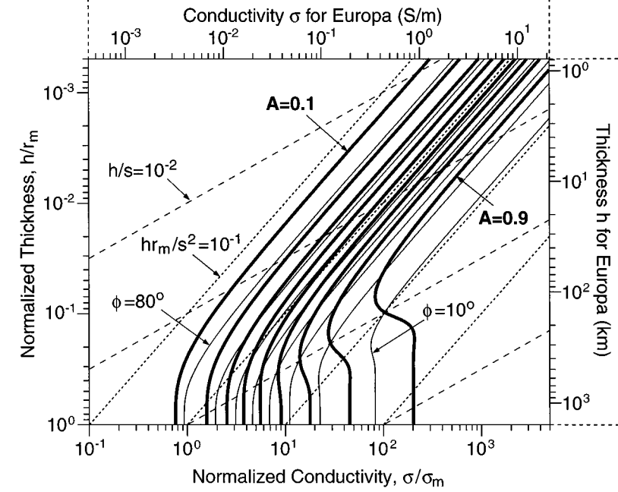
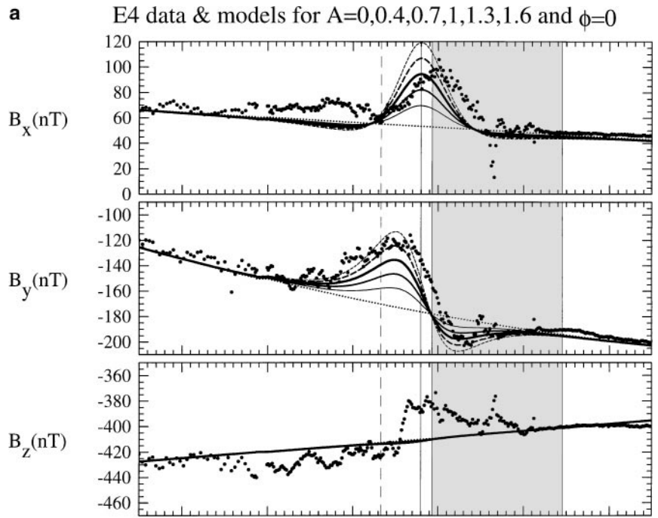
Science Question: Where Is the Ocean?
mhaynes@eas.gatech.edu
Zimmer et al. (2000)
Notes:
However, even today Europa’s subsurface stratification remains poorly constrained
Studies have applied various methods to obtain the depth/conductivity profile
Often the nature of Europa’s local environment is not considered, and the choice of inversion strategy is inspection or L-S (e.g., Weber et al., 2022)

Slide 5
Strategy: Model Assumptions
mhaynes@eas.gatech.edu
However, even today Europa’s subsurface stratification remains poorly constrained
Studies have applied various methods to obtain the depth/conductivity profile
Often the nature of Europa’s local environment is not considered, and the choice of inversion strategy is inspection or L-S (e.g., Weber et al., 2022)
Our goal: tighter constraints on Europa’s subsurface conductivity profile
To do so, we use magnetometer data from Europa’s environment, and:
- more robust inversions (truncated SVD, nonlinear methods)
- highly selective pre-processing data analysis routine (background prevention & subtraction)

Slide 6
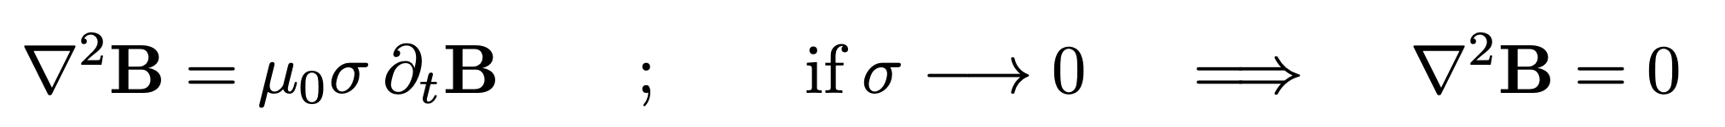
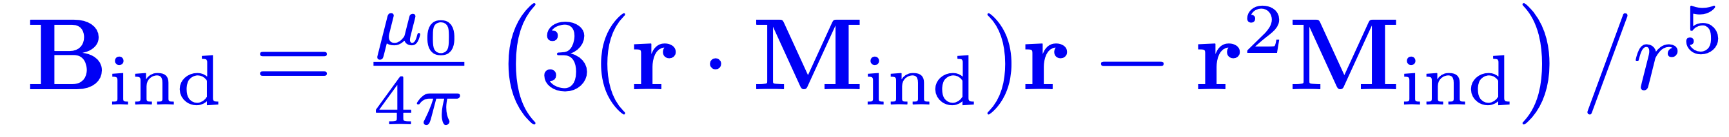
Forward Operator: Induction Physics
mhaynes@eas.gatech.edu
Dominant harmonic: synodic rotation period of Jupiter
Induction described by:
➔ spherical harmonic decomposition assuming spherical symmetry isotropic shape
For a prescribed subsurface conductivity profile, the inductive response is:
Vance et al. (2021)
Notes:
As the energetic ions impinge towards the moon’s interaction region, they experience a probability for undergoing charge exchange
If singly charged, the ion is subsequently neutralized

Slide 7
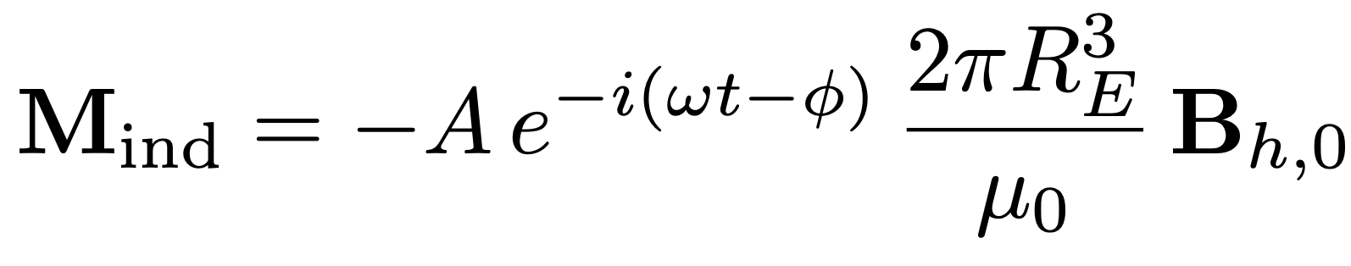
Forward Operator: Induction Physics
mhaynes@eas.gatech.edu
Dominant harmonic: synodic rotation period of Jupiter
Induction described by:
➔ spherical harmonic decomposition assuming spherical symmetry isotropic shape
For a prescribed subsurface conductivity profile, the inductive response is:
Vance et al. (2021)
Notes:
As the energetic ions impinge towards the moon’s interaction region, they experience a probability for undergoing charge exchange
If singly charged, the ion is subsequently neutralized

Slide 8
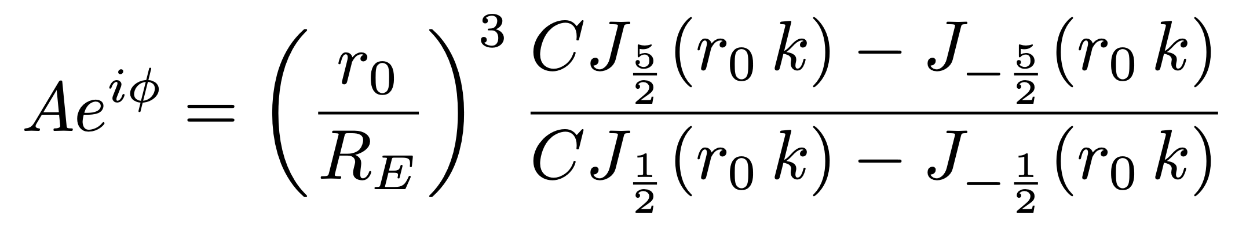
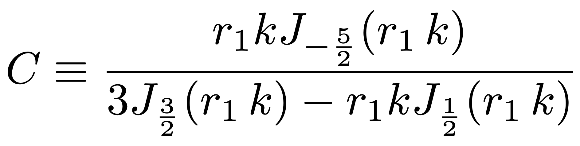
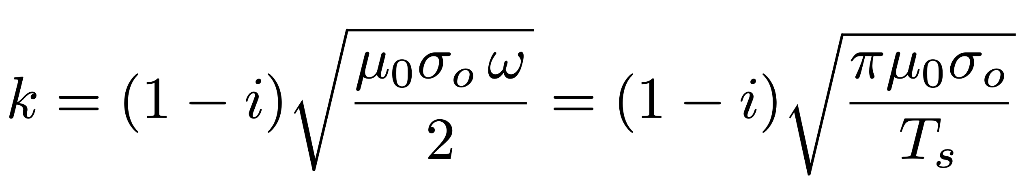
Forward Operator: Induction Physics
mhaynes@eas.gatech.edu
Amplitude, phase lag dependence
coefficient dependent on ocean depth
complex wavenumber dependent on conductivity value
Notes:
As the energetic ions impinge towards the moon’s interaction region, they experience a probability for undergoing charge exchange
If singly charged, the ion is subsequently neutralized

Slide 9
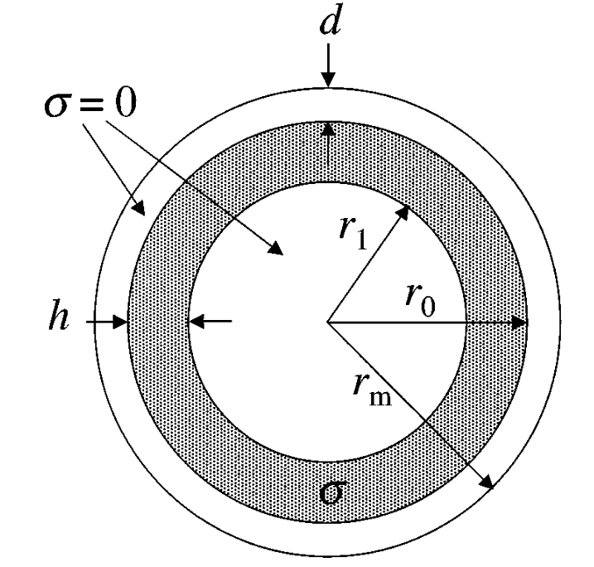
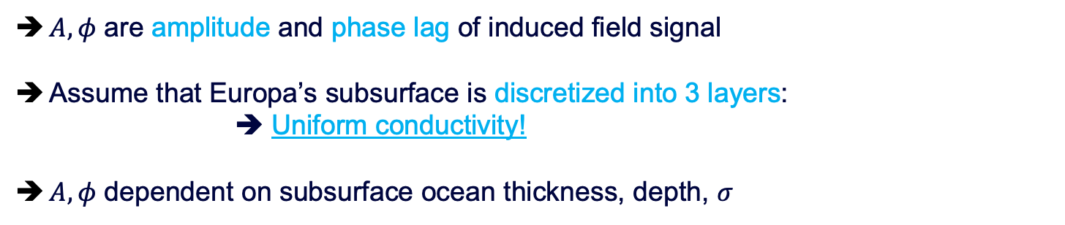
Strategy: Model Assumptions & Discretization
mhaynes@eas.gatech.edu
(Zimmer et al., 2000)
$A,φ$ are amplitude and phase lag of induced field signal
Assume that Europa’s subsurface is discretized into 3 layers:
➔ Uniform conductivity!
$A,φ$ dependent on subsurface ocean thickness, depth, $σ$

Slide 10

Inversion Strategy
mhaynes@eas.gatech.edu
Our assumed model of Europa’s subsurface is:
(Zimmer et al., 2000)
Notes:
As the energetic ions impinge towards the moon’s interaction region, they experience a probability for undergoing charge exchange
If singly charged, the ion is subsequently neutralized

Slide 11
Inversion Strategy
mhaynes@eas.gatech.edu
Our assumed model of Europa’s subsurface is:
(Zimmer et al., 2000)
Inner radius
Notes:
As the energetic ions impinge towards the moon’s interaction region, they experience a probability for undergoing charge exchange
If singly charged, the ion is subsequently neutralized

Slide 12
Inversion Strategy
mhaynes@eas.gatech.edu
Our assumed model of Europa’s subsurface is:
(Zimmer et al., 2000)
Outer radius
Notes:
As the energetic ions impinge towards the moon’s interaction region, they experience a probability for undergoing charge exchange
If singly charged, the ion is subsequently neutralized

Slide 13
Inversion Strategy
mhaynes@eas.gatech.edu
Our assumed model of Europa’s subsurface is:
(Zimmer et al., 2000)
Conductivity
Notes:
As the energetic ions impinge towards the moon’s interaction region, they experience a probability for undergoing charge exchange
If singly charged, the ion is subsequently neutralized

Slide 14
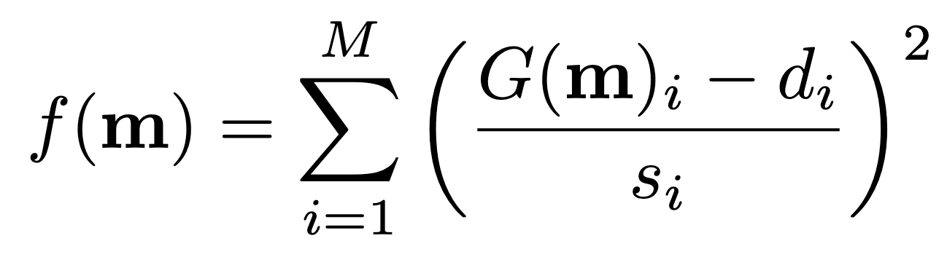
Inversion Strategy: Deterministic
mhaynes@eas.gatech.edu
For our nonlinear deterministic approaches, the objective function is:
We employ the Gauss-Newton method:
And the Levenberg-Marquardt Method (modified version: Trust Region Reflective)
Notes:
As the energetic ions impinge towards the moon’s interaction region, they experience a probability for undergoing charge exchange
If singly charged, the ion is subsequently neutralized

Slide 15
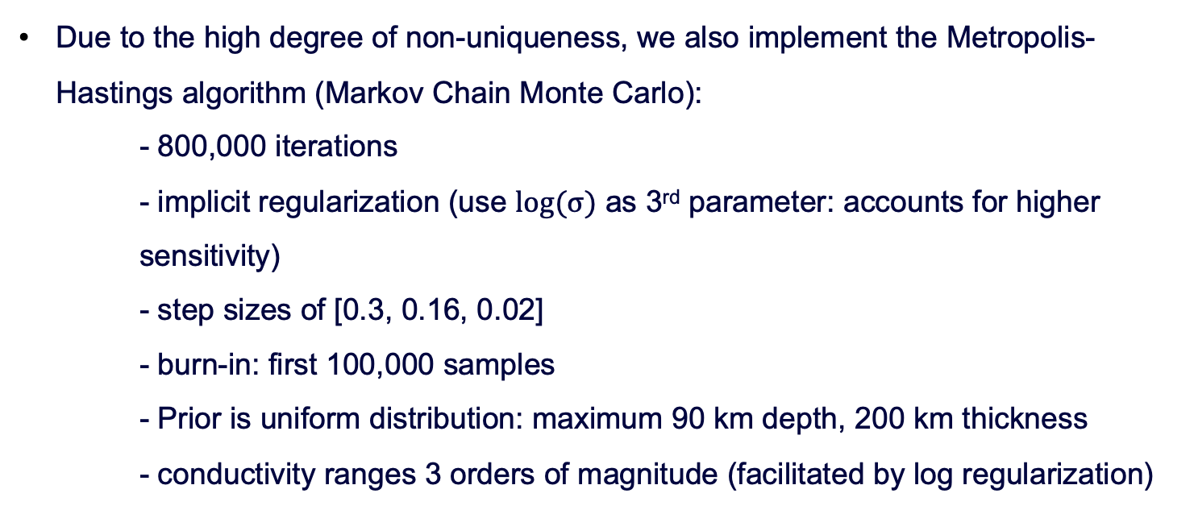
Inversion Strategy: Stochastic
mhaynes@eas.gatech.edu
Due to the high degree of non-uniqueness, we also implement the Metropolis-Hastings algorithm (Markov Chain Monte Carlo):
- 800,000 iterations
- implicit regularization (use $log(σ)$ as 3rd parameter: accounts for higher sensitivity)
- step sizes of [0.3, 0.16, 0.02]
- burn-in: first 100,000 samples
- Prior is uniform distribution: maximum 90 km depth, 200 km thickness
- conductivity ranges 3 orders of magnitude (facilitated by log regularization)
Notes:
As the energetic ions impinge towards the moon’s interaction region, they experience a probability for undergoing charge exchange
If singly charged, the ion is subsequently neutralized

Slide 16
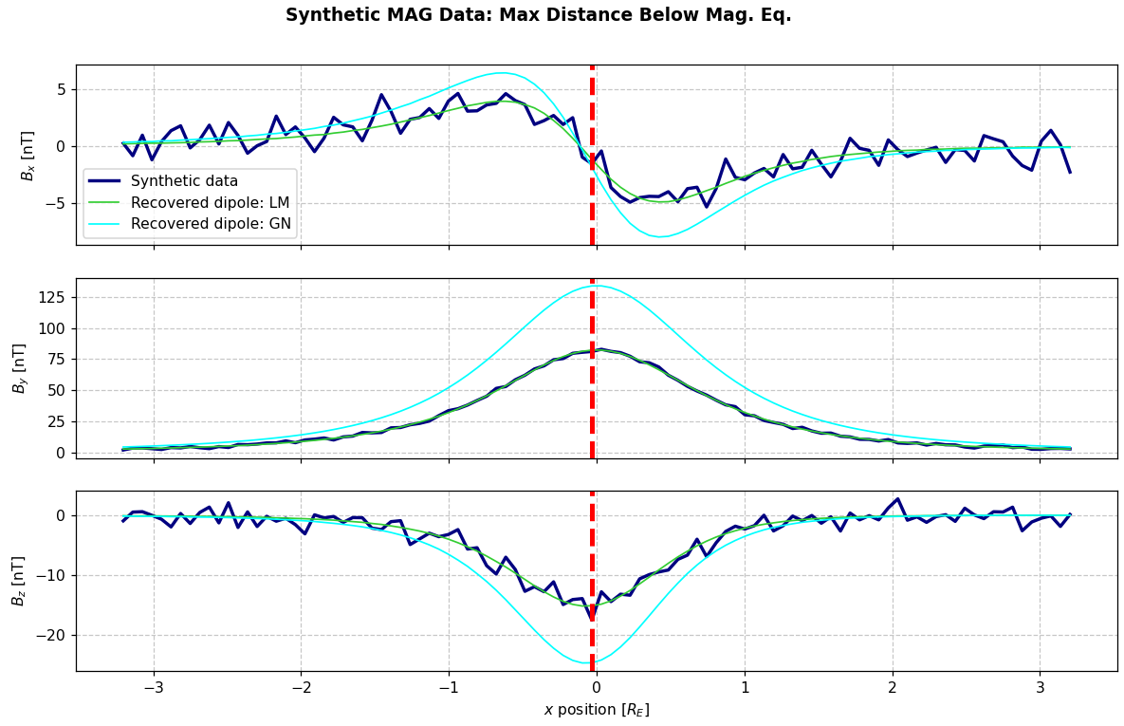

Results: Synthetic Data
mhaynes@eas.gatech.edu
m_true = [1400 km, 1540km, 2.5 S/m]
Notes:
As the energetic ions impinge towards the moon’s interaction region, they experience a probability for undergoing charge exchange
If singly charged, the ion is subsequently neutralized

Slide 17
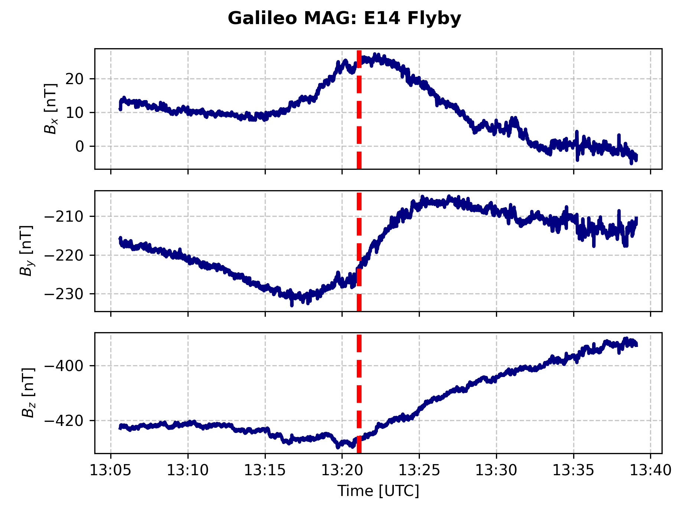
Results: Real Data
mhaynes@eas.gatech.edu
Notes:
As the energetic ions impinge towards the moon’s interaction region, they experience a probability for undergoing charge exchange
If singly charged, the ion is subsequently neutralized

Slide 18
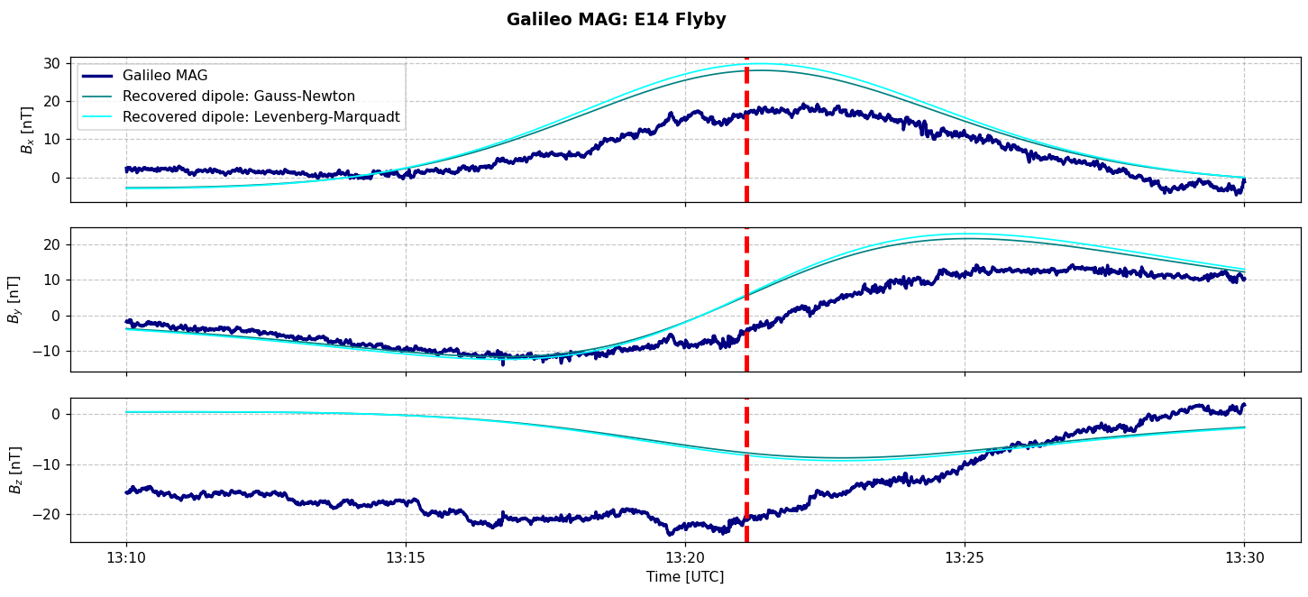
Results: Real Data
mhaynes@eas.gatech.edu
Notes:
As the energetic ions impinge towards the moon’s interaction region, they experience a probability for undergoing charge exchange
If singly charged, the ion is subsequently neutralized

Slide 19
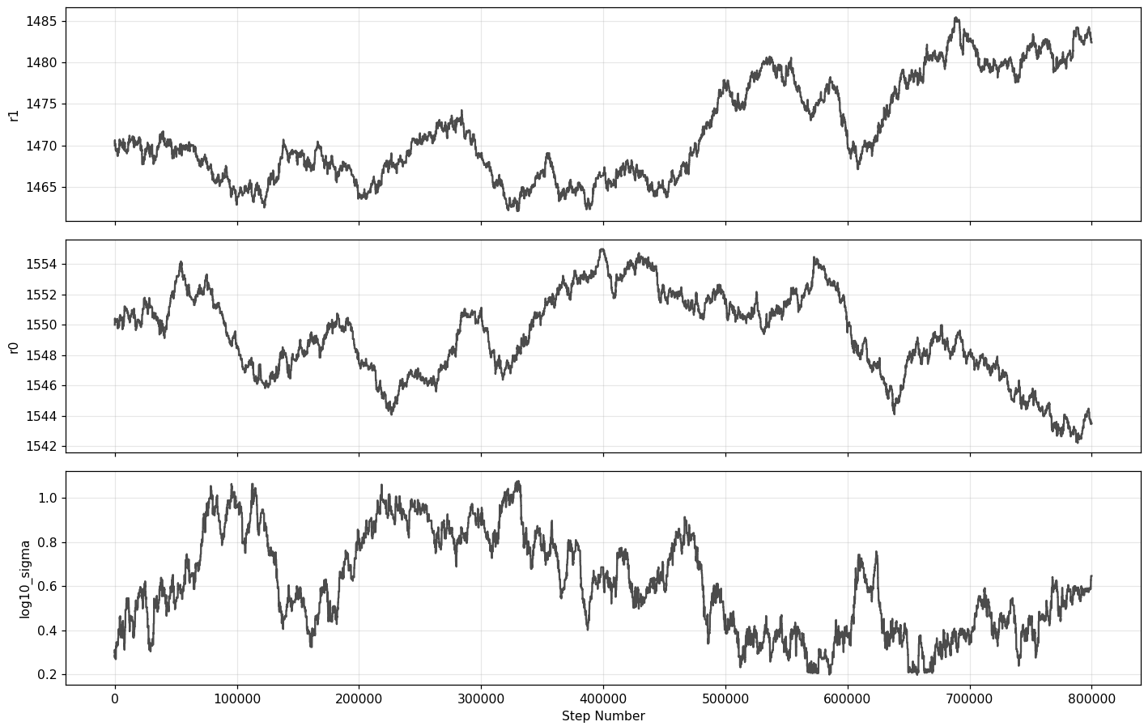
Statistical Results: Real Data
mhaynes@eas.gatech.edu
Notes:
As the energetic ions impinge towards the moon’s interaction region, they experience a probability for undergoing charge exchange
If singly charged, the ion is subsequently neutralized

Slide 20
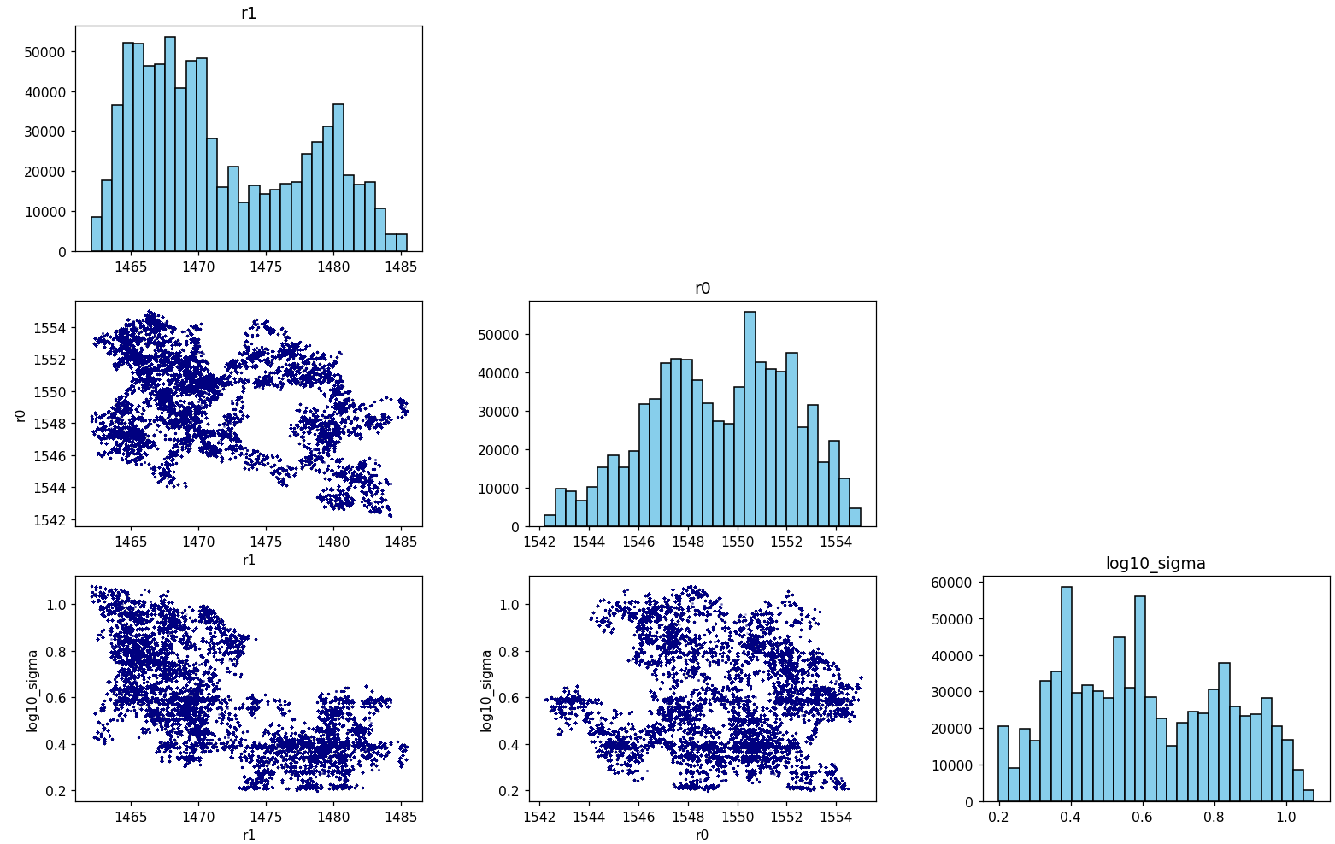
Statistical Results: Real Data
mhaynes@eas.gatech.edu
Notes:
As the energetic ions impinge towards the moon’s interaction region, they experience a probability for undergoing charge exchange
If singly charged, the ion is subsequently neutralized

Slide 21
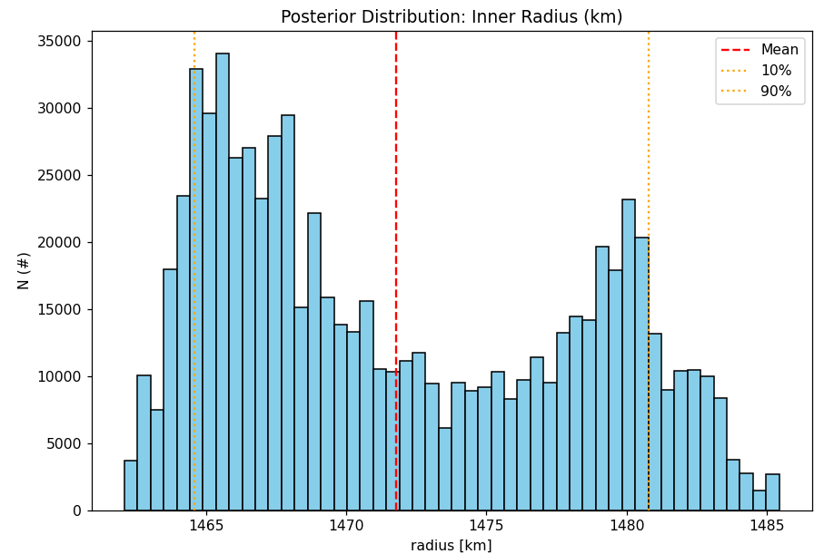
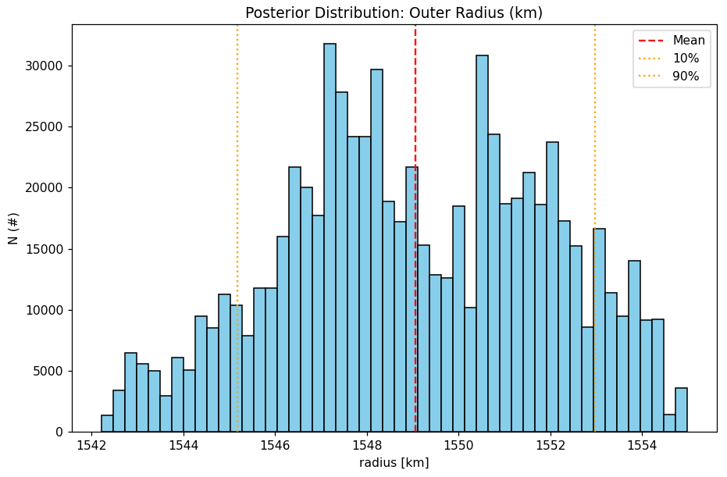
Statistical Results: Real Data
mhaynes@eas.gatech.edu
Notes:
As the energetic ions impinge towards the moon’s interaction region, they experience a probability for undergoing charge exchange
If singly charged, the ion is subsequently neutralized

Slide 22
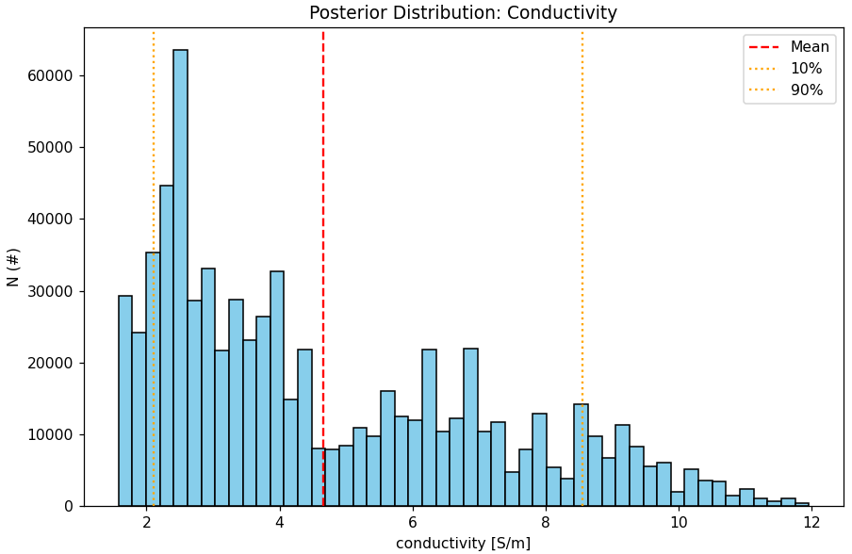
Statistical Results: Real Data
mhaynes@eas.gatech.edu
Notes:
As the energetic ions impinge towards the moon’s interaction region, they experience a probability for undergoing charge exchange
If singly charged, the ion is subsequently neutralized

Slide 23
Summary: Magnetic Induction Sounding at Europa
mhaynes@eas.gatech.edu
Goal: Constrain the depth, thickness, & conductivity of Europa’s ocean
Notes:
Results: While Ganymede’s internal field controls its ENA morphology, draping creates a discernible effect at Europa, Ganymede, and Callisto

Slide 24
Summary: Magnetic Induction Sounding at Europa
mhaynes@eas.gatech.edu
Goal: Constrain the depth, thickness, & conductivity of Europa’s ocean
Method: Combine in-situ magnetometer observations, context-driven data selection, and nonlinear Inverse methods (G-N, L-M, MCMC)
Notes:
Results: While Ganymede’s internal field controls its ENA morphology, draping creates a discernible effect at Europa, Ganymede, and Callisto

Slide 25
Summary: Magnetic Induction Sounding at Europa
mhaynes@eas.gatech.edu
Goal: Constrain the depth, thickness, & conductivity of Europa’s ocean
Method: Combine in-situ magnetometer observations, context-driven data selection, and nonlinear Inverse methods (G-N, L-M, MCMC)
Results: This problem is extremely non-unique! However, Europa definitely has a salty, liquid water ocean, with a thickness of ~100 km, depth of 10-20km, and conductivity of 1-5 S/m
Notes:
Results: While Ganymede’s internal field controls its ENA morphology, draping creates a discernible effect at Europa, Ganymede, and Callisto

Slide 26
Thank you

