Slide 1
Polymer Classification Using Machine Learning
EM/ISE 538
Mike Keating

Slide 2
Background Polymer Mechanical Testing & Material Selection
Design
Design Criteria
Data
Gather data on candidate materials to compare.
Mechanical data can be provided by supplier or performed by testing lab.
Selection
Select material based that meets the optimum criteria.
Often a balance that varies from project to project.
Physical
Mechanical
Regulatory
Cost
Notes:
Background Overview
Mechanical Testing & Material Selection:
In engineering and product development, selecting the right material is critical to ensure performance, safety, and cost-effectiveness.
Mechanical testing—such as measuring tensile strength, modulus, impact resistance, and elongation—provides quantitative data on how materials behave under different loads and conditions. These properties are essential for comparing materials and making informed choices for specific applications.
Ashby Plots:
Ashby plots are powerful visualization tools that map material properties against each other (e.g., strength vs. density). They help engineers quickly identify which materials meet the requirements for a given application by visualizing trade-offs and performance envelopes. For polymers, Ashby plots can reveal clusters and trends that correspond to different polymer classes.

Slide 3
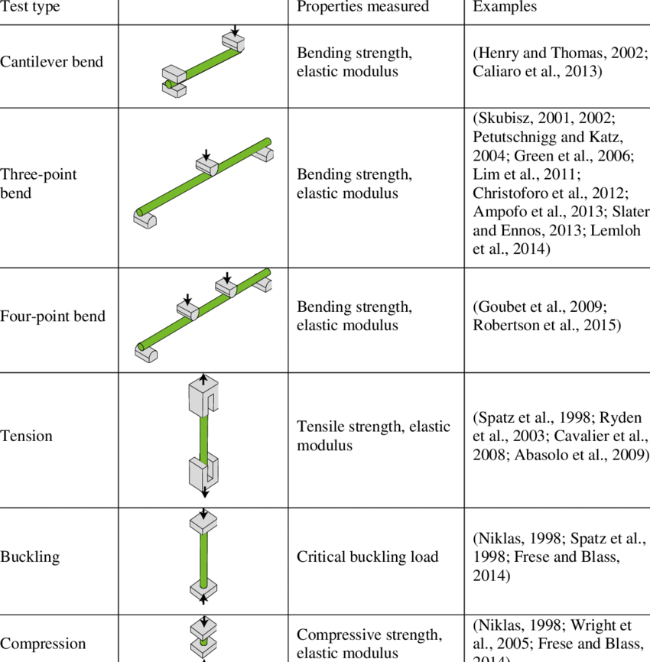
Background Polymer Mechanical Testing & Material Selection
Data
Gather data on candidate materials to compare.
Mechanical data can be provided by supplier or performed by testing lab.
Mechanical test types typically used on plant stems. Example references... | Download Table

Slide 4
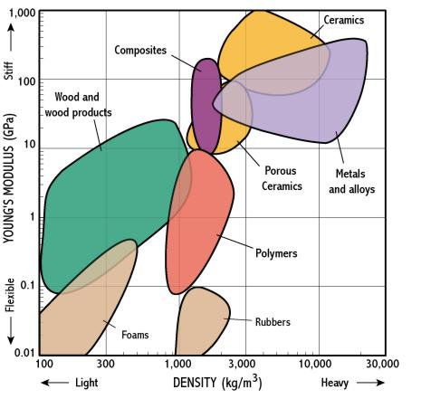
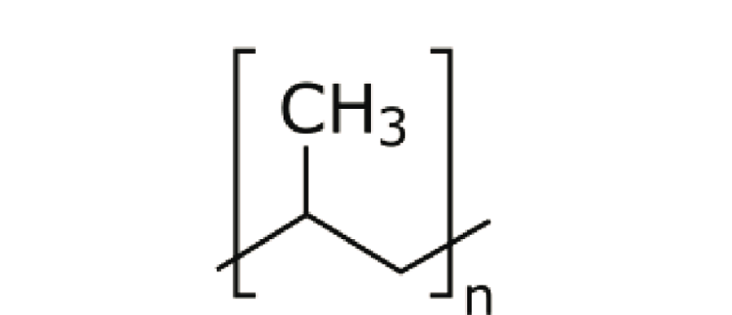
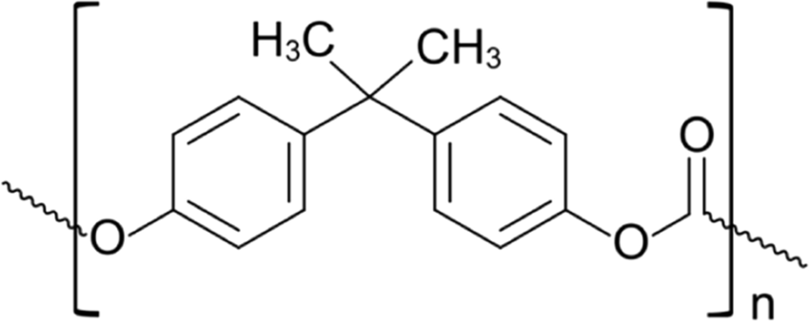
Background Material Selection & Classification
Materials can be placed in broad classes based on composition and properties.
Materials can be further divided into subclasses.
Polymers are generally classified by their polymer family (composition of repeat unit).
Ashby Plot
http://www-g.eng.cam.ac.uk/125/noflash/now/mfs/tutorial/non_IE/charts.html

Slide 5
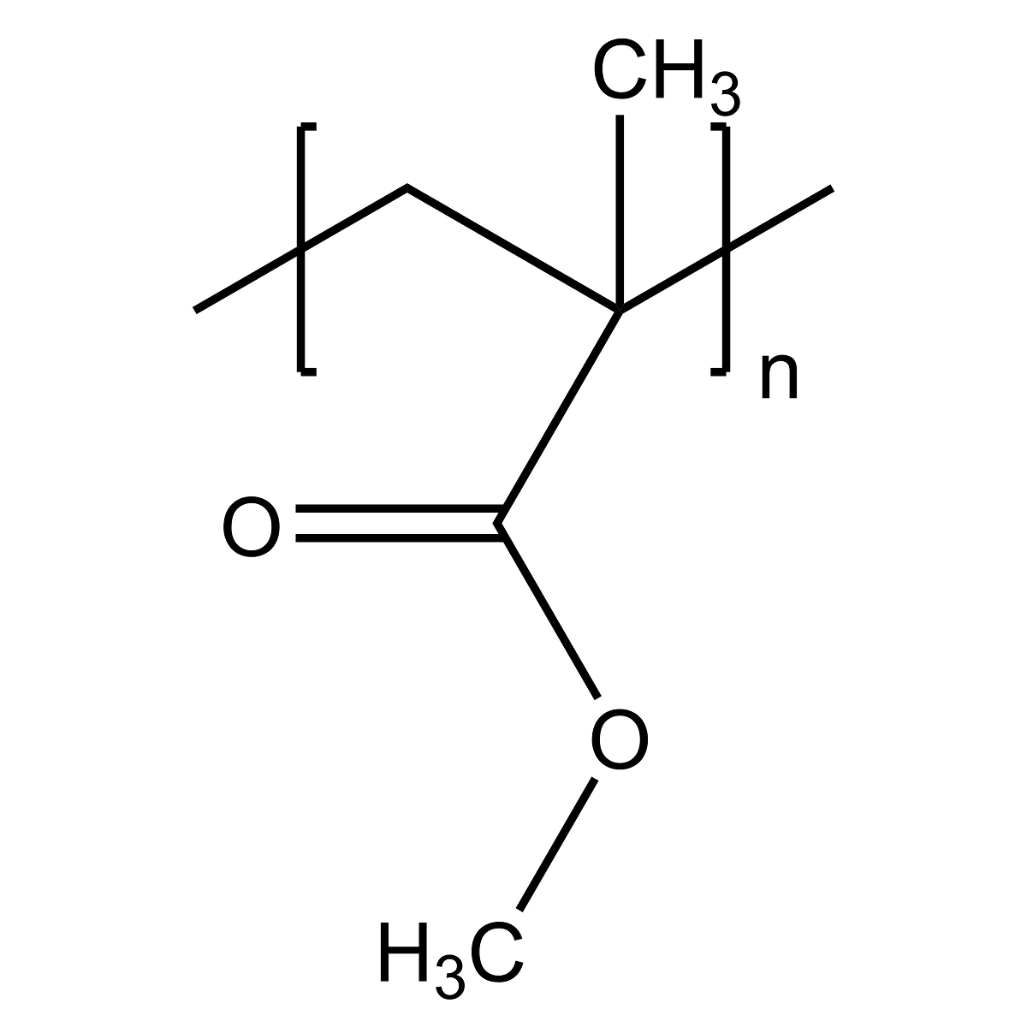
Background Polymer Subclasses
Polymers are generally classified by their polymer family (composition of repeat unit).
Poly(methyl methacrylate) [PMMA]
Polycarbonate
[PC]
Polypropylene
[PP]

Slide 6
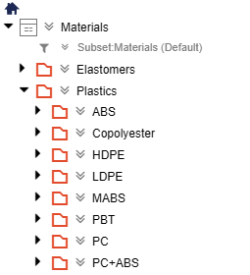
Problem Statement
Polymer subclasses offer a quick way to reference polymers with similar physical and mechanical properties.
Occasionally in R&D, the composition or subclass of a polymeric material may be unknown.
There is still a desire to group unknown materials together, particularly in a material database.
Manually determining subclass can be tedious or impractical.
There is a need for an automated assignment of polymer subclass for the purpose of database organization.

Slide 7
Goals
Create a ML model that can predict polymer subclass based on mechanical data.
Model will be trained to predict on a small subset of polymer classes, with a target of at least 5 unique classes.
Achieve at least 80% classification accuracy

Slide 8

Data Source
UL Prospector
Database containing technical data of over 100,000 polymeric materials.
Data is primarily provided by the material supplier.
Access is free with registration.

Slide 9
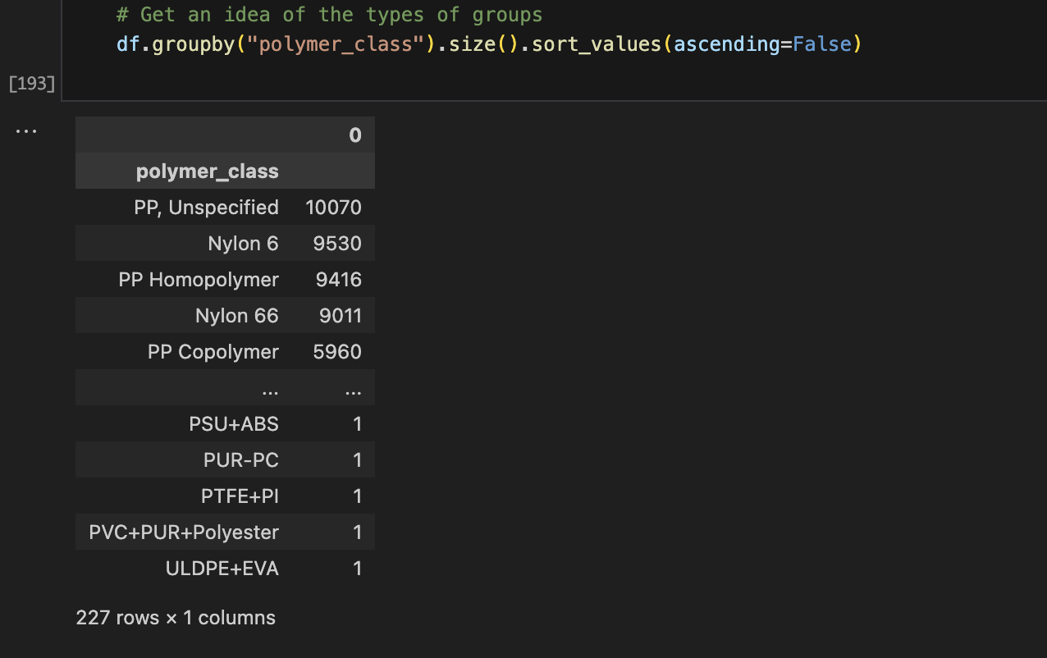
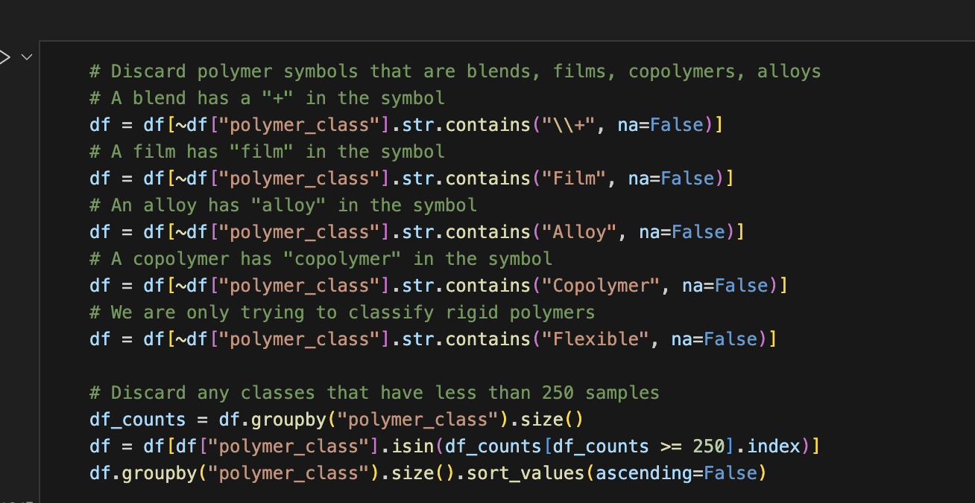
Data Preparation
Database was queried with a handful of polymer symbols (PP, ABS, etc) and a .csv file was generated for each
Raw data included blends, alloys, and composites and required extensive cleaning.

Slide 10
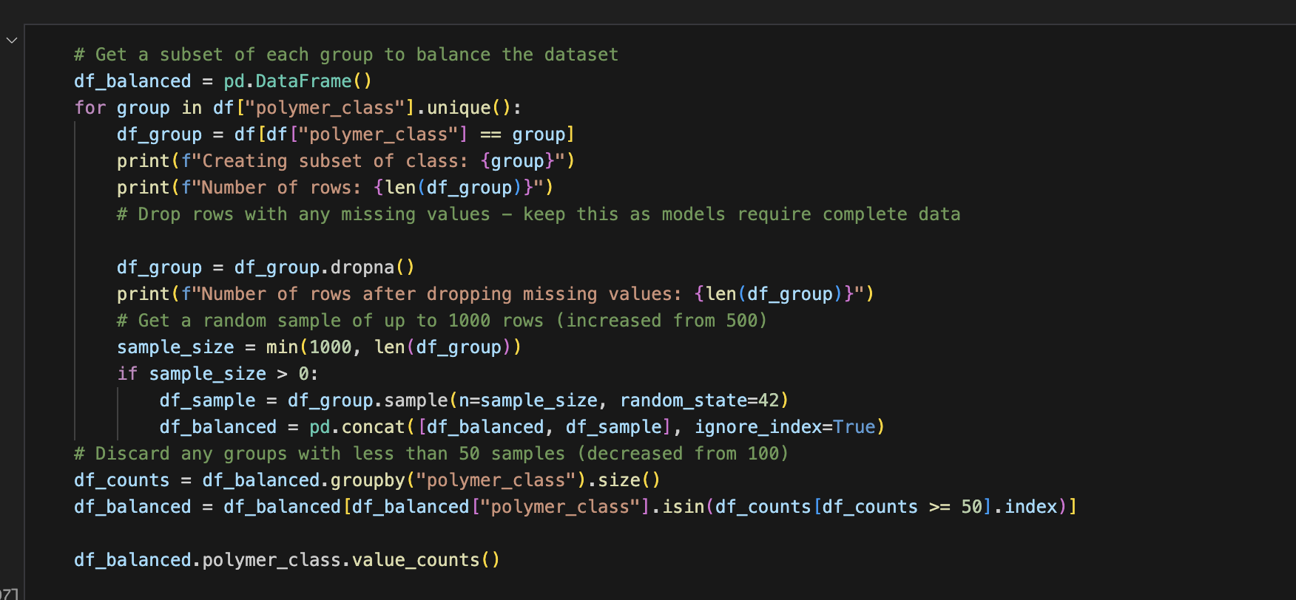
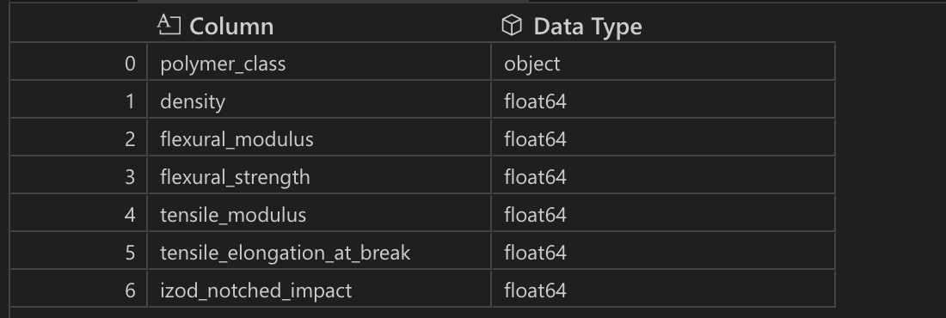
Data Preparation
Many entries missing one or more feature values.
Large potential for class imbalance if simply discarding NaN values.
Subsets with complete feature data were created from several hand selected polymer classes.
Only features with sufficient available data were selected.
Final Dataset Response and Features

Slide 11
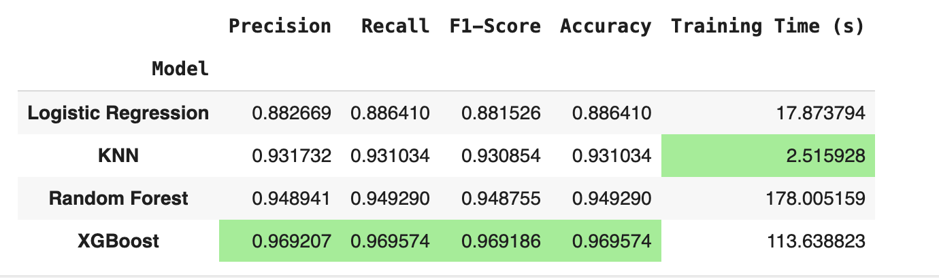
Model Results Summary

