Slide 1
Polymer Classification Using Machine Learning
EM/ISE 538
Mike Keating

Slide 2
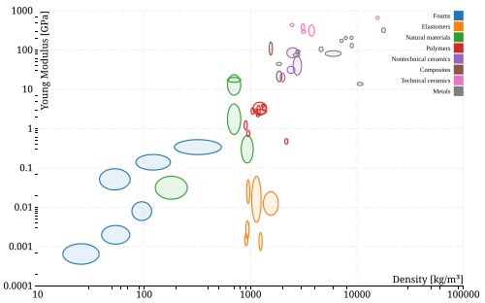
Background
Classification is important for material selection.
Materials can be organized into many broad classes including:
Metals
Ceramics
Polymers
Polymers are further organized into their subclasses (PP, PET, etc)

Slide 3
Polymer Classification
Broad: Plastics, Elastomers, Thermosets
Polymer Subclass
Generally based on polymer composition
High Strength: PEEK,

Slide 4
Goals
Create a ML model that is able to predict polymer class based on mechanical data.
Model will be trained to predict on a small subset of polymer classes, with a target of at least 5 unique classes.
Achieve at least 80% classification accuracy

Slide 5

Data Source
UL Prospector
Database containing technical data of over 100,000 polymeric materials.
Data is primarily provided by the material supplier.
Access is free with registration.

Slide 6
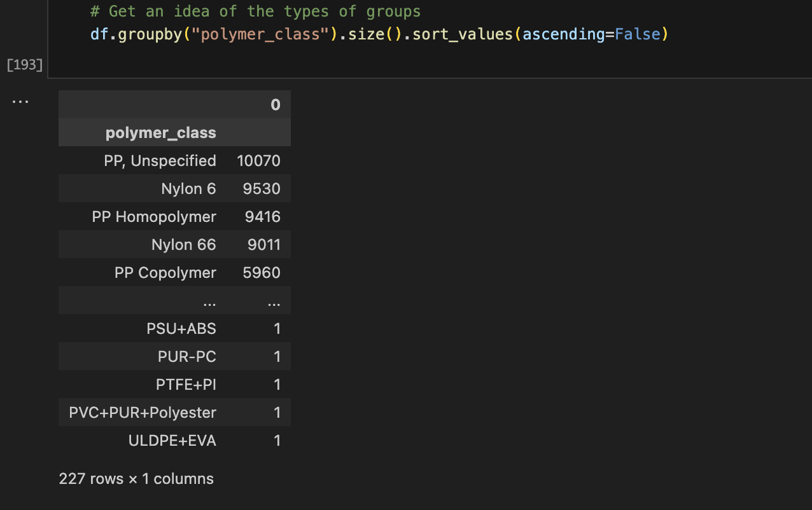
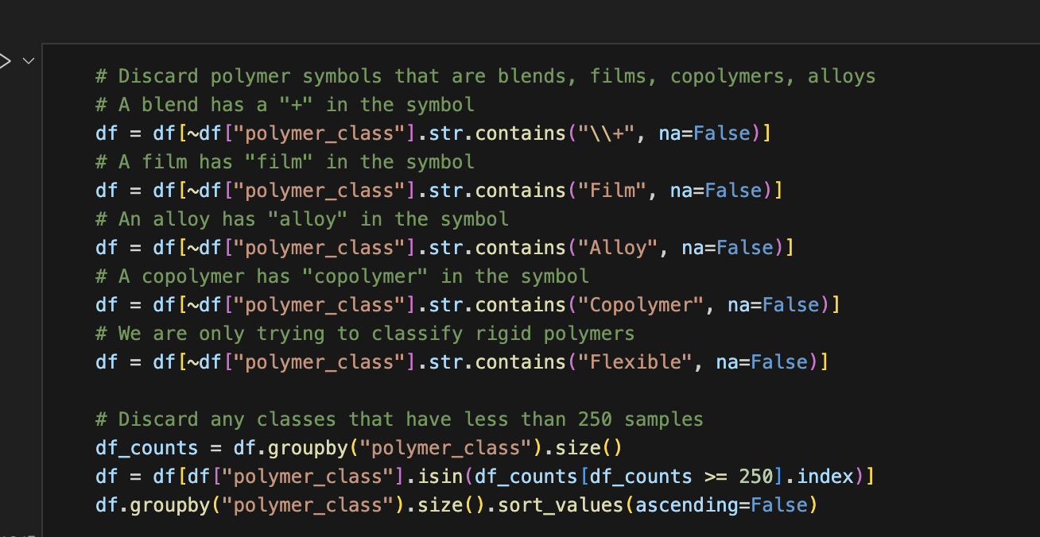
Data Preparation
Database was queried with a handful of polymer symbols (PP, ABS, etc) and a .csv file was generated for each
Raw data included blends, alloys, and composites and required extensive cleaning.

Slide 7
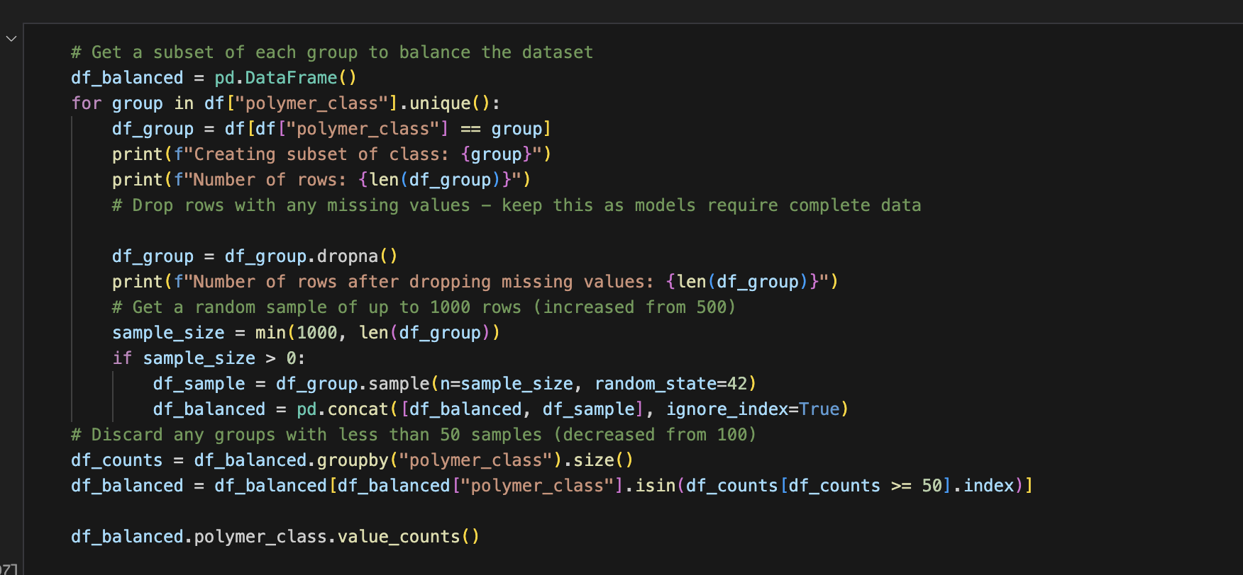
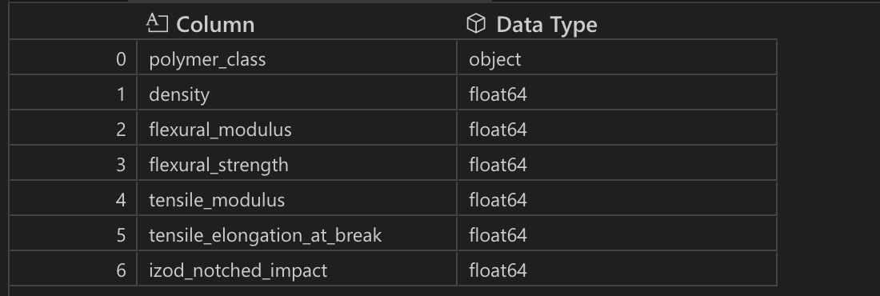
Data Preparation
Many entries missing one or more feature values.
Large potential for class imbalance if simply discarding NaN values.
Subsets with complete feature data were created from several hand selected polymer classes.
Only features with sufficient available data were selected.
Final Dataset Response and Features

Slide 8
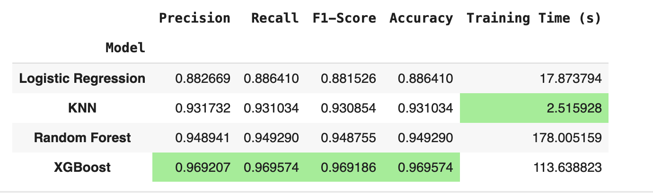
Model Results Summary

