Slide 1
Introduction to Docker
Illinois State Water Survey / Advanced Modelling Meeting
11/04/2025
Notes:
Hi everyone,
Today. I am going to tell useful information about Docker software.

Slide 2
Overview
Basic Docker Background
Workflow and Small Demos
Demo: Download Docker image Run on your Computer
Notes:
First, I will point out basic docker background.
then I will continue with docker workflow small demos about how to create docker container and how to push/commit our docker container images.
And last, I am planning to have a group exercise download our docker image and run in your computer.
Quick update : We have used the isws – demonstration models while creating our docker container.

Slide 3
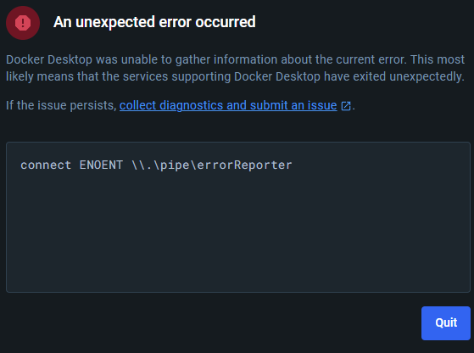
Please run Docker and Power Shell as your admin account!!!
Notes:
Just before start, I would like to kindly remind everyone we are running Docker and power shell in our administration account.
At the beginning of Parflow, I was forgetting this and getting unexpected error page that prevents me from using DockerDesktop.

Slide 4
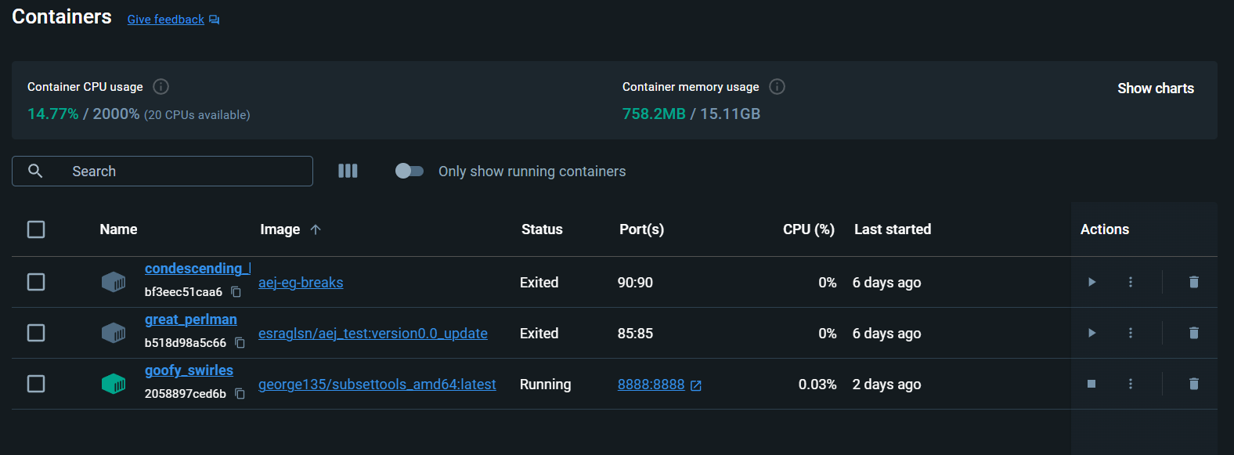
Docker Container
Docker: a software container platform.
Docker File: a text document that contains all the commands a user could call to build an image.
to create a text document that contains all commands.
once the image is built docker build then docker run.
Notes:
Let me start with meaning of docker:
Docker is a software container platform. Mostly computer engineer is using to share their programming update each other. You can share software /website update with your docker container to your co-workers.
To create this containers, we need to start with creating docker file.
Docker file: a text document that contains all the commands a user could call to build and image.
The idea behind the process of setting up and running a container is to create a text document that contains all commands.
Once the image is built then you can create container in the docker .

Slide 5
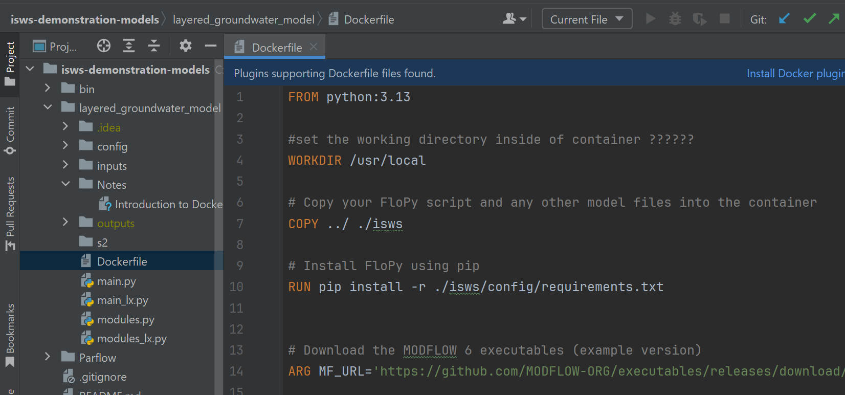
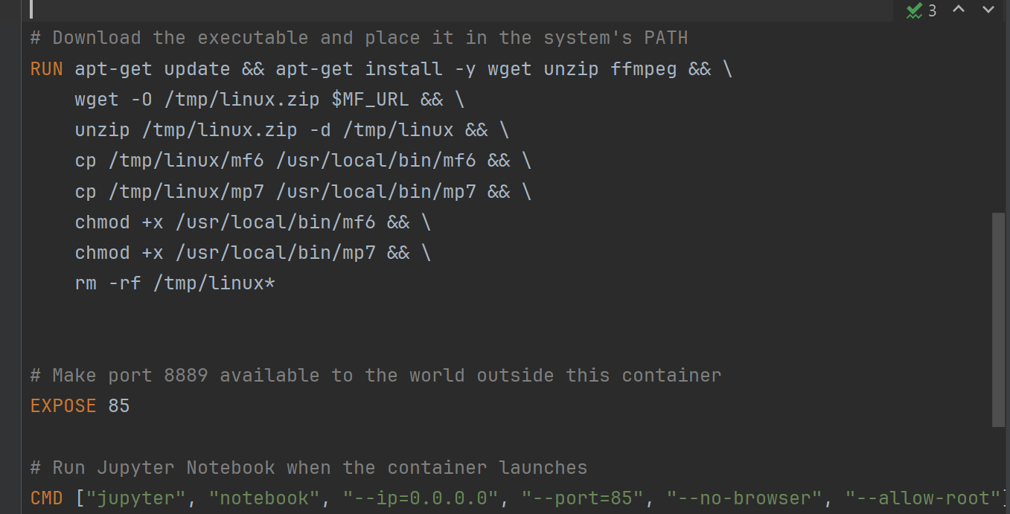
Docker file
Docker file: a text document that contains all the commands a user could call to build an image.
FROM: This includes base image structure base image start from the Docker Hub. (e.g., ubuntu: latest, python:3.9, parflow: latest).
COPY: Copies files or directories from your GitHub into the image.
ENV: Sets environment variables.
CMD: Provides default commands for an executing container.
Notes:
Here is the one example of docker file which include FROM, COPY,ENV, CMD
We have created this docker file depending on our model paths and programs .
For example: for notebook we called python 3.13 from Docker Hub. And we gave our work directory and files that we need to copy
I want to point out here is the port number inside of our Expose command:
Port number is new term for us.
The ports in docker are essential for enabling communication between docker containers and outside of the world via the internet.
After building our image from this docker file, we are gonna call our container with this port number .

Slide 6
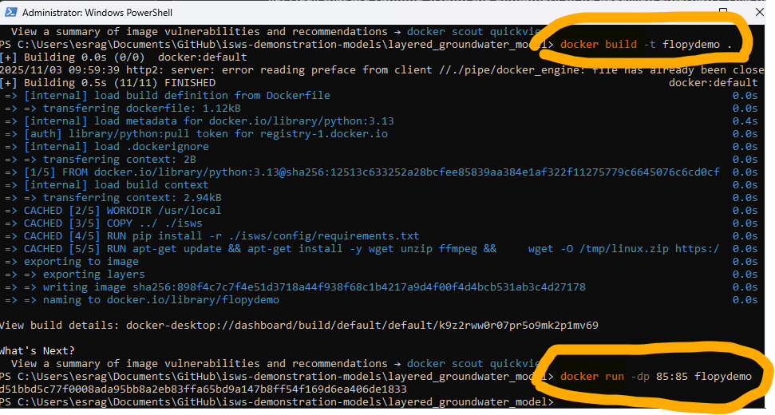
docker build/run
docker file ➔ (1) docker build ➔ image ➔(2) docker run➔ docker container (3)
docker build -t flopydemo .
docker run -dp 85:85 flopydemo
Container Active
Work in Jupyter Notebooks
-d = detachment
-p = port number by publishing a container’s network service to the host or external network through port mapping, you can make it reachable from other networked devices.
Notes:
I think the most important part is starting here.
As we talk previous slide, POINTER
First, we are creating our container with docker file then with docker build command we are building our image then with docker run command we are creating our docker container.
docker build -t flopydemo .
Point at the end of this command line is important. this specifies the build context, which is the current directory in our case.
Docker will look for the Docker file and other necessary files within this context.

Slide 7
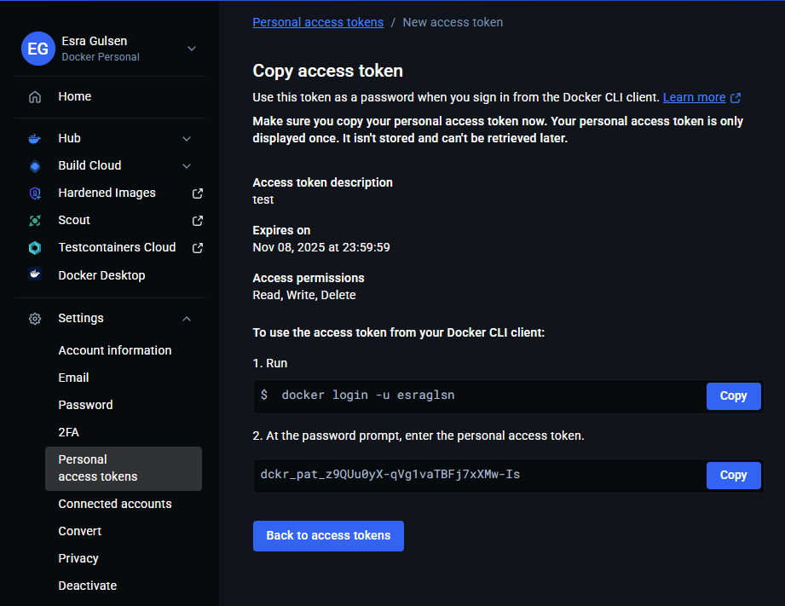
Docker Hub
docker login --username YOUR_USERNAME
Password: [paste your PAT here]
When prompted for a password, enter your personal access token instead of your Docker Hub password.
Notes:
After create our image we work with our model inside container, then We will need to share our updates with other people, So that anyone can pull our work.
This workflow will be very similar our current GitHub workflow. You can push, pull, and commit just like we do with GitHub. Similar actions, different commands. And we are gonna share our container (like GitHub Repo) via Docker Hub.
We need to login and enter with our password in PowerShell.
Password will be our token number in Docker container.

Slide 8
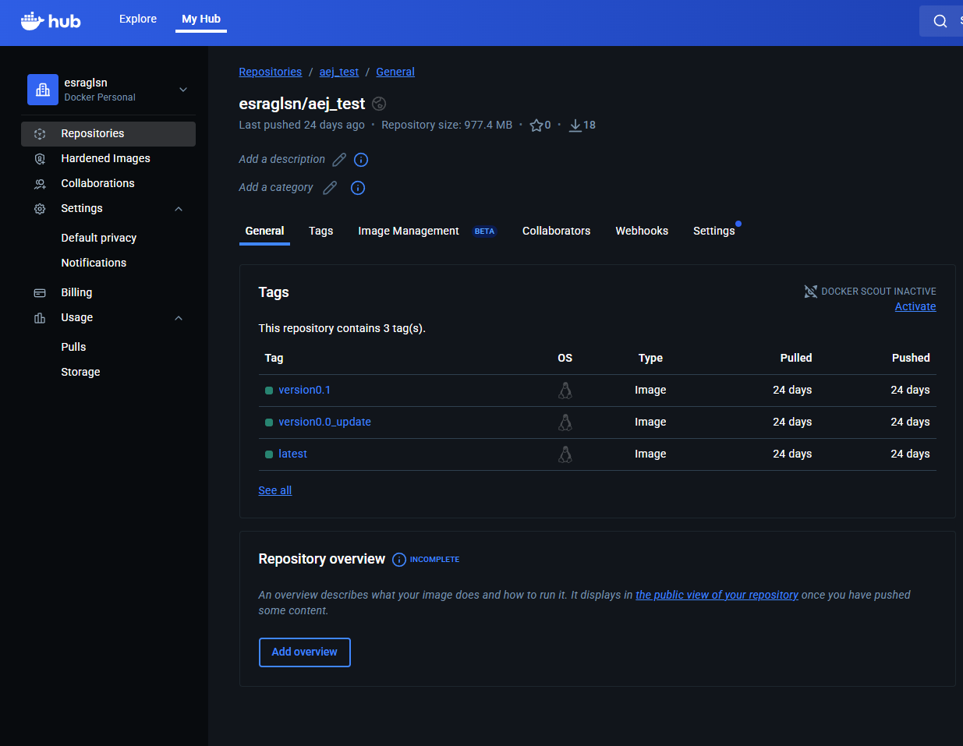
Docker Hub
Repositories
Notes:
And very similar to our github we have repositories and versions in Docker Hub.

Slide 9
docker file ➔# docker build ➔ image ➔#docker run➔ docker container
docker build -t version0.0 <<dockerfile_dir>>
docker run -dp 85:85 version0.0
… [work in container to make updates] …
docker commit <<container_name>> esraglsn/aej_test:version0.0
docker tag esraglsn/aej_test:version0.0 esraglsn/aej_test:version0.1
docker push esraglsn/aej_test:version0.1
… [Share container with others] …
docker pull esraglsn/aej_test:version0.1
docker run -dp 85:85 esraglsn/aej_test:version0.1
Build a Container like you build a Repo
Notes:
PURPLE!
Don’t pay attention to details; I would like you to pay attention to purple circle same github
Docker workflow is like GitHub workflow: commit, push, pull!!

Slide 10
docker file ➔# docker build ➔ image ➔#docker run➔ docker container
docker build -t version0.0 <<dockerfile_dir>>
docker run -dp 85:85 version0.0
… [work in container to make updates] …
docker commit <<container_name>> esraglsn/aej_test:version0.0
docker tag esraglsn/aej_test:version0.0 esraglsn/aej_test:version0.1
docker push esraglsn/aej_test:version0.1
… [Share container with others] …
docker pull esraglsn/aej_test:version0.1
docker run -dp 85:85 esraglsn/aej_test:version0.1
Build a Container like you build a Repo
Notes:
Version!!!!

Slide 11
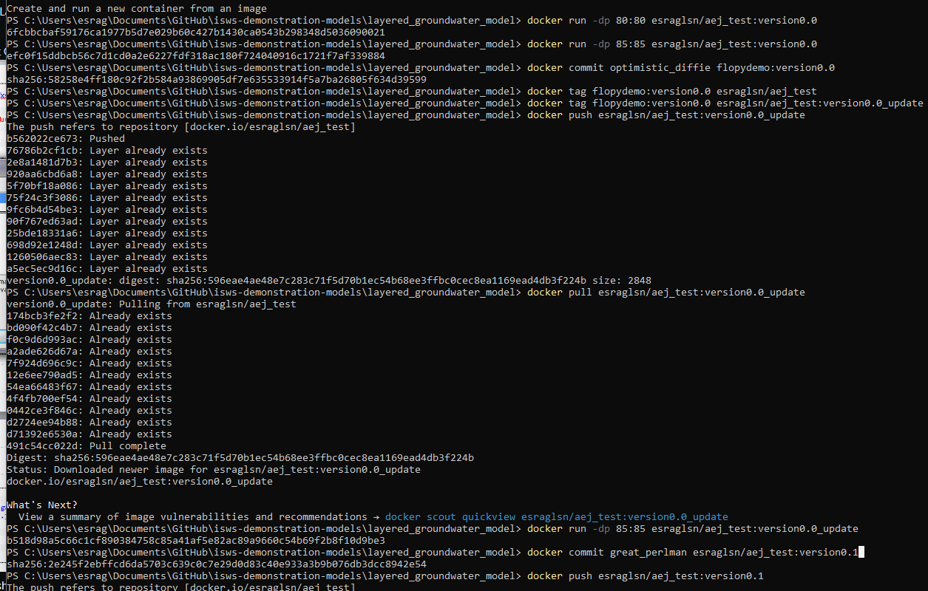

Slide 12
Docker Image
Docker Image: The file system and parameters needed to run application.
contains everything needed to run an application, including its files, configuration, and dependencies.
Notes:
Docker Image: The file system and parameters needed to run application.
Docker images, think of them as a standardized package that contains everything needed to run an application, including its files, configuration, and dependencies.

Slide 13
docker commit/push
docker commit <<container_name>> flopydemo:version0.0
docker tag flopydemo:version0.0 esraglsn/aej_test:flopydemo
docker push esraglsn/aej_test:flopydemo
- docker push = command
- esraglsn/aej_test = the repository name
docker push + repository name + : + image

Slide 14
docker file ➔# docker build ➔ image ➔#docker run➔ docker container
docker build -t flopydemo .
docker run -dp 85:85 flopydemo
… [work in container to make updates] …
docker commit <<container_name>> esraglsn/aej_test:version0.0
docker tag esraglsn/aej_test:version0.0 esraglsn/aej_test:flopydemo
docker push esraglsn/aej_test:flopydemo
… [Share container with others] …
docker pull esraglsn/aej_test:flopydemo
Build a Container like you build a Repo
Notes:
PURPLE!
Don’t pay attention to details; same github
Docker workflow is like GitHub workflow: commit, push, pull!!

