Slide 1
Getting Started with OpsWorks

Slide 2
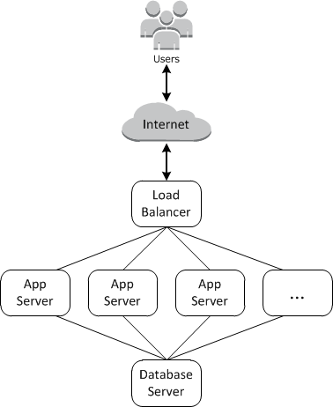
Create a Stack
A stack is a collection of instances and related resources that that have a common purpose and you want to manage them together
In addition to creating the instances and installing the necessary packages, you typically need a way to distribute applications to the application servers, monitor the stack's performance, manage security and permissions, and so on.

Slide 3
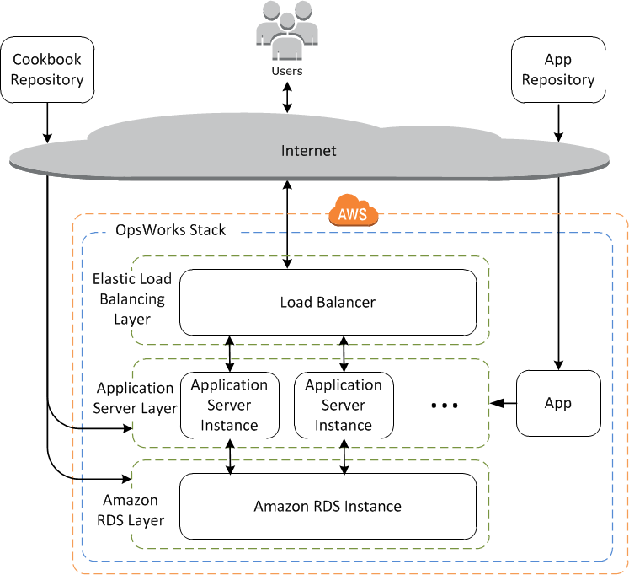
AWS Opsworks
AWS OpsWorks provides a simple and flexible way to create and manage stacks and applications.
You define the stack's constituents by adding one or more layers.

Slide 4
Layers
A layer is a blueprint for a set of Amazon EC2 instances. It specifies the instance's settings, associated resources, installed packages, profiles, and security groups.
You can customize or extend layers by modifying packages' default configurations, adding Chef recipes to perform tasks such as installing additional packages, and more.
Layers give you complete control over which packages are installed, how they are configured, how applications are deployed, and more.
You can also add recipes to lifecycle events of your instances, for example: to set up, deploy, configure your instances, or discover your resources.

Slide 5
Recipes and Lifecycle Events
Layers depend on Chef recipes to handle tasks such as installing packages on instances, deploying apps, running scripts, and so on.
One of the key AWS OpsWorks features is a set of lifecycle events:
Setup
Configure
Deploy
Undeploy
Shutdown
Each lifecycle event automatically runs a specified set of recipes at the appropriate time on each instance.
Each layer can have a set of recipes assigned to each lifecycle event, which handle a variety of tasks for that event and layer.

Slide 6
Instances
An instance represents a single computing resource, such as an Amazon EC2 instance.
It defines the resource's basic configuration, such as operating system and size.
Other configuration settings, such as Elastic IP addresses or Amazon EBS volumes, are defined by the instance's layers.
The layer's recipes complete the configuration by performing tasks such as installing and configuring packages and deploying apps.
You can use AWS OpsWorks to create instances and add them to a layer.
When you start the instance, AWS OpsWorks launches an Amazon EC2 instance using the configuration settings specified by the instance and its layer.
After the Amazon EC2 instance has finished booting, AWS OpsWorks installs an agent that handles communication between the instance and the service and runs the appropriate recipes in response to lifecycle events.
AWS OpsWorks supports the following instance types, which are characterized by how they are started and stopped.
24/7 instances are started manually and run until you stop them.
Time-based instances are run by AWS OpsWorks on a specified daily and weekly schedule.
They allow your stack to automatically adjust the number of instances to accommodate predictable usage patterns.
Load-based instances are automatically started and stopped by AWS OpsWorks, based on specified load metrics, such as CPU utilization.
They allow your stack to automatically adjust the number of instances to accommodate variations in incoming traffic. Load-based instances are available only for Linux-based stacks.

Slide 7
Applications
You store applications and related files in a repository, such as an Amazon S3 bucket.
Each application is represented by an app, which specifies the application type and contains the information that is needed to deploy the application from the repository to your instances, such as the repository URL and password.
When you deploy an app, AWS OpsWorks triggers a Deploy event, which runs the Deploy recipes on the stack's instances.
You can deploy apps in the following ways:
Automatically
When you start instances, AWS OpsWorks automatically runs the instance's Deploy recipes.
Manually
If you have a new app or want to update an existing one, you can manually run the online instances' Deploy recipes.
You typically have AWS OpsWorks run the Deploy recipes on the entire stack, which allows the other layers' instances to modify their configuration appropriately.
However, you can limit deployment to a subset of instances if, for example, you want to test a new app before deploying it to every app server instance.

Slide 8
Cookbooks
A cookbook is a Chef concept.
Cookbooks are archive files that contain configuration information, such as recipes, attribute values, files, templates, libraries, definitions, and custom resources.

Slide 9
Recipes
A recipe is also a Chef concept.
Recipes are instructions, written with Ruby language syntax, that specify the resources to use and the order in which those resources are applied.

Slide 10
Resources
A resource, as used in Chef, is a statement of configuration policy.

Slide 11
Data Bags
A data bag is also a Chef concept.
A data bag is a global variable that is stored as JSON data on an instance; the JSON data is accessible from Chef.
AWS OpsWorks stores its data bags on each stack's instances.
Data bag content can include any of the following:
String content that follows standard Ruby syntax and can use single or double quotes, although strings containing certain special characters must have double quotes. For more information, go to the Ruby documentation site.
Boolean content, which is either true or false (no quotes).
Number content, which is either integer or decimal numbers, such as 4 or 2.5 (no quotes).
List content, which takes the form of comma-separated values enclosed in square brackets (no quotes), such as [ '80', '443' ]
JSON objects, which contain additional data bag content, such as "my-app": {"elastic_ip": null,...}.
AWS OpsWorks provides the following search indexes:
aws_opsworks_app, which represents a set of deployed apps for a stack.
aws_opsworks_command, which represents a set of commands that were run on a stack.
aws_opsworks_ecs_cluster, which represents a set of Amazon EC2 Container Service (Amazon ECS) cluster instances for a stack.
aws_opsworks_elastic_load_balancer, which represents a set of Elastic Load Balancing load balancers for a stack.
aws_opsworks_instance, which represents a set of instances for a stack.
aws_opsworks_layer, which represents a set of layers for a stack.
aws_opsworks_rds_db_instance, which represents a set of Amazon Relational Database Service (Amazon RDS) instances for a stack.
aws_opsworks_stack, which represents a stack.
aws_opsworks_user, which represents a set of users for a stack.
app = search("aws_opsworks_app").first
Chef::Log.info("********** The app's short name is '#{app['shortname']}' **********")
Chef::Log.info("********** The app's URL is '#{app['app_source']['url']}' **********")

