Slide 1




Personal Banking Financial Analysis Report
(Synthetic Data Version)
Michael Mayers
October 2026

Slide 2

OUTLINE
Executive Summary
Introduction
Methodology
Results
Discussion
Conclusion
Appendix

Slide 3
EXECUTIVE SUMMARY
This project analyzes synthetic historical bank transaction data to identify patterns in spending and income.
Analyzed available bank statements across five years
Cleaned, transformed, and classified transaction data
Difference between annual expenses and income was relatively small across five years
Annual expenses and income peaked in 2025
Spending was concentrated on one entity accounting for a majority of total spending
The analysis demonstrates how synthetic financial data can be transformed into actionable insights through data analytics and visualization.

Slide 4
INTRODUCTION
This report focuses on a personal banking financial analysis project. The data consisted of 48 bank statements (synthetic data) spanning five years.
The synthetic dataset was created to reproduce characteristics of personal bank statements without exposing private financial information.
This report will present the spending and income trends, and opportunities for improved financial management.

Slide 5
METHODOLOGY
Data Sources: 48 bank statements (synthetic data) from 2022-2026
Data Collection:
Generated synthetic data as individual PDFs to simulate real-world personal banking transactions.
Files had varying lengths and blank pages with no transaction data.
Data Wrangling:
Cleaned and standardized transaction descriptions using fuzzy string matching and an LLM.
Extracted data to create a date field for easy querying.
Data Validation:
Verified that transformations did not corrupt the data.

Slide 6
METHODOLOGY
Tools & Technologies: Python, Pandas, Matplotlib, Plotly, Dash, Jupyter Notebook, Ollama
Privacy & Data Handling: All analysis was executed locally. Only the synthetic data version is shared publicly.

Slide 7
RESULTS
Summary Metrics
Indicator | Value
Total Expenses | ~BBD 210,000
Total Income | ~BBD 212,000
Number of transactions | 2,192

Slide 8
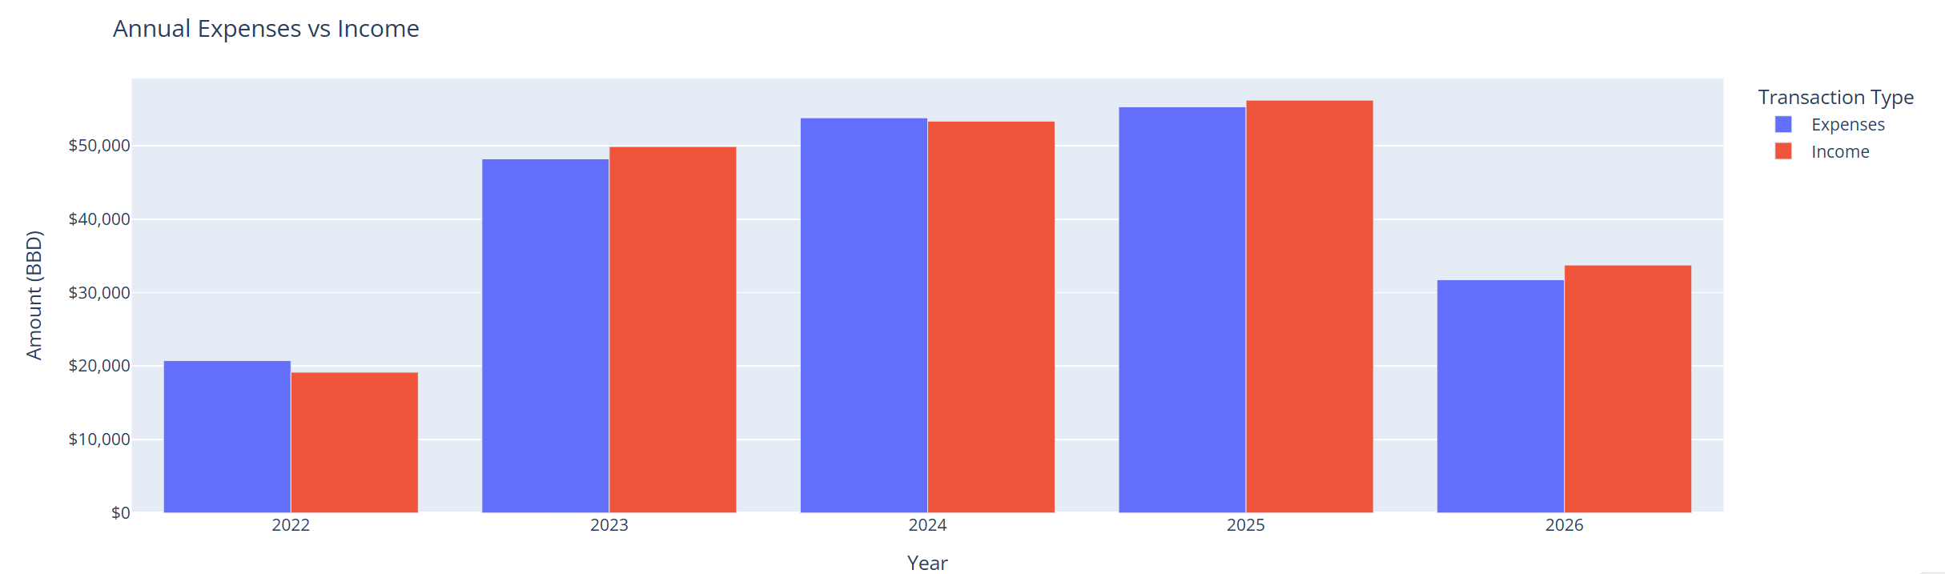
RESULTS
Annual Expenses vs Income
Expenses exceeded income in 3 out of 5 years
Greatest expenses and income occurred in 2025

Slide 9
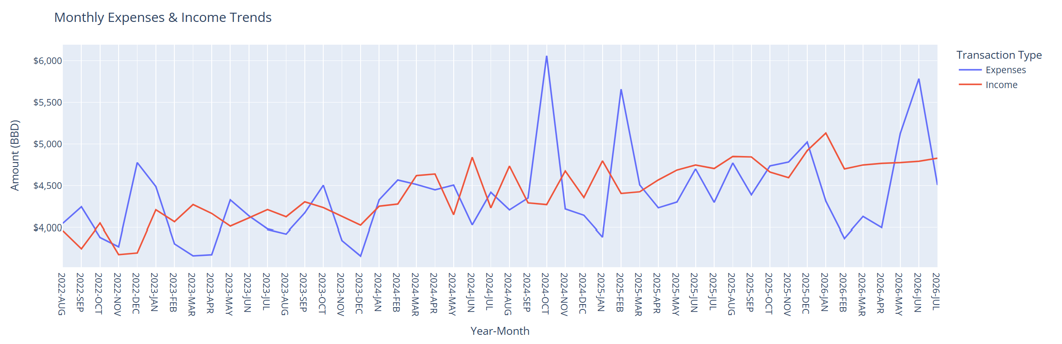
RESULTS
Monthly Expenses & Income Trends
Highest income - January 2026; Lowest income - November 2022
Highest expenses - October 2024; Lowest expenses - December 2023

Slide 10
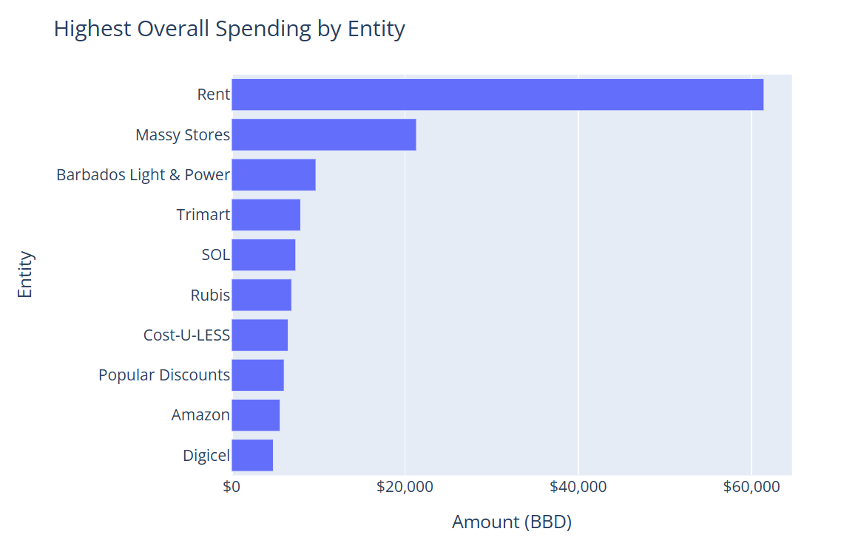
RESULTS
Highest Overall Spending by Entity
Spending for the top entity was nearly three times the spending for the second ranked entity.

Slide 11
DISCUSSION
Overall Findings
The difference between annual income and expenses remained relatively small throughout the period.
Both income and expenditure reached their highest annual levels in 2025.The highest income month occurred in January 2026 and the highest expense month in October 2024. This suggests that the annual peaks in 2025 were not influenced by the corresponding peak months.
Spending was heavily concentrated on the top ranked entity. This indicates that a single entity had a major influence on overall spending.

Slide 12
DISCUSSION
Implications
Monitoring monthly patterns can help identify high-expense periods that may warrant additional planning.
Examining the entities responsible for the largest share of spending can help identify whether the transactions are essential or non-essential.

Slide 13
DISCUSSION
Limitations
This version of the project used synthetic data that was designed to reflect realistic banking transactions. However, it does not represent actual financial behavior or real-world spending patterns.
Similar to the original dataset, the synthetic bank statements provide only partial coverage for 2022 and 2026.
The synthetic bank statements represent financial activity from a single financial institution. Therefore, the analysis does not represent a user's complete financial activity.
Transaction descriptions required cleaning and grouping into entities, which introduces the possibility of classification errors.

Slide 14
CONCLUSION
The difference between annual expenses and income remained remained relatively small throughout the five years, with annual income and expenses peaking in the same year, 2025.
Spending was heavily concentrated on one entity.
Analyzing transactions by year, month, and entity revealed patterns that annual totals alone would not show.
These insights provide a foundation for more targeted spending monitoring and future financial analysis.

Slide 15
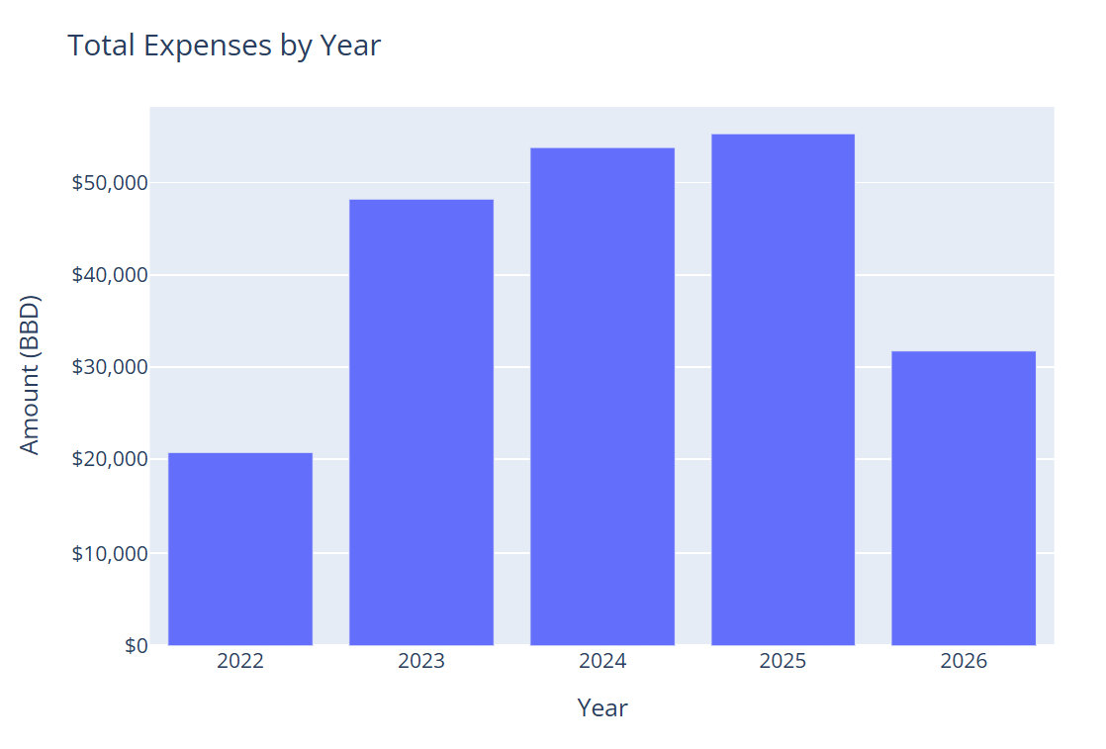
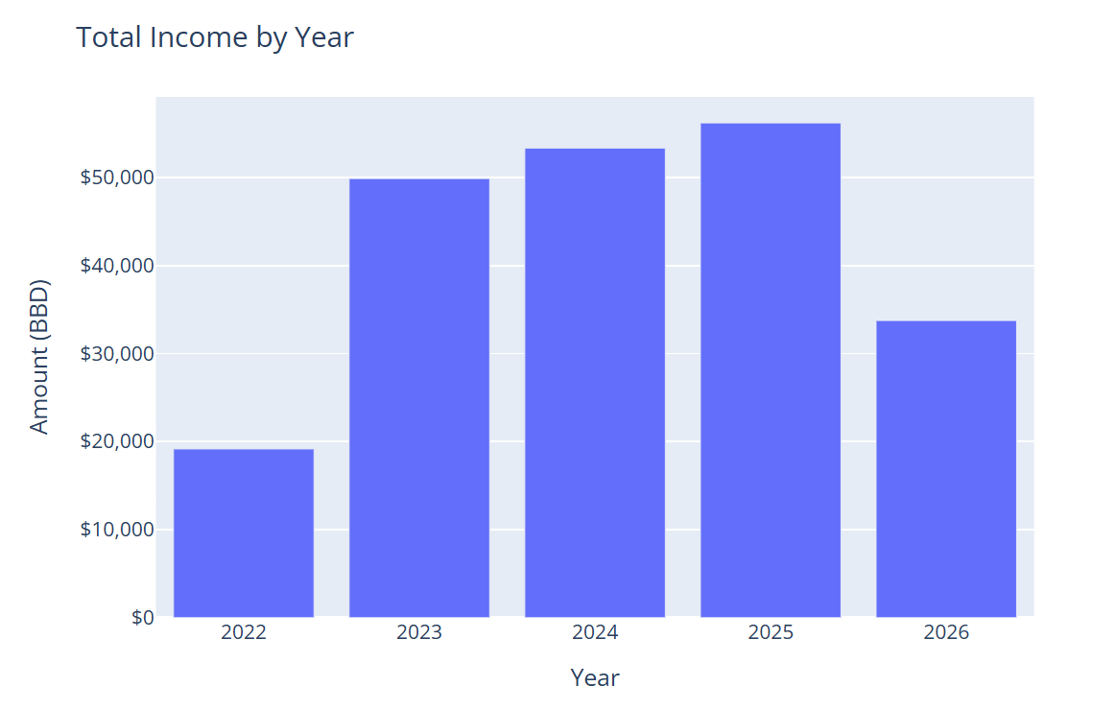
APPENDIX – Additional Visualisations
Figure 1 - Total Expenses by Year
Figure 2 - Total Income by Year

Slide 16
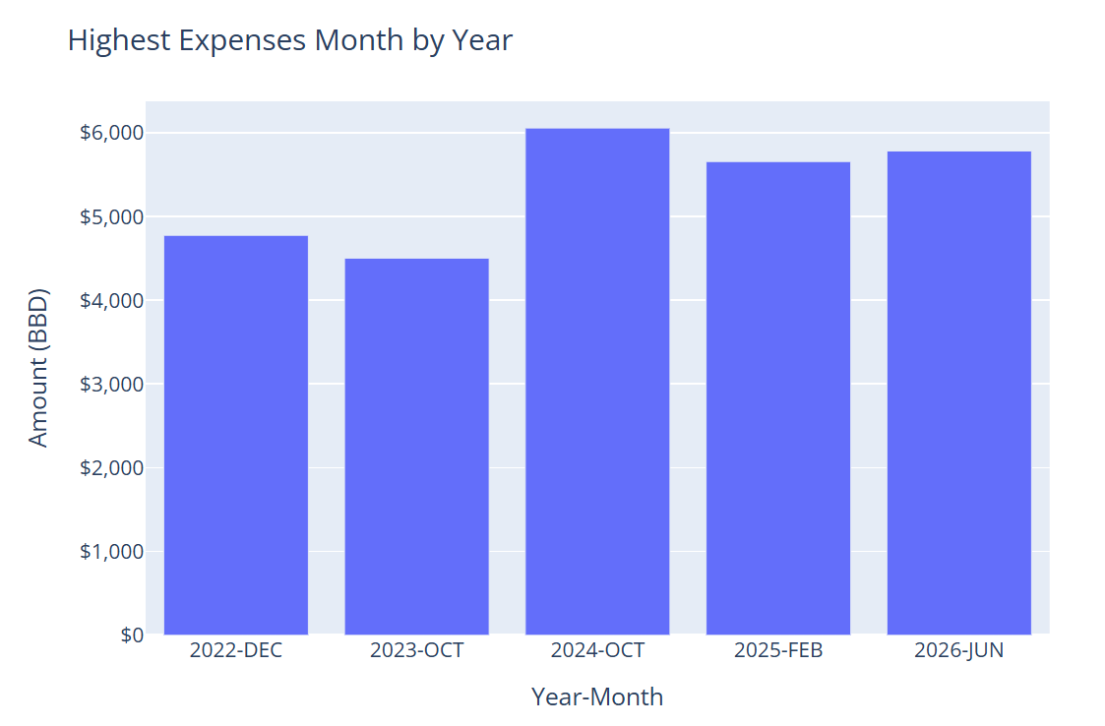
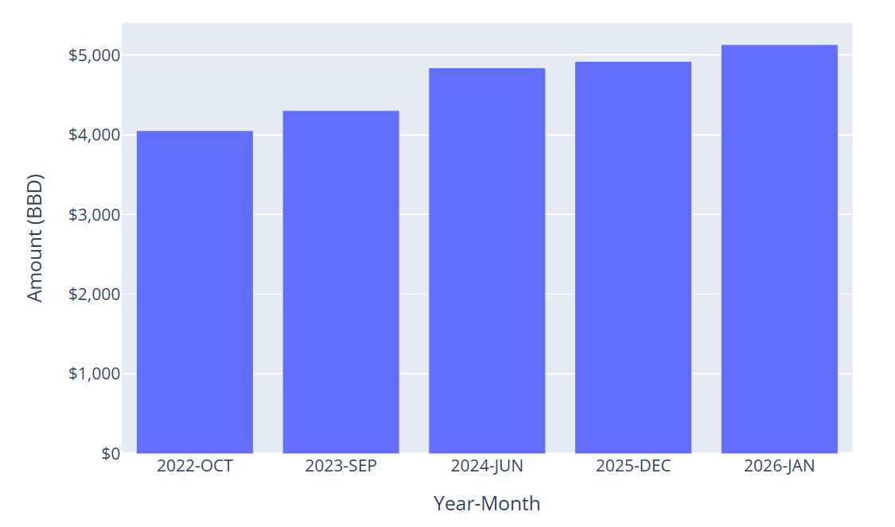
APPENDIX – Additional Visualisations
Figure 3 - Highest Expenses Month by Year
Figure 4 - Highest Income Month by Year

Slide 17
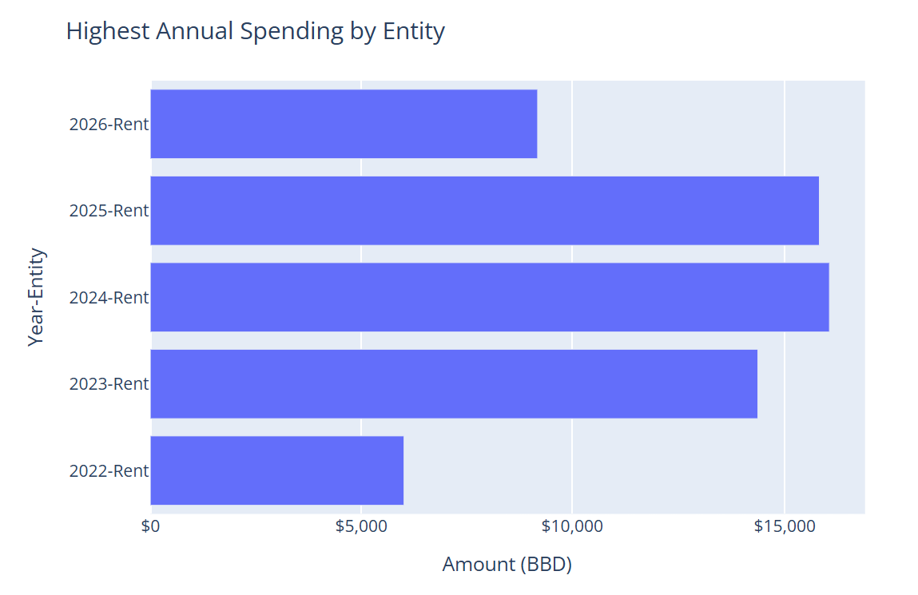
APPENDIX – Additional Visualisations
Figure 5 - Highest Annual Spending by Entity

