Slide 1
Predicting Health Care Seeking Patterns
General Assembly – Data Science Final Project
Mike Osberg
25 February 2019

Slide 2
Problem Statement
Overview: Globally, public health programs are often responsible for ensuring that people have access to the health services they need
Problem: In many situations, public health program managers have insufficient information about where patients are accessing health care and thus where supply of health services should be provided (e.g. to hospitals, clinics, or community health centers)
Project Goal: To build a model that can predict where patients will seek care for certain health services based on a set of demographic features that are widely available
Potential Impact: Public health managers will have a better understanding of the potential distribution of demand for health services, enabling them to better supply the right services to the right locations at the right time

Slide 3
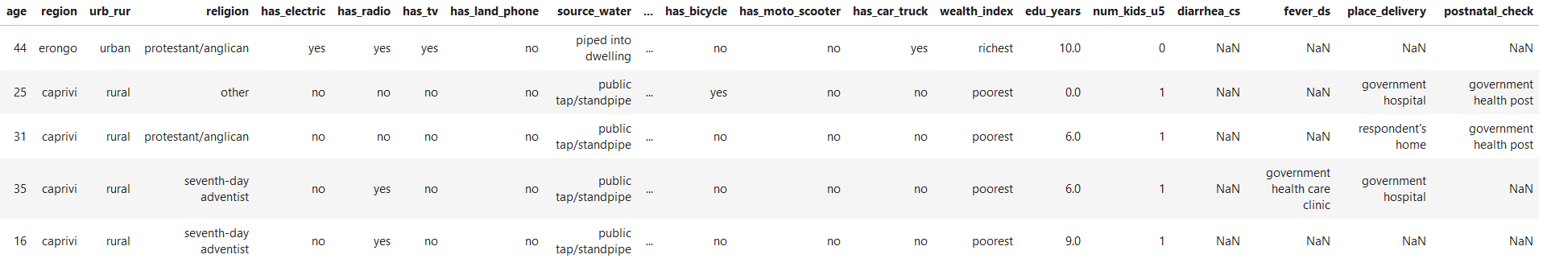
Data Overview
Demographic and Health Surveys (DHS) provide information about where patients seek care for various services. However, they are only conducted every 5-10 years, meaning patients may change their care seeking patterns or demographics may change in important ways to inform public health decisions
Features
Features
Target

Slide 4
Approach and Process
Data Characteristic | Details
Country | Namibia
Population | Women ages 15-49 (n=3925)
Variable to Predict (target) | Place of care seeking for delivery of child
Variables to Inform Prediction (features) | Age, years of education, wealth index, religion, region, urban/rural
Data prep challenges
  Oversampling - Needed to oversample records in my dataset, due to significant class imbalance in my target variable
  Excluded Nulls – Only about 2/3 of original data source had values for my feature of interest (women who gave birth)
  Categorical Variables – Most of my feature variables are categorical, so for modeling purposes, I turned them all into dummy variables

Slide 5
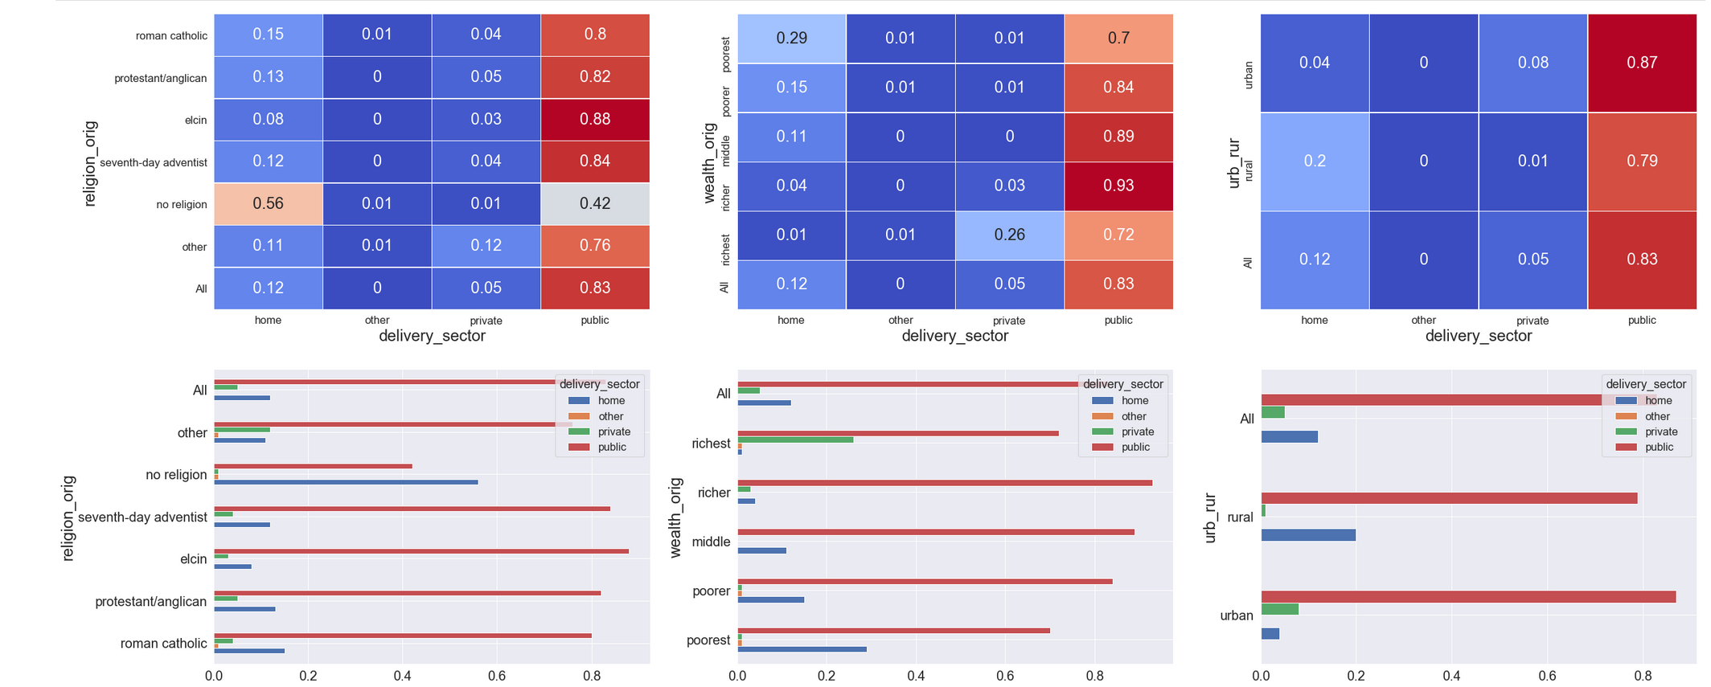
Care-Seeking and Demographic Relationships

Slide 6
Model and Results
Tested two models
  DecisionTreeClassifier
  RandomForestClassifier
Performance metrics – used accuracy as my primary performance metric (i.e. the percent of responses that my model correctly predicted)
High variance in both models
Model Type | Null Accuracy | Training Accuracy | Test Accuracy
Decision Tree | 83% | 99% | 73%
Random Forest | 83% | 99% | 82%

Slide 7
Important Demographic Information
Feature importance could help optimize future data collection activities
Decision Tree Model
Feature | Importance
edu_years | 0.312
age | 0.146
urb_rur_dum | 0.134
wealth_index_richest | 0.107
region_num | 0.090
wealth_index_poorer | 0.049
num_kids_u5 | 0.045
religion_elcin | 0.038
religion_other | 0.026
religion_protestant/anglican | 0.016
RandomForest Model
Feature | Importance
wealth_index_richest | 0.174
edu_years | 0.140
Age | 0.116
region_num | 0.096
urb_rur_dum | 0.092
num_kids_u5 | 0.078
wealth_index_poorer | 0.075
religion_elcin | 0.052
religion_protestant/Anglican | 0.047
wealth_index_richer | 0.045

Slide 8
Next Steps
Next steps
Further refinement of the model is necessary, perhaps with other feature variables
Test model on other country data, with more distributed pattern of health care seeking
Test model on other care-seeking variables
Recommendation
Do not use this model for public health planning activities (yet)
Impact
Demographic information not a good predictor of health care seeking patterns
Look for other analyses to help determine how and where distribute health services

Slide 9
Thank you!

