Slide 1

OwlVision
By OwlVision
Owlvision.us

Slide 2
OwlVision Team Members
Owner: Darek Dziamalek (ddziamalek2014@fau.edu)
Scrum Master: Austen Stone (astone2014@fau.edu)
Scrums: Zachary Goddard (zgoddard2013@fau.edu)
Michael Sherman (msherman2015@fau.edu)
Dewayne Tulloch (dtulloch2012@fau.edu)

Slide 3
Purpose / Motivation
Purpose
OwlVision's main goal is to provide students and administrators with relevant information about what’s happening on FAU’s campus, including current events, issues, and study groups. Our service’s main competition are certain social media sites: Facebook, Twitter, and Yik Yak.
Motivation
Our drive to build this application comes from the desire to connect students across campus with one easy application. We wish to bring students together by allowing them to go to events with friends, connect a class and improve their grades with a study group, or even report issues to improve the campus for everyone.
Target Audience
Students and Administration of FAU

Slide 4
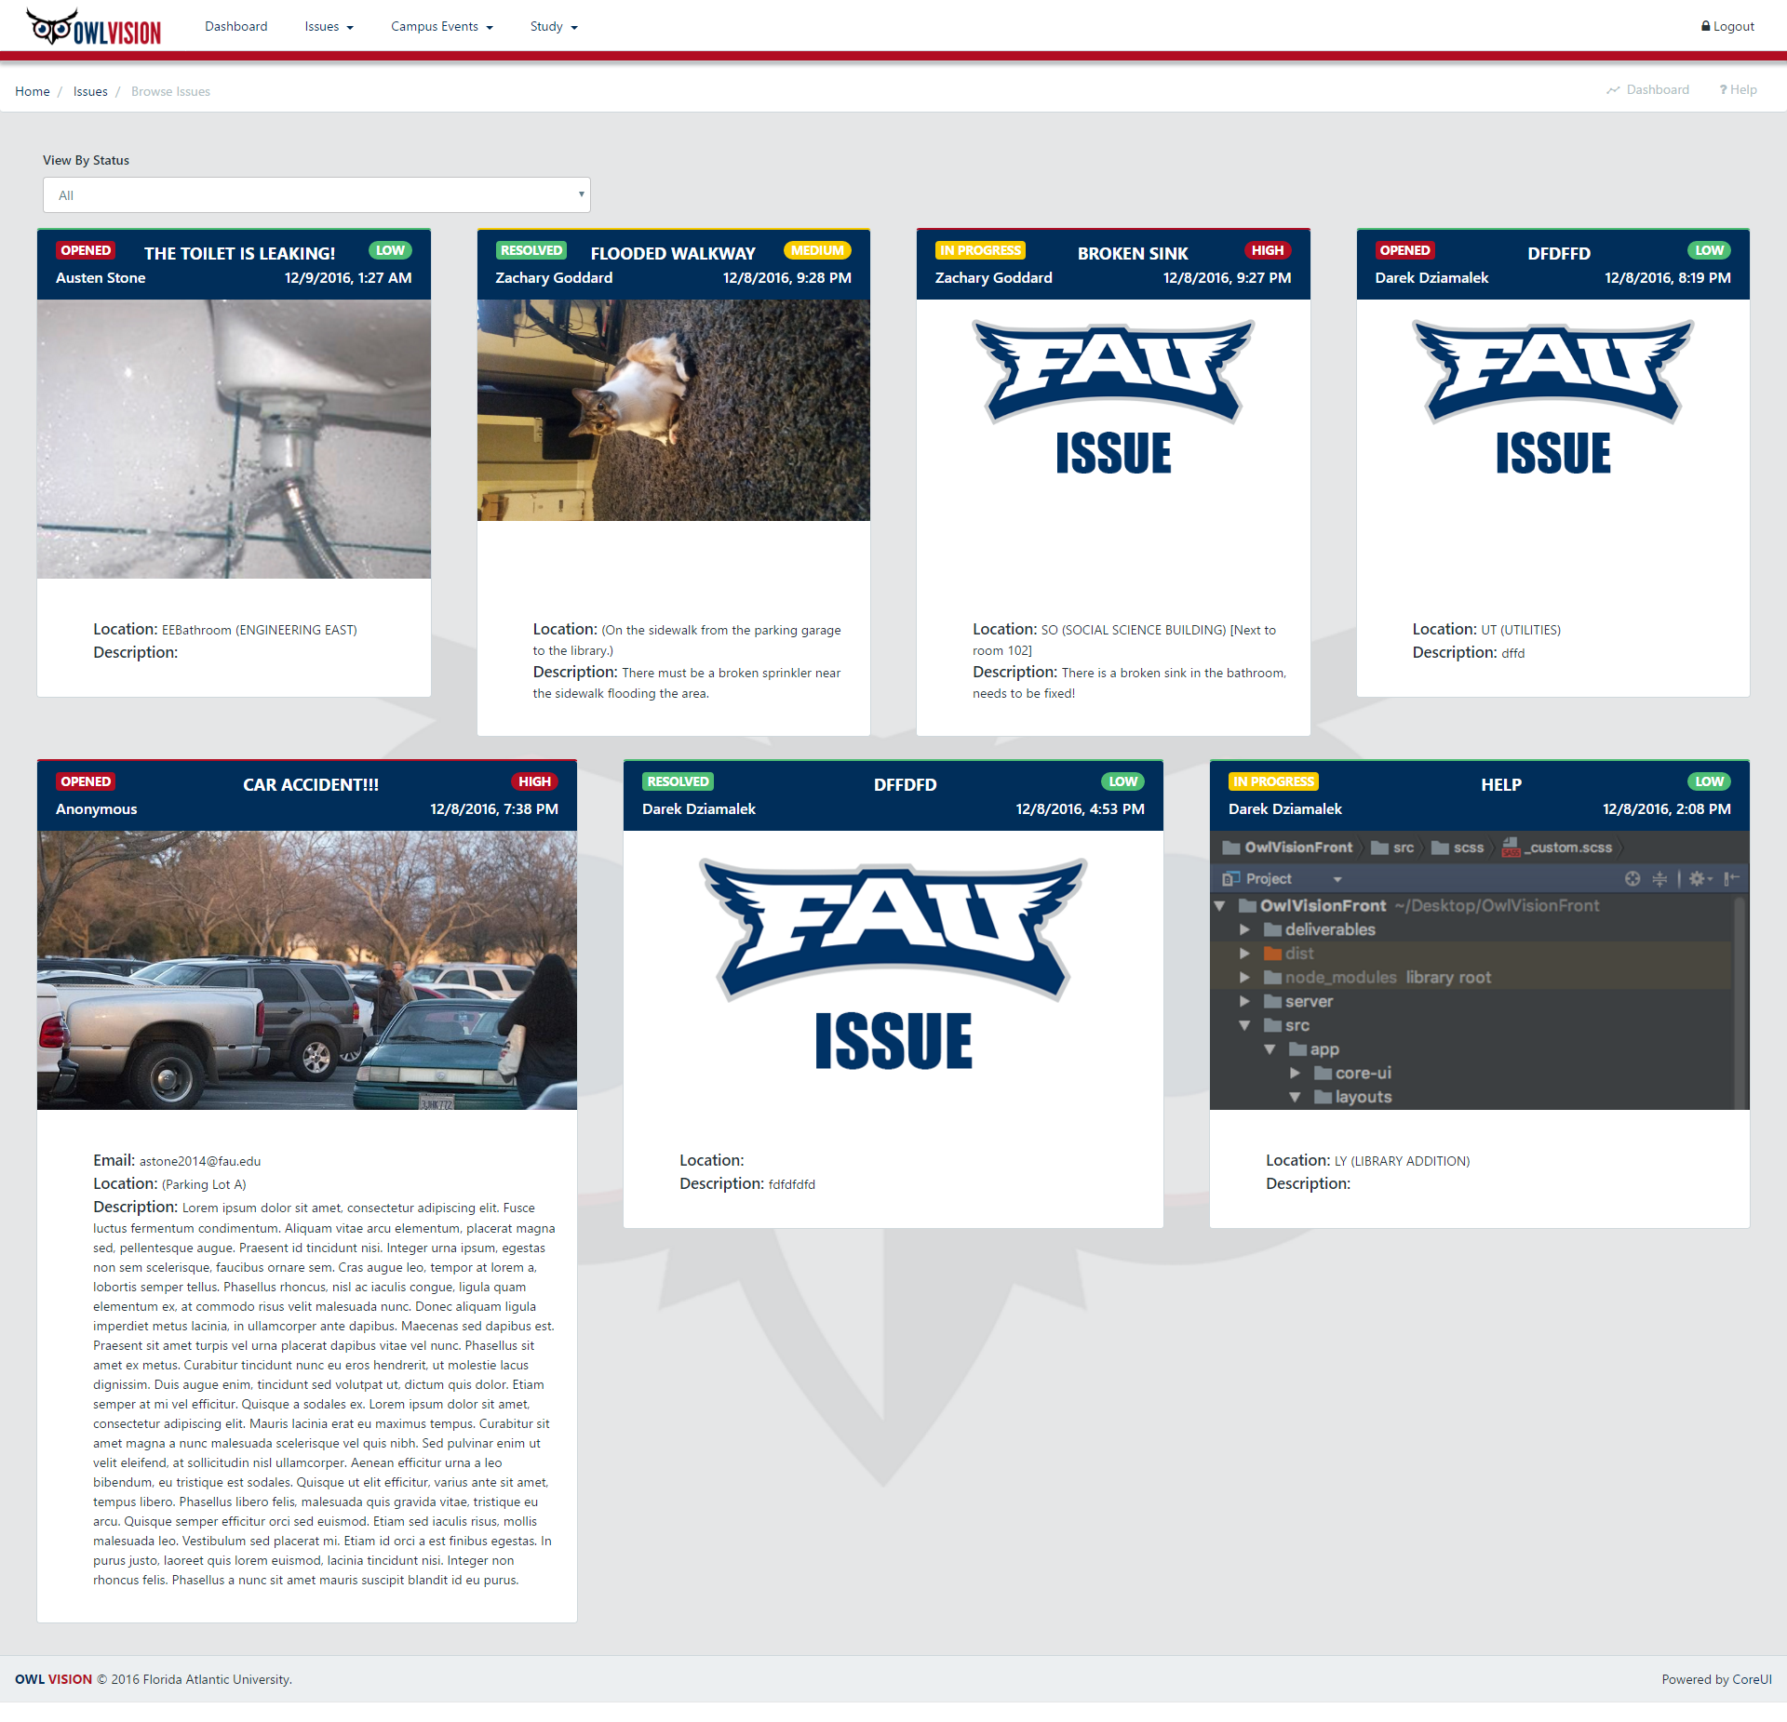
Functionalities
Post/Edit/Browse:
Issues
Events
Study Groups
Students can signup and create a profile to track activity
Administrators can also sign up and monitor issues
Dashboard displaying current state of campus

Slide 5



System Infrastructure
Languages
HTML - Handles the display of our project on a web page
CSS – Controls the layout of our webpage
Javascript/JQuery – Provides the functionality of our project
Node.js – Used to implement real-time response on actions
Database
MongoDB - A database that uses a document oriented model rather than a relational one
Firebase - Stores and syncs app data in real-time
Framework
Express.js - Framework designed to create web servers with Node.js
Bootstrap 4 - Improves the visual aspect of our project
Mongoose - Framework which extends the MongoDB core library to support schemas to our database integration

Slide 6
System Infrastructure Continued
Tools
GitLab - An application that is used for code management, issue tracking, and continuous integration
Git - Version control, has continuous integration which automatically builds and deploys to firebase when a branch is merged into master.
Slack – A text chat app and our main form of communication
Trello - An app that will helped us organize the development of our project
Angular CLI – Command line interface for angular to quickly scaffold the structure of the app and manage the build tools
WebPack – Automatically minifies, mangles, and bundles code to reduce file size
User Interface
Core UI Admin Panel
Hosting
Heroku – Node Server
Firebase - Angular Client

Slide 7
System Infrastructure Continued
Libraries
AngularFire2 - Integrates Firebase's real-time observers and authentication with Angular2
PrimeNG – UI components for Angular 2
Firebase SDK
NG2-Bootstrap - Bootstrap components powered by Angular 2
Access Methods – Desktop/Mobile Versions
Google Chrome
Mozilla Firefox
Internet Explorer 11+
Safari

Slide 8

Features
Dashboard displaying the user's profile: including issues, events, and study groups created by the user.
FirebaseAuth – Used to sign-in through google with your FAU email.
Firebase
Real-time Database
Hosting
Storage
User Management
Picture Uploading
Ability to comment on posts

Slide 9
Future Features
Profile page
Live chat messaging
Like/dislike comments
Notifications
Search bar

Slide 10
Knowledge / Lessons Learned
How to effectively communicate with a team through an application like Slack.
Organizing team members assignments through apps like GitLab and Trello.
Brainstorming ideas and writing them down where everyone can see using the Trello app.
We now know how to make changes to the application locally and push to a repository, so everyone on the team sees and can build on those changes.

