Slide 1
HAQAST Project Call Update
Mike He
April 26, 2019

Slide 2
Since Last Call
Assessing effect modification
Spatial (using % rural by population per county)
Temporal (using indicators for season)

Slide 3
Methods
Statistical analysis: Poisson regression models
Same-day PM_{2.5} exposure
Indicator variables for counties and day of week
Temperature (3 df), relative humidity (3 df), and long-term and seasonal trends (4 df per year)
Spatial-temporal effect modification
To assess impact of varying prediction model performance in space and time
Rural vs. urban (US Census)
Season (3 month, categorical variables)

Slide 4
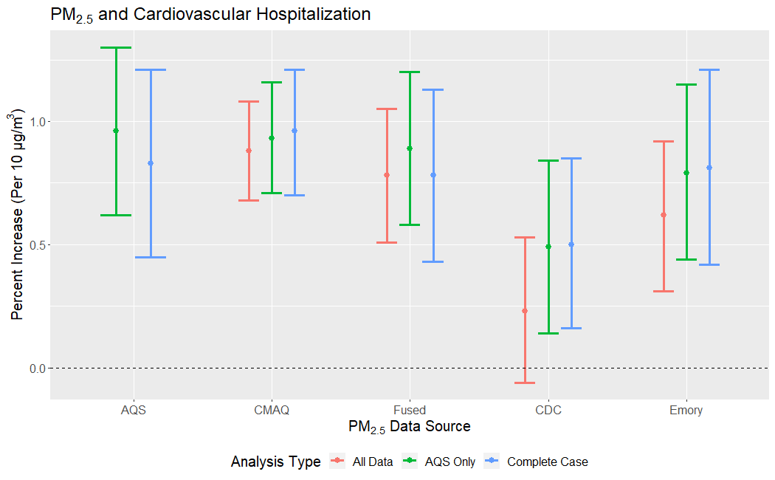

Slide 5
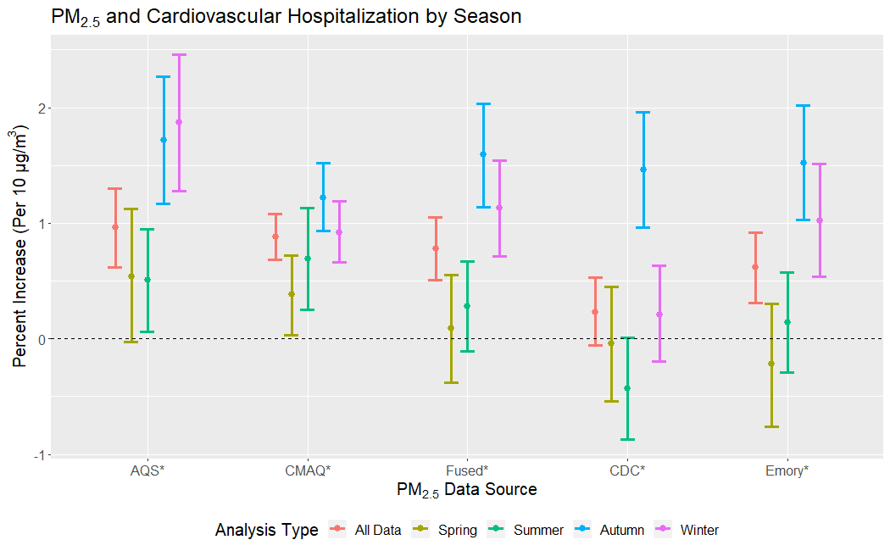
Notes:
Generally, higher in Fall/Winter, lower effect estimates in spring/summer
This could be attributable to higher contribution from more localized particles, such as traffic; since the mixing height in the winter is generally lower (same mass over smaller volume = more concentrated)
Traffic has been consistently identified as a particularly toxic source of PM, full of combustion products and metals
However, models do look somewhat different, which indicates that the performance of each prediction model likely varies by season, inducing exposure measurement error that varies by season
(However, some studies have also found higher effect estimates in the summer)

Slide 6
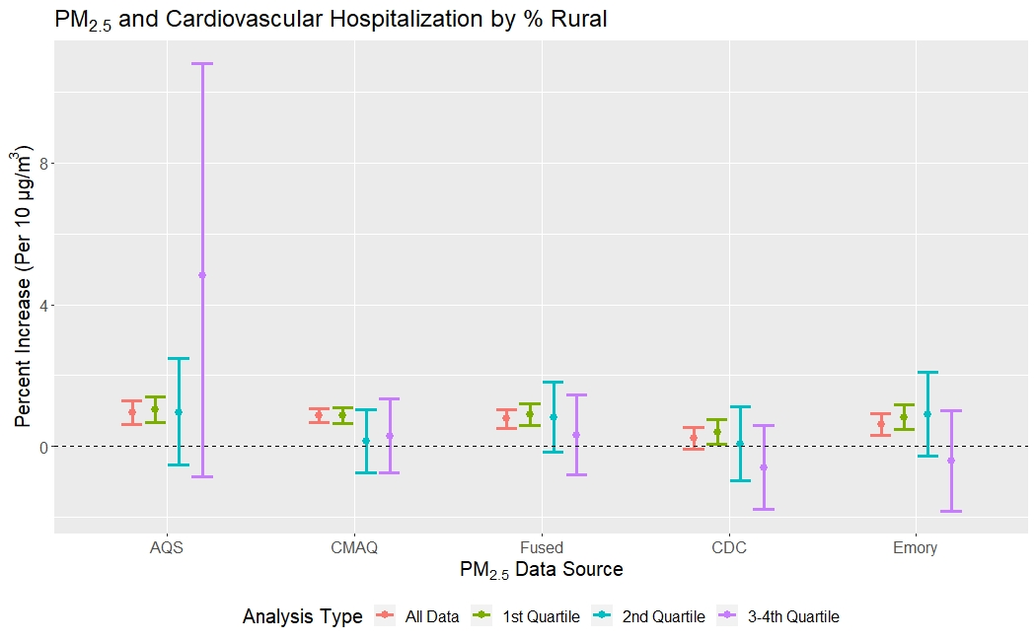
Notes:
We split the data based on % rural into 4 quartiles; completed stratified analyses
What we see here is that in the most urban areas, we do see the positive association
However, because most of our population (and hospital admissions) come from urban counties, once we stratify, we don’t really have enough power to detect any modification
So for now, we cannot draw any conclusions, but we are exploring how to look at continuous interaction in a meaningful way (to not overweight rural counties with very few residents)
Effect modification is non linear
Just saw this on Friday
Take this with a grain of salt, still working on it

Slide 7
Next Steps
Continuous interaction in a meaningful way (not overweighting rural counties with very few residents)
Spatial effect modification may be non-linear
Manuscript still being drafted
Will present results at ISEE (August 2019)

