Slide 1
HAQAST Project Call Update
Mike He
February 15, 2019

Slide 2
Since Last Call
Processed Xiaomeng’s new CMAQ/CDC datasets
Added to existing set of analyses
Began drafting manuscript – first draft by end of March

Slide 3
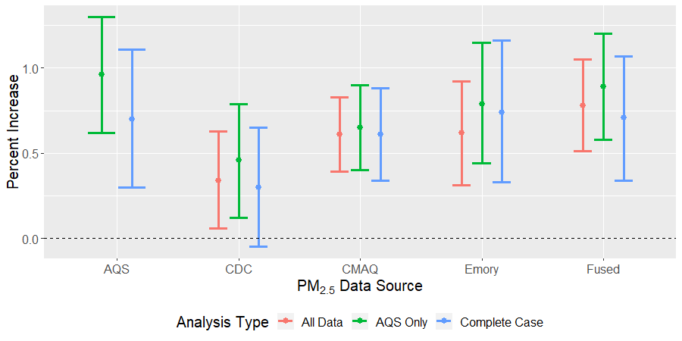
Old Results

Slide 4
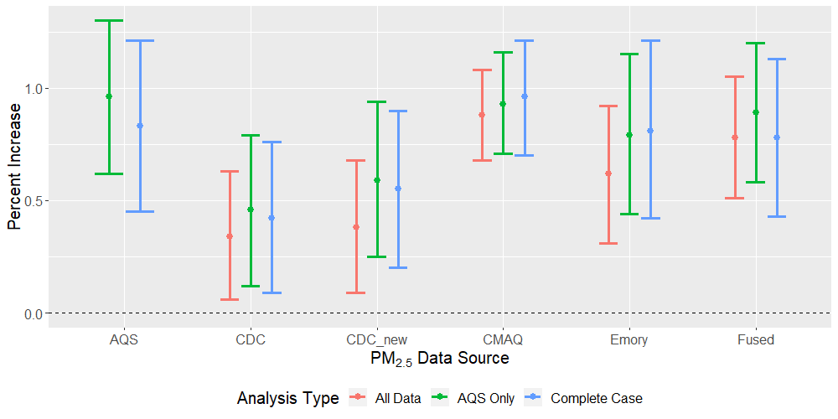
New Results

Slide 5
Questions for Discussion
Which CDC data to use?
Issues with non-public data?
Methods for processing exposures? (~2-3 sentences in paper)

