Slide 1
HAQAST Project Call Update
Mike He
June 21, 2019

Slide 2
Since Last Call
Modeling of continuous ruralness
Instead of % rural, scaled to population rural
Performing analysis for respiratory admissions
Primary analysis
Spatial and temporal effect modification
Will present these results at HAQAST6

Slide 3
Methods
Statistical analysis: Poisson regression models
Same-day PM_{2.5} exposure
Indicator variables for counties and day of week
Temperature (3 df), relative humidity (3 df), and long-term and seasonal trends (4 df per year for CVD; 5 df per year for respiratory)
Spatial-temporal effect modification
To assess impact of varying prediction model performance in space and time
Rural vs. urban (US Census)
Season (3 month, categorical variables)

Slide 4
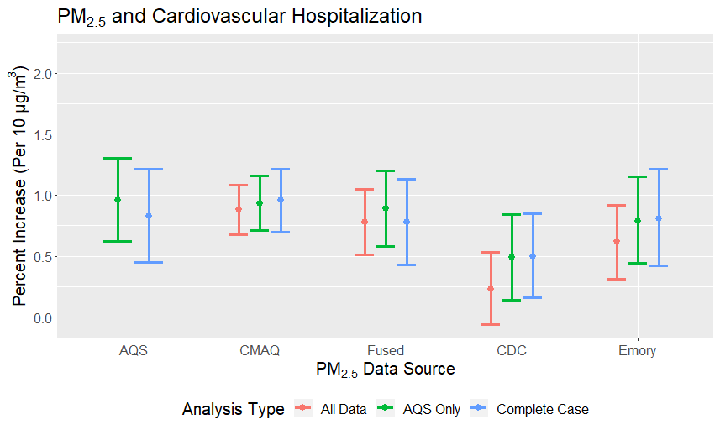

Slide 5
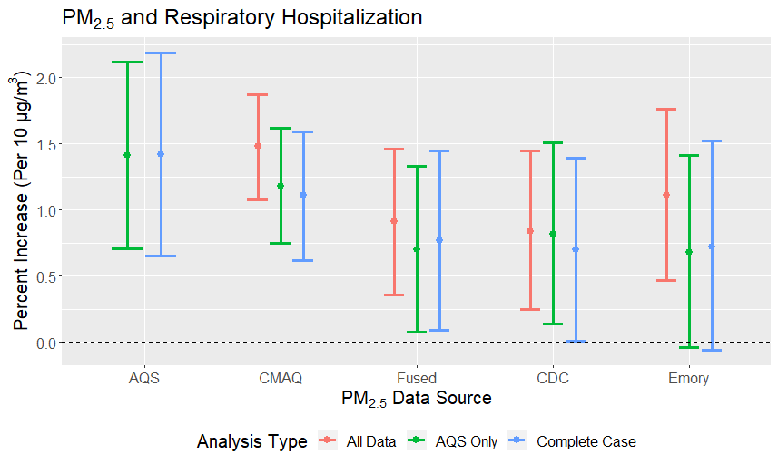

Slide 6
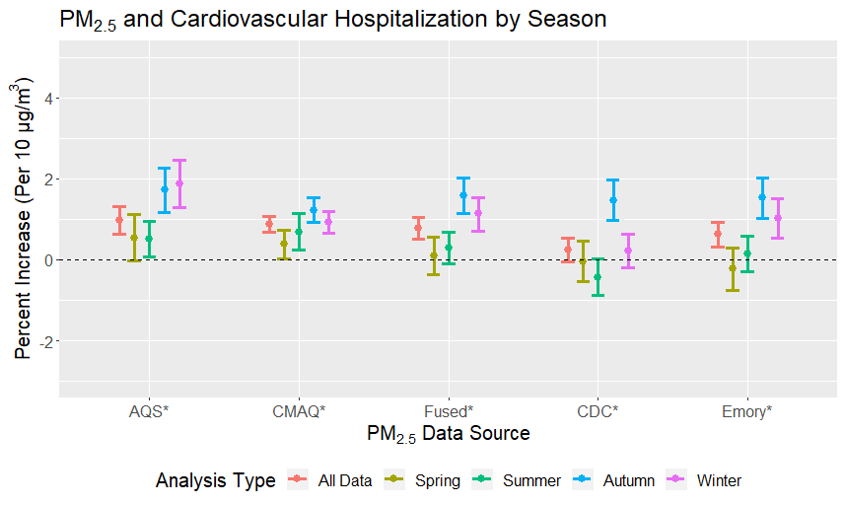
Notes:
Generally, higher in Fall/Winter, lower effect estimates in spring/summer
This could be attributable to higher contribution from more localized particles, such as traffic; since the mixing height in the winter is generally lower (same mass over smaller volume = more concentrated)
Traffic has been consistently identified as a particularly toxic source of PM, full of combustion products and metals
However, models do look somewhat different, which indicates that the performance of each prediction model likely varies by season, inducing exposure measurement error that varies by season
(However, some studies have also found higher effect estimates in the summer)

Slide 7
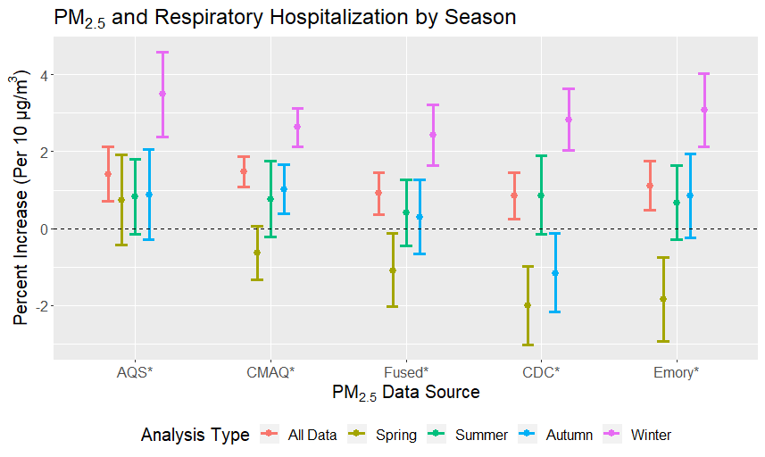

Slide 8
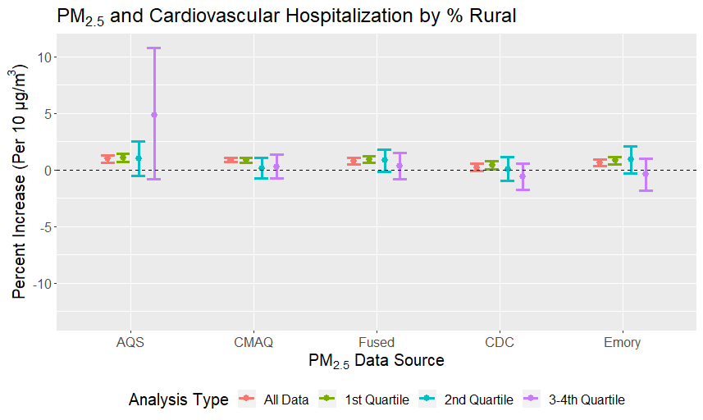
Notes:
We split the data based on % rural into 4 quartiles; completed stratified analyses
What we see here is that in the most urban areas, we do see the positive association
However, because most of our population (and hospital admissions) come from urban counties, once we stratify, we don’t really have enough power to detect any modification
So for now, we cannot draw any conclusions, but we are exploring how to look at continuous interaction in a meaningful way (to not overweight rural counties with very few residents)
Effect modification is non linear
Just saw this on Friday
Take this with a grain of salt, still working on it

Slide 9
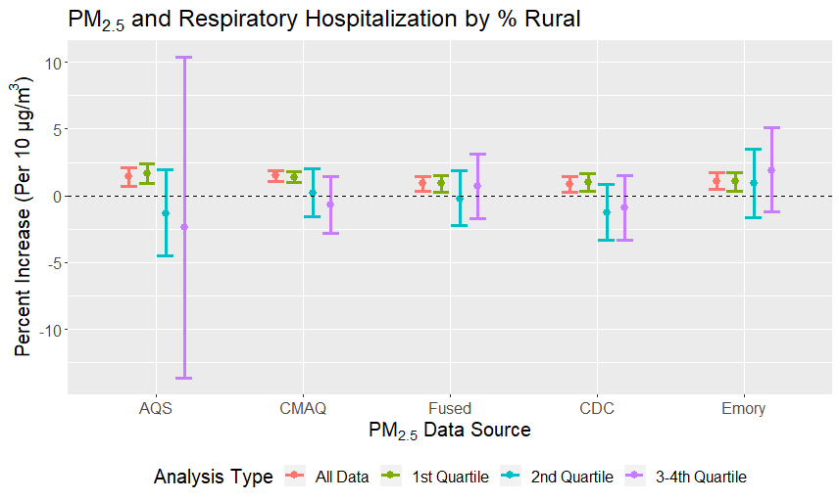

Slide 10
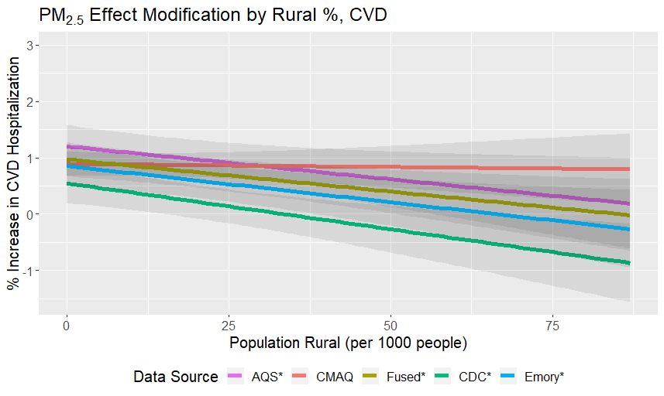

Slide 11
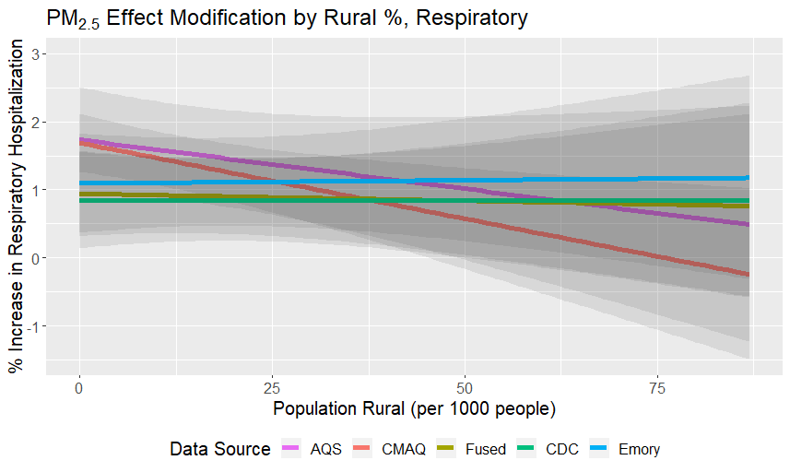

Slide 12
Discussion
Comparison of results?
Temporal effect modification significant for all
Spatial effect modification: CVD only
Note max rural population is ~87k, so I truncated the graph

