Slide 1
Covid-19 Case Surveillance Data
By: Tony Fong, Victor Verduzco, Pablo Ilabaca, Michael Medina, John Martinez
Group 3

Slide 2
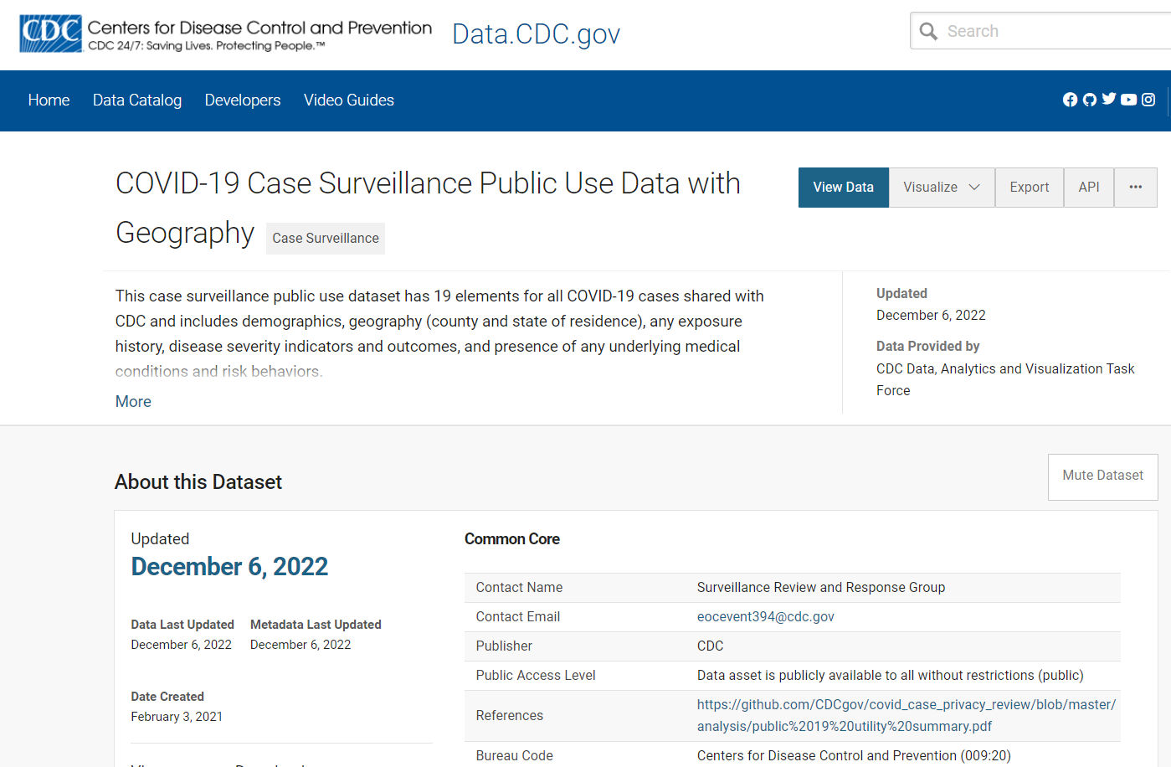
Background information about the dataset
The dataset was from the Center for Disease and Control Prevention (CDC), and it shows data on Covid-19 cases.
Link to Data Set: https://data.cdc.gov/Case-Surveillance/COVID-19-Case-Surveillance-Public-Use-Data-with-Ge/n8mc-b4w4
Data Set size: 11.2 GB

Slide 3
How unique Is our dataset?
Our dataset is unique because we aren’t just looking at the number of Covid-19 cases all around the country, but we are looking at if those with underlying conditions were more affected and had harsher outcomes.
We are also looking for the average age group that was affected the most by Covid-19, and draw up conclusions as to why this happened.

Slide 4
Cluster Specifications
Run the command Hadoop version to show the version of your Hadoop (Our version is 3.1.2)
Run the command lscpu to get the CPU specifications (The number of CPUs used is 8, and the CPU speed is 1995.309 MHZ)
Run the command yarn node –list –all to get the total number of nodes used (Total number of nodes is 3)
Run the command free –h to get the memory specifications

Slide 5
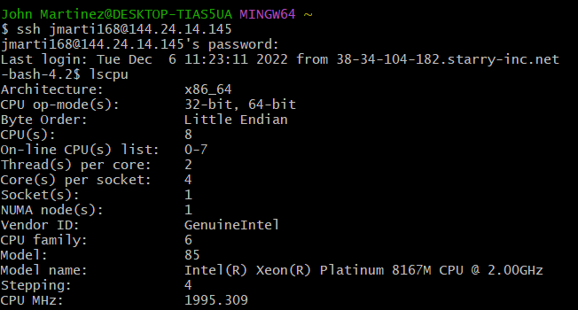

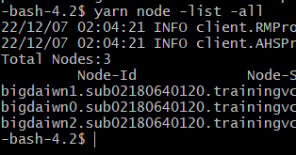
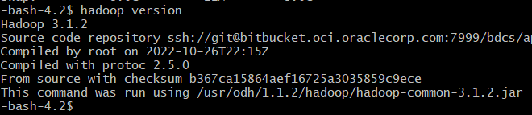
# CPUs and CPU Speed
Memory Size
# of Nodes
Hadoop Version

Slide 6
Uploading the dataset to HDFS
We found two ways to upload the dataset to HDFS:
Using the command split -l [number] [filename] and upload to Google Drive
Uploading the dataset tsv or csv file to Google Drive (since they provide 15Gb of storage data) and running the command below to upload it onto HDFS:
wget --load-cookies /tmp/cookies.txt "https://docs.google.com/uc?export=download&confirm=$(wget --quiet --save-cookies /tmp/cookies.txt --keep-session-cookies --no-check-certificate
'https://docs.google.com/uc?export=download&id=FILEID' -O- | sed -rn 's/.*confirm=([0-9A-Za-z_]+).*/\1\n/p')&id=1s-9aKPqcQq8id8oGgW6HBCQzuXKBR1xO" -O covid19data.csv && rm -rf /tmp/cookies.txt

Slide 7
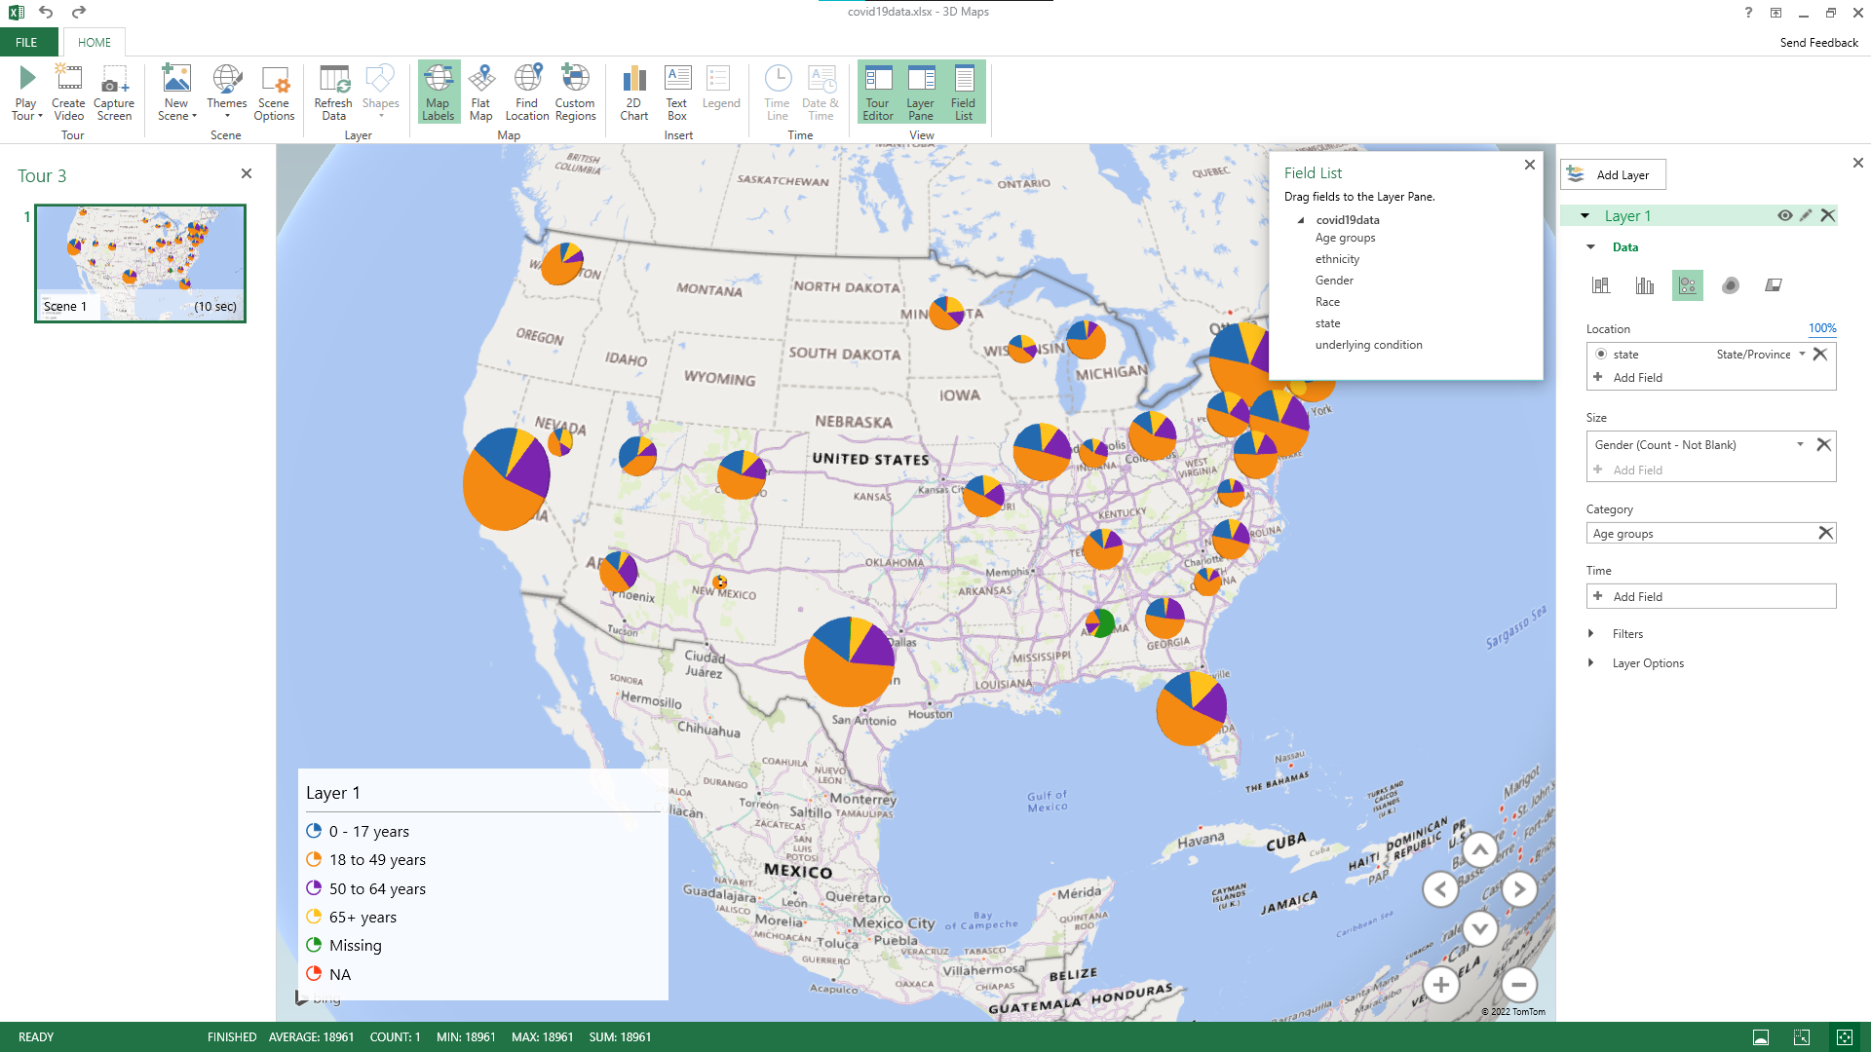
Visualization of Covid-19 Cases Per Age Group
Notes:
12- 49yrs: 0.55 M reported cases
50 – 64yrs: 0.19 M reported cases
0 – 17yrs: 0.18 M reported cases
65+ yrs: 0.12 M reported cases
Missing: 0.01 M cases

Slide 8
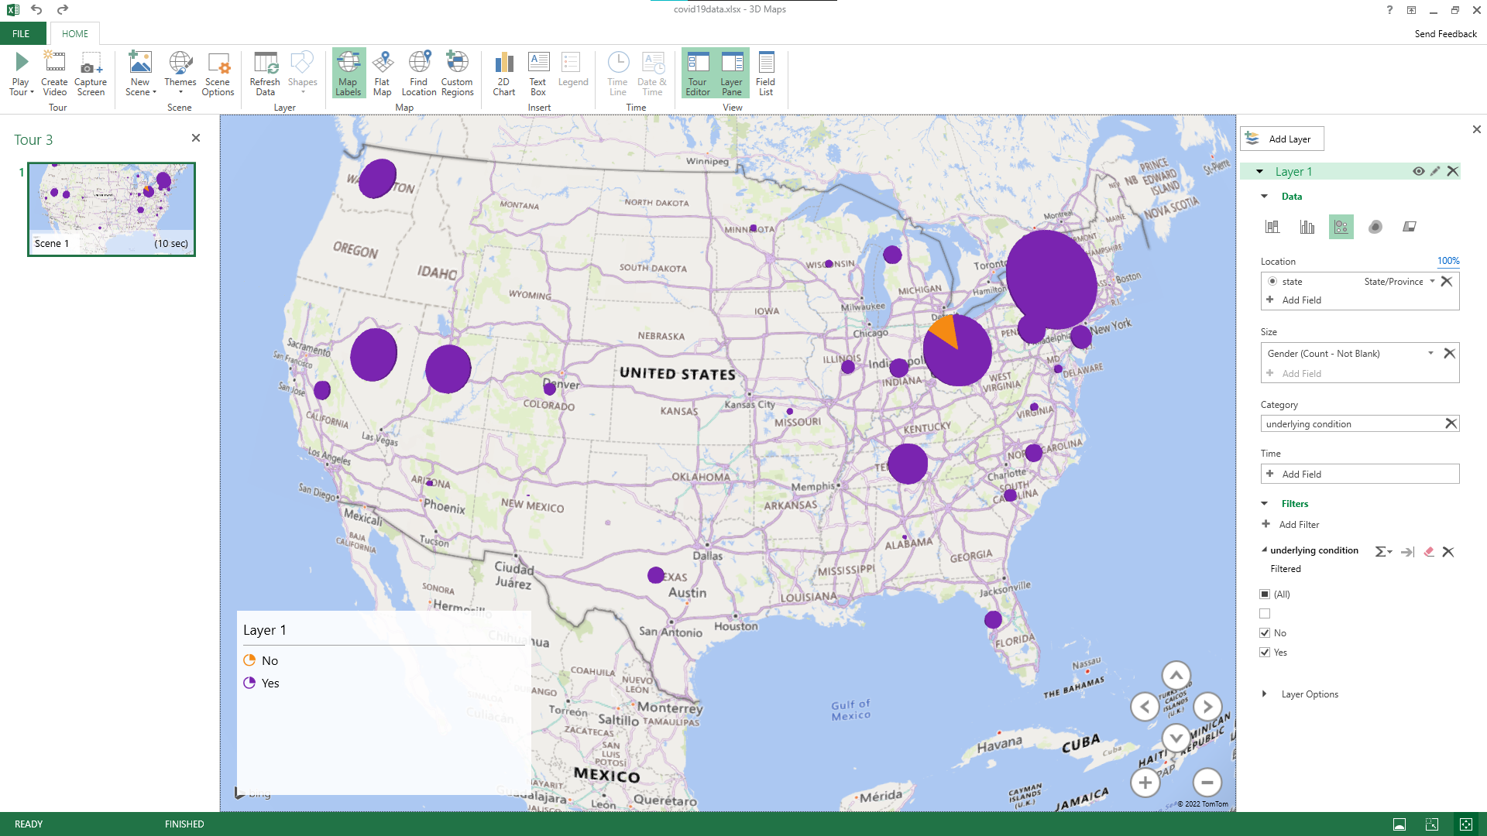
Visualization of Covid-19 Cases With Reported Underlying Conditions

Slide 9
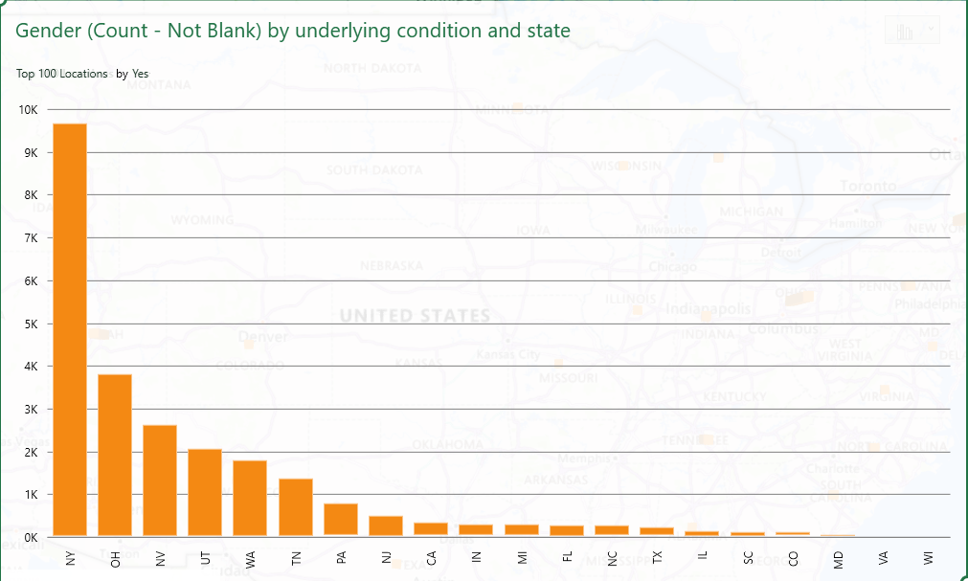
Visualization of Covid-19 Cases With Reported Underlying Conditions

Slide 10
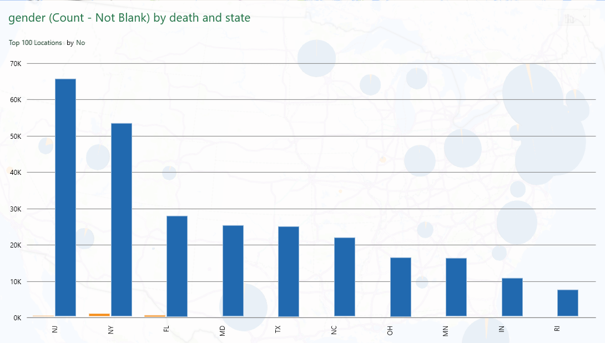
Visualization of Covid-19 Cases Per State and Death Count

Slide 11
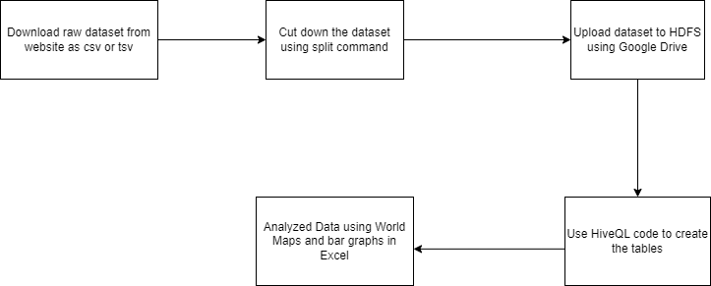
Workflow Chart

Slide 12
Understanding epidemic data and statistics: A case study of COVID‐19
Tries to interpret the number of people being infected in each country
Evaluate how effective the policies each country implements in lowering cases
Examines covid confirmed cases, recovered, and deaths
Each country's policies and reactions to the outbreak determine how fast it spread.

Slide 13
Data mining and analysis of scientific research data records on Covid-19 mortality, immunity, and vaccine development
Purpose of the research was to investigate and determine early warning systems developed in previous epidemic responses to contain the virus from spreading.
Examined Covid-19 scientific literature regarding Covid-19 mortality, vaccines, and immunity via data mining.
Bibliometric analysis was done using the Web of Science Analysis Results tool to search the most dominant keywords and related concepts with Covid-19.
Factorial analysis was done using R Studio to examine the correlation between different concepts (mortality, immunity, & vaccine development) as well as generate visualizations such as tree maps and conceptual structure maps.

Slide 14
GitHub Link
GitHub Link: https://github.com/mike0nthemic/G5_Big_Data_4560

Slide 15
Work cited
Hoseinpour Dehkordi, A., Alizadeh, M., Derakhshan, P., Babazadeh, P., & Jahandideh, A. (2020). Understanding epidemic data and statistics: A case study of COVID-19. Journal of medical virology, 92(7), 868–882. https://doi.org/10.1002/jmv.25885
Radanliev, P., De Roure, D., & Walton, R. (2020). Data mining and analysis of scientific research data records on Covid-19 mortality, immunity, and vaccine development-In the first wave of the Covid-19 pandemic. Diabetes & Metabolic Syndrome: Clinical Research & Reviews, 14(5), 1121-1132.
Phucharoen, C., Sangkaew, N., & Stosic, K. (2020). The characteristics of COVID-19 transmission from case to high-risk contact, a statistical analysis from contact tracing data. EClinicalMedicine, 27, 100543.

