Slide 1
kdiudsfhe
asdfasf

Slide 2
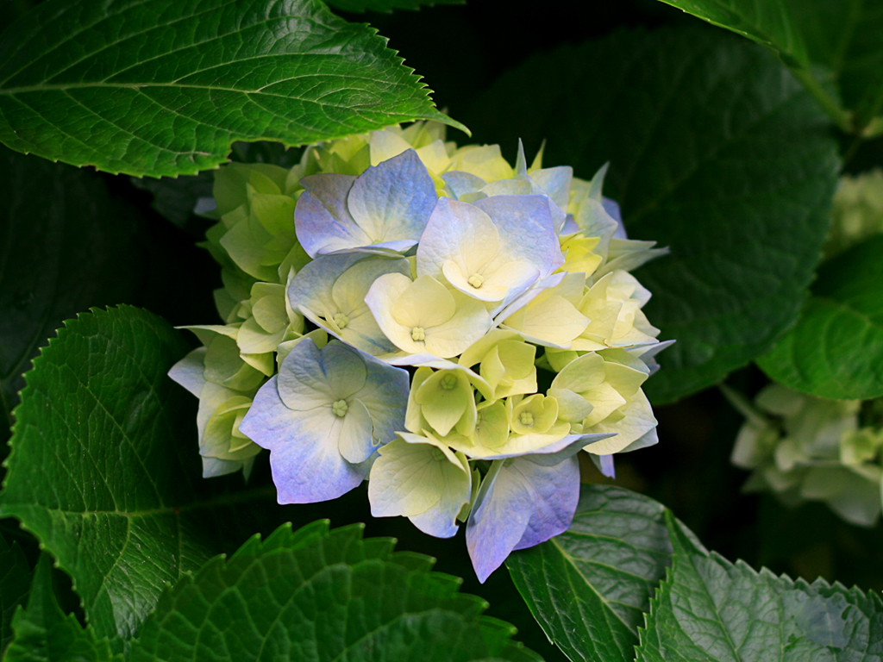

Slide 3
kjiojerthy
Dfgrse
sdfgr

