Slide 1
Lane Detection: A Survey with New Results
Liang, Dun & Guo, Yuanchen & Zhang, Shao-Kui & Mu, Tai-Jiang & Huang, Xiaolei. (2020). Lane Detection: A Survey with New Results. Journal of Computer Science and Technology. 35. 493-505. 10.1007/s11390-020-0476-4.

Slide 2
目录
Ego-lane
Ego-lane
All-road
2020年最新文章
识别任务

Slide 3
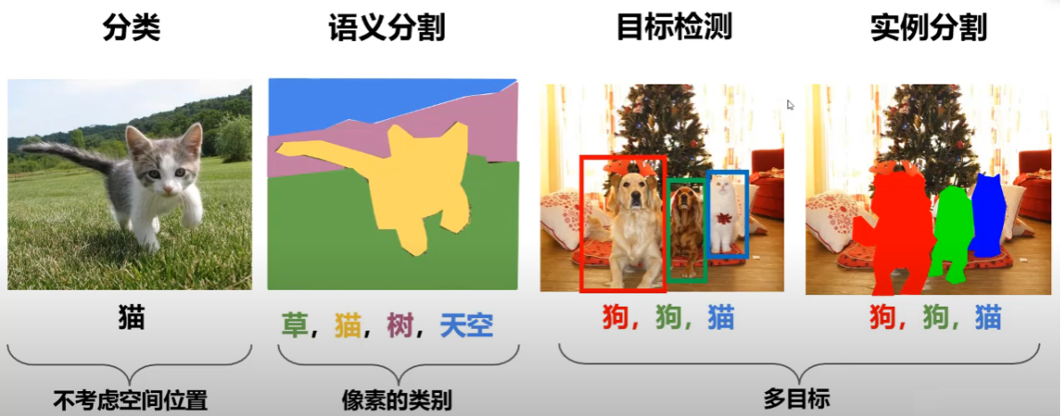
识别任务

Slide 4
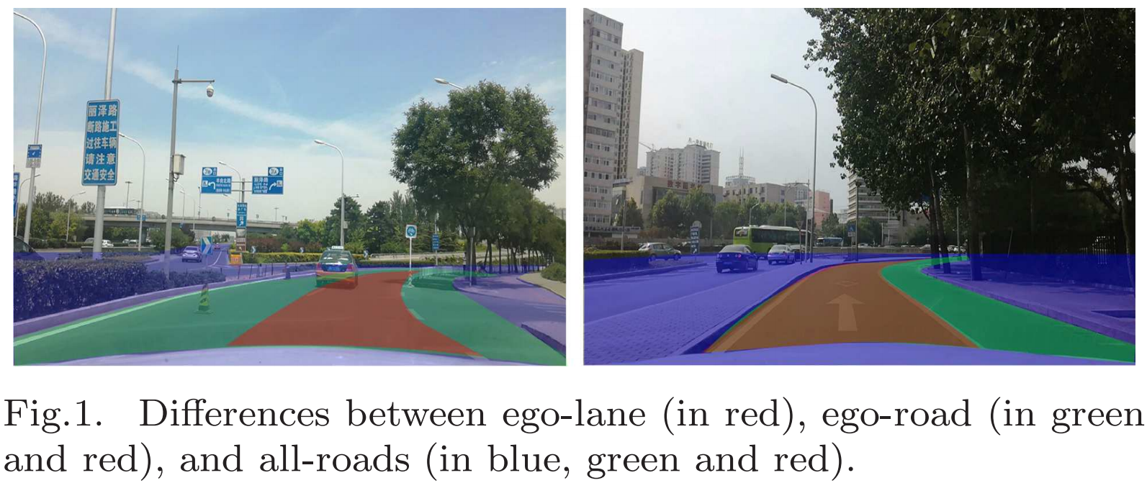
道路类型

Slide 5
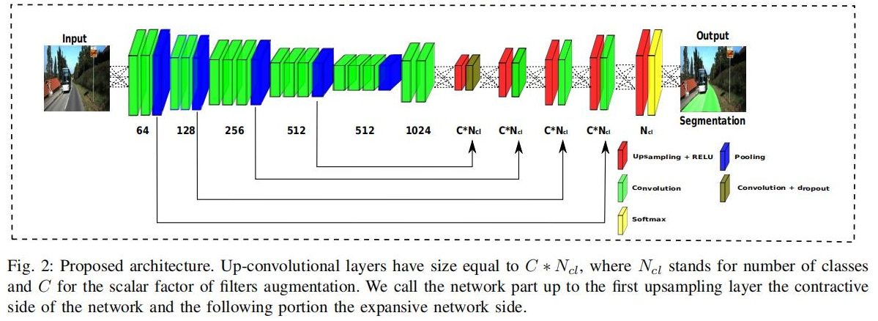
Ego-road
Oliveira G L , Burgard W , Brox T . Efficient deep models for monocular road segmentation [C] IEEE/RSJ International Conference on Intelligent Robots & Systems (IROS). IEEE, 2016.

Slide 6
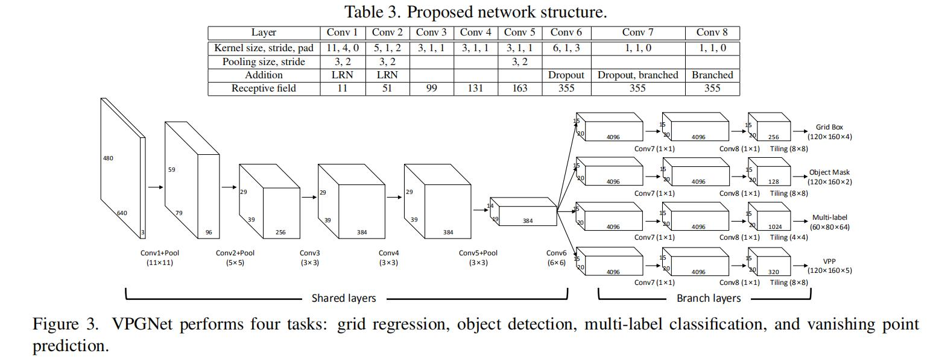
Ego-Road
Lee S , Kim J , Yoon J S , et al. VPGNet: Vanishing Point Guided Network for Lane and Road Marking Detection and Recognition[J]. 2017.

Slide 7
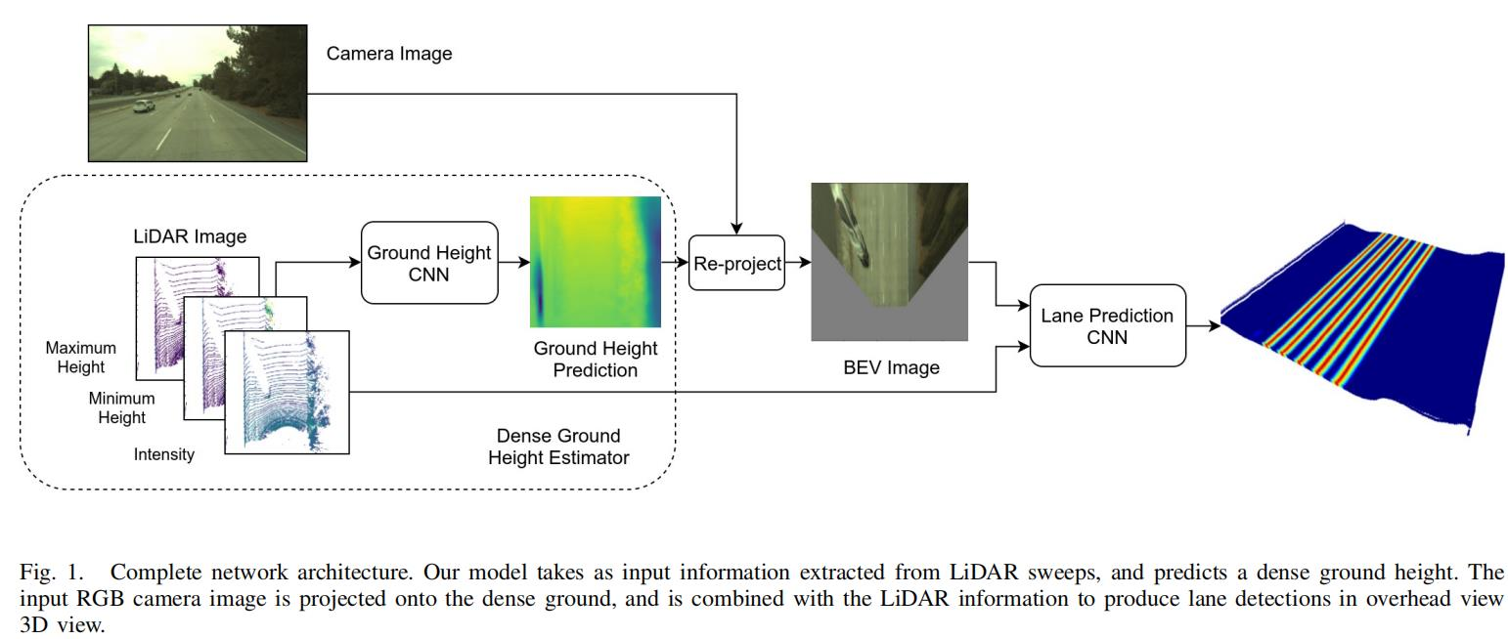
All-Road
Bai M , Mattyus G , Homayounfar N , et al. Deep Multi-Sensor Lane Detection[C]// 2018 IEEE/RSJ International Conference on Intelligent Robots and Systems (IROS). IEEE, 2018.

Slide 8
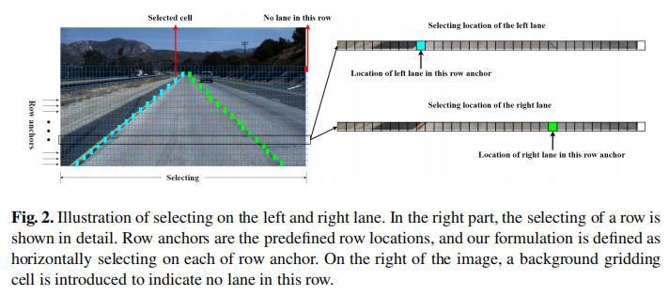
2020年最新文章
Qin, Zequn and Wang, Huanyu and Li, Xi. Ultra Fast Structure-aware Deep Lane Detection[C]// The European Conference on Computer Vision (ECCV), 2020.

Slide 9

Thanks…

